Slide 1
Stocks Analysis
Analysis Stocks’ performances Filtered by Best Growing Potential

Slide 2
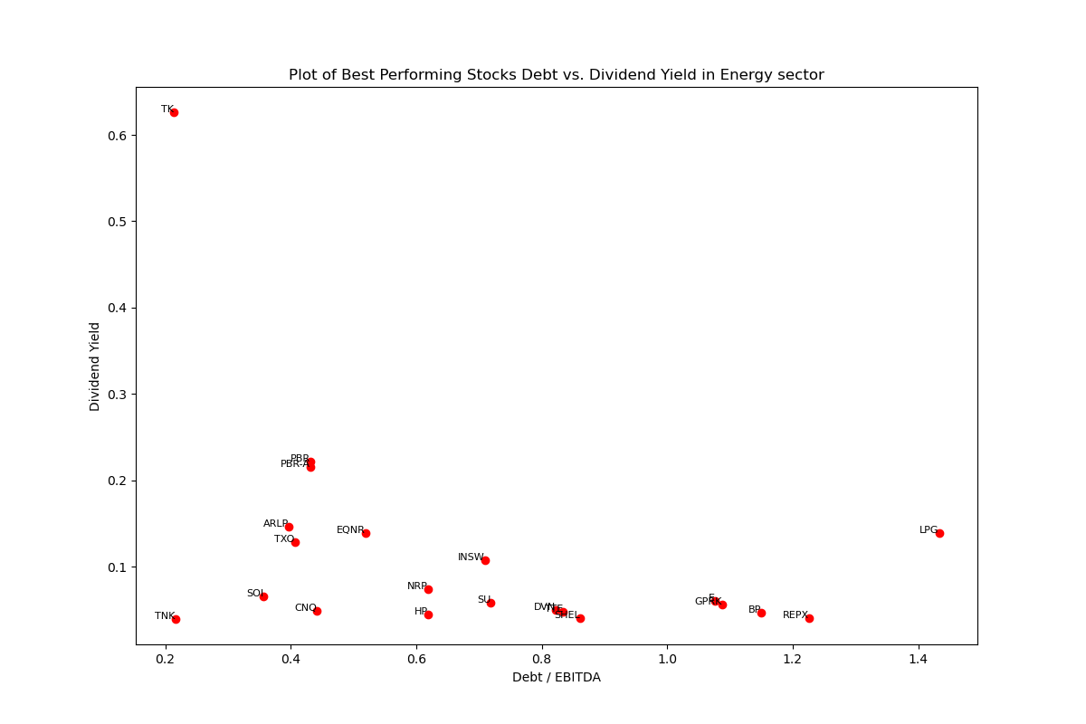
Energy Sector
273(200) Stocks in Total*
The 21 Best Performing Stocks have Debt/EBITDA distributed between 0.2 and 1.4.
Most of the Best Performing Stocks have Dividend Yields under 0.4.
The stocks have EPS Yield distribute randomly between 0 to 0.275
Most of the stocks has FCF Yield below 0.4
*WDS, INDO, NGL-PB, GLOP-PA, GLOP-PB lack EPS data; 27 stocks lack Debt data; 11 stocks lack share data; 30 other stocks have zero dividend paid. All above stocks are excluded from the calculation, with 200 stocks left.

Slide 3
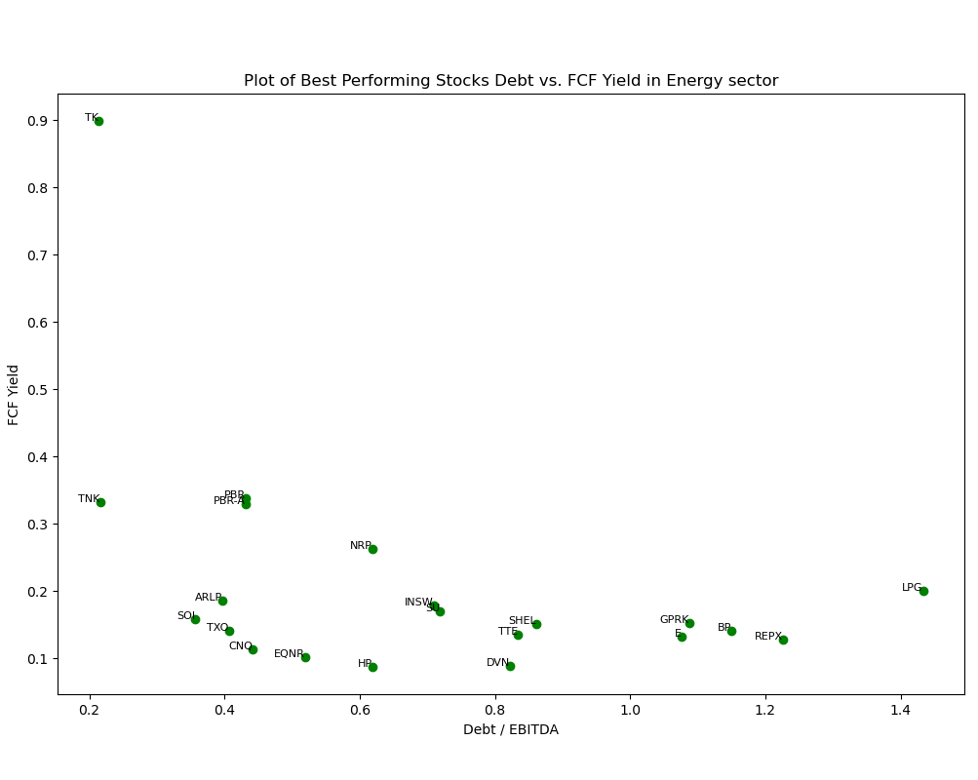
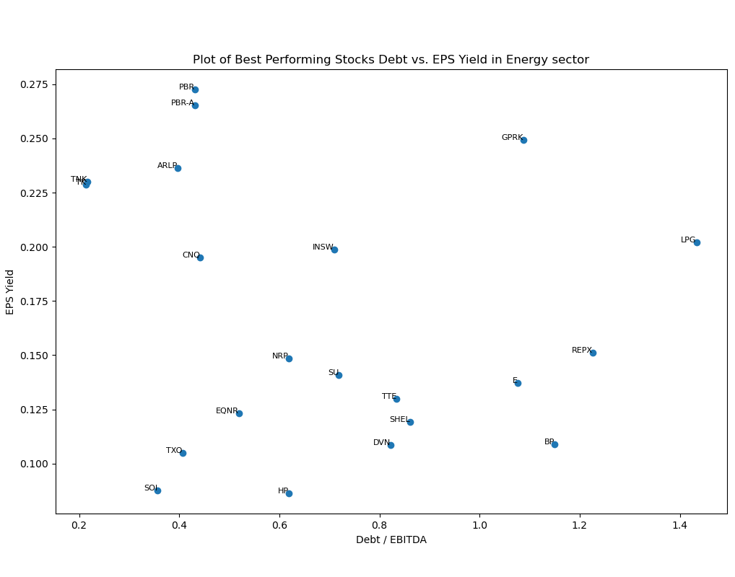
Energy Sector

Slide 4
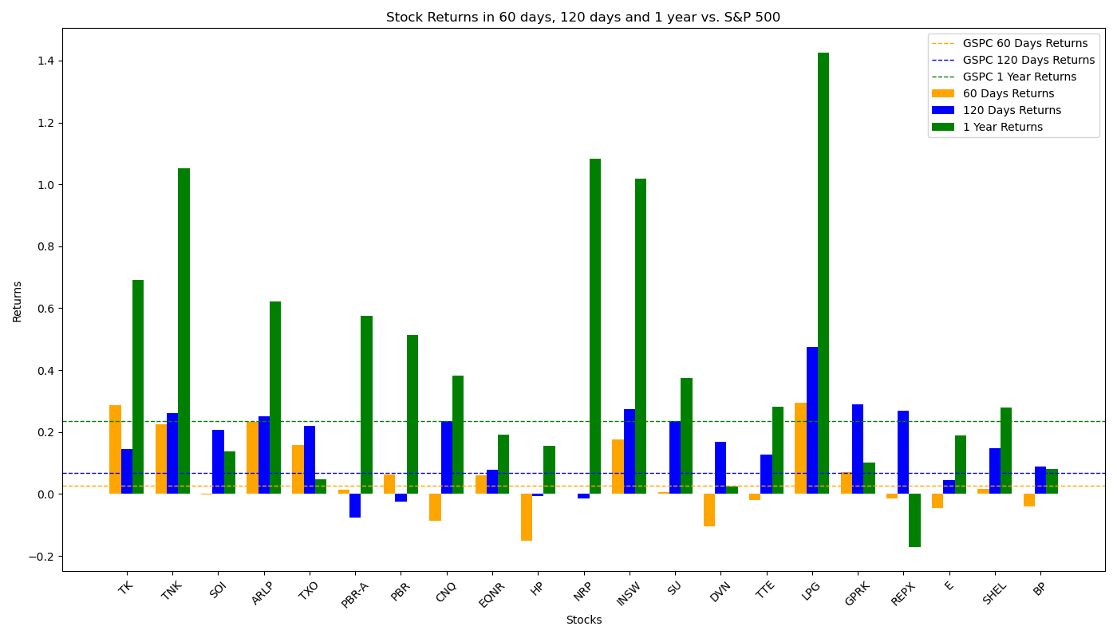
Performance of Filtered Stocks in Energy Sector
Most Filtered Stocks have above-average returns rate in 60-day, 120-day and 1-year sector; they perform especially well in a longer term.
Total 21 Filtered Stocks | 60 Days | 120 Days | 1 Year
No. Stocks with Positive Returns | 14 | 18 | 20
No. Stocks with Returns Higher than S&P 500 | 8 | 17 | 11
Total Average Returns | 5.47% | 16.17% | 43.15%
Returns of S&P 500 | 2.65% | 6.89% | 23.62%

Slide 5
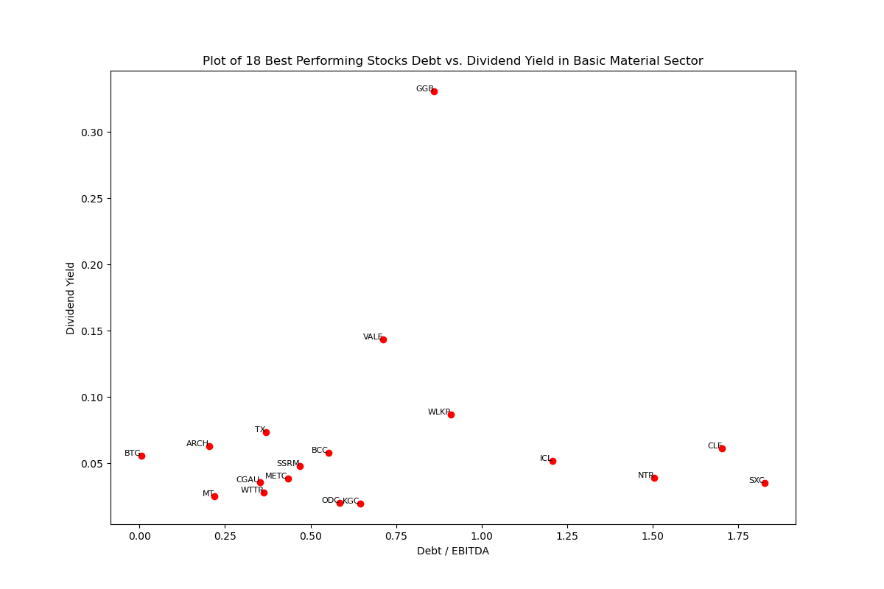
Basic Materials Sector
284(166) Stocks in Total*
The filtered 18 Best Performing Stocks have Debt/EBITDA under 1.75
Most of the Best Performing Stocks have Dividend Yield under 0.15
All but two stocks have their FCF Yields under 0.3
All but one stocks have their EPS Yield below 0.3
*8 Stocks lack EPS data; 35 stocks lack Debt data; 9 stocks lack share data; 66 other stocks have zero dividend paid. All above stocks are excluded from the calculation with 166 stocks left.

Slide 6
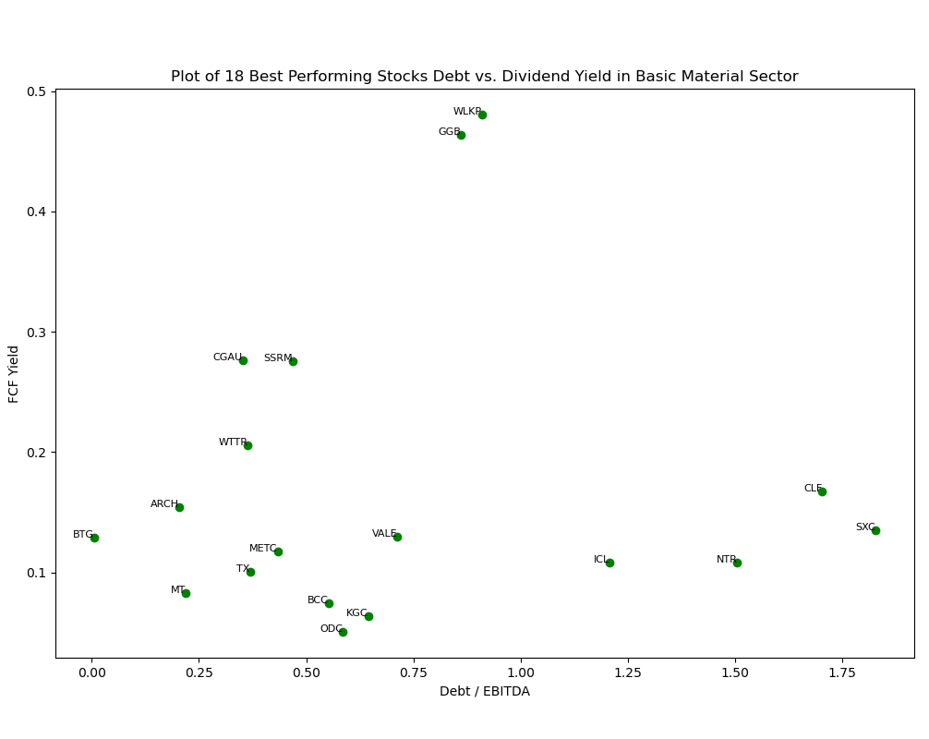
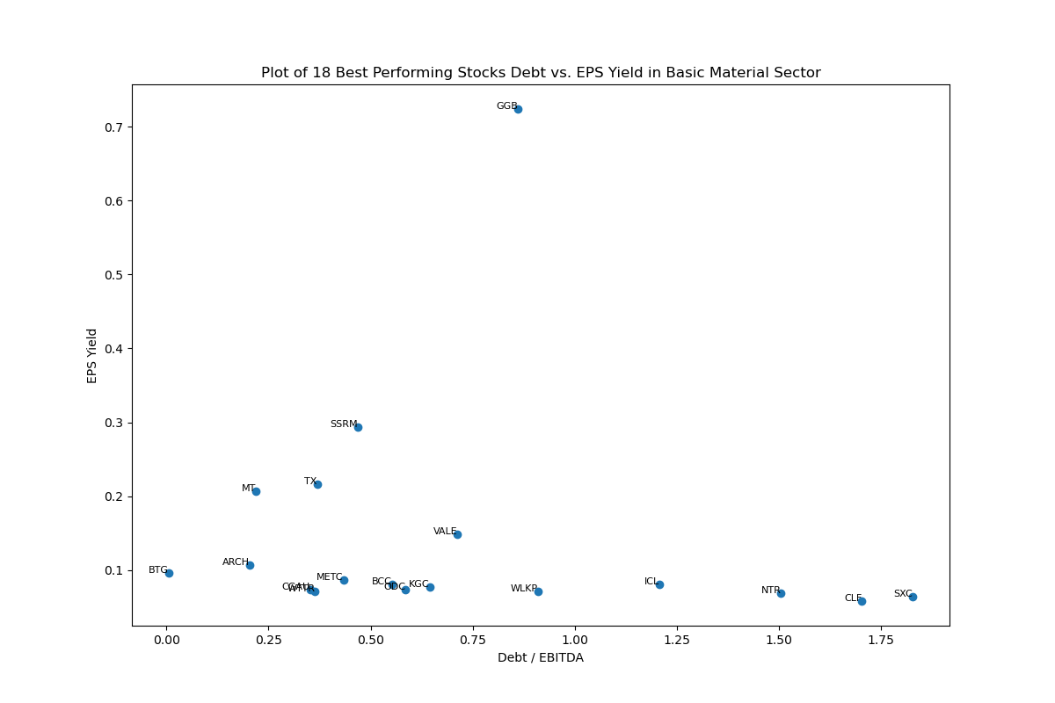
Basic Materials Sector

Slide 7
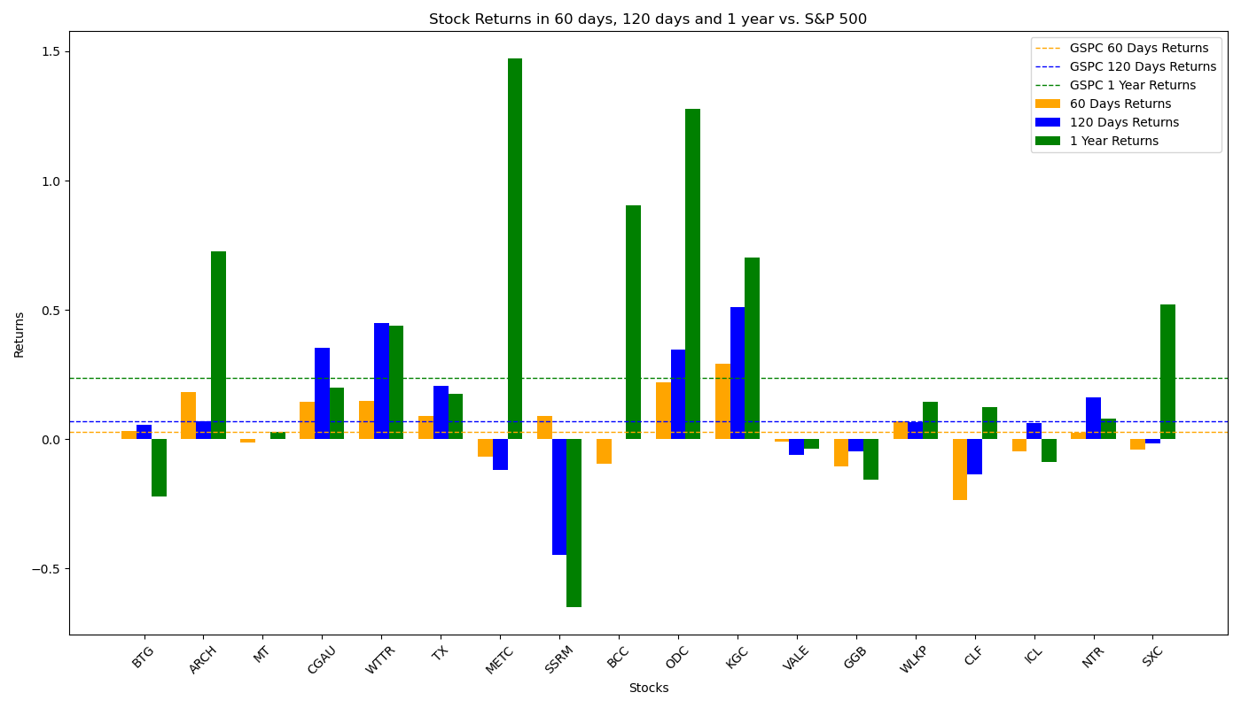
Performance of Filtered Stocks in Basic Materials Sector
Most Filtered Stocks have above-average returns rate in 60-day, 120-day and 1-year sector, higher than that of S&P 500 factors.
Total 18 Filtered Stocks | 60 Days | 120 Days | 1 Year
No. Stocks with Positive Returns | 10 | 12 | 14
No. Stocks with Returns Higher than S&P 500 | 10 | 8 | 7
Total Average Returns | 3.40% | 7.34% | 28.21%
Returns of S&P 500 | 2.65% | 6.89% | 23.62%

Slide 8
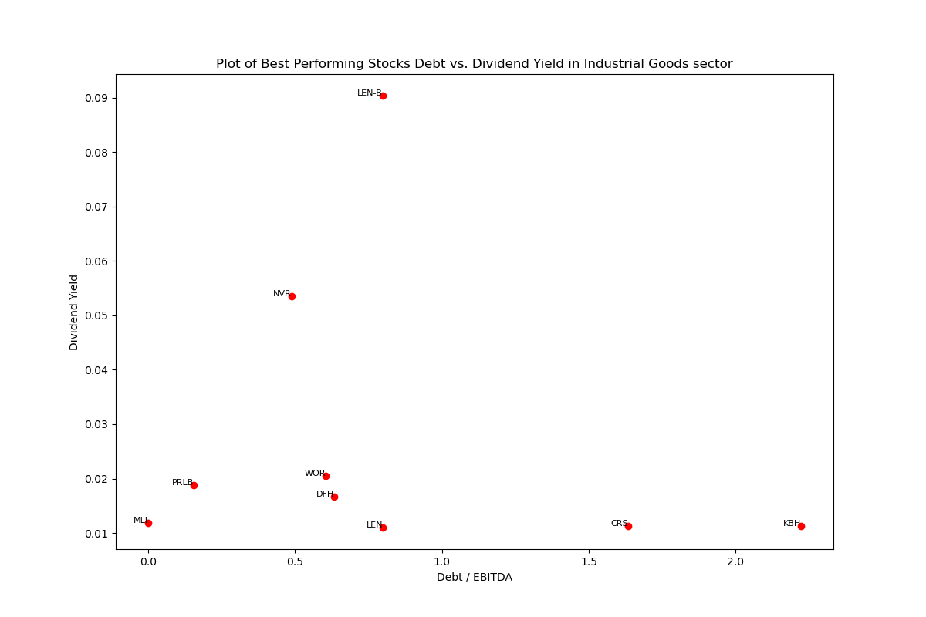
Industrial Goods Sector
85(53) Stocks in Total*
The filtered 9 Best Performing Stocks have Debt/EBITDA range from 0 to 2.4
Most of the Best Performing Stocks have Dividend Yield under 0.02
All but one of the stocks’ FCF yields are under 0.2
The Stocks have EPS Yields separates between 0 to 0.14
*ZONE has no price data in early 2024; 3 stocks lack Debt data; 3 stocks lack EBITDA data; 6 stocks lack share data; 19 other stocks have zero dividend paid. All above stocks are excluded from the calculation with 53 stocks left.

Slide 9
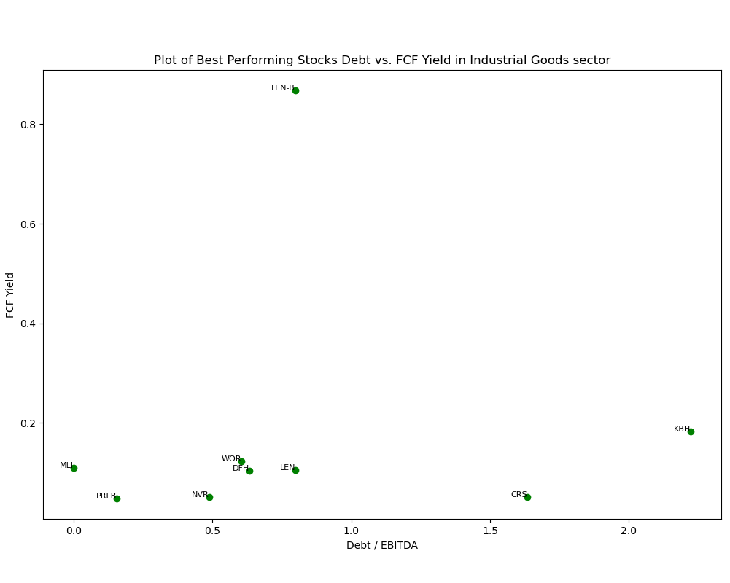
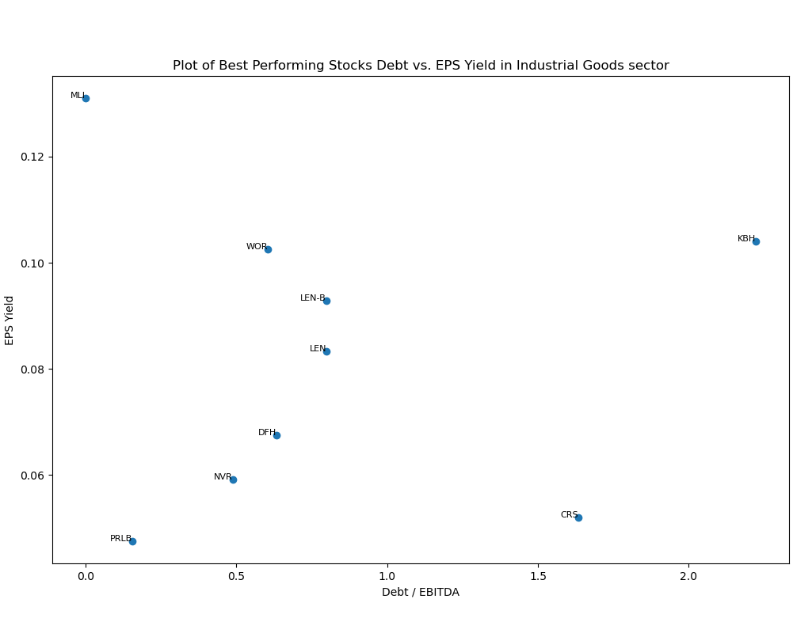
Industrial Goods Sector

Slide 10
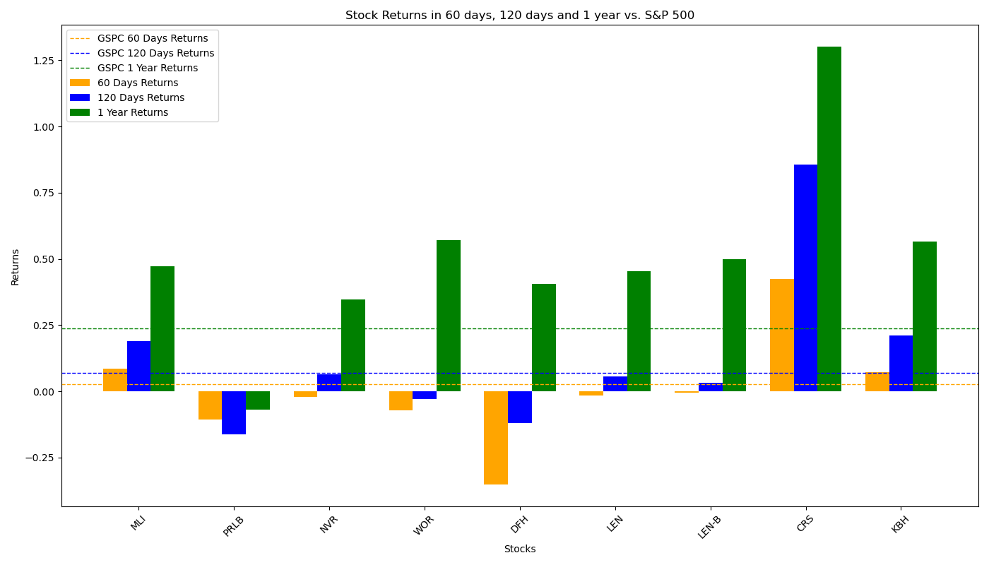
Performance of Filtered Stocks in Industrial Goods Sector
Most Filtered Stocks perform under average in 60-day period. The performance in long-term, however, is significantly good.
Total 9 Filtered Stocks | 60 Days | 120 Days | 1 Year
No. Stocks with Positive Returns | 3 | 6 | 8
No. Stocks with Returns Higher than S&P 500 | 3 | 3 | 8
Total Average Returns | 0.11% | 12.23% | 50.53%
Returns of S&P 500 | 2.65% | 6.89% | 23.62%

Slide 11
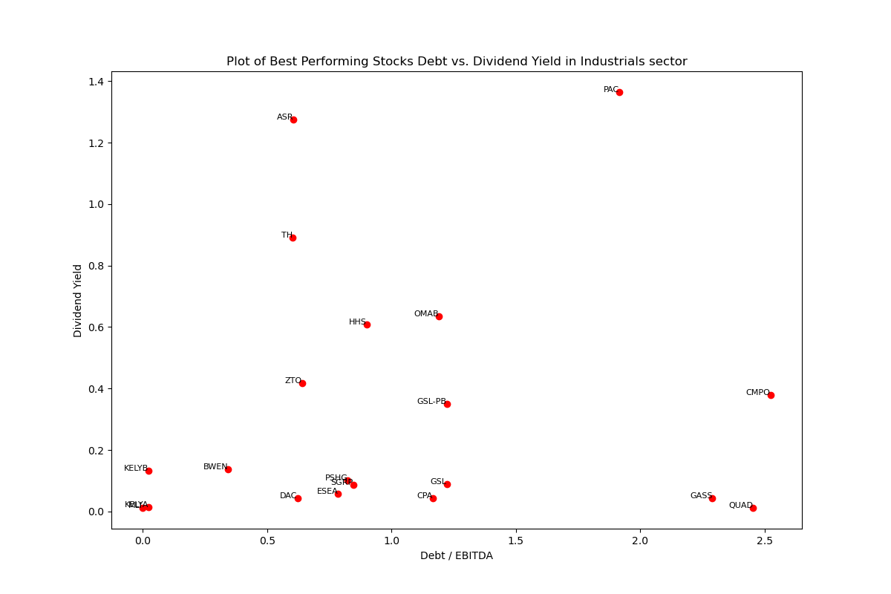
Industrials Sector
719(411) Stocks in Total*
The filtered 20 Best Performing Stocks have Debt/EBITDA range from 0 to 2.5
The filtered stocks have separate dividend yield distribution below 1.4
All but one (PSHC) of the stocks have FCF Yield under 1.5
All stocks except PSHC have EPS Yield below 0.5
*After excluding all stocks that have any of the following problems: 1) lack of Price data in a long period; 2) lack of Debt data; 3) lack of EPS data; 4) lack of share data; 5) lack of EBITDA data; 6) lack of FCF data; 7) The company has zero dividend paid; there are 441 stocks left into calculation

Slide 12
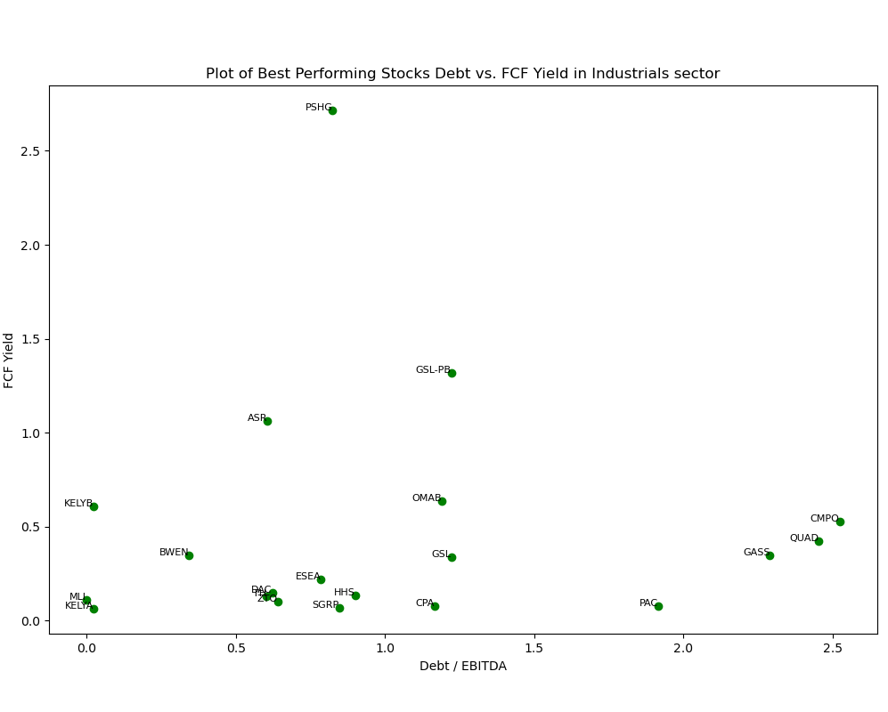
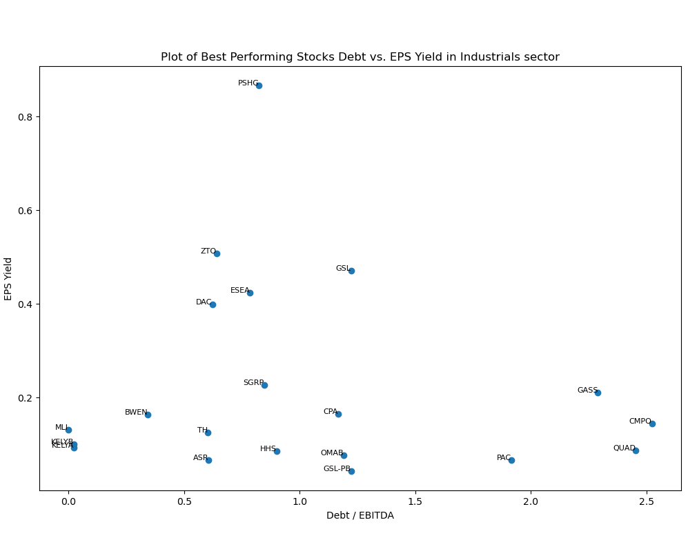
Industrials Sector

Slide 13
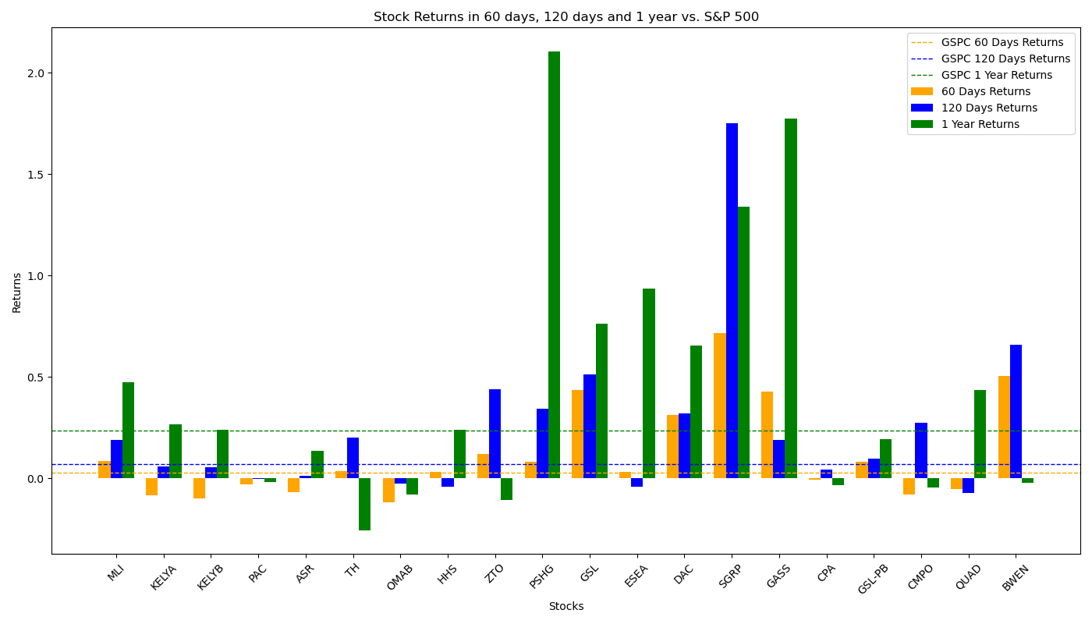
Performance of Filtered Stocks in Industrials Sector
Most Filtered Stocks perform very well in all period we have studied.
Total 20 Filtered Stocks | 60 Days | 120 Days | 1 Year
No. Stocks with Positive Returns | 12 | 16 | 13
No. Stocks with Returns Higher than S&P 500 | 12 | 11 | 11
Total Average Returns | 11.59% | 24.74% | 44.88%
Returns of S&P 500 | 2.65% | 6.89% | 23.62%

Slide 14
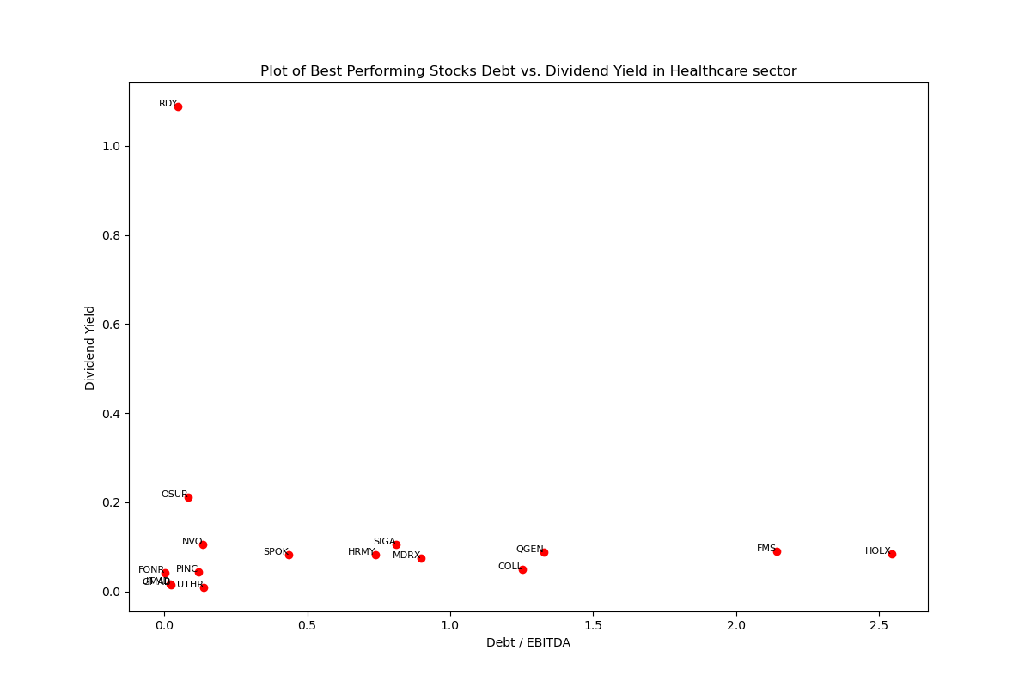
Healthcare Sector
1,302(360) Stocks in Total*
The filtered 17 Best Performing Stocks have Debt/EBITDA range from 0 to 2.5
All Stocks except RDY have FCF Yields below 0.3
Most of the Stocks have EPS Yields below 0.10
*After excluding all stocks that have any of the following problems: 1) lack of Price data in a long period; 2) lack of Debt data; 3) lack of EPS data; 4) lack of share data; 5) lack of EBITDA data; 6) lack of FCF data; 7) The company has zero dividend paid; there are 360 stocks left into calculation
*Stock “BIO-B” has been dropped from the Dividend Graph because the number is abnormally big

Slide 15
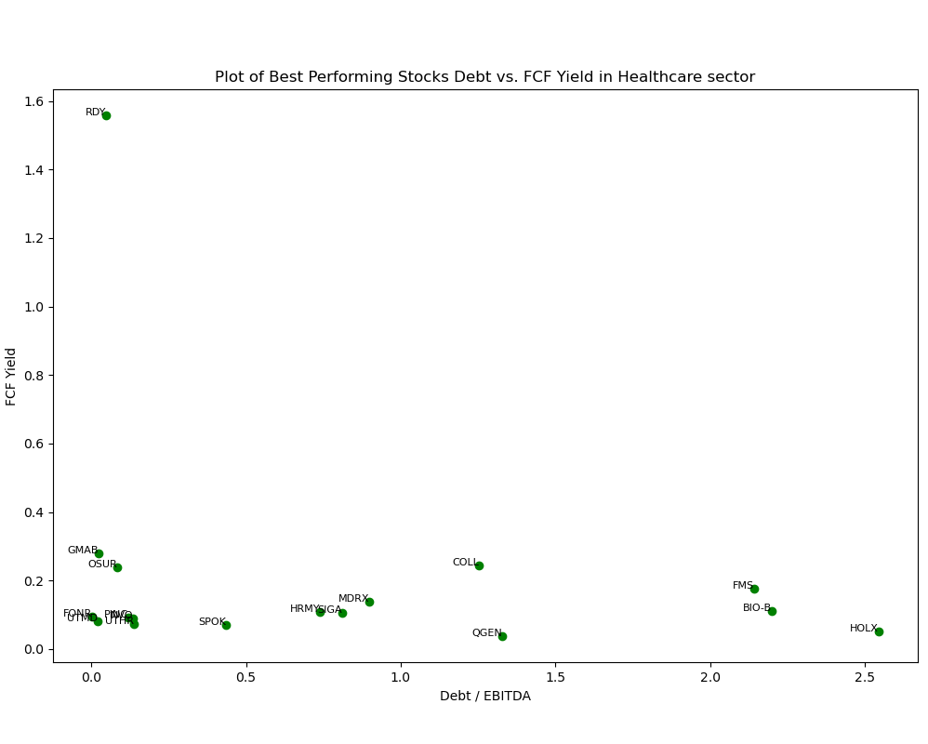
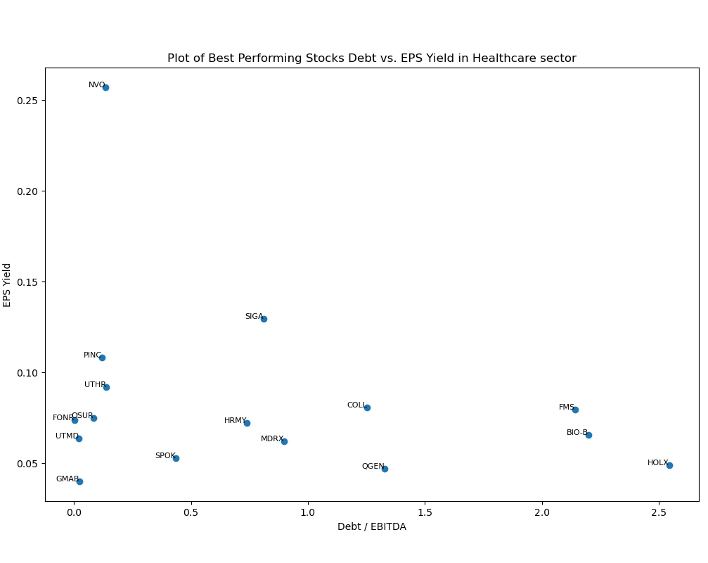
Healthcare Sector
*Stock “RDY” has been removed from the EPS graph to showing more details of other stocks’ distribution clearly

Slide 16
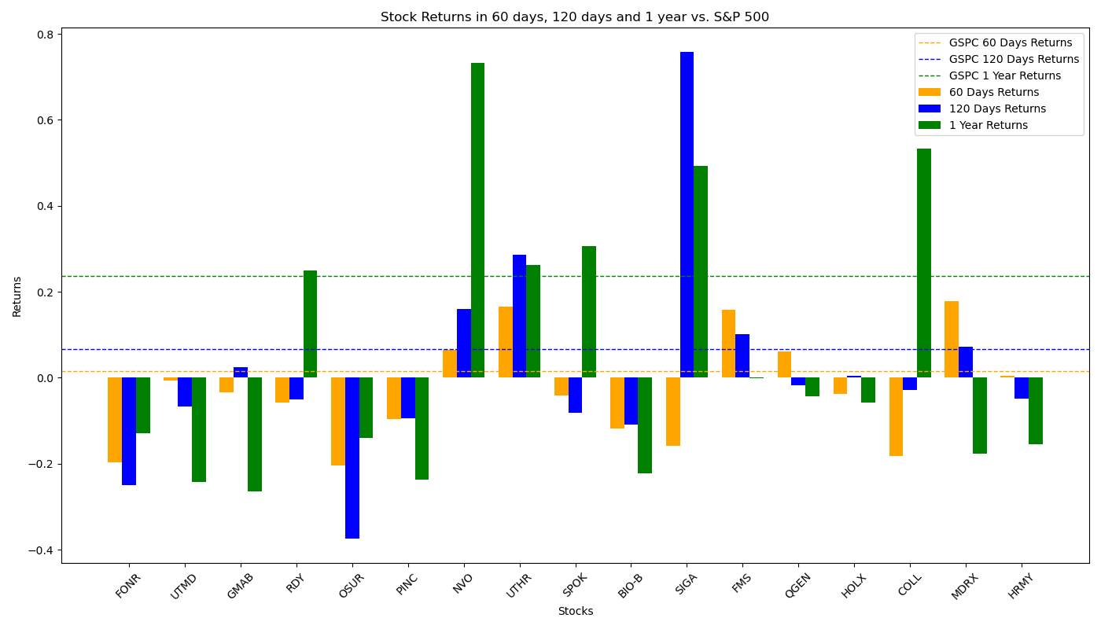
Performance of Filtered Stocks in Healthcare Sector
The Filtered Investment Portfolios don’t have a good performance in the period, including the bad point.
Total 17 Filtered Stocks | 60 Days | 120 Days | 1 Year
No. Stocks with Positive Returns | 6 | 7 | 6
No. Stocks with Returns Higher than S&P 500 | 5 | 5 | 6
Total Average Returns | -2.94% | 1.65% | 5.34%
Returns of S&P 500 | 2.65% | 6.89% | 23.62%

Slide 17
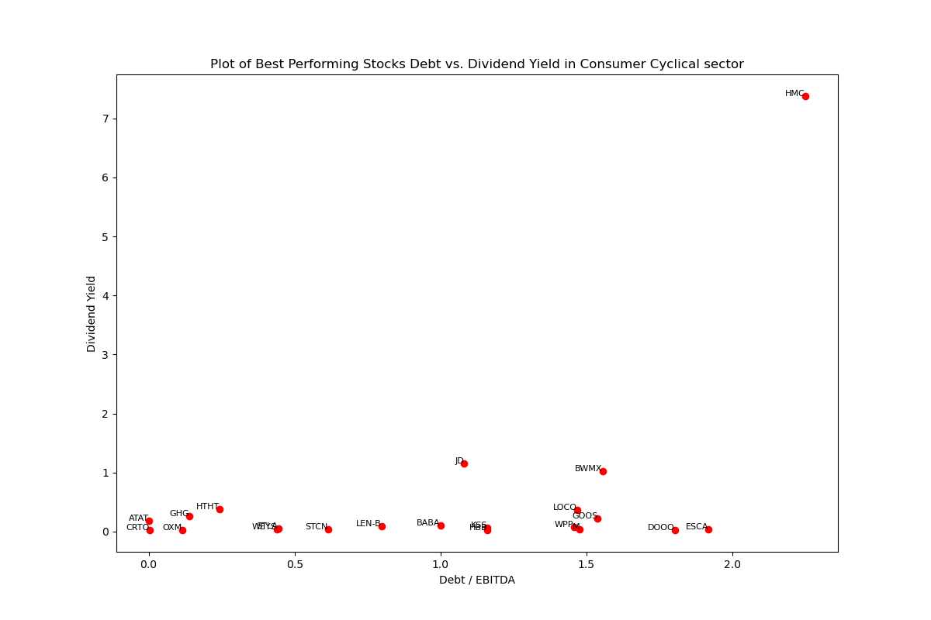
Consumer Cyclical Sector
676(356) Stocks in Total*
The filtered 21 Best Performing Stocks have Debt/EBITDA range from 0 to 2.5
Many of the filtered Stocks have dividend yield below 1
Exist a stock (HMC) with very high Div Yield and highest Debt
HMC is also higher than average in FCF Yield, and BWMX is highest both in FCF Yield and EPS Yield
All other stocks have FCF Yield below 1.5 and EPS Yield below 1.0
*After excluding all stocks that have any of the following problems: 1) lack of Price data in a long period; 2) lack of Debt data; 3) lack of EPS data; 4) lack of share data; 5) lack of EBITDA data; 6) lack of FCF data; 7) The company has zero dividend paid; there are 356 stocks left into calculation

Slide 18
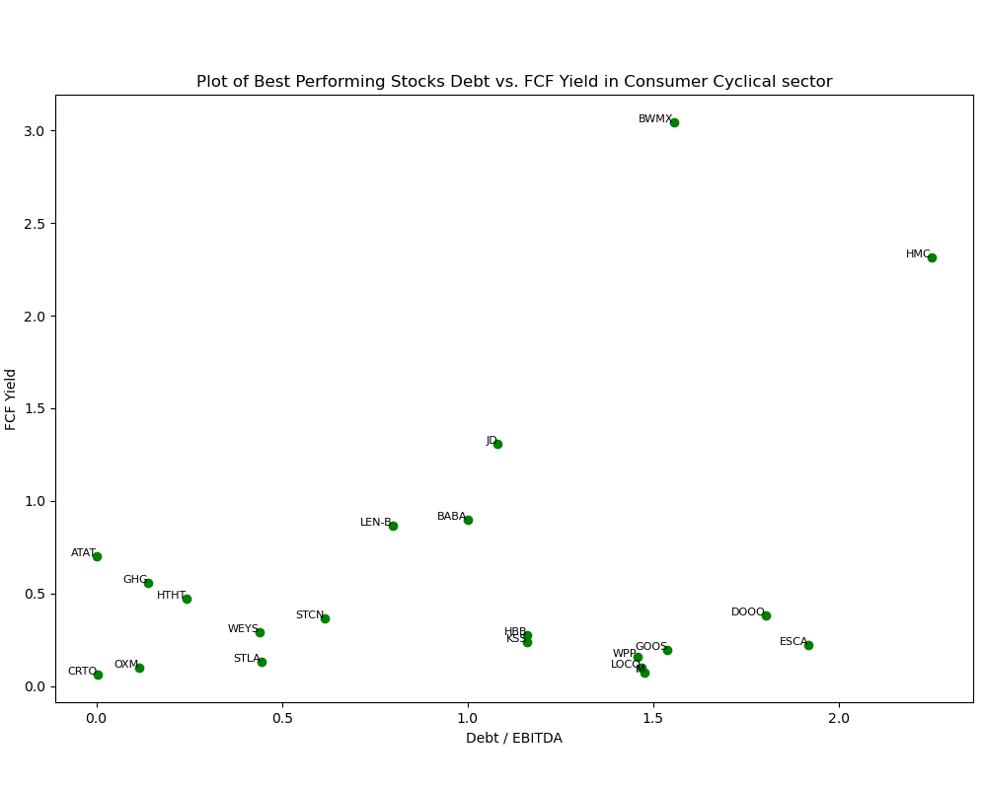
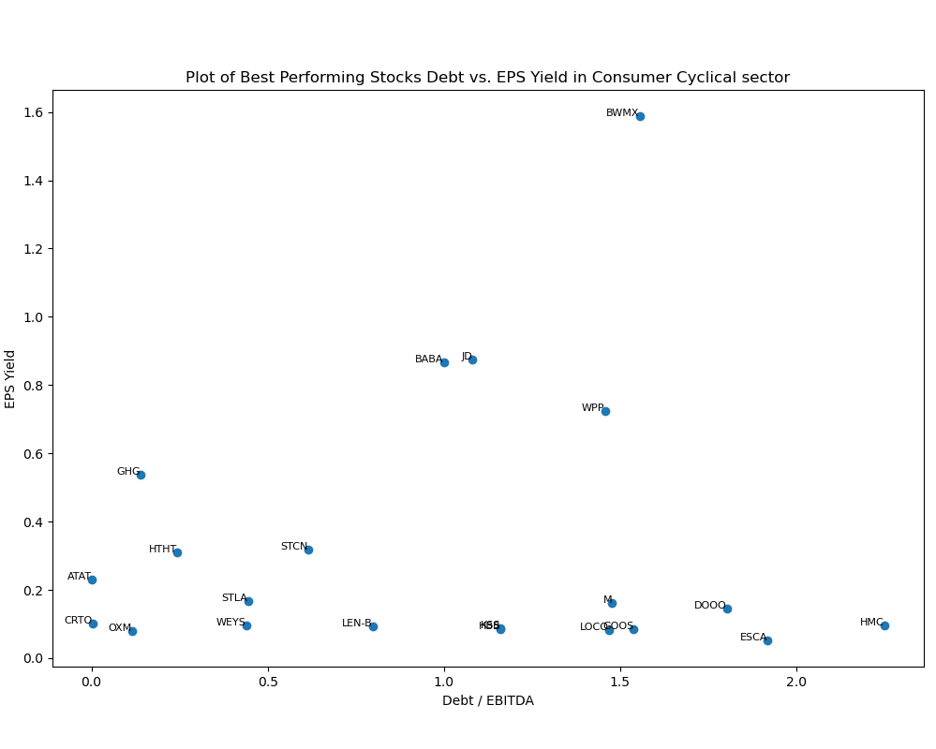
Consumer Cyclical Sector

Slide 19
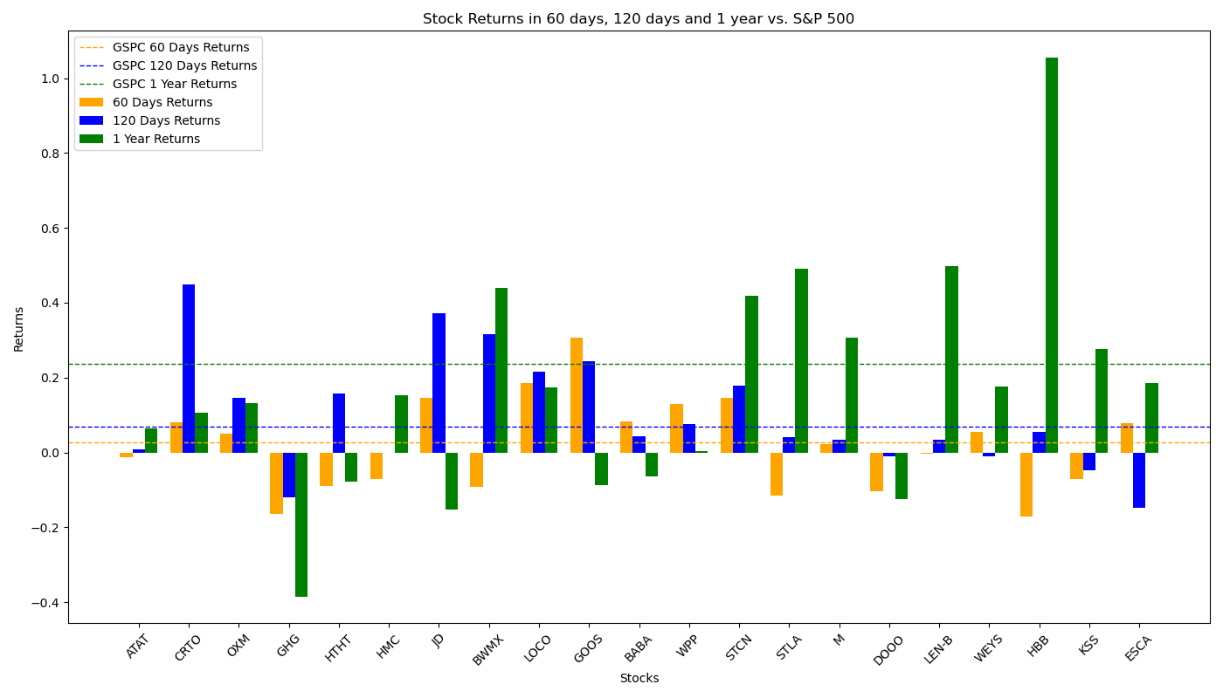
Performance of Filtered Stocks in Consumer Cyclical Sector
The Filtered Investment Portfolios performs worse than S&P 500 factors in 60-day and 1-year period but do has positive returns.
Total 21 Filtered Stocks | 60 Days | 120 Days | 1 Year
No. Stocks with Positive Returns | 11 | 15 | 14
No. Stocks with Returns Higher than S&P 500 | 10 | 9 | 7
Total Average Returns | 1.79% | 9.68% | 17.68%
Returns of S&P 500 | 2.65% | 6.89% | 23.62%

Slide 20
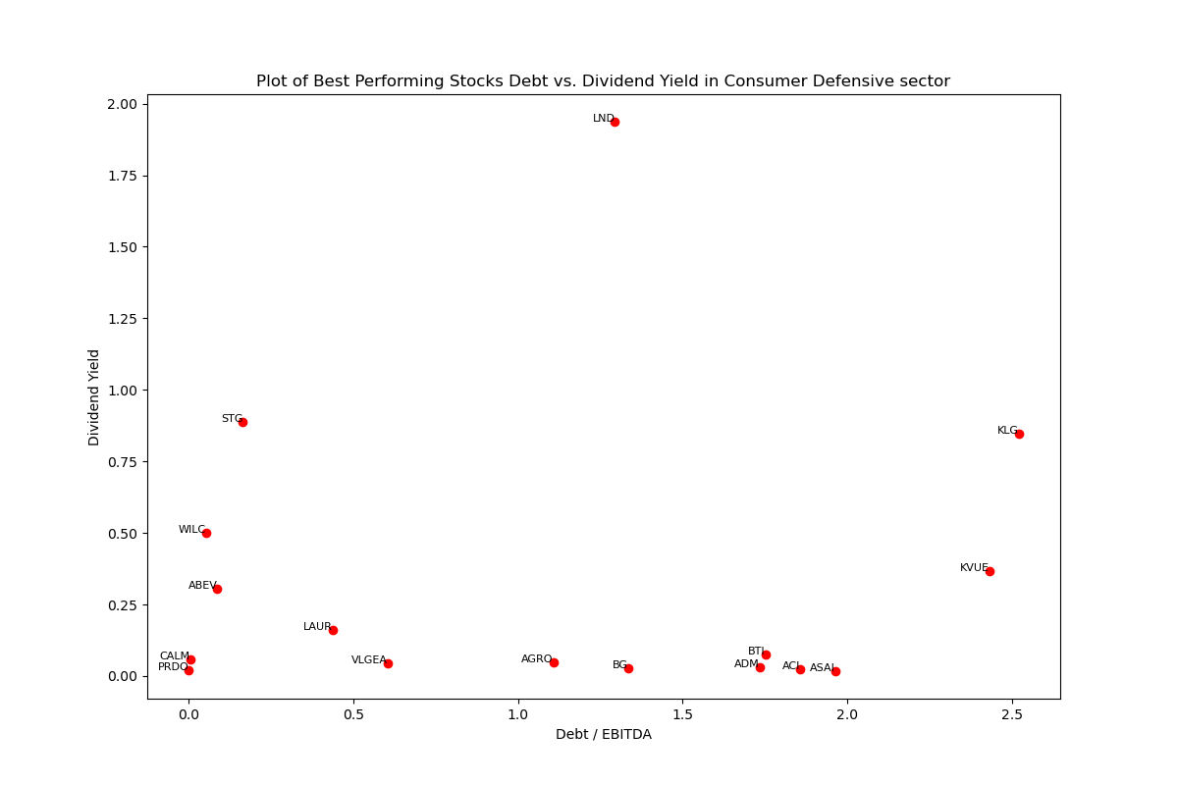
Consumer Defensive Sector
261(148) Stocks in Total*
The filtered 16 Best Performing Stocks have Debt/EBITDA range from 0 to 2.5
All but one the filtered Stocks have Dividend yield below 1
All stocks have FCF Yield below 1.1
All but two stocks have EPS Yield below 0.18
*After excluding all stocks that have any of the following problems: 1) lack of Price data in a long period; 2) lack of Debt data; 3) lack of EPS data; 4) lack of share data; 5) lack of EBITDA data; 6) lack of FCF data; 7) The company has zero dividend paid; there are 148 stocks left into calculation

Slide 21
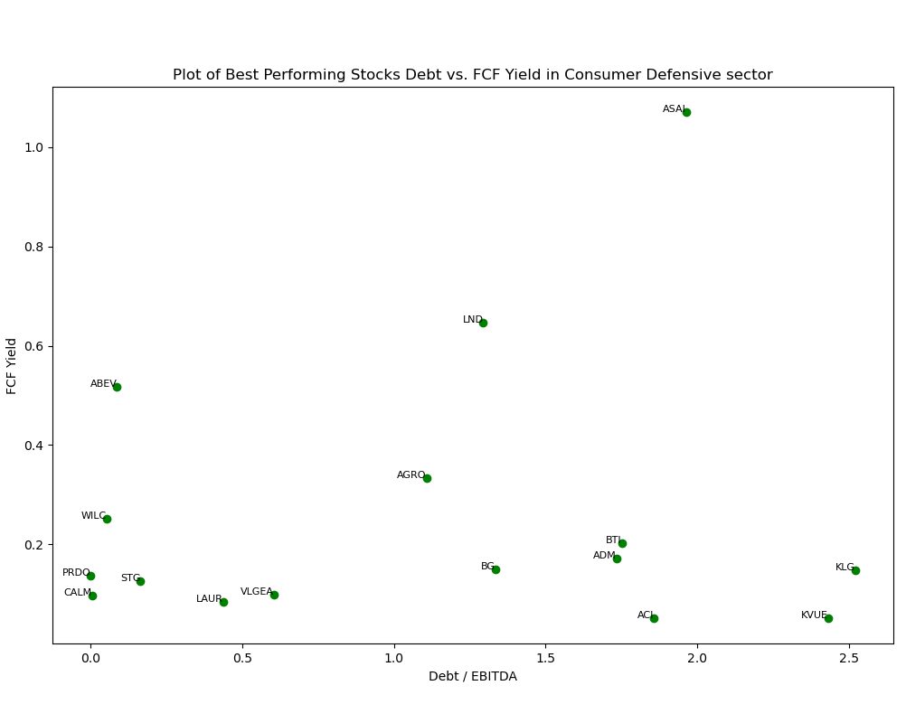
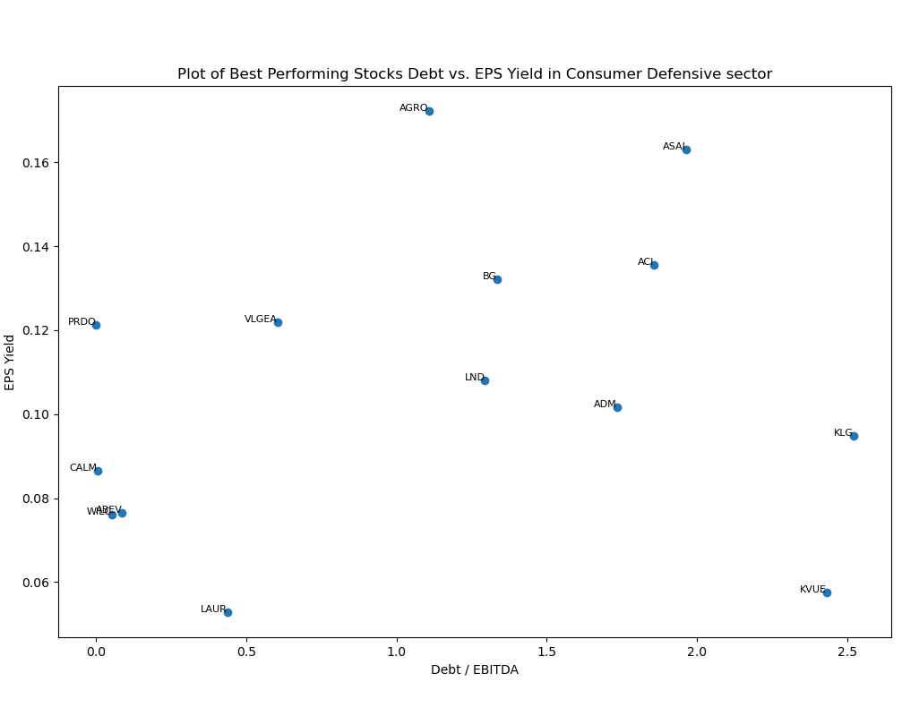
Consumer Defensive Sector
*Stock BTI and STG has been removed from the EPS graph to showing more details of other stocks’ distribution clearly

Slide 22
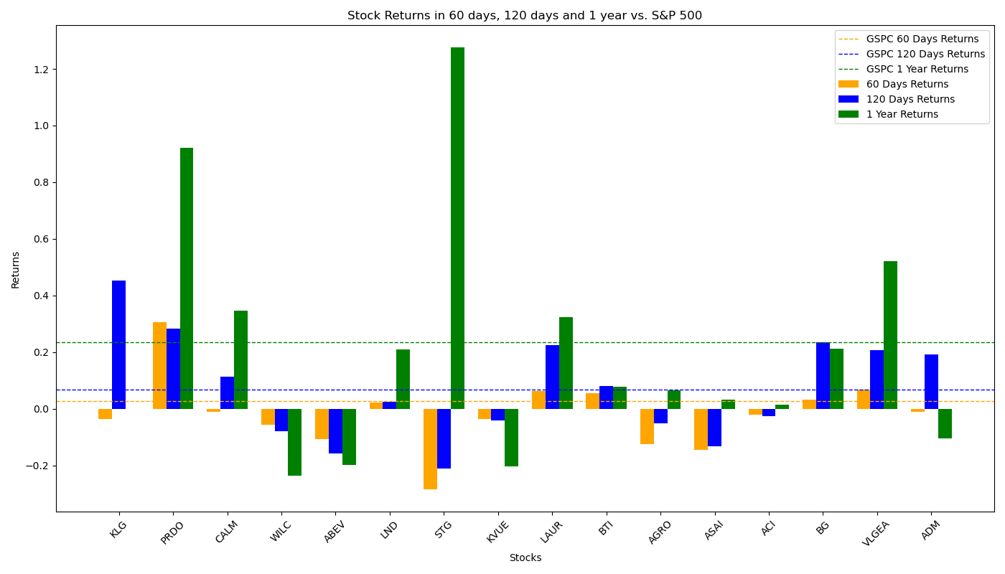
Performance of Filtered Stocks in Consumer Defensive Sector
The Filtered Investment Portfolios give negative returns in 60-day period, but in longer period their performances are close to that of S&P 500’s.
*KLG has no price data before 2023/09/28, therefore its 1-year returns is set to be 0 and is not taken into the total returns' calculation
Total 16 Filtered Stocks | 60 Days | 120 Days | 1 Year
No. Stocks with Positive Returns | 6 | 9 | 11*
No. Stocks with Returns Higher than S&P 500 | 5 | 8 | 5
Total Average Returns | -1.77% | 6.96% | 21.73%
Returns of S&P 500 | 2.65% | 6.89% | 23.62%

Slide 23
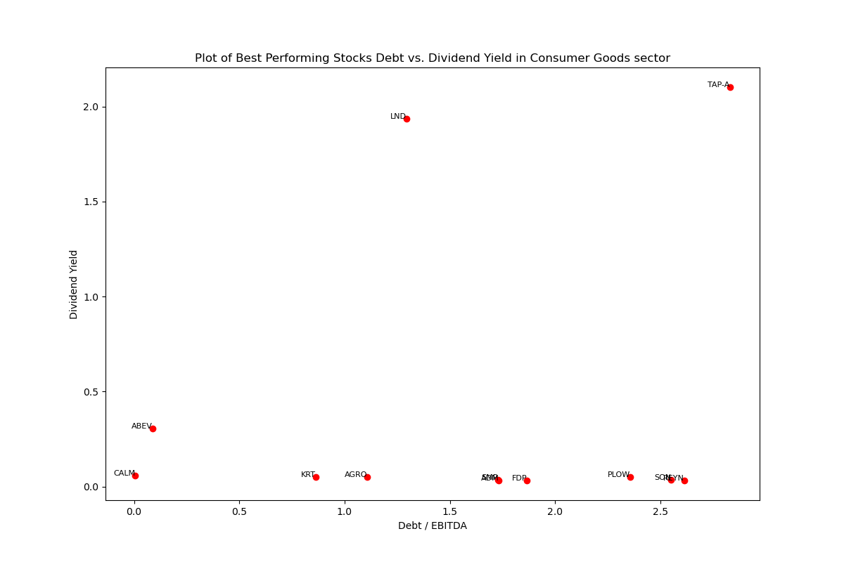
Consumer Goods Sector
189(114) Stocks in Total*
The filtered 12 Best Performing Stocks have Debt/EBITDA range from 0 to 3
Many of the filtered Stocks have dividend yield below 0.5
All the filtered Stocks except TAP-A and LND have FCF yield below 0.5
All the filtered Stocks except AGRO have EPS yield below 0.5
*After excluding all stocks that have any of the following problems: 1) lack of Price data in a long period; 2) lack of Debt data; 3) lack of EPS data; 4) lack of share data; 5) lack of EBITDA data; 6) lack of FCF data; 7) The company has zero dividend paid; there are 114 stocks left into calculation

Slide 24
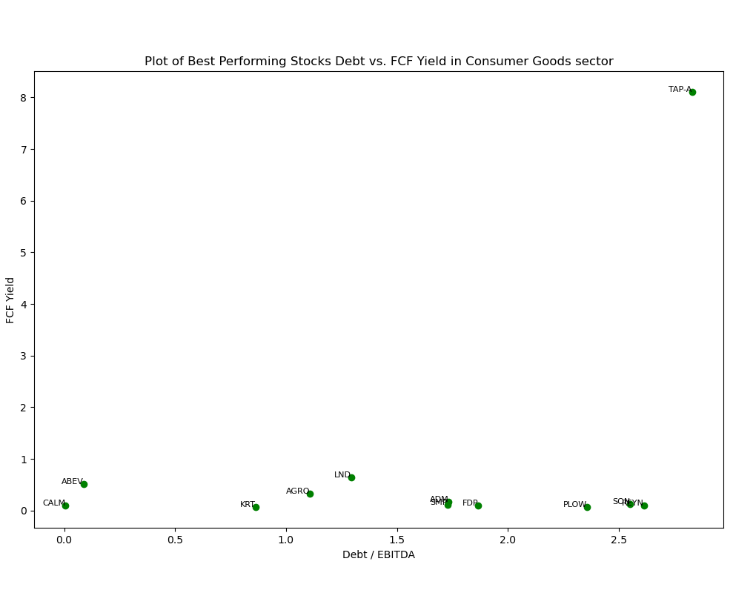
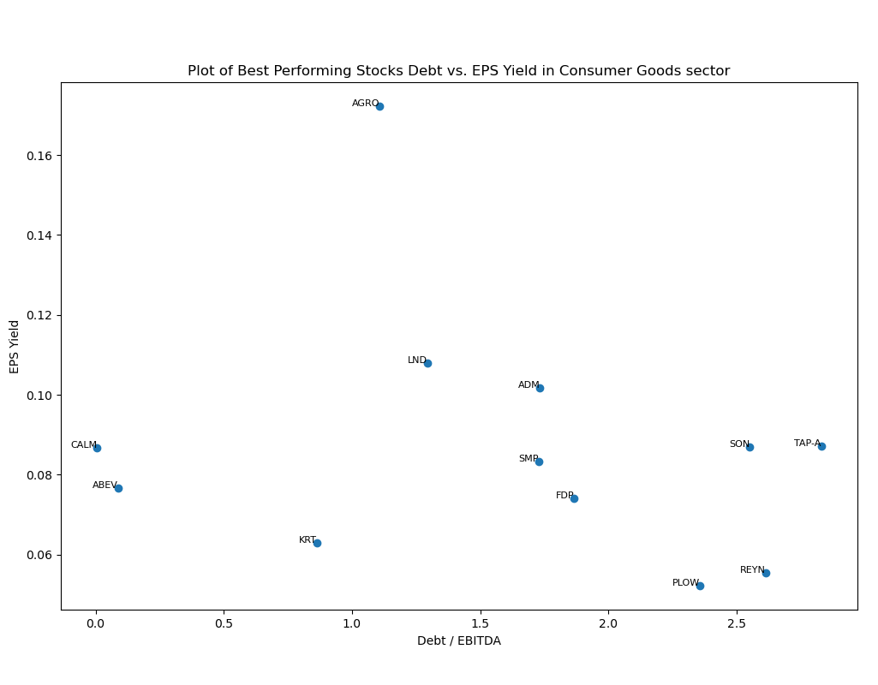
Consumer Goods Sector

Slide 25
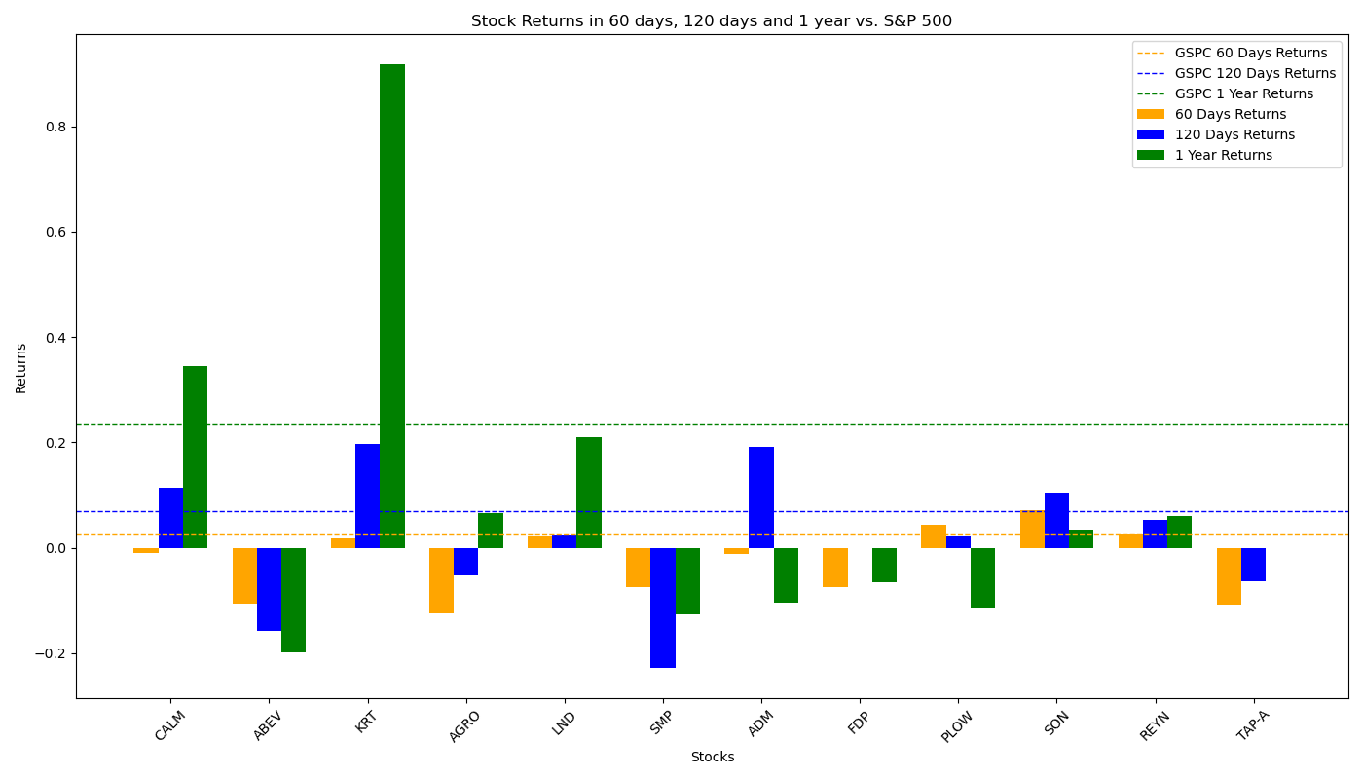
Performance of Filtered Stocks in Consumer Goods Sector
The Filtered Investment Portfolios performs badly in all three periods, especially in 60 days where they failed to provide positive returns.
Total 12 Filtered Stocks | 60 Days | 120 Days | 1 Year
No. Stocks with Positive Returns | 5 | 7 | 6
No. Stocks with Returns Higher than S&P 500 | 3 | 4 | 2
Total Average Returns | -2.71% | 1.69% | 8.53%
Returns of S&P 500 | 2.65% | 6.89% | 23.62%

Slide 26
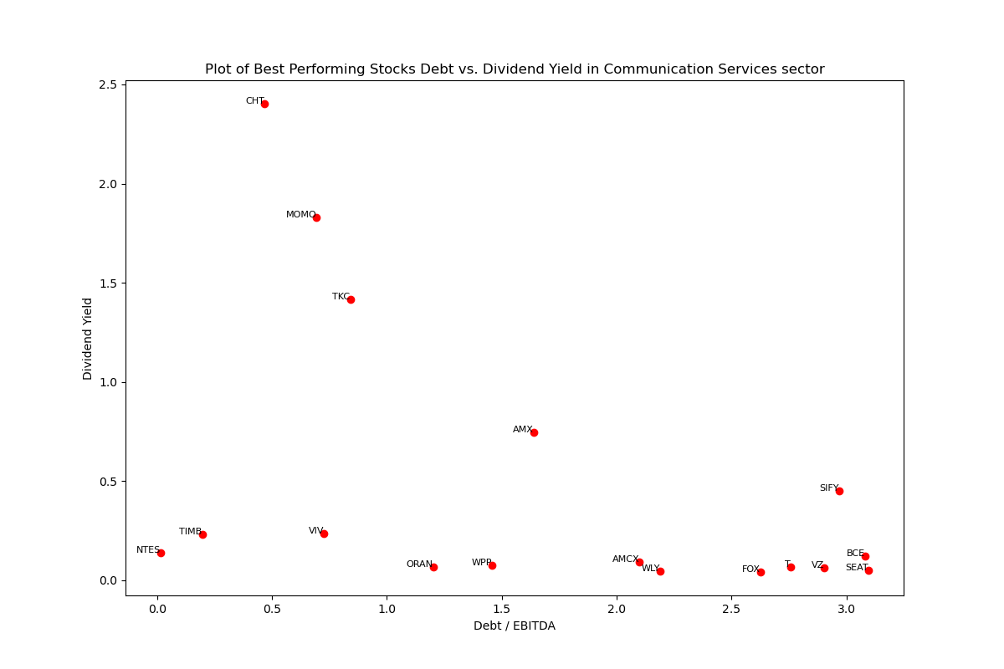
Communication Service Sector
302(147) stocks in total*
Filtered 20 Debt/EBITDA rate for the selected stocks varies between 0 to 3.2
More than half of the stocks have Dividend Yield less than 0.25
All but one stocks have FCF yield under 2
Most of the stocks have EPS Yield between 0.2
*TLK, SKM and KT have been removed from the dividend field plot and FCF yield field plot since their numbers are extremely high
*After excluding all stocks that have any of the following problems: 1) lack of Price data in a long period; 2) lack of Debt data; 3) lack of EPS data; 4) lack of share data; 5) lack of EBITDA data; 6) lack of FCF data; 7) The company has zero dividend paid; there are 147 stocks left into calculation

Slide 27
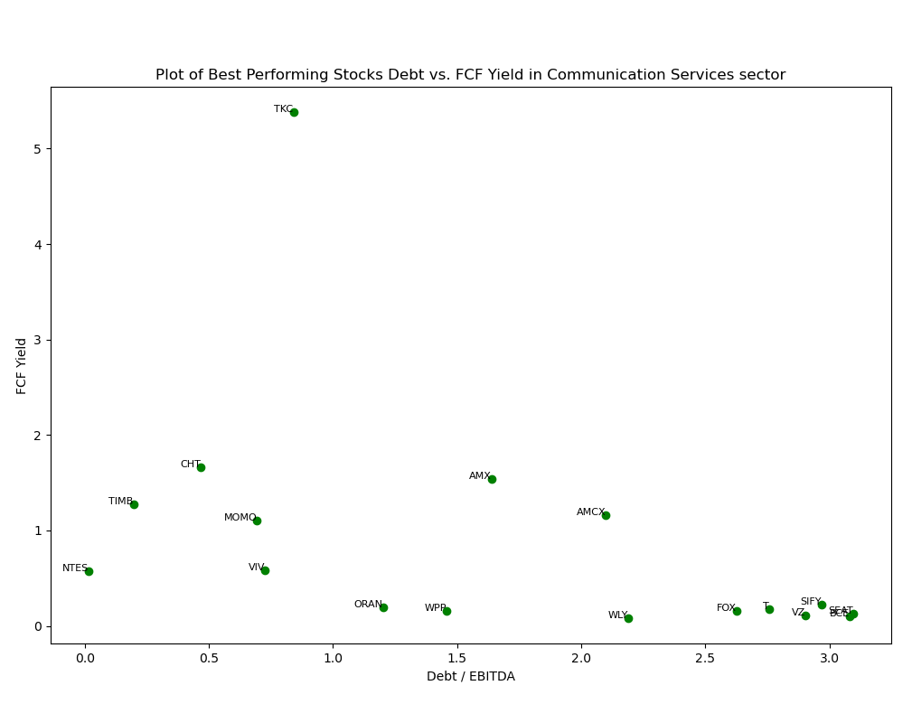
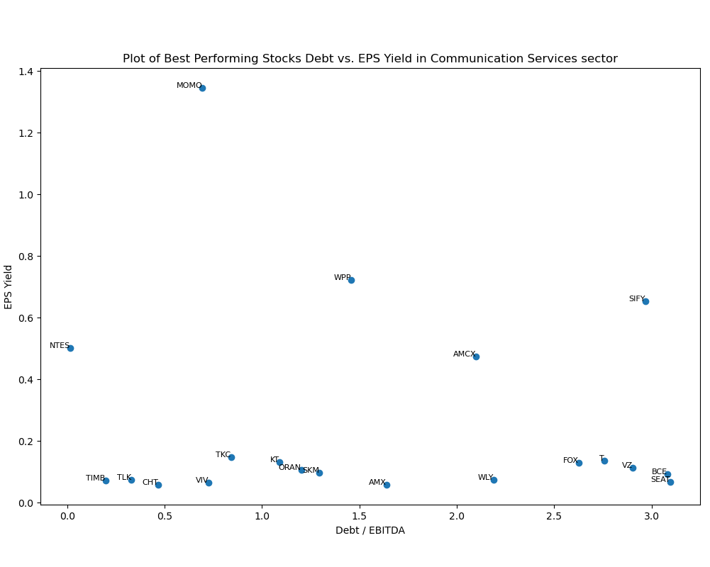
Communication Service Sector

Slide 28
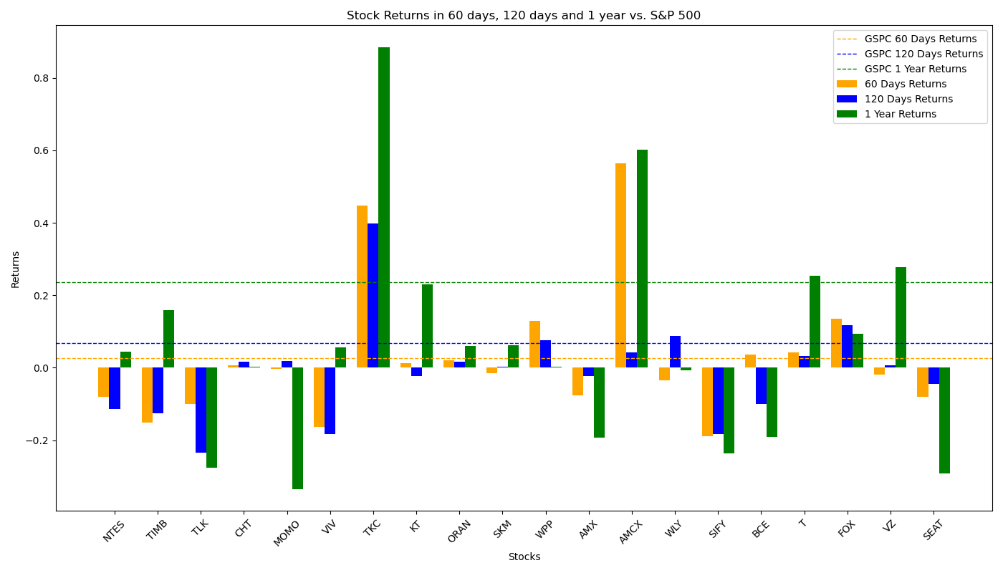
Performance of Filtered Stocks in Communication Service Sector
The Filtered Investment Portfolios performs badly in 120-day and 1-year period.
Total 20 Filtered Stocks | 60 Days | 120 Days | 1 Year
No. Stocks with Positive Returns | 9 | 9 | 11
No. Stocks with Returns Higher than S&P 500 | 5 | 4 | 4
Total Average Returns | 2.40% | -1.09% | 5.98%
Returns of S&P 500 | 2.65% | 6.89% | 23.62%

Slide 29
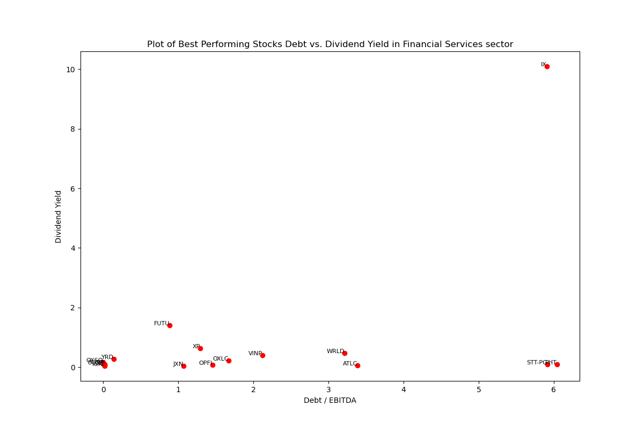
Financial Services Sector
1,375(358) stocks in total*
Filtered 18 Debt/EBITDA rate for the selected stocks varies between 0 to 3.2
Most stocks has Dividend Yield less than 0.2
Exist a stock (IX) with very high Div Yield and FCF Yield along with highest Debt, while Other Stocks have Dividend Yield under 2 and FCF Yield under 2.5
Most of the stocks have EPS Yield below 0.5
*TLK, SKM and KT have been removed from the dividend field plot and FCF yield field plot since their numbers are extremely high
*After excluding all stocks that have any of the following problems: 1) have are no financial data in database; 2) lack of Price data in a long period; 3) lack of Debt data; 4) lack of EPS data; 5) lack of share data; 6) lack of EBITDA data; 7) lack of FCF data; 8) The company has zero dividend paid; there are 358 stocks left into calculation

Slide 30
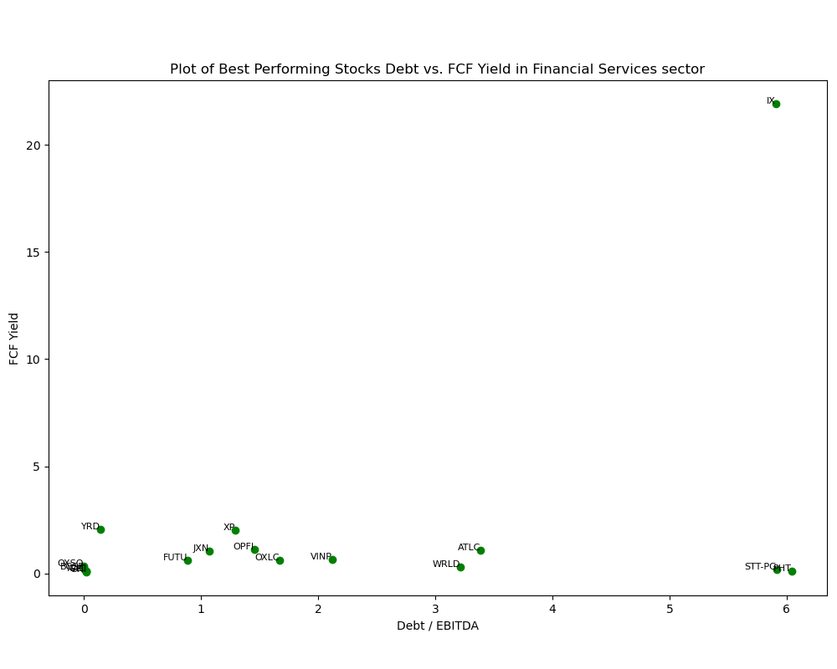
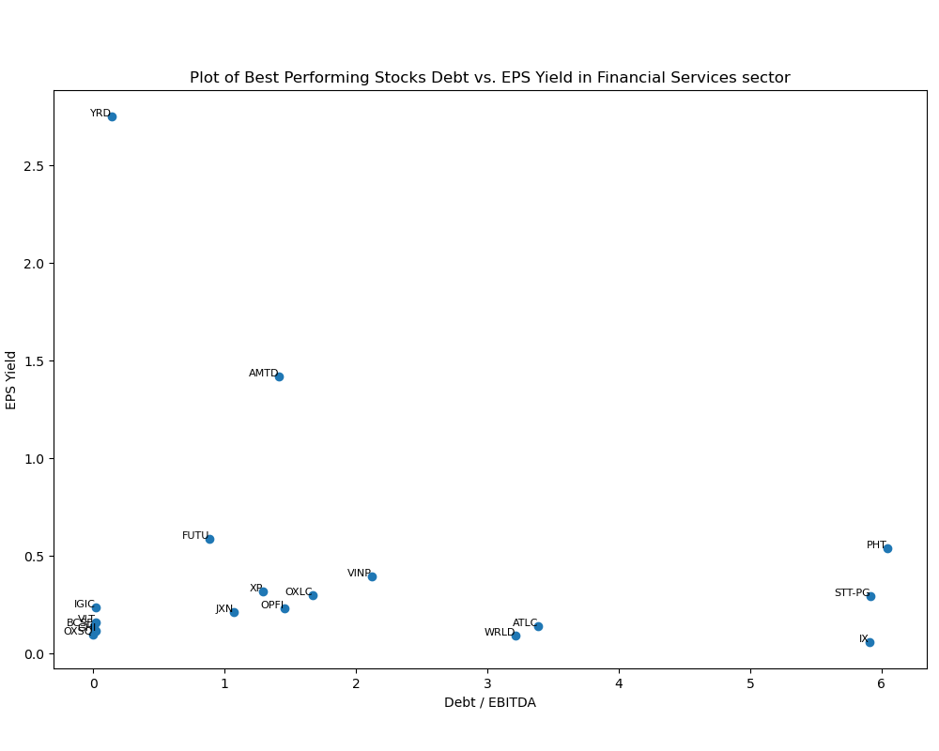
Financial Service Sector

Slide 31
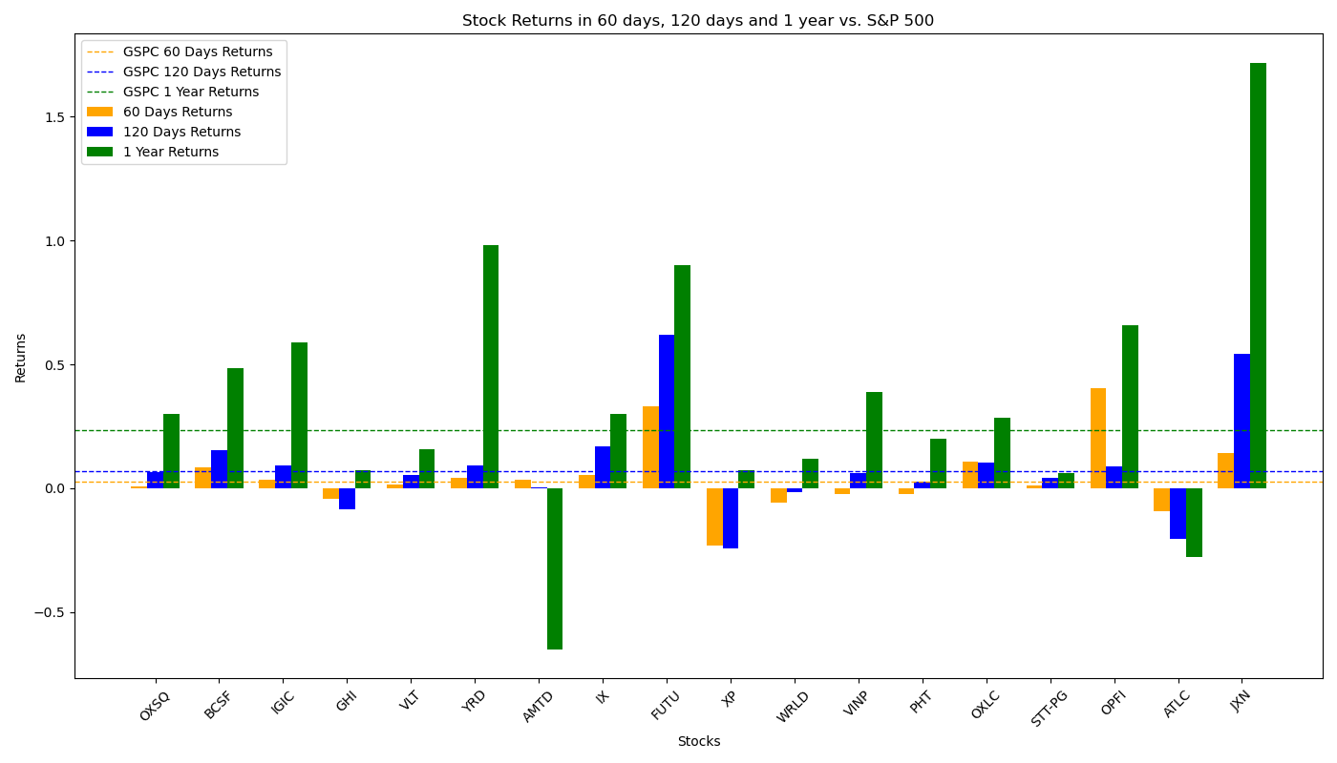
Performance of Filtered Stocks in Financial Service Sector
The Filtered Investment Portfolios performs badly in 120-day and 1-year period.
Total 18 Filtered Stocks | 60 Days | 120 Days | 1 Year
No. Stocks with Positive Returns | 9 | 9 | 11
No. Stocks with Returns Higher than S&P 500 | 5 | 4 | 4
Total Average Returns | 2.40% | -1.09% | 5.98%
Returns of S&P 500 | 2.65% | 6.89% | 23.62%

Slide 32
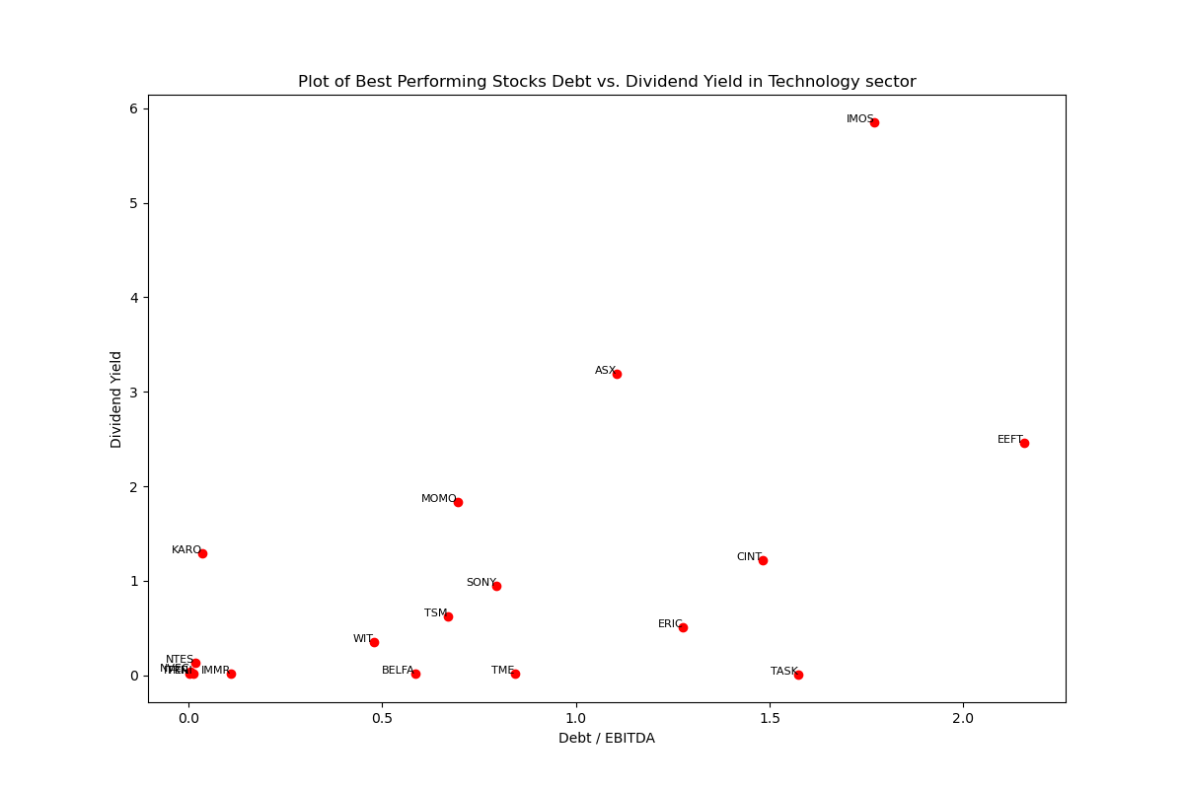
Technology Sector
1048(464) Stocks in Total*
The filtered 19 Best Performing Stocks have Debt/EBITDA range from 0 to 2.3
Most of the stocks have Dividend Yield below 2, FCF Yield Below 1 and EPS Yield Below 0.5
*After excluding all stocks that have any of the following problems: 1) lack of Price data in a long period; 2) lack of Debt data; 3) lack of EPS data; 4) lack of share data; 5) lack of EBITDA data; 6) lack of FCF data; 7) The company has zero dividend paid; there are 464 stocks left into calculation
*KSPI has been removed from all three plots and SONY has been removed from FCF yield plot, since their numbers are extremely high in those metrics

Slide 33
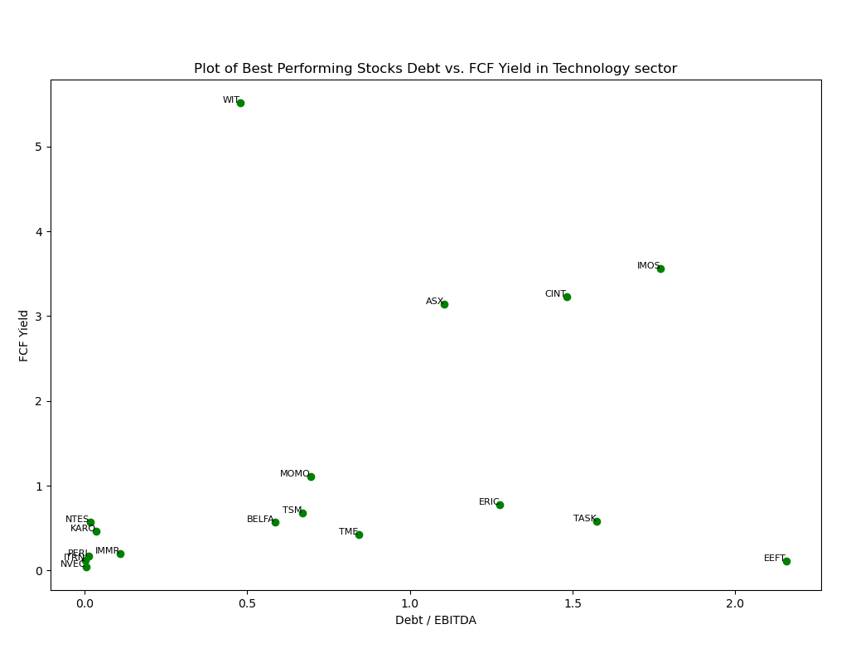
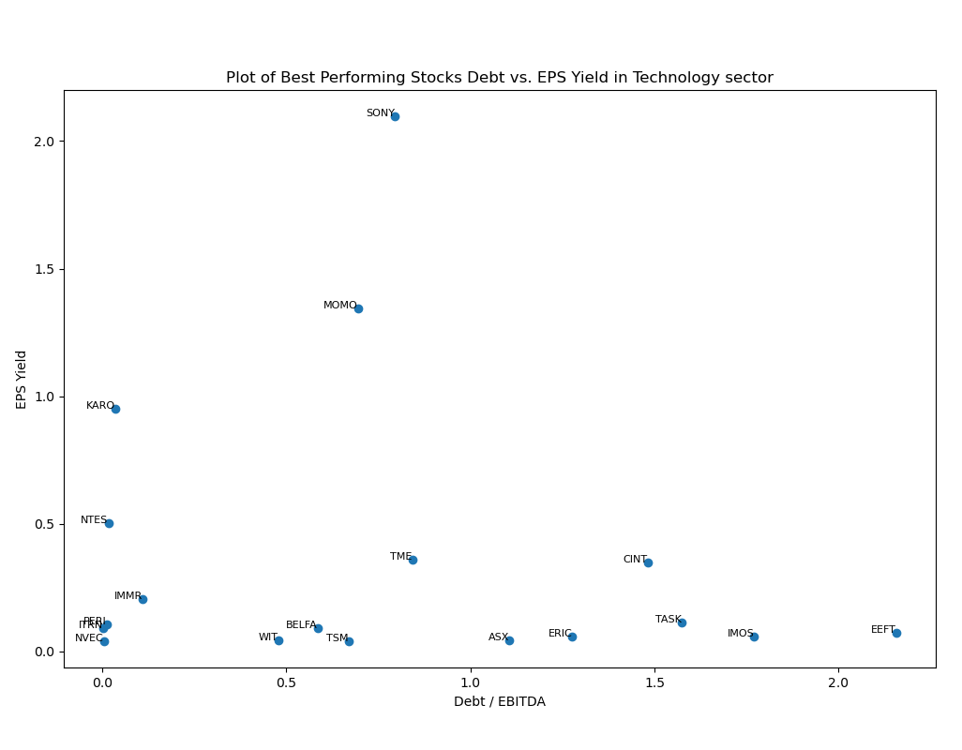
Technology Sector

Slide 34
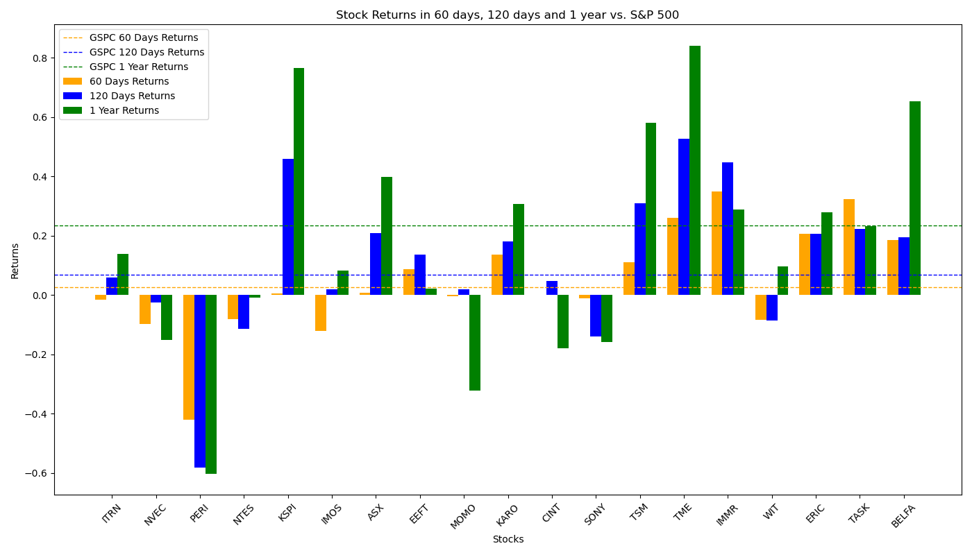
Performance of Filtered Stocks in Technology Sector
The Filtered Investment Portfolios performs worse than S&P 500 factors in 60-day and 1-year period.
Total 19 Filtered Stocks | 60 Days | 120 Days | 1 Year
No. Stocks with Positive Returns | 11 | 15 | 14
No. Stocks with Returns Higher than S&P 500 | 10 | 9 | 7
Total Average Returns | 4.42% | 10.96% | 17.13%
Returns of S&P 500 | 2.65% | 6.89% | 23.62%

Slide 35
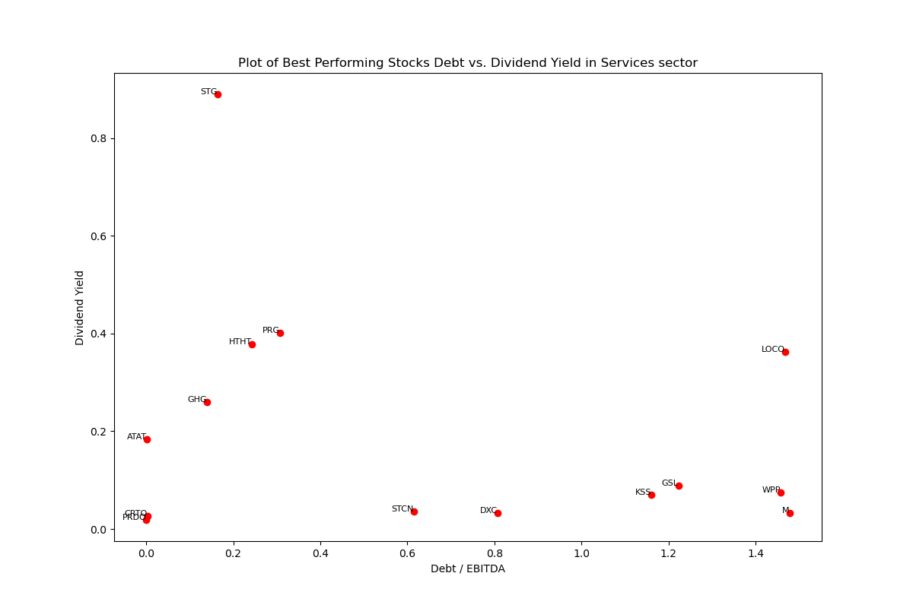
Services Sector
376(220) Stocks in Total*
The filtered 19 Best Performing Stocks have Debt/EBITDA range from 0 to 1.6
Most of the dividend yields are below 0.4
FCF Yield distributes randomly between 0 and 0.7
All but one stocks have EPS Yield below 1
*After excluding all stocks that have any of the following problems: 1) lack of Price data in a long period; 2) lack of Debt data; 3) lack of EPS data; 4) lack of share data; 5) lack of EBITDA data; 6) lack of FCF data; 7) The company has zero dividend paid; there are 220 stocks left into calculation

Slide 36
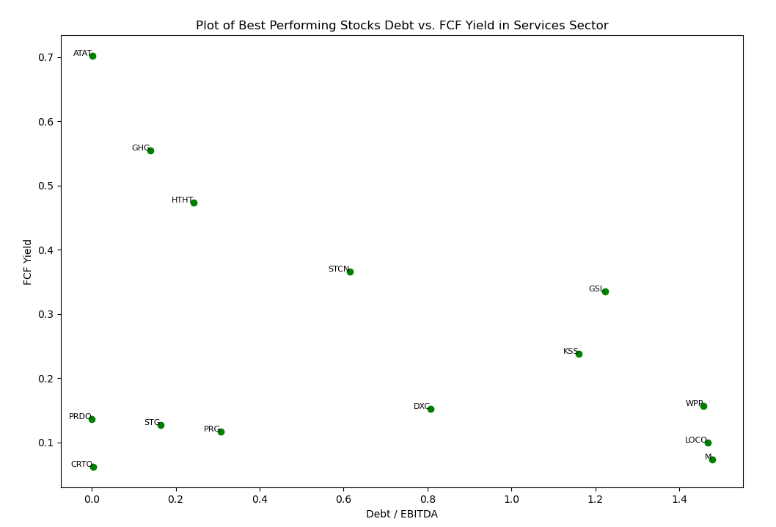
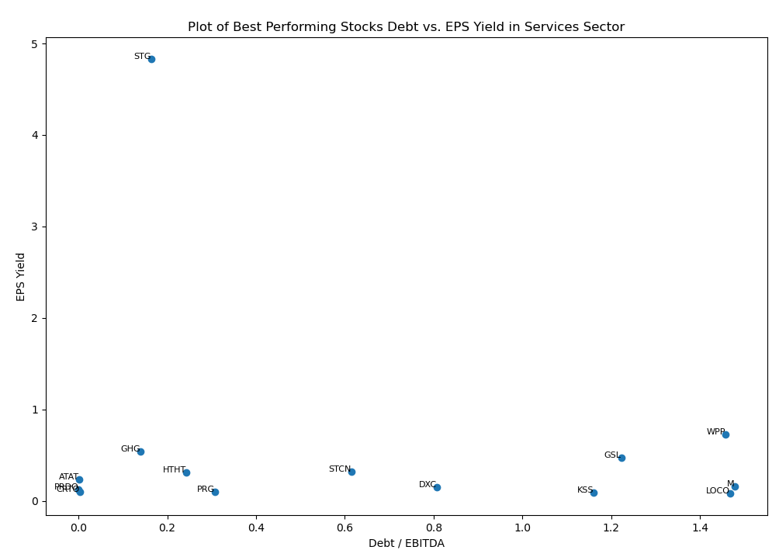
Services Sector

Slide 37
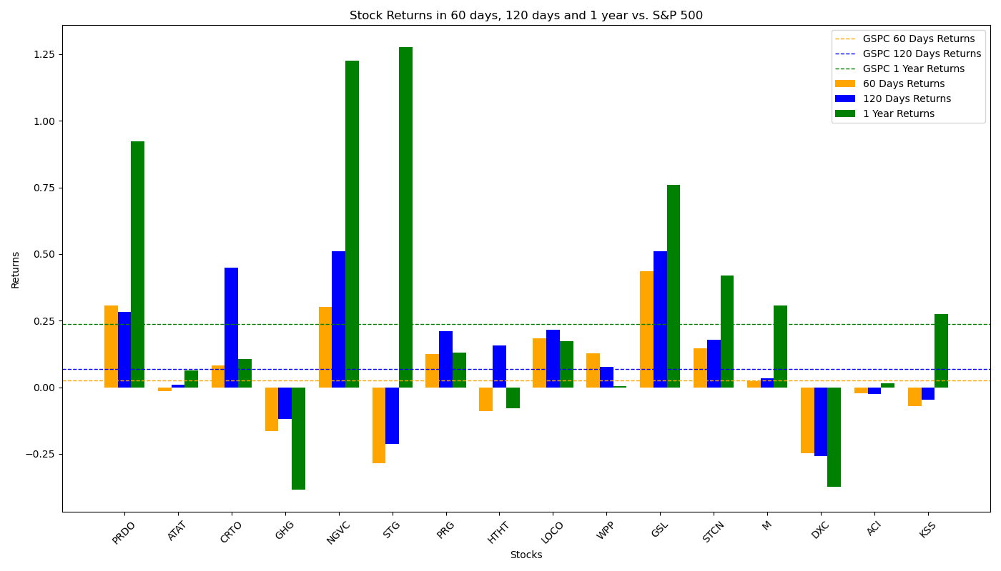
Performance of Filtered Stocks in Services Sector
The Filtered Investment Portfolios performs very good in all three time periods, giving returns twice of that of S&P 500 factor.
Total 16 Filtered Stocks | 60 Days | 120 Days | 1 Year
No. Stocks with Positive Returns | 9 | 11 | 12
No. Stocks with Returns Higher than S&P 500 | 8 | 9 | 7
Total Average Returns | 5.21% | 12.30% | 30.27%
Returns of S&P 500 | 2.65% | 6.89% | 23.62%

Slide 38
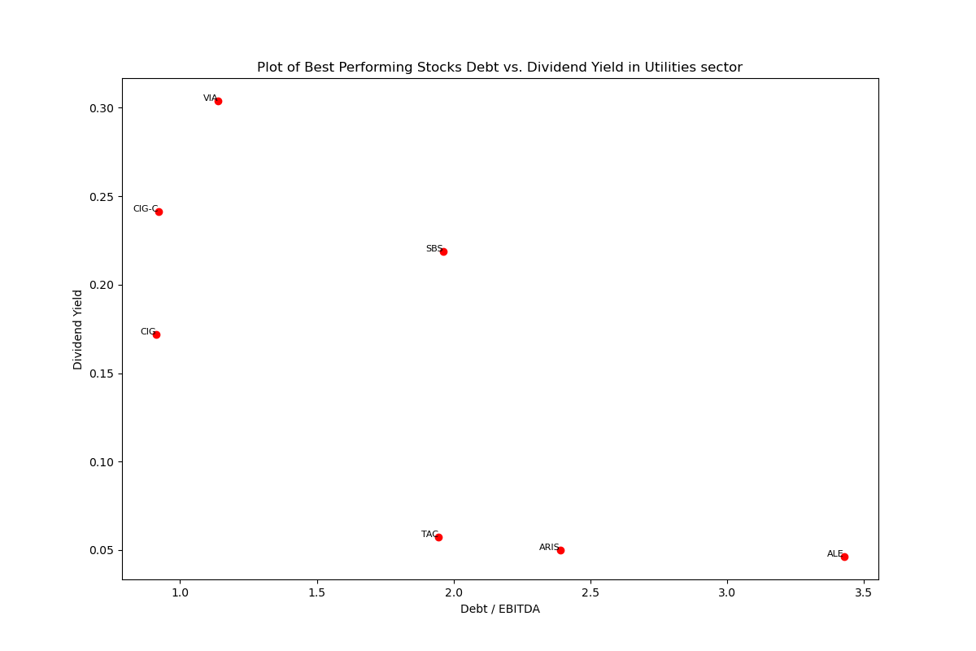
Utilities Sector
97(84) Stocks in Total*
The filtered 9 Best Performing Stocks have Debt/EBITDA range from 0 to 3.5
After dropping extreme points, dividend yield values range from 0.05 to 0.30, FCF Yield from 0 to 1.4, and EPS Yield from 0 to 0.38
*After excluding all stocks that have any of the following problems: 1) lack of Price data in a long period; 2) lack of Debt data; 3) lack of EPS data; 4) lack of share data; 5) lack of EBITDA data; 6) lack of FCF data; 7) The company has zero dividend paid; there are 84 stocks left into calculation
*CEPU and ENIC have been removed from all three plots since their numbers are extremely high in those metrics

Slide 39
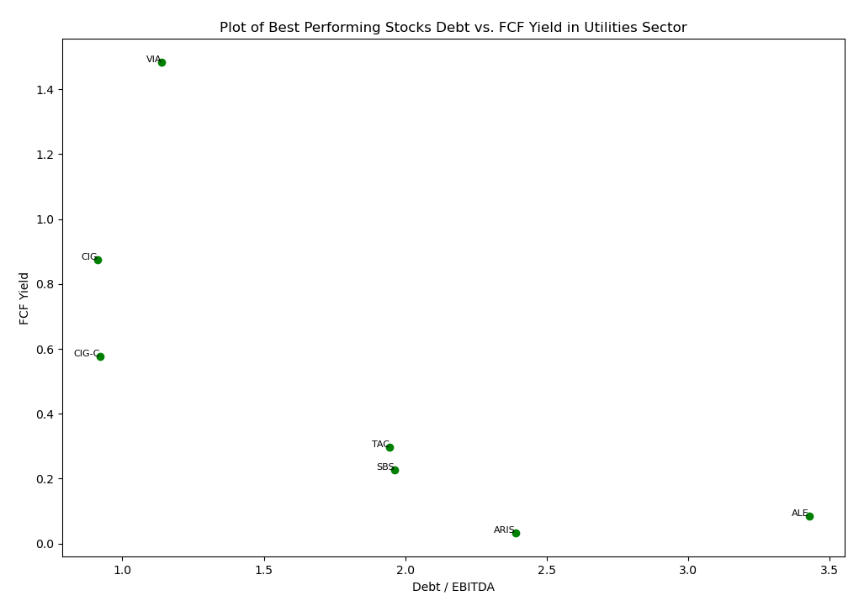

Utilities Sector

Slide 40

Performance of Filtered Stocks in Utilities Sector
The Filtered Investment Portfolios performs worse than S&P 500 factors in 60-day and 1-year period, especially in 60-day when the returns fail to get positive.
Total 9 Filtered Stocks | 60 Days | 120 Days | 1 Year
No. Stocks with Positive Returns | 6 | 7 | 6
No. Stocks with Returns Higher than S&P 500 | 3 | 4 | 3
Total Average Returns | -1.33% | 10.26% | 14.52%
Returns of S&P 500 | 2.65% | 6.89% | 23.62%

Slide 41
Other Sector
None of the 301 stocks in Other Sector pass the filter before being taken into calculation.

Slide 42
Stock Name |  | 60 Days | 120 Days | 1 Year
Basic Materials | % With positive return | 56% | 67% | 78%
 | % Outperforming the market | 56% | 44% | 39%
 | Total Average Return | 3.40% | 7.34% | 28.21%
Consumer Cyclical | % With positive return | 52% | 71% | 67%
 | % Outperforming the market | 48% | 43% | 33%
 | Total Average Return | 1.79% | 9.68% | 17.68%
Consumer Defensive | % With positive return | 38% | 56% | 69%
 | % Outperforming the market | 31% | 50% | 31%
 | Total Average Return | -1.77% | 6.96% | 21.73%
Consumer Goods | % With positive return | 42% | 58% | 50%
 | % Outperforming the market | 25% | 33% | 17%
 | Total Average Return | -2.71% | 1.69% | 8.53%
Communication Service | % With positive return | 45% | 45% | 55%
 | % Outperforming the market | 25% | 20% | 20%
 | Total Average Return | 2.40% | -1.09% | 5.98%
Conglomerates | % With positive return | 67% | 67% | 67%
 | % Outperforming the market | 50% | 33% | 33%
 | Total Average Return | 0.65% | 8.49% | 17.28%
Energy | % With positive return | 67% | 86% | 95%
 | % Outperforming the market | 38% | 81% | 52%
 | Total Average Return | 5.47% | 16.17% | 43.15%
S&P 500 Factors | Returns | 2.65% | 6.89% | 23.62%
Stock Name |  | 60 Days | 120 Days | 1 Year
Financial Services | % With positive return | 50% | 50% | 61%
 | % Outperforming the market | 28% | 22% | 22%
 | Total Average Return | 2.40% | -1.09% | 5.98%
Healthcare | % With positive return | 58% | 79% | 74%
 | % Outperforming the market | 53% | 47% | 37%
 | Total Average Return | 4.42% | 10.96% | 17.13%
Industrial Goods | % With positive return | 33% | 67% | 89%
 | % Outperforming the market | 33% | 33% | 89%
 | Total Average Return | 0.11% | 12.23% | 50.53%
Industrials | % With positive return | 60% | 80% | 65%
 | % Outperforming the market | 60% | 55% | 55%
 | Total Average Return | 11.59% | 24.74% | 44.88%
Services | % With positive return | 47% | 58% | 63%
 | % Outperforming the market | 42% | 47% | 37%
 | Total Average Return | 5.21% | 12.30% | 30.27%
Technology | % With positive return | 58% | 79% | 74%
 | % Outperforming the market | 53% | 47% | 37%
 | Total Average Return | 4.42% | 10.96% | 17.13%
Utilities | % With positive return | 67% | 78% | 67%
 | % Outperforming the market | 33% | 44% | 33%
 | Total Average Return | -1.33% | 10.26% | 14.52%
S&P 500 Factors | Returns | 2.65% | 6.89% | 23.62%

