Slide 2
Definition of Best Performing Stocks
In this process, we analyze the performance of stocks basing on 4 metrics:
Debt/ EBITDA
Dividend Yield
EPS Yield
FCF Yield
A good-performing stock should have low Debt/ EBITDA and high in other 3 metrics
First, Stocks with negative EBITDA are dropped to simplify calculation.
Then, stocks are sorted into four list based on the above metrics.
Top X stocks in each list are picked and combined to get a preliminary set.
Then each stock in the preliminary set is checked, and if it is among the bottom Y stocks on any of the four lists, it should be removed from the set.
The stocks remained in the set after being checked is defined as the best performing stocks.
In each sector, based on the number of the stocks in the sector and the metrics’ distribution, X and Y are chosen to be different pairs of numbers, to get a final investing portfolio with a size of between 5 to 20.
For example, in the Healthcare sector, X is selected to be 30 and Y is selected to be 75, while in the Energy Sector X is 50 and Y is 100.

Slide 3
Basic Materials Sector
Among all 353 stocks in financial services sector, 225 of which move forward to analysis process. Other stocks are dropped because: 1) 8 stocks lack EPS data; 2) 35 stocks lack debt data; 3) 7 stocks lack shares data; 4) 2 stocks lack EBITDA data; 5) 75 stocks paid zero dividend; 6) 1 stock lacks FCF data.
After eliminating outliers in the stocks by IQR method with sensitivity = 1.5 (This may drop out some best-performing stocks), the stocks in Financial Services sector have the following distribution:
Factors for Best-performing Filter:
X = 75, Y = 120,
Final Size of Portfolio = 18
 | Max | Min | Mean | Median
Debt/EBITDA | 17.19 | -7.82 | 3.51 | 2.32
Dividend Yield | 0.22 | 0.00 | 0.05 | 0.04
EPS Yield | 0.27 | -0.11 | 0.08 | 0.08
FCF Yield | 0.41 | -0.20 | 0.09 | 0.08

Slide 4
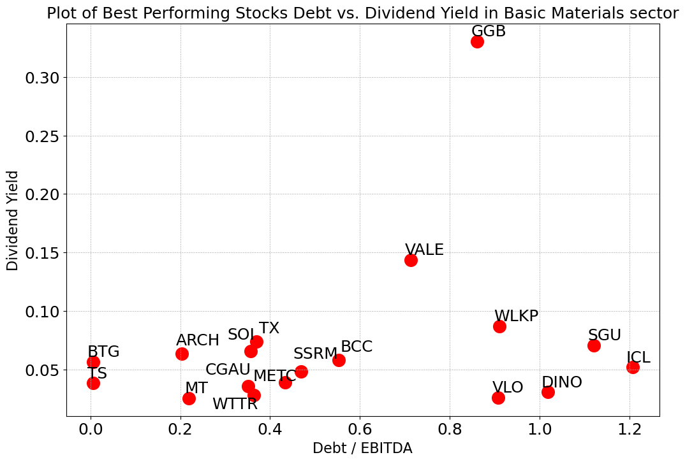
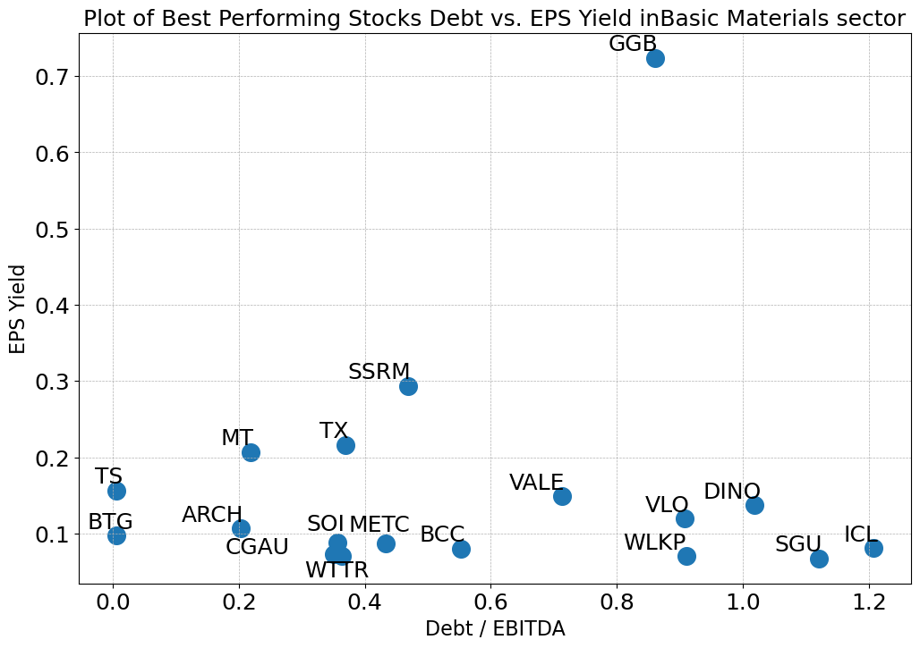
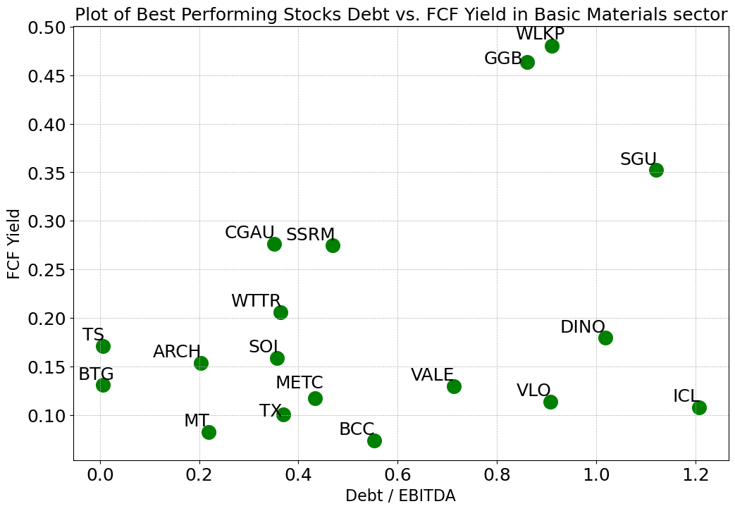
Basic Materials Sector
Most of the best-performing stocks have Debt/EBITDA between 0.0 and 3.5, compared to all 157 stocks with a range of -7.82~17.19 (negative exist because of negative EBITDA)
All but one of the best-performing stocks have a Dividend Yield between 0.1 and 0.6, while YRD’s dividend is close to 3.0, compared to all 157 stocks with a range of 0.00~0.22
Most of the 18 stocks have EPS Yields between 0.1 and 0.6, compared to all stocks in -0.11~0.27
Most of the 18 stocks have FCF Yields between 0.1 and 2.5, compared to all stocks in -0.20~0.41

Slide 5
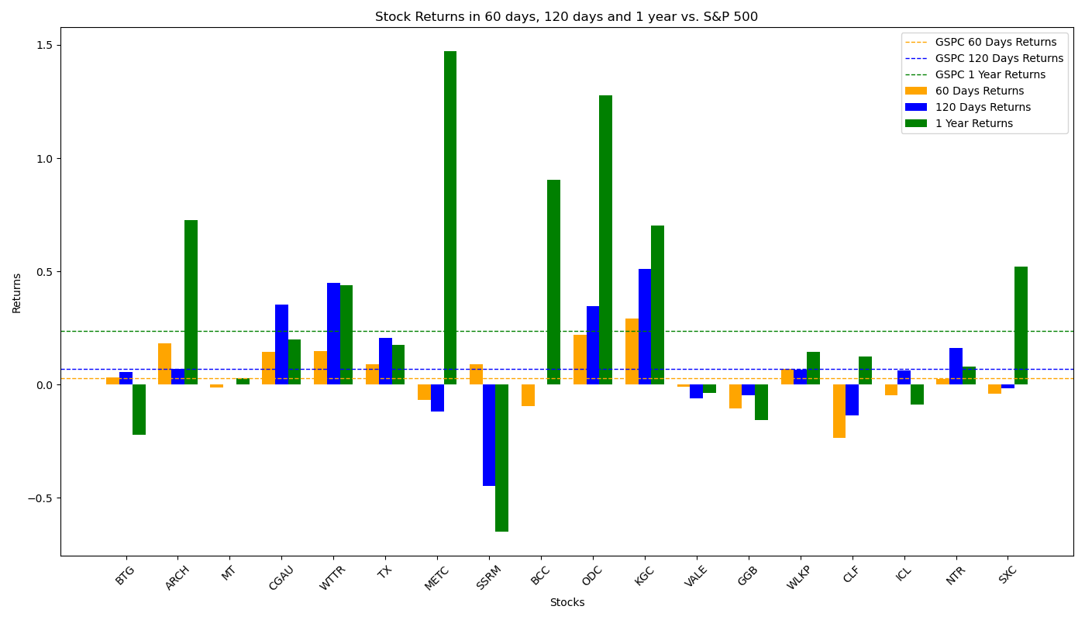
Performance of Filtered Stocks in Basic Materials Sector
Most Filtered Stocks have above-average returns rate in 60-day, 120-day and 1-year sector, higher than that of S&P 500 factors.
Total 18 Filtered Stocks | 60 Days | 120 Days | 1 Year
No. Stocks with Positive Returns | 10 | 12 | 14
No. Stocks with Returns Higher than S&P 500 | 10 | 8 | 7
Total Average Returns | 3.40% | 7.34% | 28.21%
Returns of S&P 500 | 2.65% | 6.89% | 23.62%

Slide 6
Communication Services Sector
Among all 1372 stocks in financial services sector, 357 of which move forward to analysis process. Other stocks are dropped because: 1) 270 stocks have no financial data in the database; 2) 26 stocks lack EPS data; 3) 32 stocks lack price data in a long period; 4) 500 stocks lack debt data; 5) 86 stocks lack shares data; 6) 11 stocks lack EBITDA data; 7) 85 stocks paid zero dividend; 8) 5 stocks lack FCF data.
After eliminating outliers in the stocks by IQR method with sensitivity = 1.5 (This may drop out some best-performing stocks), the stocks in Financial Services sector have the following distribution:
Factors for Best-performing Filter:
X = 15, Y = 100,
Final Size of Portfolio = 18
 | Max | Min | Mean | Median
Debt/EBITDA | 17.19 | -7.82 | 3.51 | 2.32
Dividend Yield | 0.22 | 0.00 | 0.05 | 0.04
EPS Yield | 0.27 | -0.11 | 0.08 | 0.08
FCF Yield | 0.41 | -0.20 | 0.09 | 0.08

Slide 7
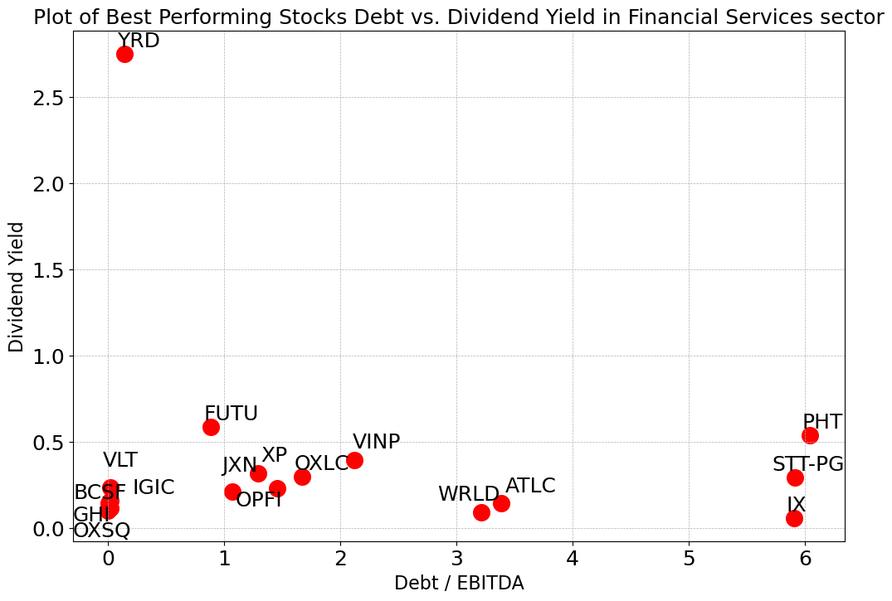
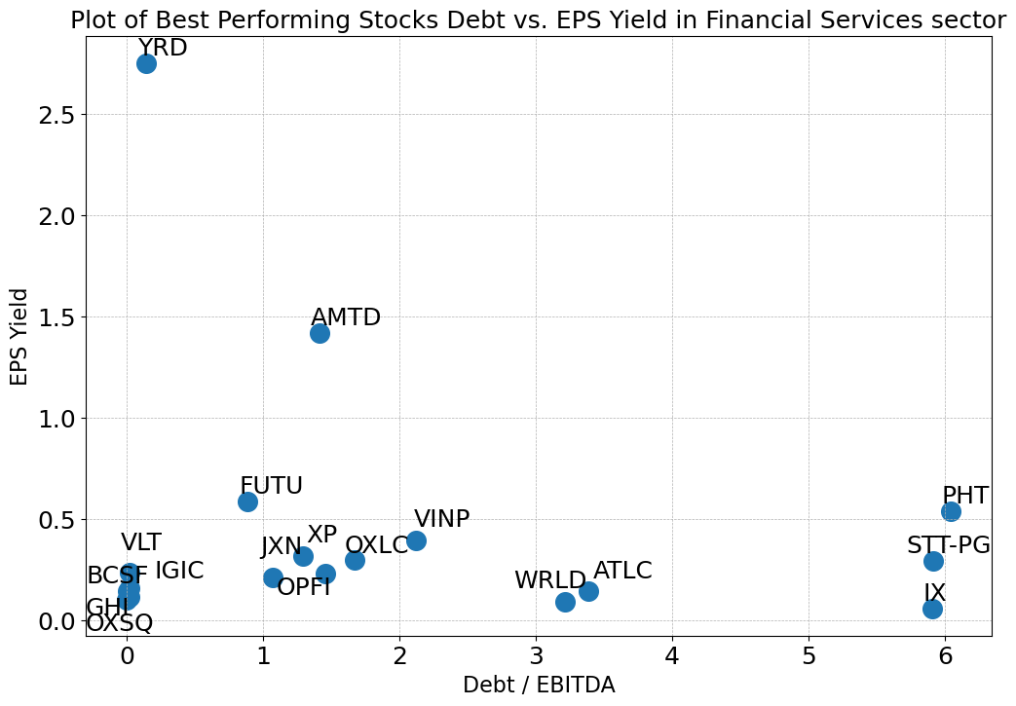
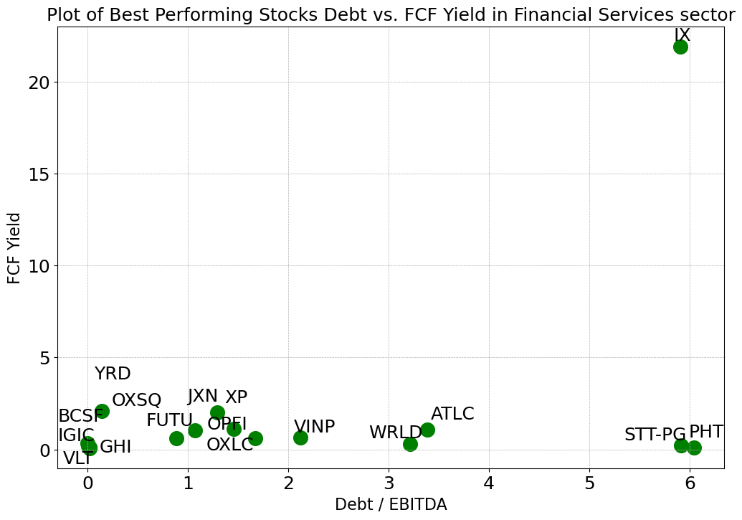
Communication Services Sector
Most of the best-performing stocks have Debt/EBITDA between 0.0 and 3.5, compared to all 157 stocks with a range of -7.82~17.19 (negative exist because of negative EBITDA)
All but one of the best-performing stocks have a Dividend Yield between 0.1 and 0.6, while YRD’s dividend is close to 3.0, compared to all 157 stocks with a range of 0.00~0.22
Most of the 18 stocks have EPS Yields between 0.1 and 0.6, compared to all stocks in -0.11~0.27
Most of the 18 stocks have FCF Yields between 0.1 and 2.5, compared to all stocks in -0.20~0.41

Slide 8
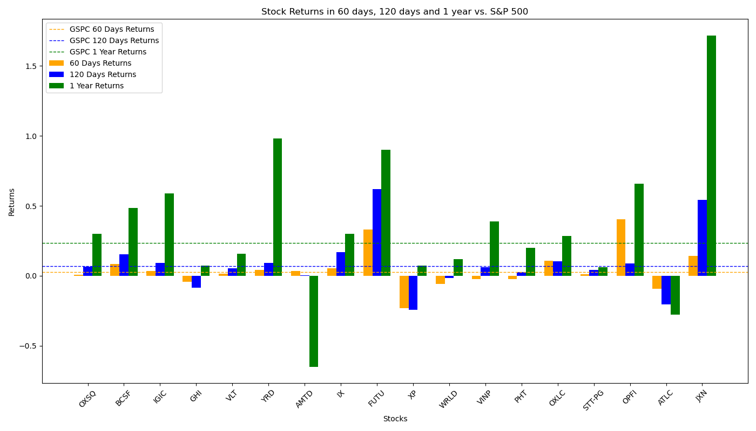
Performance of Filtered Stocks in Communication Services Sector
The Filtered Investment Portfolios performs badly in 120-day and 1-year period.
Total 18 Filtered Stocks | 60 Days | 120 Days | 1 Year
No. Stocks with Positive Returns | 9 | 9 | 11
No. Stocks with Returns Higher than S&P 500 | 5 | 4 | 4
Total Average Returns | 2.40% | -1.09% | 5.98%
Returns of S&P 500 | 2.65% | 6.89% | 23.62%

Slide 9
Conglomerates Sector
Among all 29 stocks in financial services sector, 18 of which move forward to analysis process. Other stocks are dropped because: 1) 3 stocks lack EPS data; 2) 3 stocks lack shares data; 3)5 stocks paid zero dividend;
After eliminating outliers in the stocks by IQR method with sensitivity = 1.5 (This may drop out some best-performing stocks), the stocks in Financial Services sector have the following distribution:
Factors for Best-performing Filter:
X = 15, Y = 4,
Final Size of Portfolio = 6
 | Max | Min | Mean | Median
Debt/EBITDA | 8.21 | -3.87 | 2.61 | 2.91
Dividend Yield | 0.08 | 0.00 | 0.03 | 0.02
EPS Yield | 0.16 | 0.03 | 0.08 | 0.09
FCF Yield | 0.13 | -0.10 | 0.04 | 0.04

Slide 10
Conglomerates Sector
Most of the best-performing stocks have Debt/EBITDA between 0.0 and 3.5, compared to all 157 stocks with a range of -7.82~17.19 (negative exist because of negative EBITDA)
All but one of the best-performing stocks have a Dividend Yield between 0.1 and 0.6, while YRD’s dividend is close to 3.0, compared to all 157 stocks with a range of 0.00~0.22
Most of the 18 stocks have EPS Yields between 0.1 and 0.6, compared to all stocks in -0.11~0.27
Most of the 18 stocks have FCF Yields between 0.1 and 2.5, compared to all stocks in -0.20~0.41

Slide 11
Performance of Filtered Stocks in Conglomerates Sector
The Filtered Investment Portfolios performs badly in 120-day and 1-year period.
Total 18 Filtered Stocks | 60 Days | 120 Days | 1 Year
No. Stocks with Positive Returns | 9 | 9 | 11
No. Stocks with Returns Higher than S&P 500 | 5 | 4 | 4
Total Average Returns | 2.40% | -1.09% | 5.98%
Returns of S&P 500 | 2.65% | 6.89% | 23.62%

Slide 12
Consumer Cyclical Sector
Among all 1372 stocks in financial services sector, 357 of which move forward to analysis process. Other stocks are dropped because: 1) 270 stocks have no financial data in the database; 2) 26 stocks lack EPS data; 3) 32 stocks lack price data in a long period; 4) 500 stocks lack debt data; 5) 86 stocks lack shares data; 6) 11 stocks lack EBITDA data; 7) 85 stocks paid zero dividend; 8) 5 stocks lack FCF data.
After eliminating outliers in the stocks by IQR method with sensitivity = 1.5 (This may drop out some best-performing stocks), the stocks in Financial Services sector have the following distribution:
Factors for Best-performing Filter:
X = 15, Y = 100,
Final Size of Portfolio = 18
 | Max | Min | Mean | Median
Debt/EBITDA | 17.19 | -7.82 | 3.51 | 2.32
Dividend Yield | 0.22 | 0.00 | 0.05 | 0.04
EPS Yield | 0.27 | -0.11 | 0.08 | 0.08
FCF Yield | 0.41 | -0.20 | 0.09 | 0.08

Slide 13
Consumer Cyclical Sector
Most of the best-performing stocks have Debt/EBITDA between 0.0 and 3.5, compared to all 157 stocks with a range of -7.82~17.19 (negative exist because of negative EBITDA)
All but one of the best-performing stocks have a Dividend Yield between 0.1 and 0.6, while YRD’s dividend is close to 3.0, compared to all 157 stocks with a range of 0.00~0.22
Most of the 18 stocks have EPS Yields between 0.1 and 0.6, compared to all stocks in -0.11~0.27
Most of the 18 stocks have FCF Yields between 0.1 and 2.5, compared to all stocks in -0.20~0.41

Slide 14
Performance of Filtered Stocks in Consumer Cyclical Sector
The Filtered Investment Portfolios performs badly in 120-day and 1-year period.
Total 18 Filtered Stocks | 60 Days | 120 Days | 1 Year
No. Stocks with Positive Returns | 9 | 9 | 11
No. Stocks with Returns Higher than S&P 500 | 5 | 4 | 4
Total Average Returns | 2.40% | -1.09% | 5.98%
Returns of S&P 500 | 2.65% | 6.89% | 23.62%

Slide 15
Consumer Defensive Sector
Among all 1372 stocks in financial services sector, 357 of which move forward to analysis process. Other stocks are dropped because: 1) 270 stocks have no financial data in the database; 2) 26 stocks lack EPS data; 3) 32 stocks lack price data in a long period; 4) 500 stocks lack debt data; 5) 86 stocks lack shares data; 6) 11 stocks lack EBITDA data; 7) 85 stocks paid zero dividend; 8) 5 stocks lack FCF data.
After eliminating outliers in the stocks by IQR method with sensitivity = 1.5 (This may drop out some best-performing stocks), the stocks in Financial Services sector have the following distribution:
Factors for Best-performing Filter:
X = 15, Y = 100,
Final Size of Portfolio = 18
 | Max | Min | Mean | Median
Debt/EBITDA | 17.19 | -7.82 | 3.51 | 2.32
Dividend Yield | 0.22 | 0.00 | 0.05 | 0.04
EPS Yield | 0.27 | -0.11 | 0.08 | 0.08
FCF Yield | 0.41 | -0.20 | 0.09 | 0.08

Slide 16
Consumer Defensive Sector
Most of the best-performing stocks have Debt/EBITDA between 0.0 and 3.5, compared to all 157 stocks with a range of -7.82~17.19 (negative exist because of negative EBITDA)
All but one of the best-performing stocks have a Dividend Yield between 0.1 and 0.6, while YRD’s dividend is close to 3.0, compared to all 157 stocks with a range of 0.00~0.22
Most of the 18 stocks have EPS Yields between 0.1 and 0.6, compared to all stocks in -0.11~0.27
Most of the 18 stocks have FCF Yields between 0.1 and 2.5, compared to all stocks in -0.20~0.41

Slide 17
Performance of Filtered Stocks in Consumer Defensive Sector
The Filtered Investment Portfolios performs badly in 120-day and 1-year period.
Total 18 Filtered Stocks | 60 Days | 120 Days | 1 Year
No. Stocks with Positive Returns | 9 | 9 | 11
No. Stocks with Returns Higher than S&P 500 | 5 | 4 | 4
Total Average Returns | 2.40% | -1.09% | 5.98%
Returns of S&P 500 | 2.65% | 6.89% | 23.62%

Slide 18
Consumer Goods Sector
Among all 1372 stocks in financial services sector, 357 of which move forward to analysis process. Other stocks are dropped because: 1) 270 stocks have no financial data in the database; 2) 26 stocks lack EPS data; 3) 32 stocks lack price data in a long period; 4) 500 stocks lack debt data; 5) 86 stocks lack shares data; 6) 11 stocks lack EBITDA data; 7) 85 stocks paid zero dividend; 8) 5 stocks lack FCF data.
After eliminating outliers in the stocks by IQR method with sensitivity = 1.5 (This may drop out some best-performing stocks), the stocks in Financial Services sector have the following distribution:
Factors for Best-performing Filter:
X = 15, Y = 100,
Final Size of Portfolio = 18
 | Max | Min | Mean | Median
Debt/EBITDA | 17.19 | -7.82 | 3.51 | 2.32
Dividend Yield | 0.22 | 0.00 | 0.05 | 0.04
EPS Yield | 0.27 | -0.11 | 0.08 | 0.08
FCF Yield | 0.41 | -0.20 | 0.09 | 0.08

Slide 19
Consumer Goods Sector
Most of the best-performing stocks have Debt/EBITDA between 0.0 and 3.5, compared to all 157 stocks with a range of -7.82~17.19 (negative exist because of negative EBITDA)
All but one of the best-performing stocks have a Dividend Yield between 0.1 and 0.6, while YRD’s dividend is close to 3.0, compared to all 157 stocks with a range of 0.00~0.22
Most of the 18 stocks have EPS Yields between 0.1 and 0.6, compared to all stocks in -0.11~0.27
Most of the 18 stocks have FCF Yields between 0.1 and 2.5, compared to all stocks in -0.20~0.41

Slide 20
Performance of Filtered Stocks in Consumer Goods Sector
The Filtered Investment Portfolios performs badly in 120-day and 1-year period.
Total 18 Filtered Stocks | 60 Days | 120 Days | 1 Year
No. Stocks with Positive Returns | 9 | 9 | 11
No. Stocks with Returns Higher than S&P 500 | 5 | 4 | 4
Total Average Returns | 2.40% | -1.09% | 5.98%
Returns of S&P 500 | 2.65% | 6.89% | 23.62%

Slide 21
Financial Services Sector
Among all 1372 stocks in financial services sector, 357 of which move forward to analysis process. Other stocks are dropped because: 1) 270 stocks have no financial data in the database; 2) 26 stocks lack EPS data; 3) 32 stocks lack price data in a long period; 4) 500 stocks lack debt data; 5) 86 stocks lack shares data; 6) 11 stocks lack EBITDA data; 7) 85 stocks paid zero dividend; 8) 5 stocks lack FCF data.
After eliminating outliers in the stocks by IQR method with sensitivity = 1.5 (This may drop out some best-performing stocks), the stocks in Financial Services sector have the following distribution:
Factors for Best-performing Filter:
X = 15, Y = 100,
Final Size of Portfolio = 18
 | Max | Min | Mean | Median
Debt/EBITDA | 17.19 | -7.82 | 3.51 | 2.32
Dividend Yield | 0.22 | 0.00 | 0.05 | 0.04
EPS Yield | 0.27 | -0.11 | 0.08 | 0.08
FCF Yield | 0.41 | -0.20 | 0.09 | 0.08

Slide 22
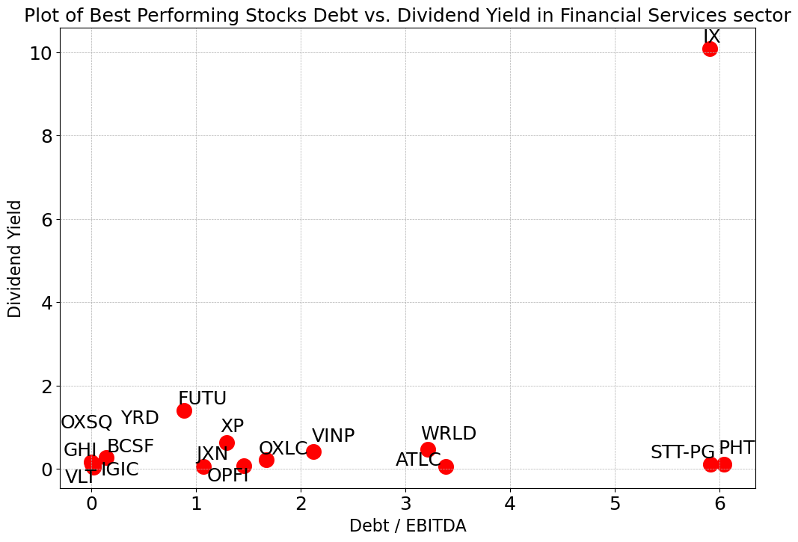
Financial Services Sector
Most of the best-performing stocks have Debt/EBITDA between 0.0 and 3.5, compared to all 157 stocks with a range of -7.82~17.19 (negative exist because of negative EBITDA)
All but one of the best-performing stocks have a Dividend Yield between 0.1 and 1.8, compared to all 157 stocks with a range of 0.00~0.22
Most of the 18 stocks have EPS Yields between 0.1 and 0.6, compared to all stocks in -0.11~0.27
Most of the 18 stocks have FCF Yields between 0.1 and 2.5, compared to all stocks in -0.20~0.41
*TLK, SKM and KT have been removed from the Dividend Yield plot and FCF Yield plot since their numbers are extremely high

Slide 23
Performance of Filtered Stocks in Financial Service Sector
The Filtered Investment Portfolios performs badly in 120-day and 1-year period.
Total 18 Filtered Stocks | 60 Days | 120 Days | 1 Year
No. Stocks with Positive Returns | 9 | 9 | 11
No. Stocks with Returns Higher than S&P 500 | 5 | 4 | 4
Total Average Returns | 2.40% | -1.09% | 5.98%
Returns of S&P 500 | 2.65% | 6.89% | 23.62%

Slide 24
Healthcare Sector
Among all 1372 stocks in financial services sector, 357 of which move forward to analysis process. Other stocks are dropped because: 1) 270 stocks have no financial data in the database; 2) 26 stocks lack EPS data; 3) 32 stocks lack price data in a long period; 4) 500 stocks lack debt data; 5) 86 stocks lack shares data; 6) 11 stocks lack EBITDA data; 7) 85 stocks paid zero dividend; 8) 5 stocks lack FCF data.
After eliminating outliers in the stocks by IQR method with sensitivity = 1.5 (This may drop out some best-performing stocks), the stocks in Financial Services sector have the following distribution:
Factors for Best-performing Filter:
X = 15, Y = 100,
Final Size of Portfolio = 18
 | Max | Min | Mean | Median
Debt/EBITDA | 17.19 | -7.82 | 3.51 | 2.32
Dividend Yield | 0.22 | 0.00 | 0.05 | 0.04
EPS Yield | 0.27 | -0.11 | 0.08 | 0.08
FCF Yield | 0.41 | -0.20 | 0.09 | 0.08

Slide 25
Healthcare Sector
Most of the best-performing stocks have Debt/EBITDA between 0.0 and 3.5, compared to all 157 stocks with a range of -7.82~17.19 (negative exist because of negative EBITDA)
All but one of the best-performing stocks have a Dividend Yield between 0.1 and 0.6, while YRD’s dividend is close to 3.0, compared to all 157 stocks with a range of 0.00~0.22
Most of the 18 stocks have EPS Yields between 0.1 and 0.6, compared to all stocks in -0.11~0.27
Most of the 18 stocks have FCF Yields between 0.1 and 2.5, compared to all stocks in -0.20~0.41

Slide 26
Performance of Filtered Stocks in Healthcare Sector
The Filtered Investment Portfolios performs badly in 120-day and 1-year period.
Total 18 Filtered Stocks | 60 Days | 120 Days | 1 Year
No. Stocks with Positive Returns | 9 | 9 | 11
No. Stocks with Returns Higher than S&P 500 | 5 | 4 | 4
Total Average Returns | 2.40% | -1.09% | 5.98%
Returns of S&P 500 | 2.65% | 6.89% | 23.62%

Slide 27
Industrial Goods Sector
Among all 1372 stocks in financial services sector, 357 of which move forward to analysis process. Other stocks are dropped because: 1) 270 stocks have no financial data in the database; 2) 26 stocks lack EPS data; 3) 32 stocks lack price data in a long period; 4) 500 stocks lack debt data; 5) 86 stocks lack shares data; 6) 11 stocks lack EBITDA data; 7) 85 stocks paid zero dividend; 8) 5 stocks lack FCF data.
After eliminating outliers in the stocks by IQR method with sensitivity = 1.5 (This may drop out some best-performing stocks), the stocks in Financial Services sector have the following distribution:
Factors for Best-performing Filter:
X = 15, Y = 100,
Final Size of Portfolio = 18
 | Max | Min | Mean | Median
Debt/EBITDA | 17.19 | -7.82 | 3.51 | 2.32
Dividend Yield | 0.22 | 0.00 | 0.05 | 0.04
EPS Yield | 0.27 | -0.11 | 0.08 | 0.08
FCF Yield | 0.41 | -0.20 | 0.09 | 0.08

Slide 28
Industrial Goods Sector
Most of the best-performing stocks have Debt/EBITDA between 0.0 and 3.5, compared to all 157 stocks with a range of -7.82~17.19 (negative exist because of negative EBITDA)
All but one of the best-performing stocks have a Dividend Yield between 0.1 and 0.6, while YRD’s dividend is close to 3.0, compared to all 157 stocks with a range of 0.00~0.22
Most of the 18 stocks have EPS Yields between 0.1 and 0.6, compared to all stocks in -0.11~0.27
Most of the 18 stocks have FCF Yields between 0.1 and 2.5, compared to all stocks in -0.20~0.41

Slide 29
Performance of Filtered Stocks in Industrial Goods Sector
The Filtered Investment Portfolios performs badly in 120-day and 1-year period.
Total 18 Filtered Stocks | 60 Days | 120 Days | 1 Year
No. Stocks with Positive Returns | 9 | 9 | 11
No. Stocks with Returns Higher than S&P 500 | 5 | 4 | 4
Total Average Returns | 2.40% | -1.09% | 5.98%
Returns of S&P 500 | 2.65% | 6.89% | 23.62%

Slide 30
Industrials Sector
Among all 1372 stocks in financial services sector, 357 of which move forward to analysis process. Other stocks are dropped because: 1) 270 stocks have no financial data in the database; 2) 26 stocks lack EPS data; 3) 32 stocks lack price data in a long period; 4) 500 stocks lack debt data; 5) 86 stocks lack shares data; 6) 11 stocks lack EBITDA data; 7) 85 stocks paid zero dividend; 8) 5 stocks lack FCF data.
After eliminating outliers in the stocks by IQR method with sensitivity = 1.5 (This may drop out some best-performing stocks), the stocks in Financial Services sector have the following distribution:
Factors for Best-performing Filter:
X = 15, Y = 100,
Final Size of Portfolio = 18
 | Max | Min | Mean | Median
Debt/EBITDA | 17.19 | -7.82 | 3.51 | 2.32
Dividend Yield | 0.22 | 0.00 | 0.05 | 0.04
EPS Yield | 0.27 | -0.11 | 0.08 | 0.08
FCF Yield | 0.41 | -0.20 | 0.09 | 0.08

Slide 31
Industrials Sector
Most of the best-performing stocks have Debt/EBITDA between 0.0 and 3.5, compared to all 157 stocks with a range of -7.82~17.19 (negative exist because of negative EBITDA)
All but one of the best-performing stocks have a Dividend Yield between 0.1 and 0.6, while YRD’s dividend is close to 3.0, compared to all 157 stocks with a range of 0.00~0.22
Most of the 18 stocks have EPS Yields between 0.1 and 0.6, compared to all stocks in -0.11~0.27
Most of the 18 stocks have FCF Yields between 0.1 and 2.5, compared to all stocks in -0.20~0.41

Slide 32
Performance of Filtered Stocks in Industrials Sector
The Filtered Investment Portfolios performs badly in 120-day and 1-year period.
Total 18 Filtered Stocks | 60 Days | 120 Days | 1 Year
No. Stocks with Positive Returns | 9 | 9 | 11
No. Stocks with Returns Higher than S&P 500 | 5 | 4 | 4
Total Average Returns | 2.40% | -1.09% | 5.98%
Returns of S&P 500 | 2.65% | 6.89% | 23.62%

Slide 33
Services Sector
Among all 1372 stocks in financial services sector, 357 of which move forward to analysis process. Other stocks are dropped because: 1) 270 stocks have no financial data in the database; 2) 26 stocks lack EPS data; 3) 32 stocks lack price data in a long period; 4) 500 stocks lack debt data; 5) 86 stocks lack shares data; 6) 11 stocks lack EBITDA data; 7) 85 stocks paid zero dividend; 8) 5 stocks lack FCF data.
After eliminating outliers in the stocks by IQR method with sensitivity = 1.5 (This may drop out some best-performing stocks), the stocks in Financial Services sector have the following distribution:
Factors for Best-performing Filter:
X = 15, Y = 100,
Final Size of Portfolio = 18
 | Max | Min | Mean | Median
Debt/EBITDA | 17.19 | -7.82 | 3.51 | 2.32
Dividend Yield | 0.22 | 0.00 | 0.05 | 0.04
EPS Yield | 0.27 | -0.11 | 0.08 | 0.08
FCF Yield | 0.41 | -0.20 | 0.09 | 0.08

Slide 34
Services Sector
Most of the best-performing stocks have Debt/EBITDA between 0.0 and 3.5, compared to all 157 stocks with a range of -7.82~17.19 (negative exist because of negative EBITDA)
All but one of the best-performing stocks have a Dividend Yield between 0.1 and 0.6, while YRD’s dividend is close to 3.0, compared to all 157 stocks with a range of 0.00~0.22
Most of the 18 stocks have EPS Yields between 0.1 and 0.6, compared to all stocks in -0.11~0.27
Most of the 18 stocks have FCF Yields between 0.1 and 2.5, compared to all stocks in -0.20~0.41

Slide 35
Performance of Filtered Stocks in Services Sector
The Filtered Investment Portfolios performs badly in 120-day and 1-year period.
Total 18 Filtered Stocks | 60 Days | 120 Days | 1 Year
No. Stocks with Positive Returns | 9 | 9 | 11
No. Stocks with Returns Higher than S&P 500 | 5 | 4 | 4
Total Average Returns | 2.40% | -1.09% | 5.98%
Returns of S&P 500 | 2.65% | 6.89% | 23.62%

Slide 36
Technology Sector
Among all 1057 stocks in financial services sector, 465 of which move forward to analysis process. Other stocks are dropped because: 1) 16 stocks lack EPS data; 2) 13 stocks lack price data in a long period; 3) 166 stocks lack debt data; 4) 52 stocks lack shares data; 5) 36 stocks lack EBITDA data; 6) 306 stocks paid zero dividend; 7) 3 stocks lack FCF data.
After eliminating outliers in the stocks by IQR method with sensitivity = 1.5 (This may drop out some best-performing stocks), the stocks in Financial Services sector have the following distribution:
Factors for Best-performing Filter:
X = 20, Y = 150,
Final Size of Portfolio = 19
 | Max | Min | Mean | Median
Debt/EBITDA | 8.02 | -4.82 | 1.51 | 0.84
Dividend Yield | 0.14 | 0.00 | 0.02 | 0.01
EPS Yield | 0.17 | -0.13 | 0.04 | 0.04
FCF Yield | 0.18 | -0.11 | 0.04 | 0.04

Slide 37
Technology Sector
Most of the best-performing stocks have Debt/EBITDA between 0.0 and 3.5, compared to all 157 stocks with a range of -7.82~17.19 (negative exist because of negative EBITDA)
All but one of the best-performing stocks have a Dividend Yield between 0.1 and 0.6, while YRD’s dividend is close to 3.0, compared to all 157 stocks with a range of 0.00~0.22
Most of the 18 stocks have EPS Yields between 0.1 and 0.6, compared to all stocks in -0.11~0.27
Most of the 18 stocks have FCF Yields between 0.1 and 2.5, compared to all stocks in -0.20~0.41

Slide 38
Performance of Filtered Stocks in Technology Sector
The Filtered Investment Portfolios performs badly in 120-day and 1-year period.
Total 18 Filtered Stocks | 60 Days | 120 Days | 1 Year
No. Stocks with Positive Returns | 9 | 9 | 11
No. Stocks with Returns Higher than S&P 500 | 5 | 4 | 4
Total Average Returns | 2.40% | -1.09% | 5.98%
Returns of S&P 500 | 2.65% | 6.89% | 23.62%

Slide 39
Utilities Sector
Among all 1372 stocks in financial services sector, 357 of which move forward to analysis process. Other stocks are dropped because: 1) 270 stocks have no financial data in the database; 2) 26 stocks lack EPS data; 3) 32 stocks lack price data in a long period; 4) 500 stocks lack debt data; 5) 86 stocks lack shares data; 6) 11 stocks lack EBITDA data; 7) 85 stocks paid zero dividend; 8) 5 stocks lack FCF data.
After eliminating outliers in the stocks by IQR method with sensitivity = 1.5 (This may drop out some best-performing stocks), the stocks in Financial Services sector have the following distribution:
Factors for Best-performing Filter:
X = 15, Y = 100,
Final Size of Portfolio = 18
 | Max | Min | Mean | Median
Debt/EBITDA | 17.19 | -7.82 | 3.51 | 2.32
Dividend Yield | 0.22 | 0.00 | 0.05 | 0.04
EPS Yield | 0.27 | -0.11 | 0.08 | 0.08
FCF Yield | 0.41 | -0.20 | 0.09 | 0.08

Slide 40
Utilities Sector
Most of the best-performing stocks have Debt/EBITDA between 0.0 and 3.5, compared to all 157 stocks with a range of -7.82~17.19 (negative exist because of negative EBITDA)
All but one of the best-performing stocks have a Dividend Yield between 0.1 and 0.6, while YRD’s dividend is close to 3.0, compared to all 157 stocks with a range of 0.00~0.22
Most of the 18 stocks have EPS Yields between 0.1 and 0.6, compared to all stocks in -0.11~0.27
Most of the 18 stocks have FCF Yields between 0.1 and 2.5, compared to all stocks in -0.20~0.41

Slide 41
Performance of Filtered Stocks in Utilities Sector
The Filtered Investment Portfolios performs badly in 120-day and 1-year period.
Total 18 Filtered Stocks | 60 Days | 120 Days | 1 Year
No. Stocks with Positive Returns | 9 | 9 | 11
No. Stocks with Returns Higher than S&P 500 | 5 | 4 | 4
Total Average Returns | 2.40% | -1.09% | 5.98%
Returns of S&P 500 | 2.65% | 6.89% | 23.62%

Slide 42
Summary of Portfolios Returns
Stock Name |  | 60 Days | 120 Days | 1 Year
Basic Materials | % With positive return | 56% | 67% | 78%
 | % Outperforming the market | 56% | 44% | 39%
 | Total Average Return | 3.40% | 7.34% | 28.21%
Consumer Cyclical | % With positive return | 52% | 71% | 67%
 | % Outperforming the market | 48% | 43% | 33%
 | Total Average Return | 1.79% | 9.68% | 17.68%
Consumer Defensive | % With positive return | 38% | 56% | 69%
 | % Outperforming the market | 31% | 50% | 31%
 | Total Average Return | -1.77% | 6.96% | 21.73%
Consumer Goods | % With positive return | 42% | 58% | 50%
 | % Outperforming the market | 25% | 33% | 17%
 | Total Average Return | -2.71% | 1.69% | 8.53%
Communication Service | % With positive return | 45% | 45% | 55%
 | % Outperforming the market | 25% | 20% | 20%
 | Total Average Return | 2.40% | -1.09% | 5.98%
Conglomerates | % With positive return | 67% | 67% | 67%
 | % Outperforming the market | 50% | 33% | 33%
 | Total Average Return | 0.65% | 8.49% | 17.28%
Energy | % With positive return | 67% | 86% | 95%
 | % Outperforming the market | 38% | 81% | 52%
 | Total Average Return | 5.47% | 16.17% | 43.15%
S&P 500 Factors | Returns | 2.65% | 6.89% | 23.62%
Stock Name |  | 60 Days | 120 Days | 1 Year
Financial Services | % With positive return | 50% | 50% | 61%
 | % Outperforming the market | 28% | 22% | 22%
 | Total Average Return | 2.40% | -1.09% | 5.98%
Healthcare | % With positive return | 58% | 79% | 74%
 | % Outperforming the market | 53% | 47% | 37%
 | Total Average Return | 4.42% | 10.96% | 17.13%
Industrial Goods | % With positive return | 33% | 67% | 89%
 | % Outperforming the market | 33% | 33% | 89%
 | Total Average Return | 0.11% | 12.23% | 50.53%
Industrials | % With positive return | 60% | 80% | 65%
 | % Outperforming the market | 60% | 55% | 55%
 | Total Average Return | 11.59% | 24.74% | 44.88%
Services | % With positive return | 47% | 58% | 63%
 | % Outperforming the market | 42% | 47% | 37%
 | Total Average Return | 5.21% | 12.30% | 30.27%
Technology | % With positive return | 58% | 79% | 74%
 | % Outperforming the market | 53% | 47% | 37%
 | Total Average Return | 4.42% | 10.96% | 17.13%
Utilities | % With positive return | 67% | 78% | 67%
 | % Outperforming the market | 33% | 44% | 33%
 | Total Average Return | -1.33% | 10.26% | 14.52%
S&P 500 Factors | Returns | 2.65% | 6.89% | 23.62%

