Slide 1
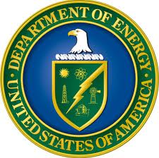


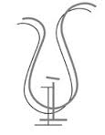

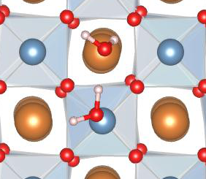
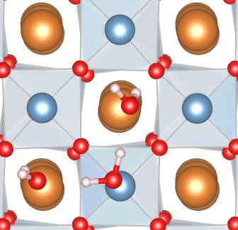
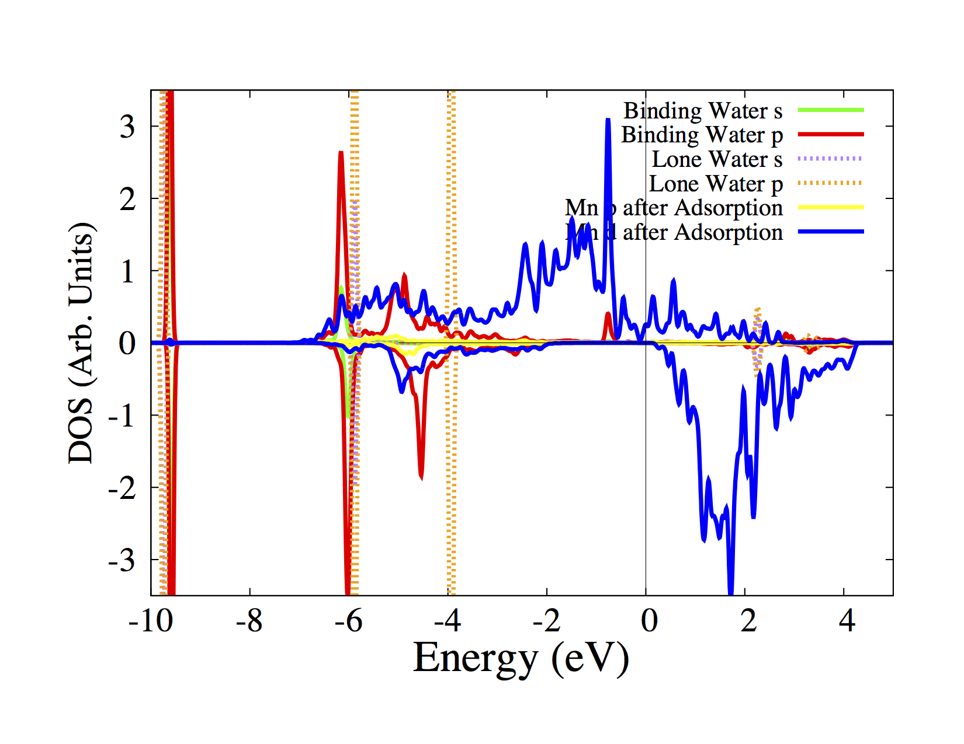
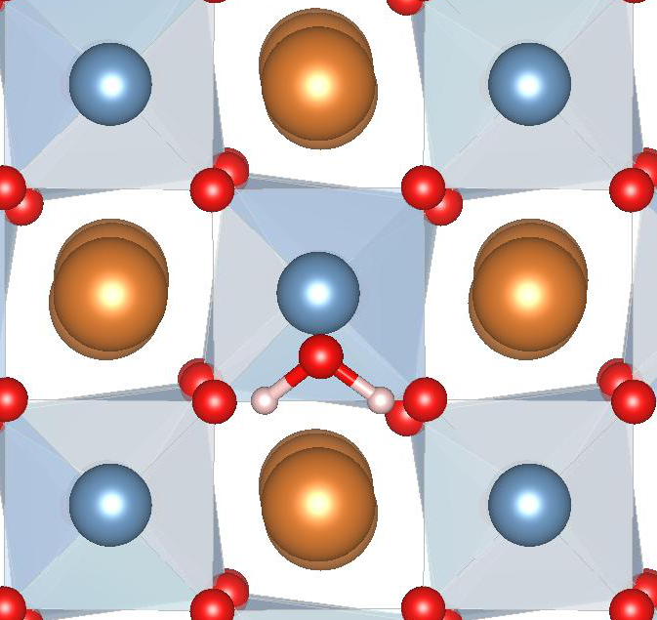
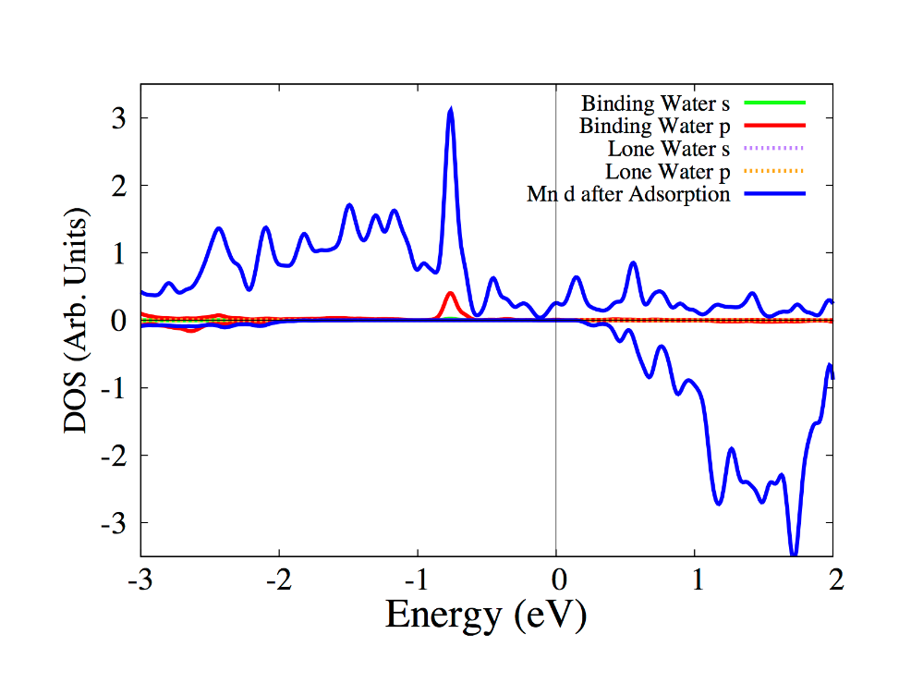
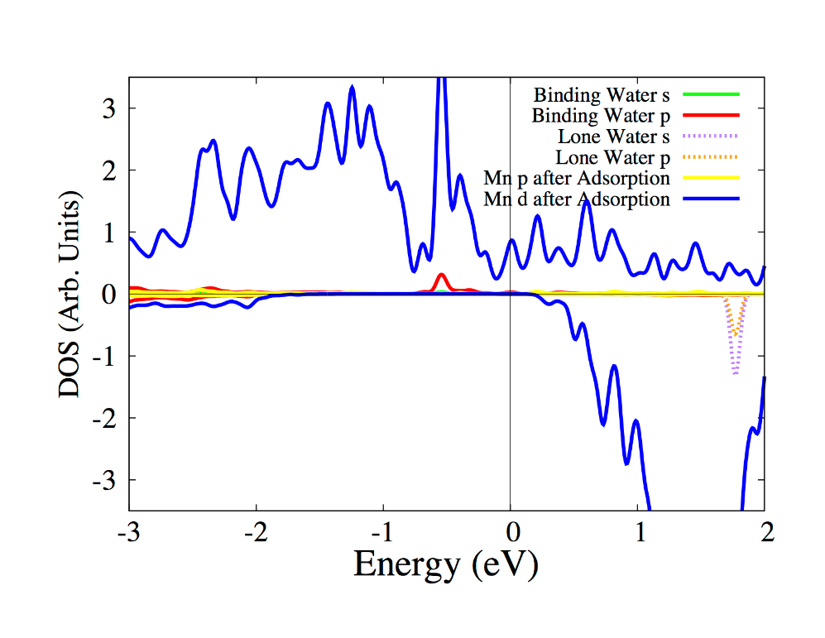
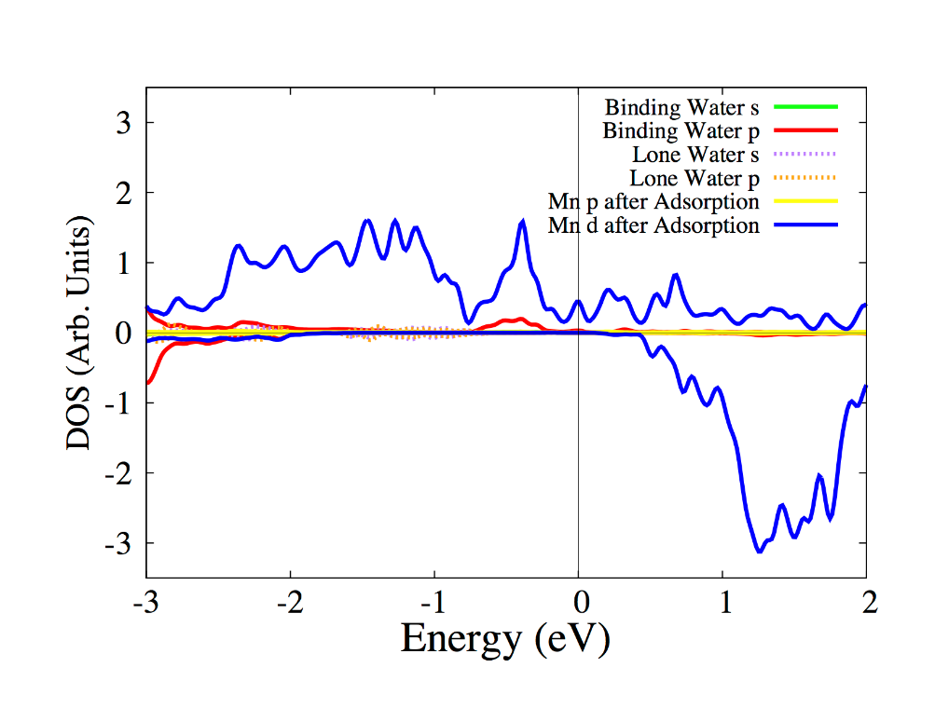
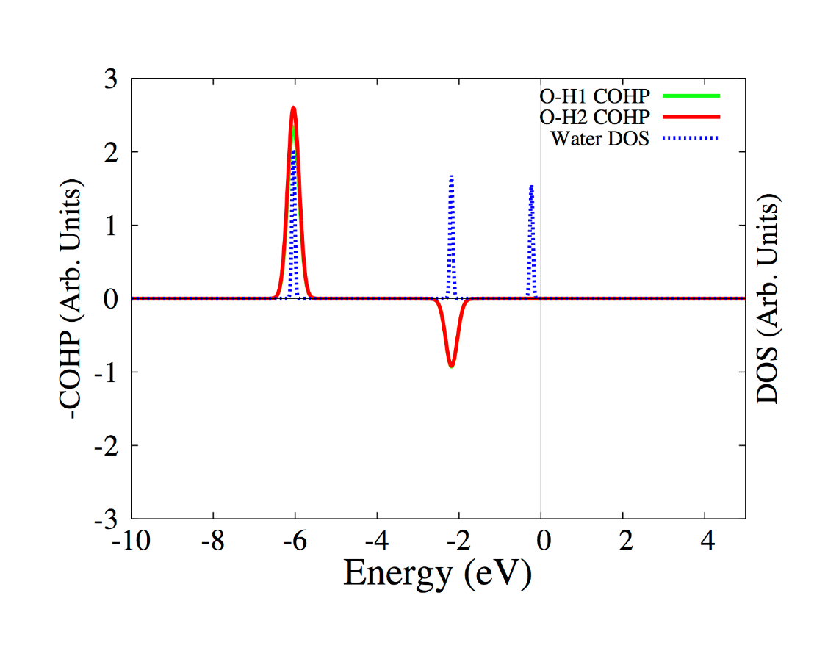
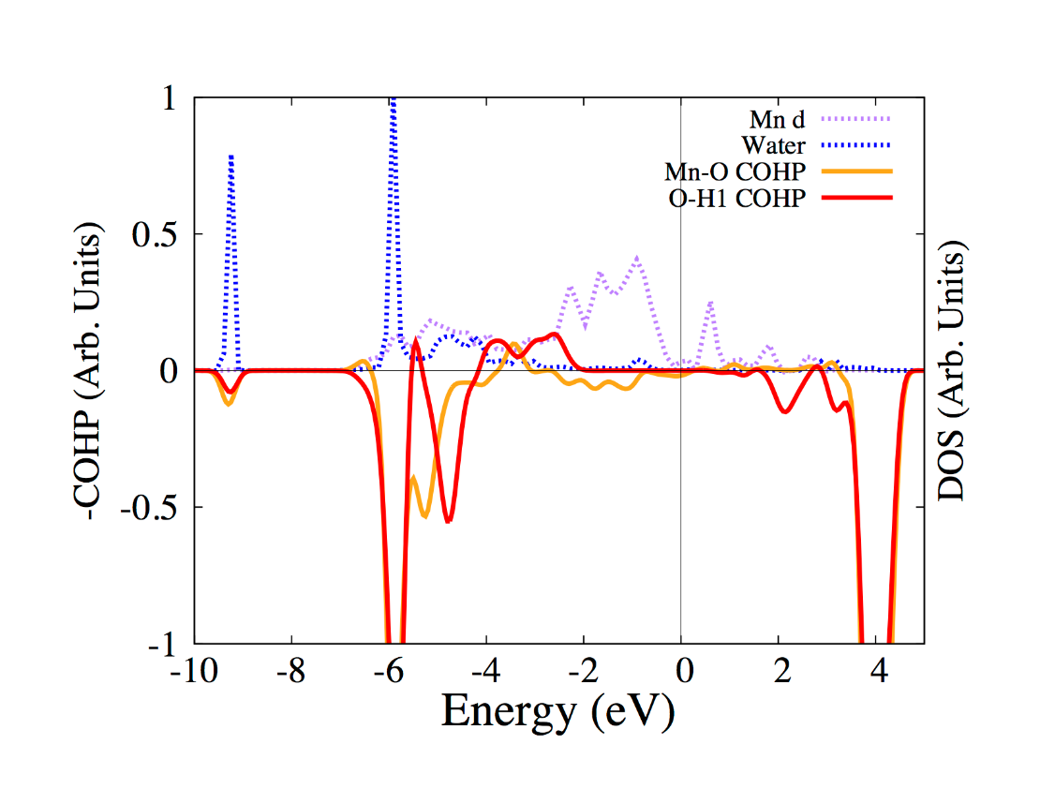

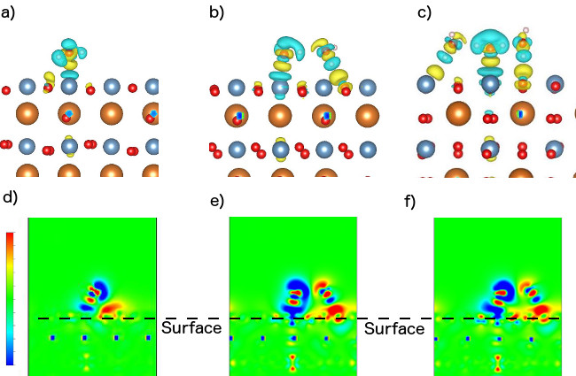
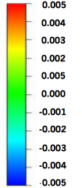

Adsorption of Water Clusters on the
LaMnO₃ Surface
Chris Billman and Hai-Ping Cheng
Quantum Theory Project, Department of Physics, University of Florida, Gainesville, FL 32611
1
INTRODUCTION
Structure and Energetics
PDOS and COHP Analysis
LaMnO₃ has been shown to have tremendous catalytic activity when used as a cathode in alkaline fuel cells¹, and has recently been used as an electrode in a supercapacitor, where rapid intercalation of oxygen ions into the surface have caused a high pseudocapacitive effect².
Both of these applications involve the interface of LaMnO₃ and water. The effect of water clusters adsorbed on the surface can affect the rate of the reaction, and the structure of water on the surface will dictate the electric double layer contribution to the supercapacitance.
While there is previous work on adsorption of oxygen ions² and the intermediates of the oxygen reduction reaction for its fuel cell applications³, there has been no work in exploring the adsorption of water on the surface.
By exploring the formation of water clusters on the surface of lanthanum manganite we broaden our understanding of adsorption on the LaMnO₃ surface, laying the foundation for future computational studies to directly address these complex applications.
The ground state structure for the monomer is parallel above the Mn-site.
Additional water molecules adsorb by attaching to the monomer through hydrogen bonds.
In the ground state dimer and trimer configurations, peripheral molecules also hydrogen bond to surface oxygen atoms.
Adsorption energy per molecule increases for the dimer, but decreases slightly for the trimer
PDOS of water monomer on the LaMnO₃ surface
Monomer
Dimer
Trimer
Upon adsorption, deep water peaks shift downward, but some states mix with surface states. Note the similar shape of the binding water p-orbitals (red) and Mn d-orbitals (blue), and contrast this with the narrow peaks of the lone water p-orbitals (orange). The strongest mixing is the 3a₁ and 1b₂ orbitals. Because both bonding and antibonding 3a₁ orbitals are filled, this cannot be responsible for stabilizing during adsorption.
1b₁
3a₁
1b₂
Monomer
Dimer
Trimer
Structure | E_{A} (eV) | E_{A}/molecule (eV) | Mn-O Distance (Å) | Hydrogen Bond Length (Å)
Monomer | -0.570 | -0.570 | 2.34 | --
Dimer | -1.34 | -0.670 | 2.11 | 1.65
Trimer | -1.99 | -0.665 | 2.06 | 1.72/1.73
Near the Fermi energy, adsorption of additional clusters broadens a water peak (Red line), pushing some of the states above the Fermi energy. If the water states here are antibonding orbitals, this effect will strengthen the surface adsorption.
Charge Density Analysis
COHP and DOS of Lone Water Monomer
COHP and DOS of Adsorbed Monomer on LaMnO₃ surface
Charge density differences show that there is significant charge reorganiation in both the surface and the adsorbed water molecules upon adsorption.
The reorganization at the monomer adsorption site is strongly enhanced upon adsorption of a second water molecule, but the effect does not continue when a third is adsorbed.
1b₁
3a₁
1b₂
Negative parts of the COHP plot are anti-bonding, positive are bonding
1b₁
3a₁
1b₂
METHODS
All DFT calculations were performed using VASP⁴. K-points were sampled using a 2x2x1 mesh in a Monkhorst-Pack scheme². The exchange-correlation functional was PBE, with van der Waals interactions added with optB88⁵. The ferromagnetic half-metallic state was chosen, as in most applications the material is doped so that it is in the half-metallic state. For each cluster, many different configurations were relaxed. Only the lowest energy structures are shown here. For the dimer and trimer, configurations for relaxation were generated by a quantum molecular dynamics simulation, to better sample the potential landscape. The number of configurations relaxed were 4, 7, and 13 for each cluster respectively.
To analyze bonding, we use three main tools:
Adsorption Energy:
Where E_{A} is adsorption energy, E_{surf+Ads} is the energy of the adsorbed
system, and E_{surf} and E_{ads} are the energies of the isolated surface and
adsorbate respectively.
2. Charge Density Difference:
Where ρ _{surf+Ads} is the charge density of the adsorbed system, and
ρ _{surf} and ρ _{ads} are the charge densities of the isolated surface and
adsorbate respectively.
3. Crystal orbital Hamilton population (COHP). The COHP uses orbital overlaps and band structure to determine the bonding nature of portions of the density of states. These calculations were performed using LOBSTER⁶.
COHP analysis shows that the water states near the Fermi energy are antibonding, so broadening during adsorption stabilizes the molecule by pushing antibonding orbitals (hybridized between the purple Mn d-orbitals and blue water p-orbitals) above the Fermi Energy. However, the COHP shows that an antibonding contribution that is quite small, so that it appears that electrostatic interactions dominate.
CONCLUSIONS
Water adsorbed on the LaMnO₃ shows a balance between water-water interactions and water-surface interactions, which causes a surprising trend with E_{A}/molecule, where it increases for the dimer but stays constant for the trimer.
While the dimer structure remains mostly unchanged upon adsorption, the strong water-surface interaction causes a broken hydrogen bond for the trimer cluster, contributing to the plateau in E_{A}/molecule.
Covalent interaction between the central molecule and the surface are enhanced slightly when additional molecules are adsorbed, by depopulating antibonding orbitals. However, the COHP and PDOS show that it is a small contribution, implying that the electrostatic interaction is the main cause of adsorption.
These results not only give insight into the application of LaMnO₃ in aqueous environments, it contributes to our understanding of adsorption on a complex transition metal oxide surface.
Future work: using an implicit solvation model to look at water cluster adsorption. This will enable a multi-scale approach that only treats the area of adsorption explicitly, but adds the effect of the surrounding aqueous environment.
References:
J. Suntivich, et. al. 2011, 3, 546.
J. Mefford, et. al. 2014, 13, 726.
E. Kotomin, et. al. JCCP. 2008, 10, 4644.
Y. Wang, et. al. JPCC. 2013, 117, 2106.
G. Kresse, et. al. Phys. Rev. B. 1993, 47, 558
J. Klimes, et. al. Phys. Rev. B. 2011, 83, 195131.
S. Maintz, et. al. J Comput. Chem. 2013, 34, 2557.
$$E_{A}=E_{surf+ads}−(E_{surf}+E_{ads})$$
Monomer
Dimer
Trimer
$$ρ_{diff}=ρ_{surf+ads}−(ρ_{surf}+ρ_{ads})$$
Picture at top, charge density differences for the water monomer, dimer, and trimer respectively. At the bottom are the charge density differences projected upon the xz plane, which cuts between the central molecule for each cluster. Note the rotation between the total charge density difference and projected difference for the trimer.

