Slide 1
DFT calculations of motional effects on NQR parameters in molecular crystals
Allen Majewski, Chris Billman, Hai-Ping Cheng, Neil Sullivan
University of Florida
March 9, 2018

Slide 2
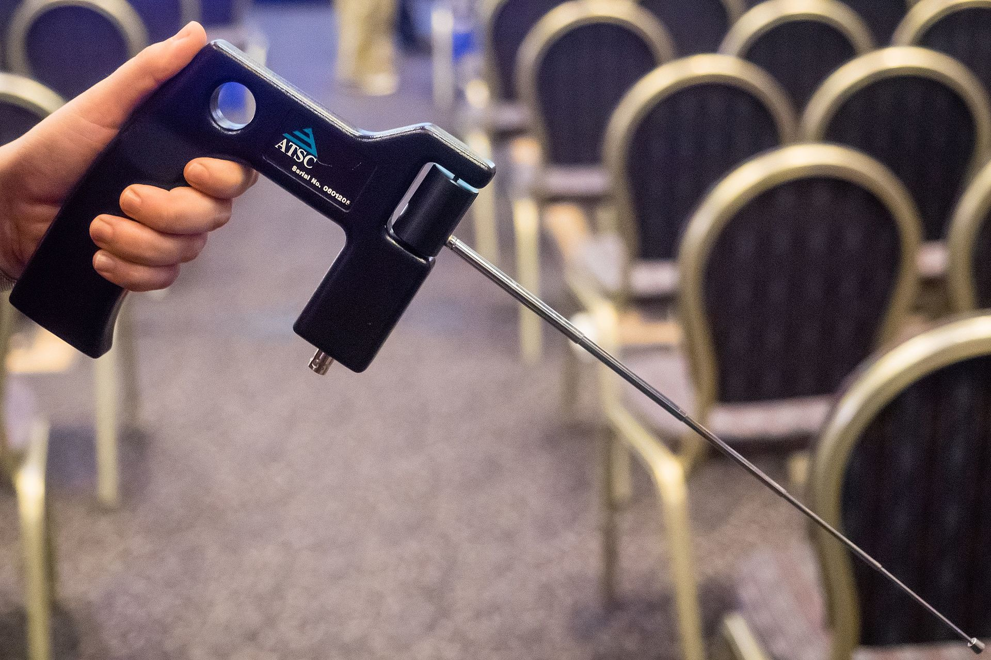
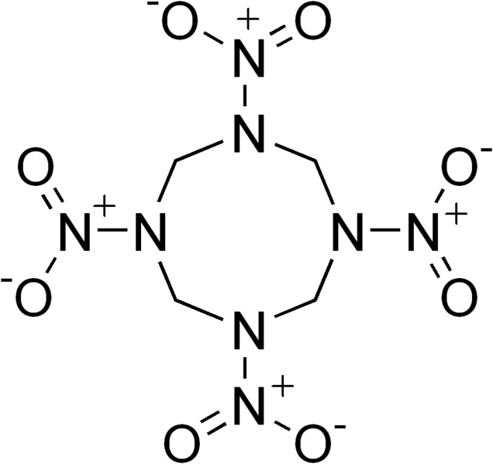
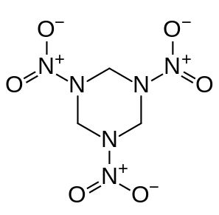
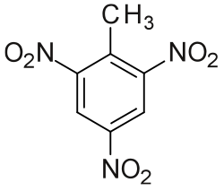
NQR explosives detection
ADE 651 – fake NQR bomb detector
NQR is a “chemical fingerprint”: material-specific frequencies
¹⁴N has quadrupole moment
Unlike NMR, no external B required
US Patents 1992-2017 for NQR bomb detectors: ~ 10²
sold in Iraq 2008-2009
$50k/ea, total $42M
does not actually work
TNT HMX RDX

Slide 3
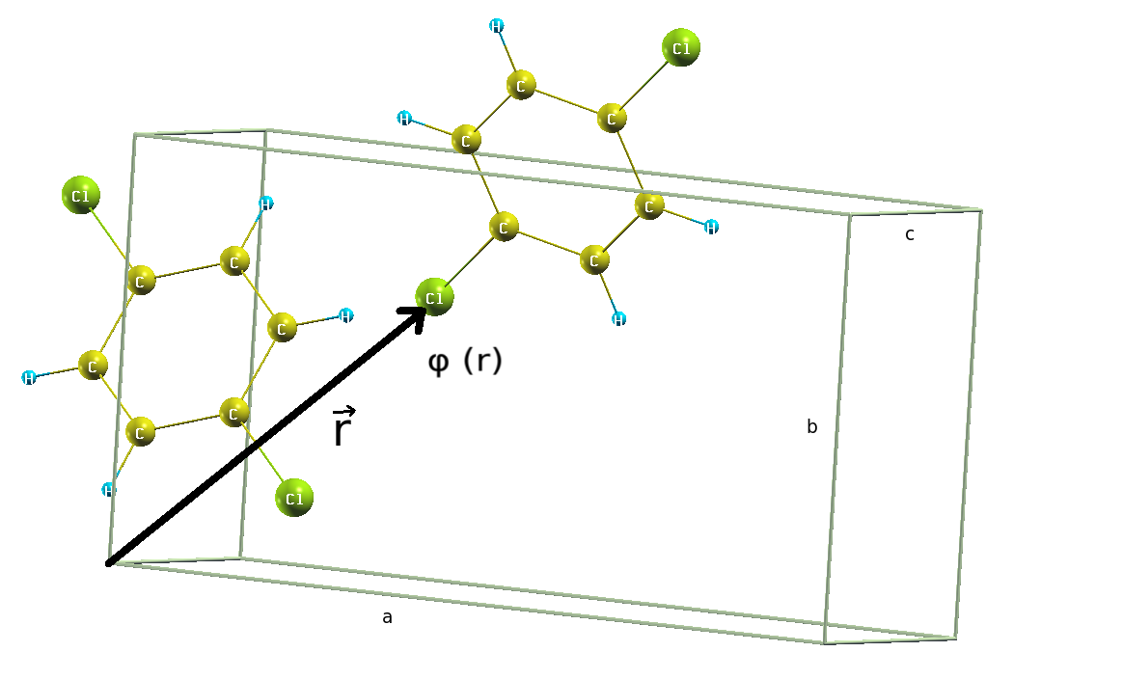
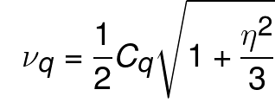
NQR frequencies in the static lattice
electric field gradient (EFG)
NQR frequencies
for spin 3/2 nuclei e.g. 35Cl
nuclear electric quadrupole moment
potential energy of charge distribution
(nucleus) in an external electric potential
define the quadrupole coupling constant and asymmetry parameter
for spin 1 nuclei e.g. 14N

Slide 4
T-dependence
NQR frequency decreases with increasing temperature by two mechanisms
thermal expansion
internal motions

Slide 5
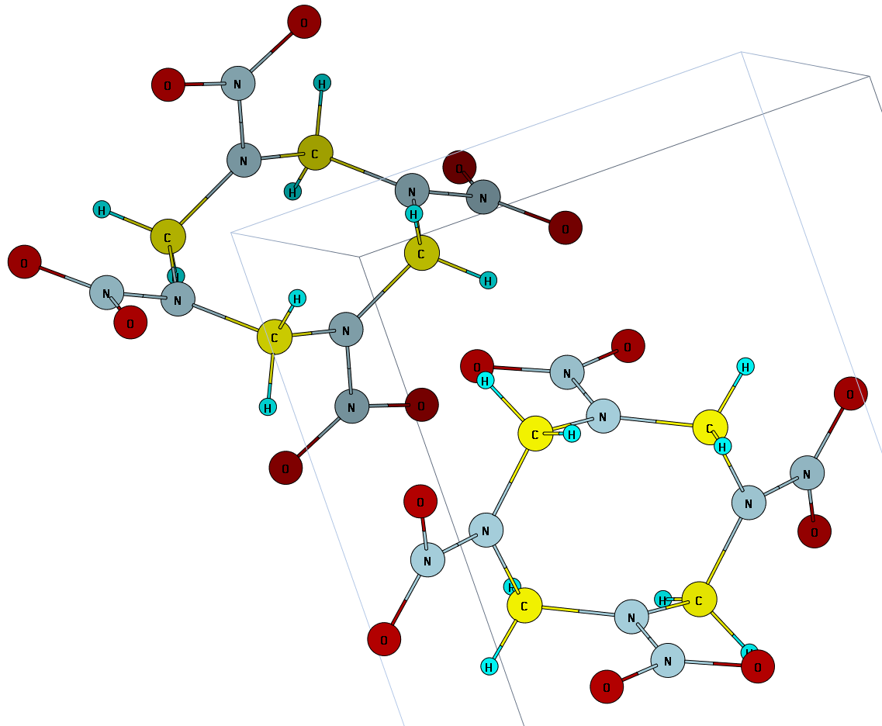
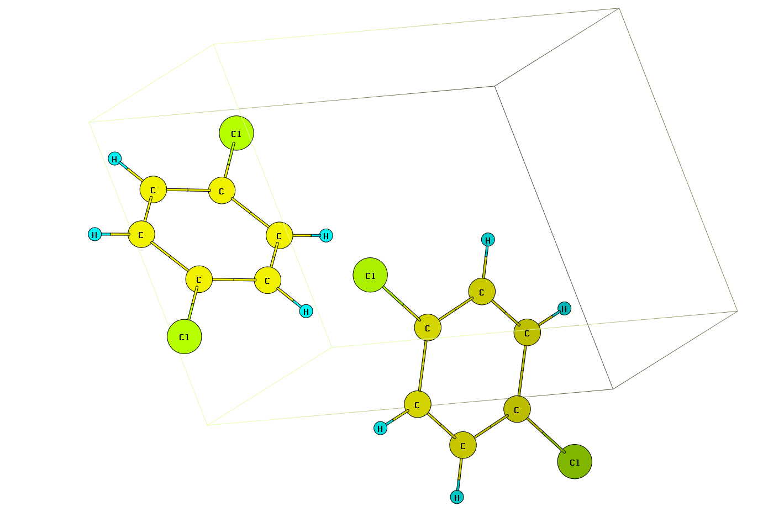
systems

