Slide 1
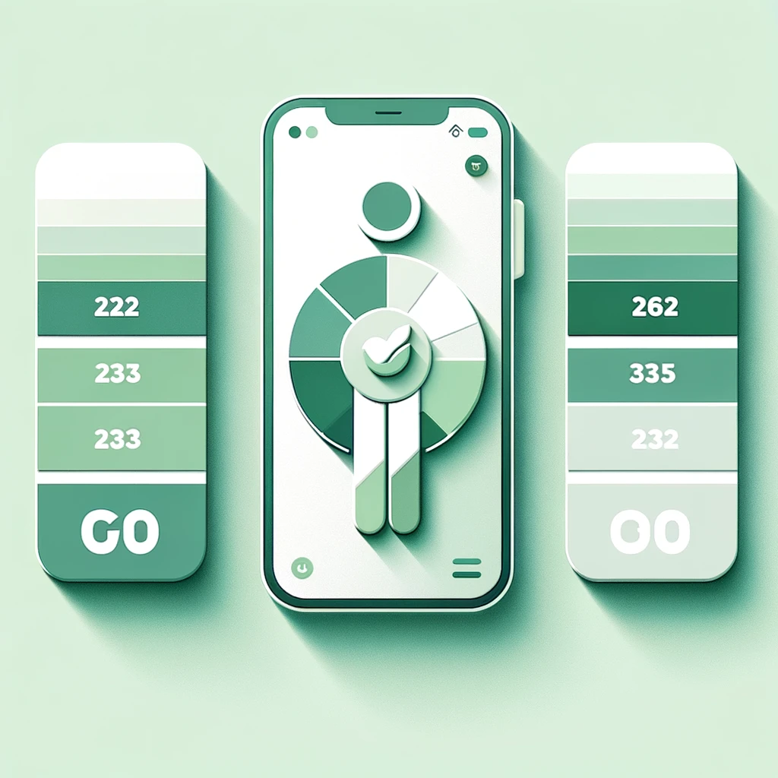
#499880
#27795B
#93C9A2
#5EA68E
#A7D9B2
#D8E7DC
#7CB894
#B0B0B0
#D7D7D7

