Slide 1

"Itghurls"

Slide 2

Introduction to HAHAH - a platform as a service for startup pitch deck.

Slide 3
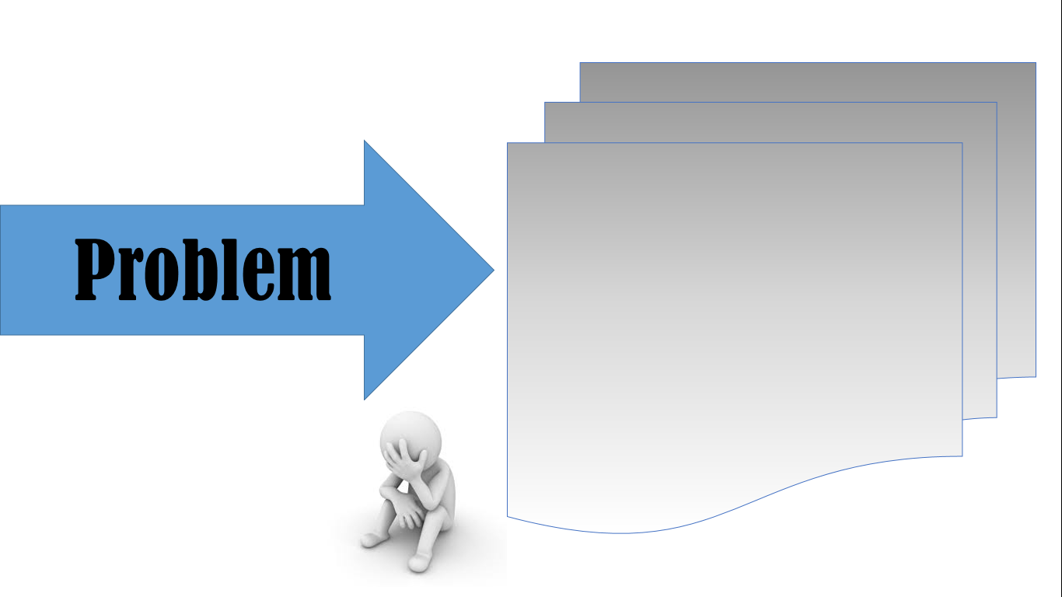
- Having hard time creating pitch deck - having hard time finding templates

Slide 4
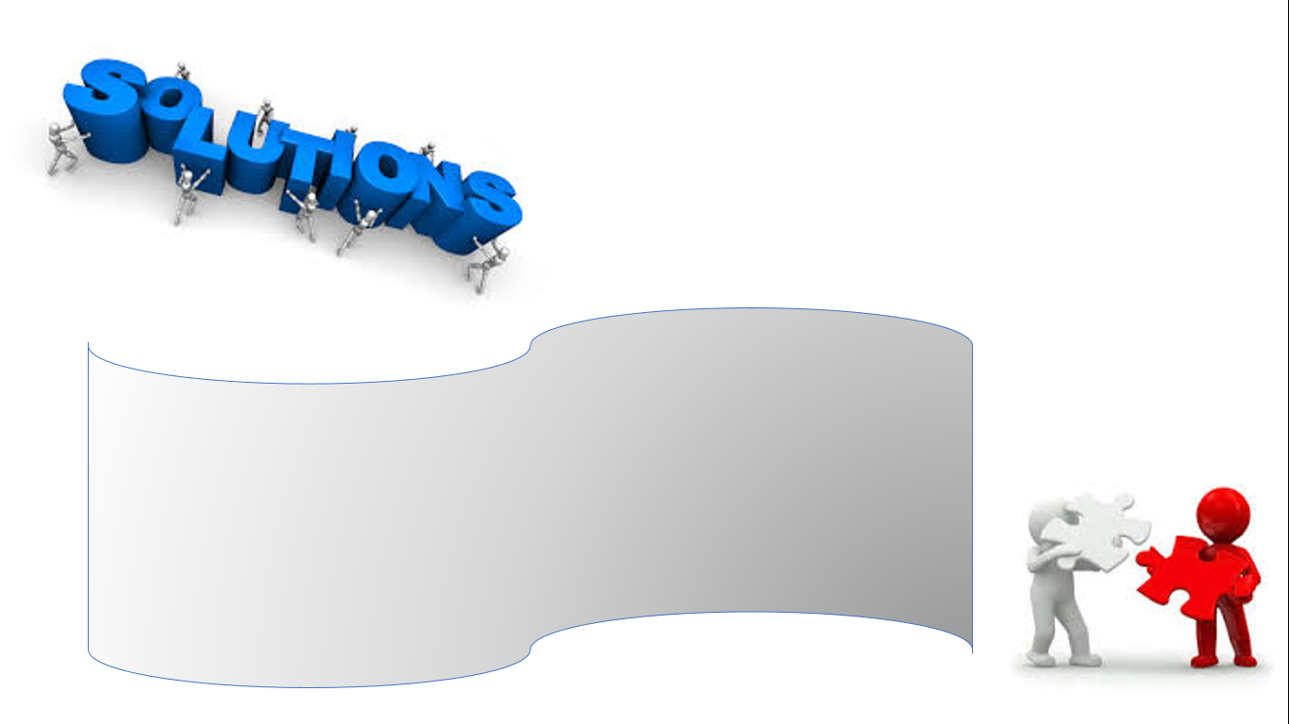
"HAHAH" HAHAH - a platform as a service for startup pitch deck.

Slide 5

Benefits :
Features :
- Befmwkniwjk
- ijbwyuvew7beuh

