Slide 1

"Team Bahug Taler"

Slide 2

Introduction to PitchItup - A pitch deck nindot generatoraa

Slide 3
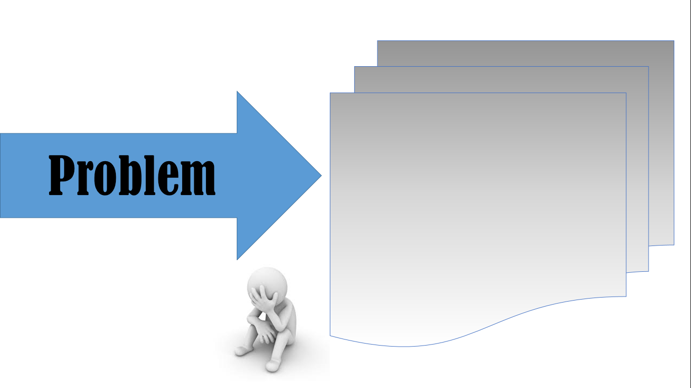
- Having hard time - dakog ulok

Slide 4

"PitchItup" PitchItup - A pitch deck nindot generatoraa

Slide 5

Benefits :
Features :
- agagaga
- asd

