Slide 1

"Pitchitup"

Slide 2

Introduction to Instagram - a photo sharing app

Slide 3
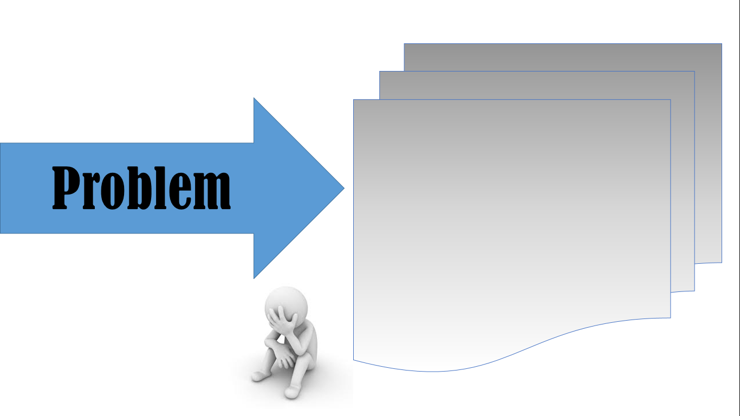
- hard to share pictures online -

Slide 4

"Instagram" Instagram - a photo sharing app

Slide 5

Benefits :
Features :
- share, like, view
- view photos, instant messaging

