Slide 1

"Itghurls"

Slide 2

Introduction to PitchItup - a platform as a service for startup pitch deck.

Slide 3

What is the Problem ?
- Having hard time creating pitch deck - having hard time finding templates

Slide 4

Our Solution
"PitchItup" PitchItup - a platform as a service for startup pitch deck.

Slide 5

Benefits :
Features :
- Befmwkniwjk
- ijbwyuvew7beuh

Slide 6

The Market
Channels :
- gybgbhj

Slide 7

- iubg

Slide 8
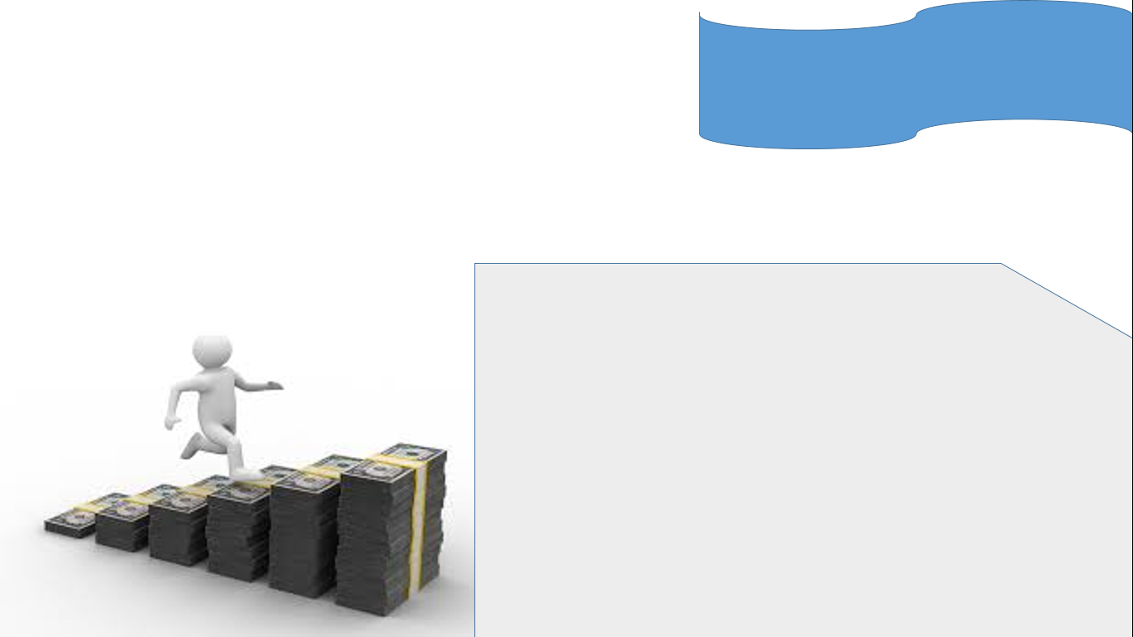
How to make money ?
Revenue Streams :
- buuhjbh

Slide 9

Competitors Analysist:
- jbwuvwuevhkjwev

