Slide 1
CONTENT
introduction of data
Data Wrangling
content
Exploratory Data Analysis
Formal Analysis
Conclusion and Further task

Slide 2
Formal Analysis
Principle Component Analysis
Relationship among three variables and qualityclass
Summary of PCA consequence
coefficients | Estimate | Std.Error | z value | Pr(>|z|)
aroma | 6.03872 | 0.99701 | 6.057 | 1.39E-09
flavor | 8.29375 | 1.15796 | 7.162 | 7.93E-13
acidity | 6.21276 | 0.98315 | 6.319 | 2.63E-10
 | PC1 | PC2 | PC3
Standard deviation | 1.5170 | 0.6790 | 0.48747
Proportion of variance | 0.7671 | 0.1537 | 0.07921
Cumulative proportion | 0.7671 | 0.9208 | 1.0000
As we mentioned the probability of multilinearity
PCA process is considerable
We choose PC1 + PC2

Slide 3
Formal Analysis
Model Selection
Original model fitting
PCA model fitting
 | AIC
start | 445.12
harvested | 441.02
altitude_mean_meters | 440.31
 | AIC
start | 446.01
harvested | 441.55
altitude_mean_meters | 440.57
AIC almost the same

Slide 4
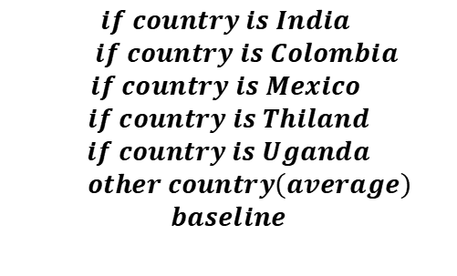
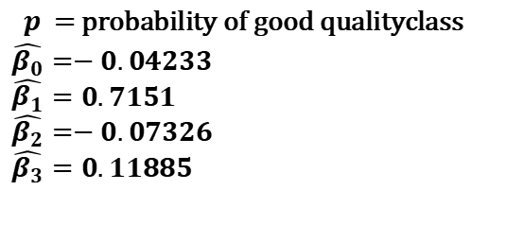
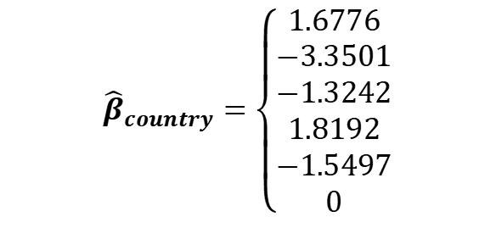
Formal Analysis
Model Formula
$\ln\left(\frac{p}{1−p}\right)=\hat{β_{0}}+\hat{β_{1}}∙$ $x_{PC1}$+ $\hat{β_{2}}∙x_{PC2}$ + ${\hat{β}}_{country}$+ $\hat{β_{3}}∙x_{category}$ + $ε$
$${\hat{β}}_{country}=\left\{\begin{aligned}1.6776 \\ −3.3501 \\ −1.3242 \\ 1.8192 \\ −1.5497 \\ 0\end{aligned}\right.$$
$$if country is India$$
$$if country is Colombia$$
$$if country is Mexico$$
$$if country is Thiland$$
$$if country is Uganda$$
$$other country\left(average\right)$$
$$baseline$$
$p$ = probability of good qualityclass
$$\hat{β_{0}}=−0.04233$$
$$\hat{β_{1}}=0.7151$$
$$\hat{β_{2}}=−0.07326$$
$$\hat{β_{3}}=0.11885$$

Slide 5
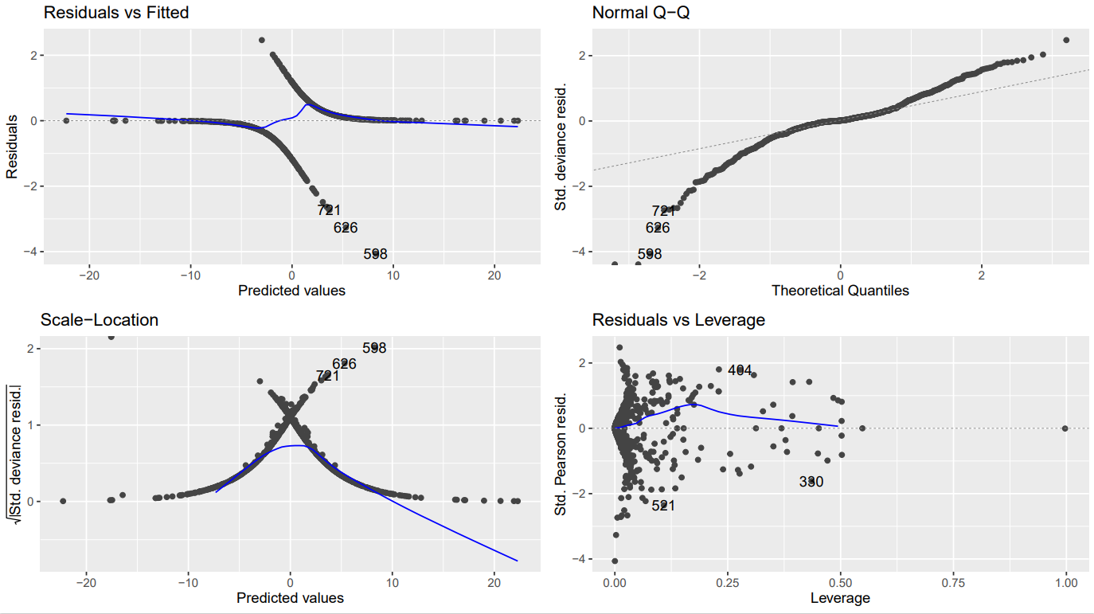
Formal Analysis
Assumption Check
Residual vs Fitted:
Appearing some non-random pattern, non-linear correlation might exist
Normal QQ:
The tail of the residual has some deviation
Scale-Location:
As the fit value increases, so does the variation
Residuals vs Leverage:
Some possible outliers might exist

Slide 6
Formal Analysis
Cross-validation
accuracy | kappa
0.8343 | 0.6675
poor | good
340 | 386
Accuracy:
model correctly predicted the class labels for around 83.44% of the samples
Kappa:
A kappa value of approximately 0.67 indicates substantial agreement between the predicted and actual class labels

Slide 7
CONTENT
introduction of data
Data Wrangling
content
Exploratory Data Analysis
Formal Analysis
Conclusion and Further task

Slide 8
Formal Analysis
Conclusion and Further Task
Conclusion:
After fitting the optimal model (PCA), 4 possible exploratory variables could be considered: PC1, PC2(linear combination of aroma, flavor and acidity), country_of_origin and category_two_defects, which means the change of 4 variables might make an impact on the quality of a batch of coffee.
Additionally, because of a smaller P-value of PC1, it is possible that changes in these three variables have a bigger impact.
Further Task:
Check nonlinearity: Try to add polynomial terms or interaction terms for predictors to capture nonlinear relationships.
Variable transformations: Given the signs of heteroscesticity, we can try to transform the response or predictor variables, such as using logarithms, square roots, or reciprocal transformations.
Data stratification: If there are many levels of classification variables such as country_of_origin or defects, consider whether some rare classes need to be combined to reduce model complexity and prevent overfitting

Slide 9
THANKS
Thank you for listening
Group 11

