Slide 1
CONTENT
introduction of data
Data Wrangling
content
Exploratory Data Analysis
Formal Analysis
conclusion

Slide 2
Formal Analysis
Principle Component Analysis
Relationship among three variables and qualityclass
Summary of PCA consequence
coefficients | Estimate | Std.Error | z value | Pr(>|z|)
aroma | 6.03872 | 0.99701 | 6.057 | 1.39E-09
flavor | 8.29375 | 1.15796 | 7.162 | 7.93E-13
acidity | 6.21276 | 0.98315 | 6.319 | 2.63E-10
 | PC1 | PC2 | PC3
standard deviation | 1.5170 | 0.6790 | 0.48747
proportion of variance | 0.7671 | 0.1537 | 0.07921
cumulative proportion | 0.7671 | 0.9208 | 1.000
As we mentioned the probability of multilinearity
PCA process is considerable
We choose PC1 + PC2

Slide 3
Formal Analysis
Model Selection
Original model fitting
PCA model fitting
 | AIC
start | 445.12
harvested | 441.02
altitude_mean_meters | 440.31
 | AIC
start | 446.01
harvested | 441.55
altitude_mean_meters | 440.57
AIC almost the same
Quanlityclass$=β_{0}+β_{1}×$ PC1 + $β_{2}×$ PC2 + $β_{3}×$ country_of_origin + $β_{4}×$ category_two_defects + $ε$

Slide 4
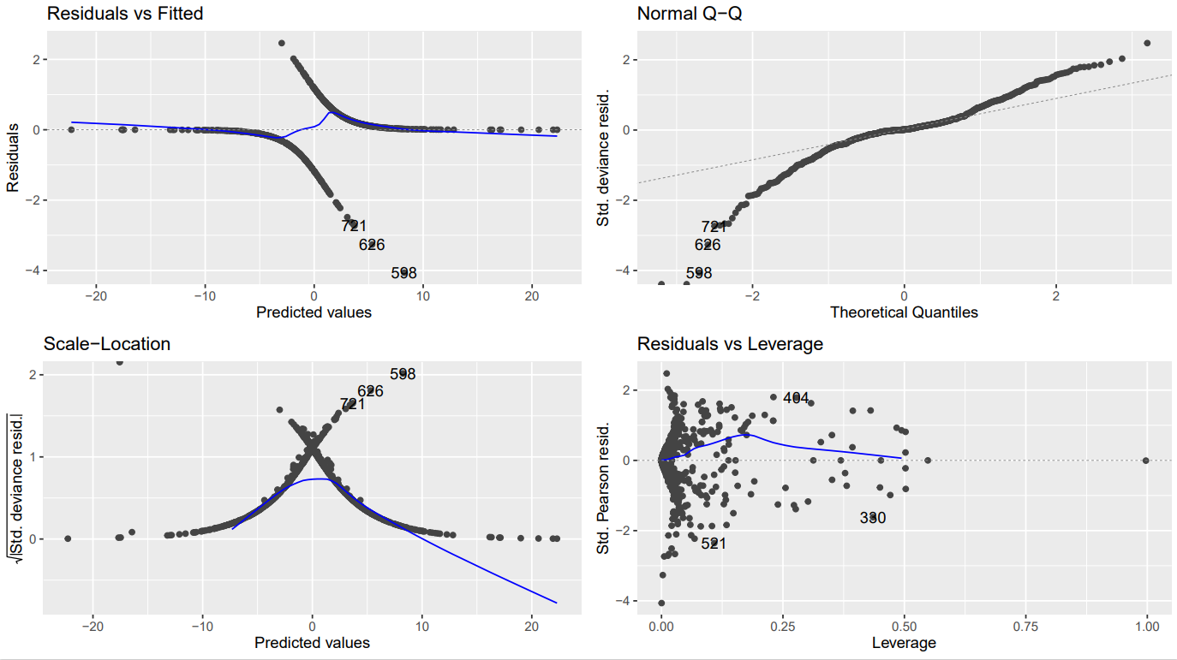
Formal Analysis
Assumption Check
Residual vs Fitted:
Randomly distributed around 0, no apparent pattern
Normal QQ:
The tail of the residual has some deviation
Scale-Location:
As the fit value increases, so does the variation
Residuals vs Leverage:
Some possible outliers might exist

Slide 5
Formal Analysis
Cross-validation
accuracy | kappa
0.8343 | 0.6675
Accuracy:
model correctly predicted the class labels for around 83.44% of the samples
Kappa:
A kappa value of approximately 0.67 indicates substantial agreement between the predicted and actual class labels

Slide 6
THANKS
Thank you for listening
Group 11

