Slide 1
Concept
Test the candidates with real use cases, in a well known environment (hopefully)
The exercises are all stored in Github
The development environment must be set prior to the evaluation
Tools will be proposed to the business managers in order to evaluate the candidate

Slide 2
Prerequisites installation…

Slide 3
For all the languages
Install Github desktop : download the installer here If you’re not automatically authenticated, follow those basic steps: authenticating to github
Set the default working directory in the « GitHub Desktop » application, click on the gear button located on the top right corner and choose « options ». On the « Clone path » field, put the following value: C:\Dev\Qualif

Slide 4
Tests C# & C++
Visual Studio: download
Execute the downloaded file with the default options

Slide 5
Tests Java
Install the JDK (Java Development Kit)
go to the download page
choose the latest version (today: jdk-8u111-windows-x64)
Launch the install with the default parameters
Install Eclipse
Eclipse installer Choose « Eclipse IDE for Java Developers » when proposed
DRAFT

Slide 6
Tests PHP
Install Eclipse
Eclipse installer Choose « Eclipse IDE for PHP Developers » when proposed
Install wamp
Installer (choose the default parameters)
Install PHPUnit
Installer
Install script
DRAFT

Slide 7
Preparing the tests for the candidate

Slide 8
The tests names are giving informations about the complexity and the type of the exercise.
The naming scheme is:
LANGUAGE-COMPLEXITY-TYPE-Name
COMPLEXITY:
STD: Standard (easy)
EXP: Expert
TYPE:
PB: Problem solving, the candidate must design an algorithm
LK: Language knowledge, indicates if the candidate knows the basics of a language
NAME:
In case of a « LK » typed test, gives an indication about what is tested (for example: boolean expressions, LINQ, …).
to be precised
- Add the duration of the exercices

Slide 9
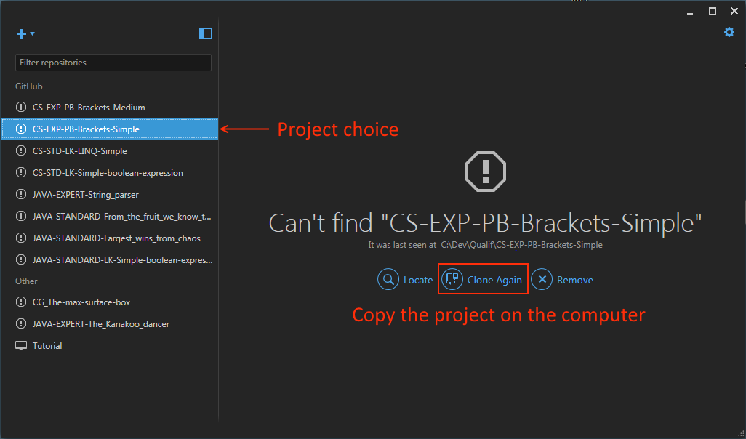
Reminder: All the projects will be located in the directory: C:\Dev\Qualif
Empty the « C:\Dev\Qualif » directory (back it up if it contains tests you want to keep)
In the « GitHub » application, click on a project you want to add to the test campaign and click on the « Clone Again » button
After this operation, the C:\Dev\Qualif directory should contain all the projects directories
Don’t forget to close the GitHub application

Slide 10
From this point, you can give the computer to the candidate, explaining him that the exercises are located in the C:\Dev\Qualif directory.
He/she should be able to open the projects and work on them.
Note that if the candidate is not able to understand what to do with those directories, it’s not a good sign…

