Slide 1
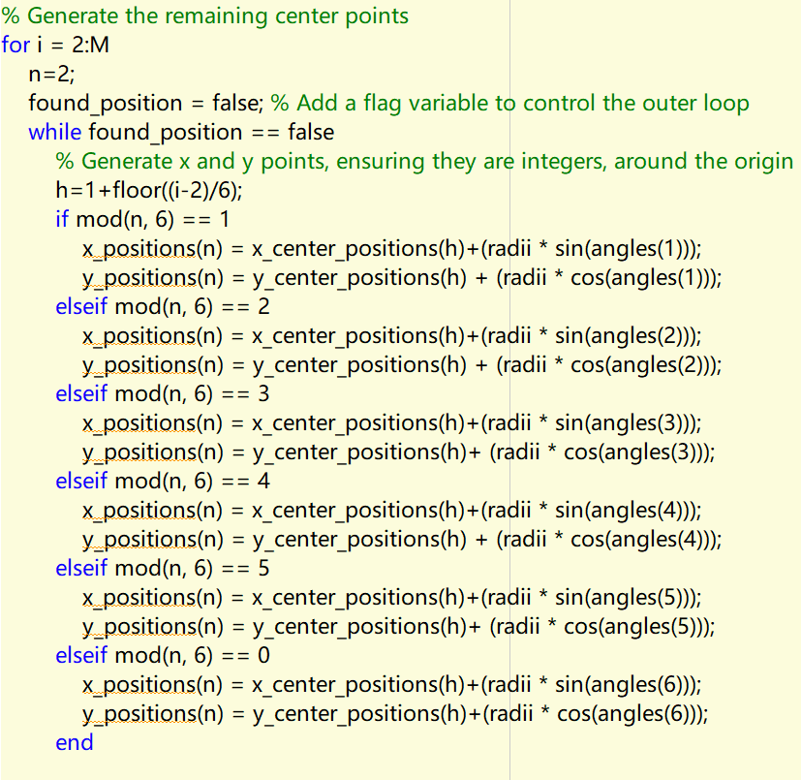
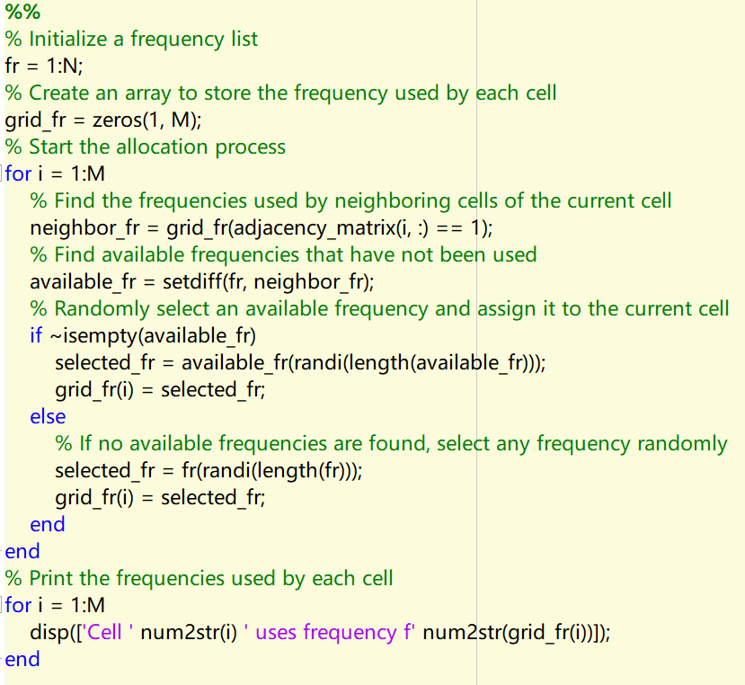
An M-cell IFRN network (reuse factor N)
Key Issues:
1，Generating M-cells:
Try to generate hexagons as close as possible around the center
2，Assigning the group number of frequency for each cell based on N.
Greedy Coloring Algorithm

Slide 2
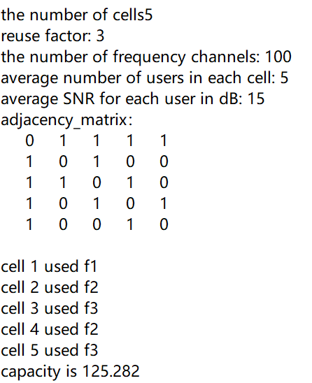
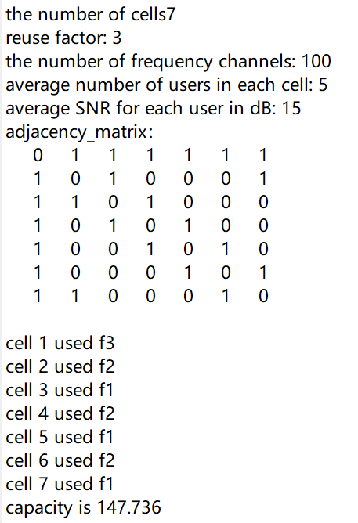
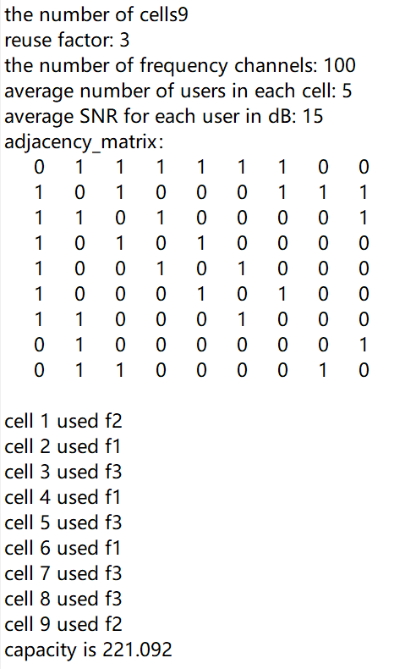
When changing the number of cells

Slide 3
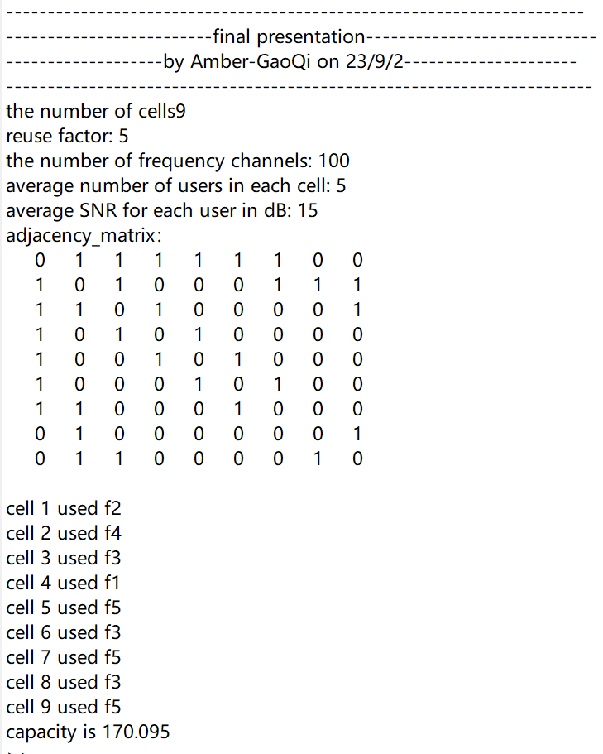
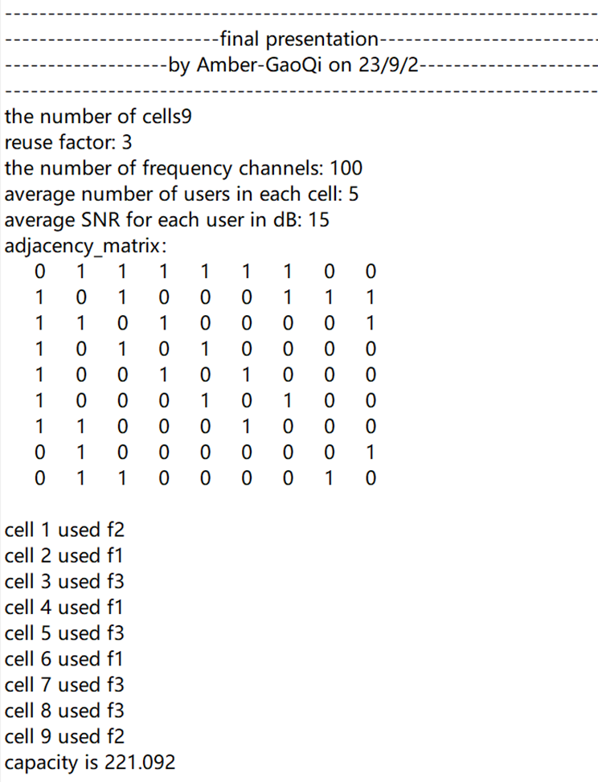
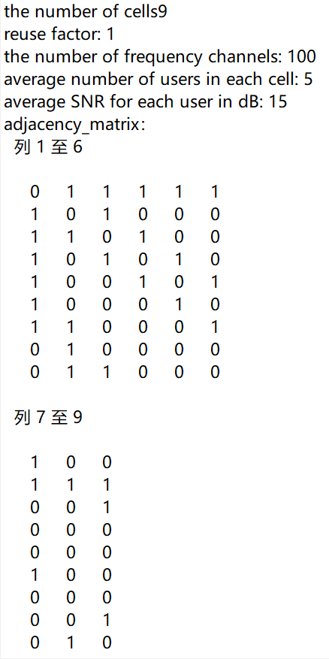
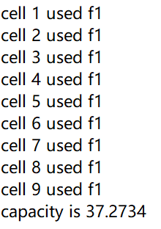
When changing the reuse factor

Slide 4
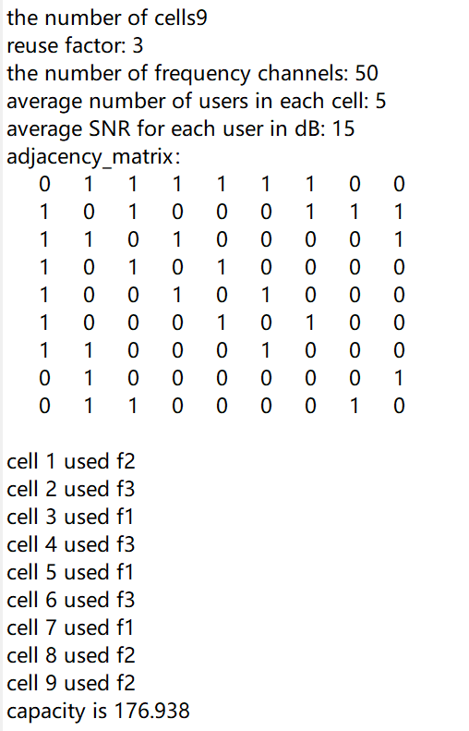
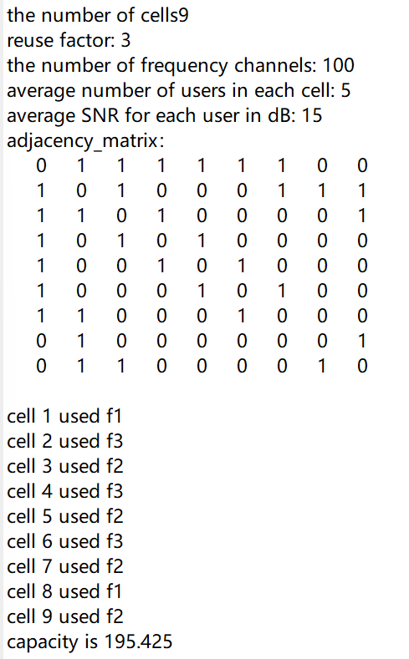
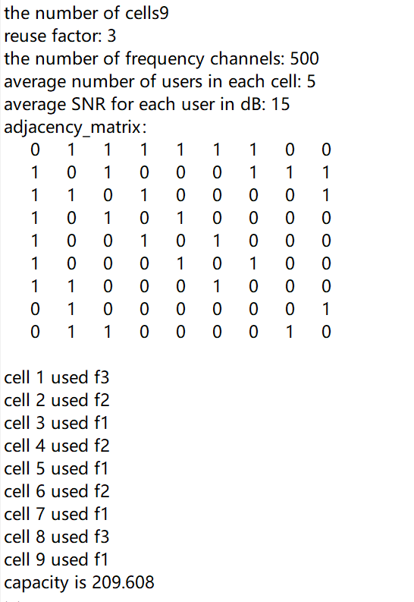
When changing the number of frequency channels

Slide 5
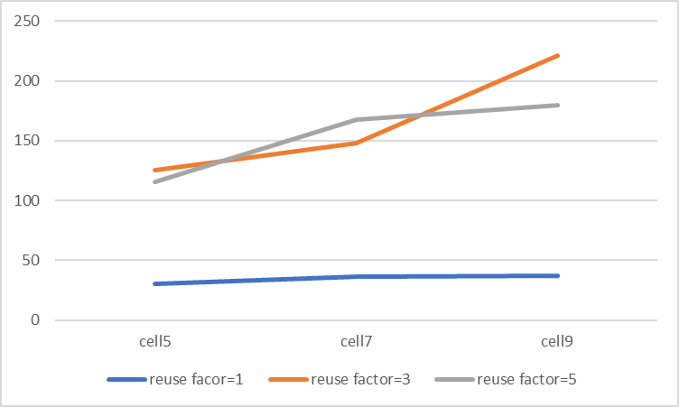
Summary
The number of cells
Capacity
1, When changing the number of cells:
the number of cells: 5->7 -> 9
the capacity: 125.282->147.736 -> 221.092
2, When changing the reuse factor:
the reuse factor: 5 -> 3 -> 1
the capacity: 175.54->198.93->37.2734
3, When changing number of frequency channels:
the number of frequency channels: 50 -> 100->500
the capacity: 168.6->195.36->196.93
Capacity
number of frequency channels

Slide 6
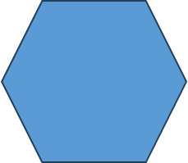

2
3
1
6
4
5

