Slide 1

SoftwareONE
WELCOME TO

Slide 2

SoftwareONE
EMPOWERING COMPANIES TO TRANSFORM

Slide 4

OCP 4 Workshop Agenda
01
Who we are…
02
For Infrastructure Specialists
03
For Developers
04
Architectural Overview of Workshops

Slide 5
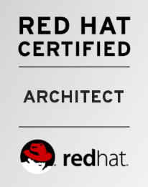
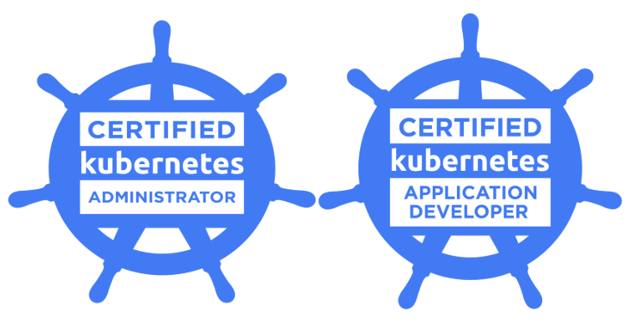
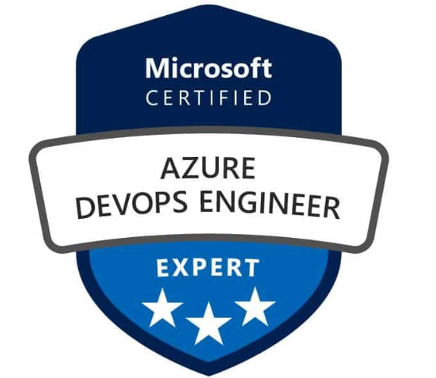
Team Members
Who we are…
Celalettin Altınpınar - Technology & Solution Development Manager
Mustafa Uysal – Solution Architect
Altuğ Yıldırım – DevOps Solutions Lead

Slide 6
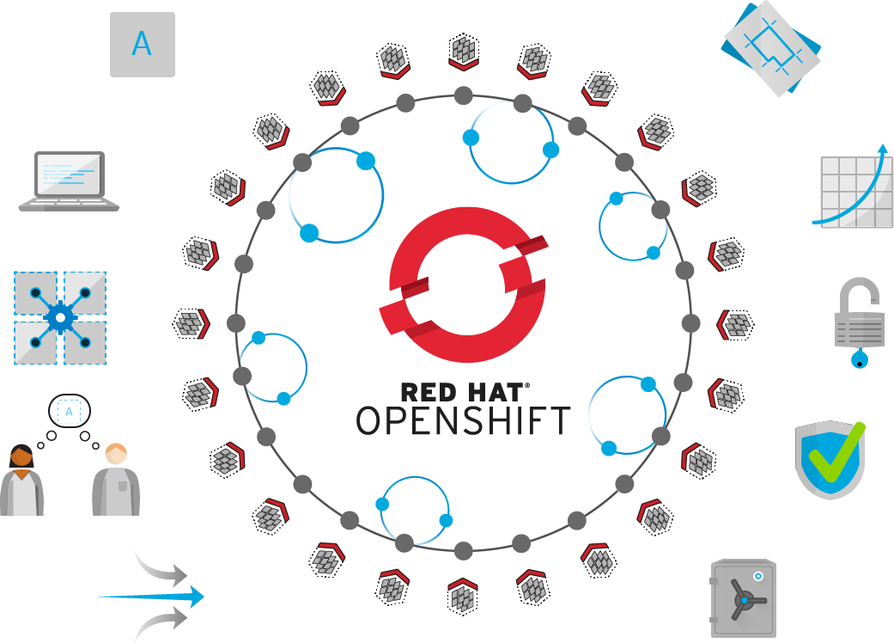
Day 1 – Theorical
For Infrastructure Specialists
Linux Containers
OpenShift Concepts Overview
OpenShift Architecture
OpenShift Installation Architecture
Technical Deep Dive
Monitoring Application Health *
Networking *
Logging & Metrics *
Security *
Persistent Storage *
Operator Framework *
Reference Architectures *
Build & Deploy Container Images
Continuous Integration (CI) & Continuous Delivery (CD)
Developer Workflow
Application Services
OpenShift 4
* : especially to be explained

Slide 7

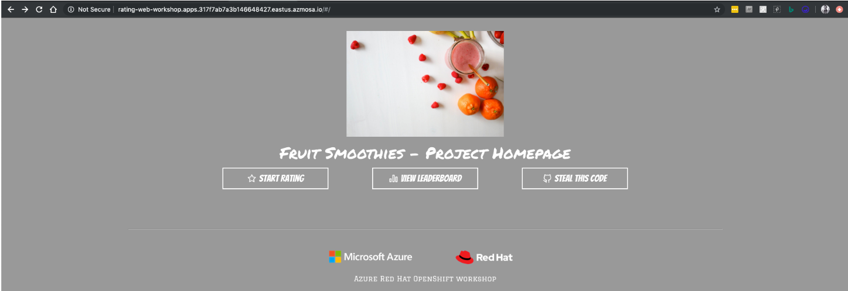
Day 2: Scenario 1 - Azure Red Hat OpenShift Workshop:
For Infrastructure Specialists
Prerequisites
Basic concepts
Lab 1 - Go Microservices
Application Overview
Create cluster
Create Project
Deploy MongoDB
Deploy Ratings API
Deploy Ratings frontend
Create Network Policy
Scaling ARO Cluster
Lab 2 - ARO Internals
Application Overview
Application Deployment
Logging
Exploring Health Checks
Persistent Storage
Configuration
Networking and Scaling

Slide 8
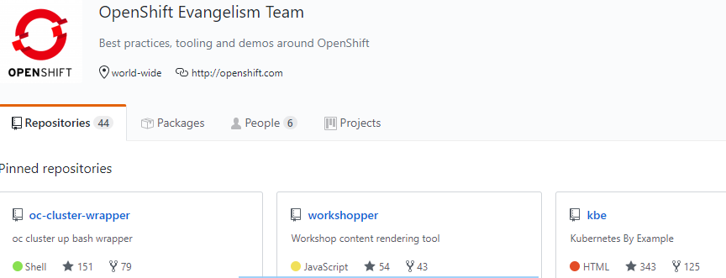
Day 2: Scenario 2 - OpenShift Evangelists Workshop:
For Infrastructure Specialists
Environment Overview
Installing the *oc* client tool
Exploring the CLI and Web Console
Architecture Overview
Deploying Your First Container Image
Scaling and Self Healing
Exposing Your Application to the Outside
Exploring OpenShift's Logging Capabilities
Role-Based Access Control
Remote Access to Your Application
Deploying Java Code
Adding a Database (MongoDB)
Application Health and Monitoring

Slide 9

Day 1 – Theorical
For Developers
Linux Containers
OpenShift Concepts Overview
OpenShift Architecture
OpenShift Installation Architecture
Technical Deep Dive
Monitoring Application Health
Networking
Logging & Metrics
Security
Persistent Storage
Operator Framework
Reference Architectures
Build & Deploy Container Images *
Continuous Integration (CI) & Continuous Delivery (CD) *
Developer Workflow *
Application Services *
OpenShift 4
* : especially to be explained
Web
Application
Data Virtualization
Intelligent
Process
Micro services
API
Management
Single
Sign-On
Java EE Application
Mobile
Integration
Messaging
Data Grid
Real Time Decision

Slide 10
Day 2: OpenShift Evangelists Workshop
For Developers
Environment Overview
Installing the *oc* client tool
Exploring the CLI and Web Console
Architecture Overview
Deploying Your First Container Image
Scaling and Self Healing
Exposing Your Application to the Outside
Exploring OpenShift's Logging Capabilities
Role-Based Access Control
Remote Access to Your Application
Deploying Java Code
Adding a Database (MongoDB)
Application Health and Monitoring
Automate Build and Deployment with Pipelines
Automation for Your Application on Code Changes
Using Application Templates
Binary Builds for Day to Day Development
Using Port-Forwarding and Remote Debugging

Slide 11
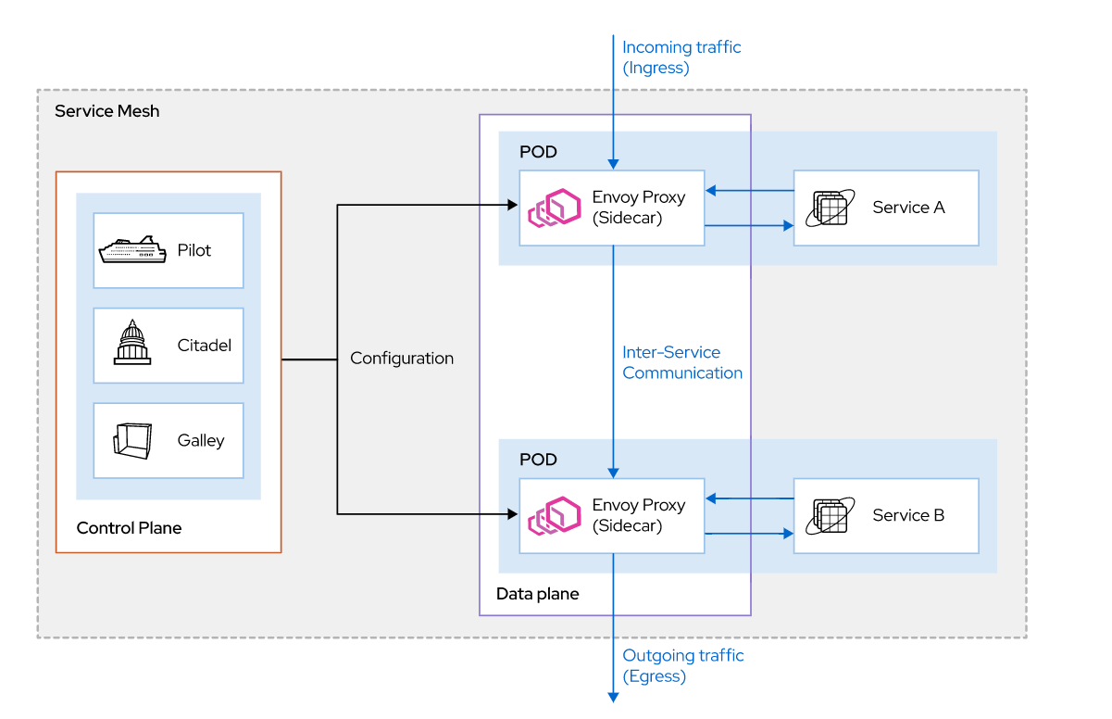
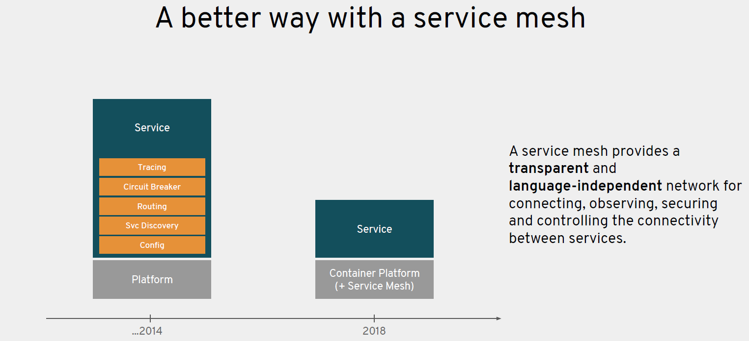
Optional - Day 2: Red Hat Service Mesh
For Developers
Environment Overview
Installing Red Hat Service Mesh
Deploy example Web Site
And enjoy the mesh!

Slide 12
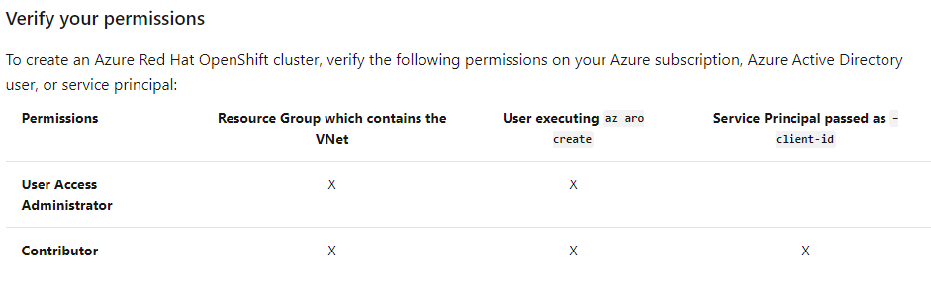
Verify your permissions
Installation of ARO 4.x

Slide 13
Install and Register The «az aro» extension
Installation of ARO 4.x
az extension add -n aro --index https://az.aroapp.io/stable
az extension update -n aro --index https://az.aroapp.io/stable
az provider register -n Microsoft.RedHatOpenShift –wait
az -v

Slide 14
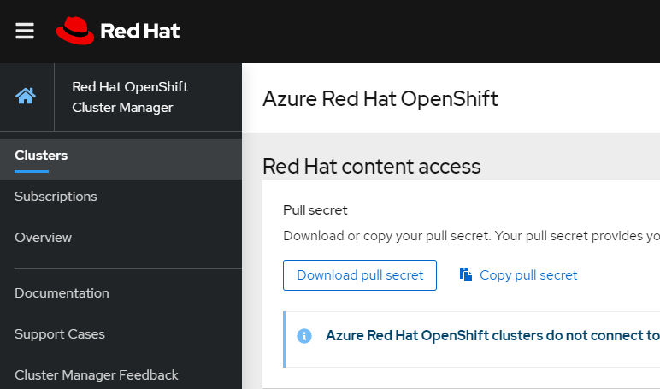
Get a Red Hat pull secret
Installation of ARO 4.x
https://cloud.redhat.com/openshift/install/azure/aro-provisioned
Create an account and login
Keep the saved pull-secret.txt file

Slide 15
Create a virtual network containing two empty subnets
Installation of ARO 4.x
LOCATION=eastus # the location of your cluster
RESOURCEGROUP=aro-rg # the name of the resource group where you want to create your cluster
CLUSTER=cluster # the name of your cluster
Create a resource group
az group create --name $RESOURCEGROUP --location $LOCATION
Create a virtual network.
az network vnet create --resource-group $RESOURCEGROUP --name aro-vnet --address-prefixes 10.0.0.0/22

Slide 16
Create a virtual network containing two empty subnets
Installation of ARO 4.x
Add an empty subnet for the master nodes
az network vnet subnet create --resource-group $RESOURCEGROUP --vnet-name aro-vnet --name master-subnet --address-prefixes 10.0.0.0/23 --service-endpoints Microsoft.ContainerRegistry
Add an empty subnet for the worker nodes
az network vnet subnet create --resource-group $RESOURCEGROUP --vnet-name aro-vnet --name worker-subnet --address-prefixes 10.0.2.0/23 --service-endpoints Microsoft.ContainerRegistry
Disable subnet private endpoint policies on the master subnet. This is required to be able to connect and manage the cluster.
az network vnet subnet update --name master-subnet --resource-group $RESOURCEGROUP --vnet-name aro-vnet --disable-private-link-service-network-policies true

Slide 17
Create the Cluster
Installation of ARO 4.x
az aro create \
--resource-group $RESOURCEGROUP \
--name $CLUSTER \
--vnet aro-vnet \
--master-subnet master-subnet \
--worker-subnet worker-subnet \
--pull-secret @pull-secret.txt
# --domain foo.example.com # [OPTIONAL] custom domain

Slide 18
Connect to the cluster
Connect to an Azure Red Hat OpenShift 4 cluster
az aro list-credentials --name $CLUSTER --resource-group $RESOURCEGROUP
{
"kubeadminPassword": "<generated password>",
"kubeadminUsername": "kubeadmin"
}
az aro show --name $CLUSTER --resource-group $RESOURCEGROUP --query "consoleProfile.url" -o tsv

Slide 19
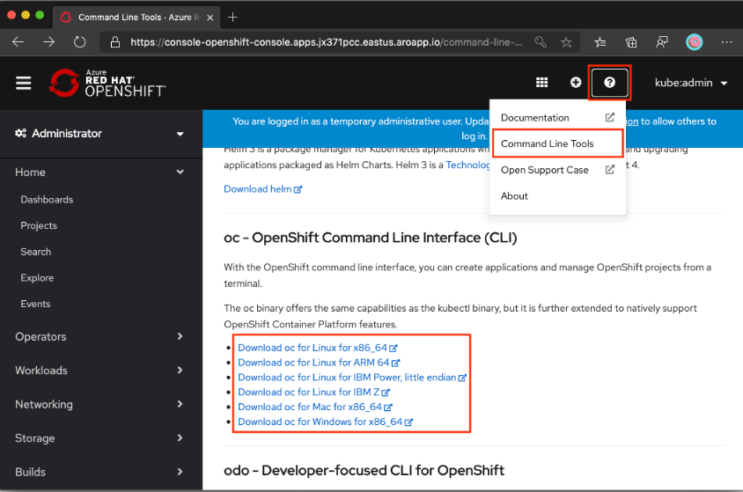
Install the OpenShift CLI
Connect to an Azure Red Hat OpenShift 4 cluster
cd ~
wget https://mirror.openshift.com/pub/openshift-v4/clients/ocp/latest/openshift-client-linux.tar.gz
mkdir openshift
tar -zxvf openshift-client-linux.tar.gz -C openshift
echo 'export PATH=$PATH:~/openshift' >> ~/.bashrc && source ~/.bashrc

Slide 20

Connect using the OpenShift CLI
Connect to an Azure Red Hat OpenShift 4 cluster
apiServer=$(az aro show -g $RESOURCEGROUP -n $CLUSTER --query apiserverProfile.url -o tsv)
oc login $apiServer -u kubeadmin -p <kubeadmin password>

Slide 21
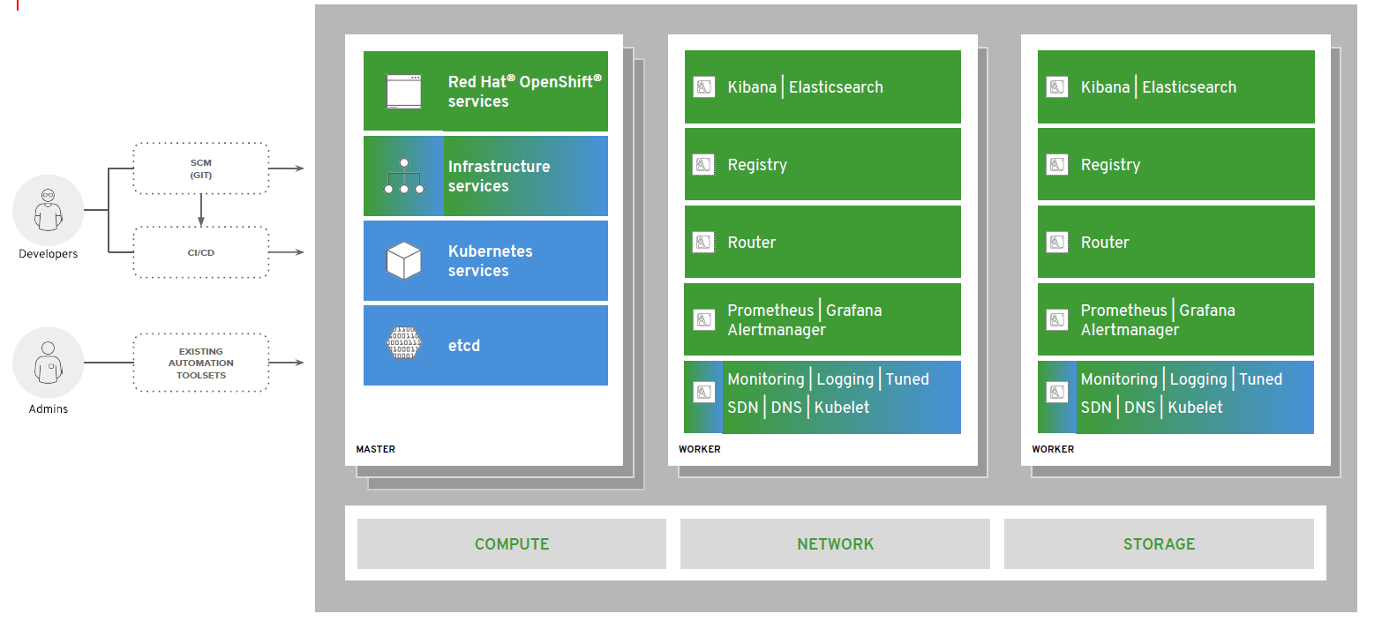
Architectural Overview
OpenShift Container Platform

Slide 22
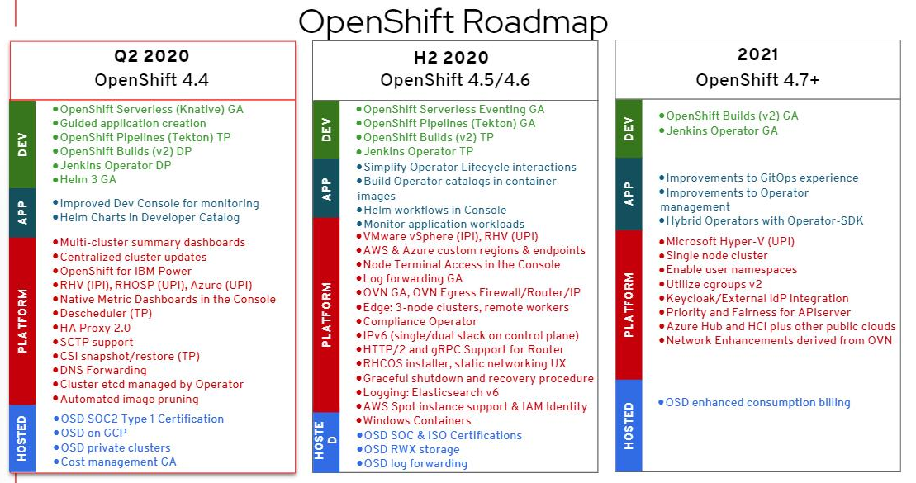

Slide 23

THANK YOU!

