Slide 1

Dr. Medica
Get Healthy With Dr.Medica

Slide 2
GROUP MEMBER NAMES :
NAME PRN
1. Vishal A Burud 20UCS027
2. Prerana B Dudhane 20UCS045
3. Manali M Kavade 20UCS072

Slide 3
CONTENT :
Introduction
Objectives
Requirements
Methodology
Application
Future Scope
References

Slide 4
What is the use of Dr. Medica?

Slide 5
INTRODUCTION :
Nowdays , everyone is concerned about their health. But they don’t have enough knowledge to take first care for any health issue.
So our system recommend the medicine for the first-care but after first-care they have to take doctor suggestion properly for safety purpose.
The main goals of health recommender systems are to retrieve trusted health information from the Internet , People are looking for appropriate health information which they are concerned about.
The Internet is great resource of this kind of information , but we have to be careful if we don’t want to get harmful information.
In this way , our technology helps the people about medicine consumption and also aware them about use of that medicine.

Slide 6
OBJECTIVE :
To create software which is based on medicine text recognization on medicine wrapper.
The main goals of health recommender systems are to retrieve trusted health information from the Internet.
Our system recommend the medicine for first-care.
A place where hospitals not available easily.
For the traveller’s.
Use for normal/daily based symptoms

Slide 7
REqUIREMENT :
Hardware:
Computer
Database:
Medicine information
Software:
Operating System
Editor – VS code
Languages : HTML , CSS , JavaScript , PHP
Input :
Disease name
Medicine wrapper image
Output:
Medicine name and it’s details

Slide 8
Methodology :
Input:
Search for disease
Medicine wrapper image
Compare the Disease with database
Retrieve data related to Disease
Output:
Display Medicine name and it’s Details

Slide 9
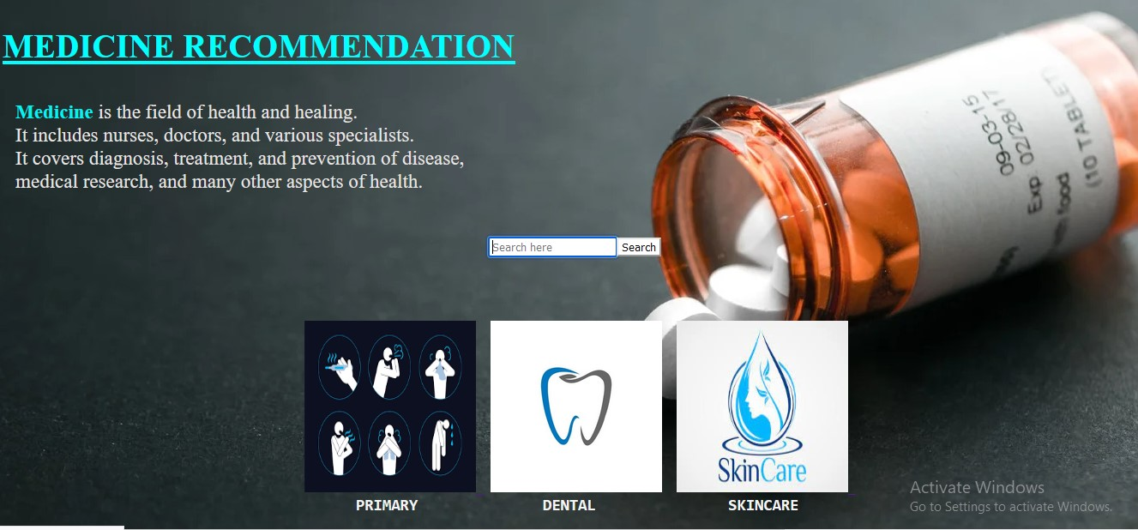
Dr. Medica

Slide 10
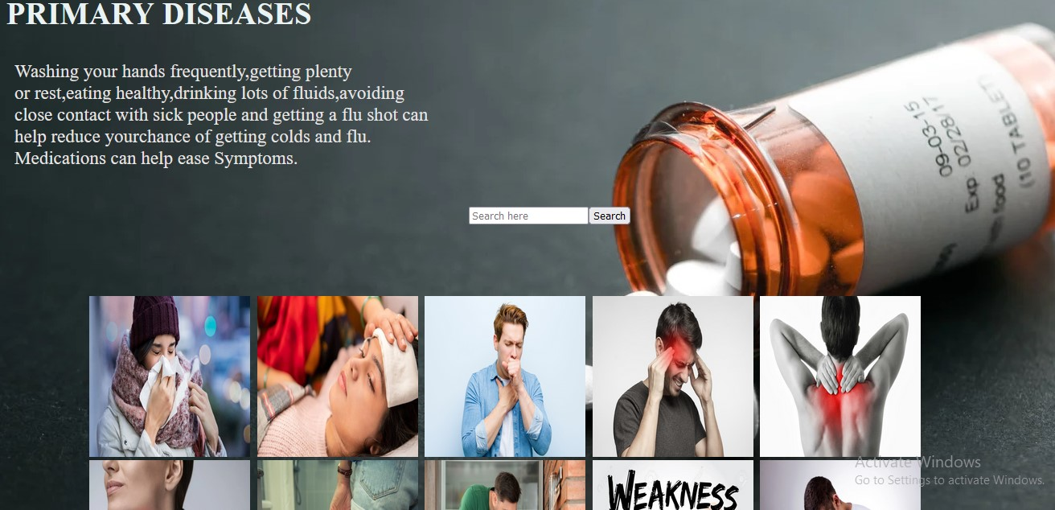
Primary disease

Slide 11
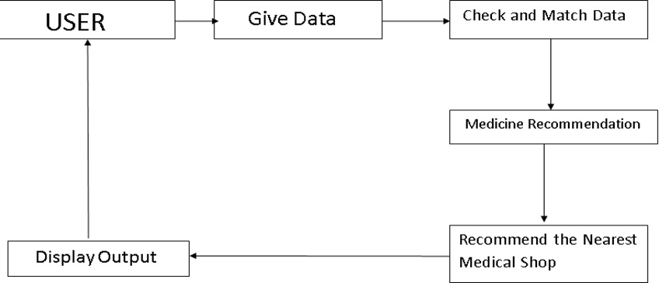
BLOCK DIAGRAM OF MEDICINE RECOMMENDATION SYSTEM

Slide 12
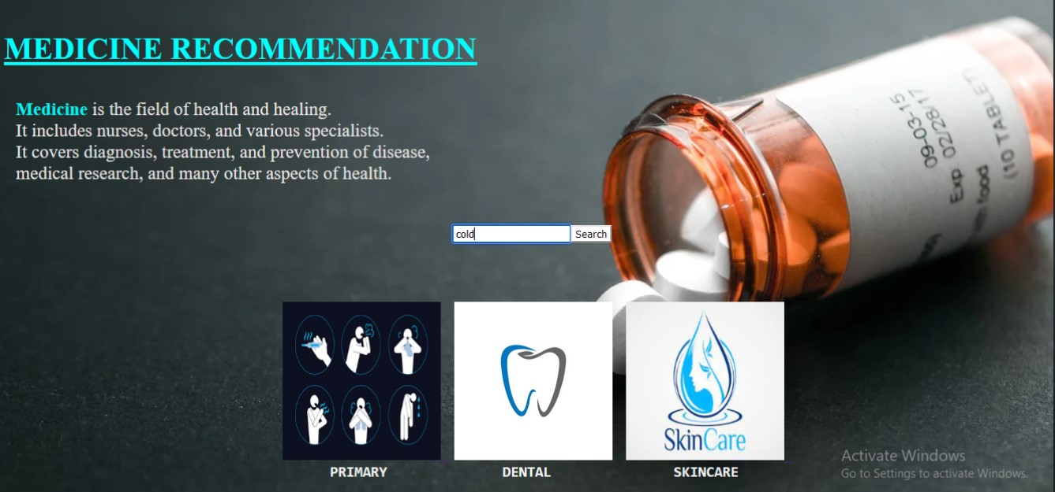
SAMPLE INPUT IMAGE :

Slide 13
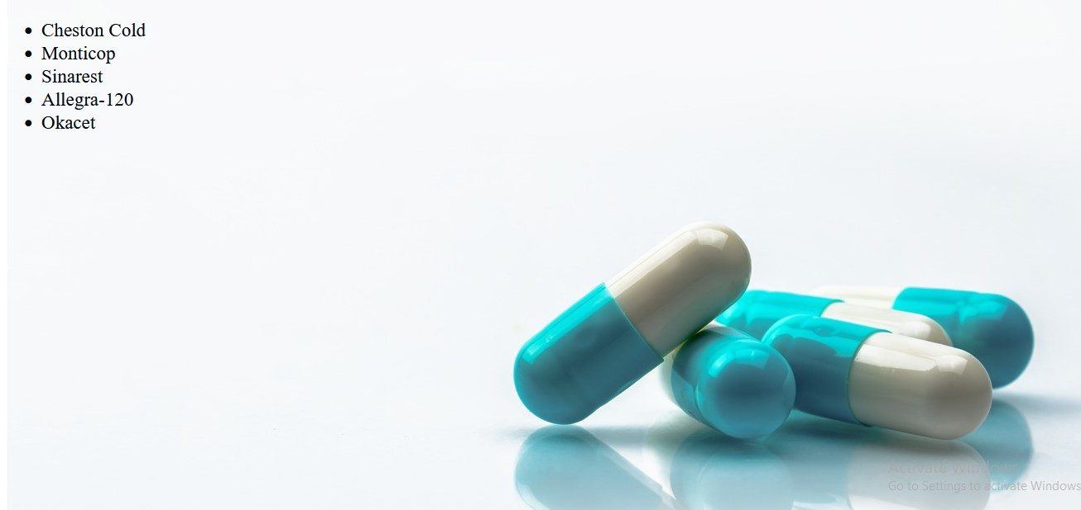
SAMPLE OUTPUT :

Slide 14
APPLICATION :
This software is helpful for recommend the proper medicine details regarding the disease.
It is easy to handle.
This software is useful for illiterate people.
It is a time saving software for primary symptoms.

Slide 15
FUTURE SCOPE :
In future we can add other features in like
Doctor appointment -
Taking a online doctor appointment.
Voice Technology
We can give input in various languages.

Slide 16
REFERENCE :
Markov Decision-based Recommender System for Sleep Apnea Patients.
Content-bootstrapped Collaborative Filtering for Medical Article Recommendations.
A Recommender System to Help Discovering Cohorts in Rare Diseases

