Slide 1


Predicting Drug Combination Activity
Novartis Discoverathon 2026 Team Sanjeevani
Challenge 1
Topic : Oncology
Dataset: NCI-ALMANAC
Target: COMBO_SCORE
Priyanka Yadav Mentor
Alupana Balaji Reddy Team Lead
Harish P S Team Member
Sudhish Gupta Team Member

Slide 2
Molecular Features & Feature Representation
Converting chemical structure and experimental context into an ML-ready representation
2.87M | 105 | 5,242 | 60 | 107
Valid observations | Unique drugs | Drug pairs | Cancer cell lines | Model features
Dataset
NCI-ALMANAC
Drug 1
Drug 1 features
Biological Data
Experimental Data
Chemical structure /SMILES
MW • LogP • HBD HBA • topology • …
Drug-pair Representation
RDKit
FINAL FEATURE VECTOR → ML MODEL
Molecular Descriptors
[A₁ … A₁₂ | B₁ … B₁₂]
trained ML model uses 107 input features
Drug 2
Drug 2 features
Chemical structure /SMILES
MW • LogP • HBD HBA • topology • …
Predicted SCORE

Slide 3
Objectives - From data to reliable prediction
A reproducible workflow for predicting and evaluating drug-combination activity
01
Dataset
02
Features
03
Prediction
04
Evaluation
05
Explainability
NCI-ALMANAC
Clean
Preprocess
RDKit descriptors:
Drug-pair +
biological +
experimental
features
ML models Reproducible
Train
Validation
Test splits
Random split
Cold combination
Cold cell line
Cold drug
Feature importance SHAP
Training-data effect
Evaluation Design
1. RANDOM
Baseline
Seen distribution
2) COLD-COMBINATION
Main task
Drug pair absent from training
3) COLD-CELL-LINE
Biological transfer
Cell line absent from training
4) COLD-DRUG
Hardest test
Drug absent from training
RELIABLE DRUG-COMBINATION PREDICTION PIPELINE
Design principle: predict using molecular, biological and experimental information - without target-derived information.

Slide 4
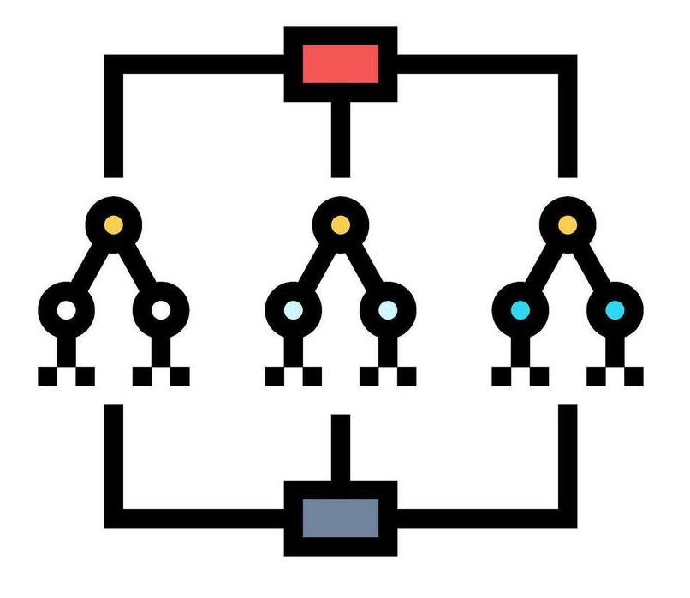

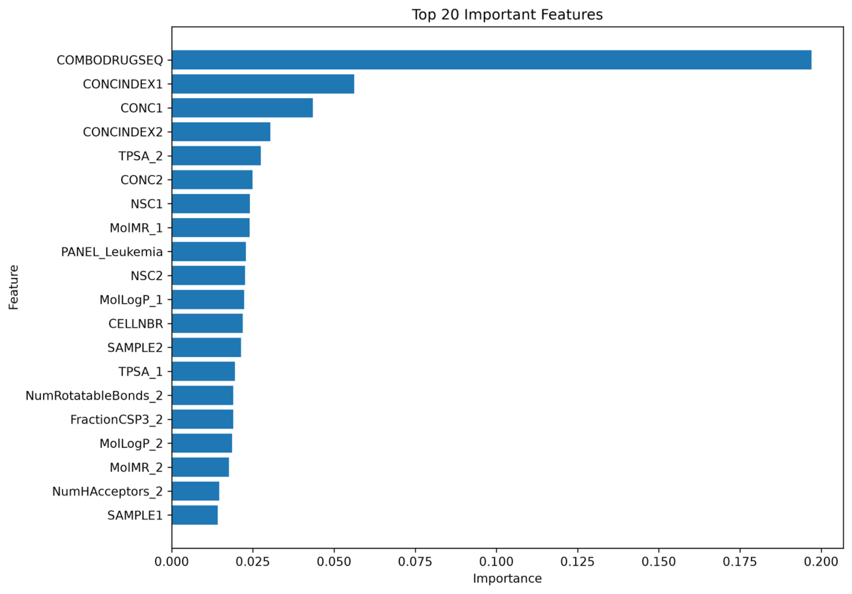

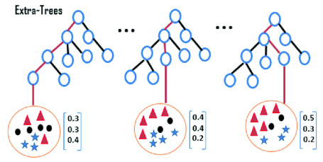
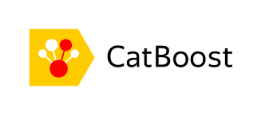
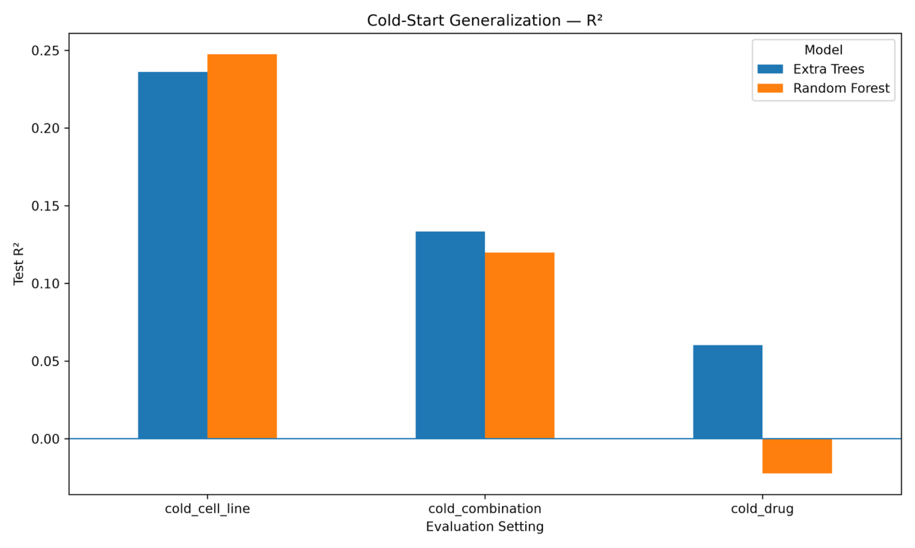
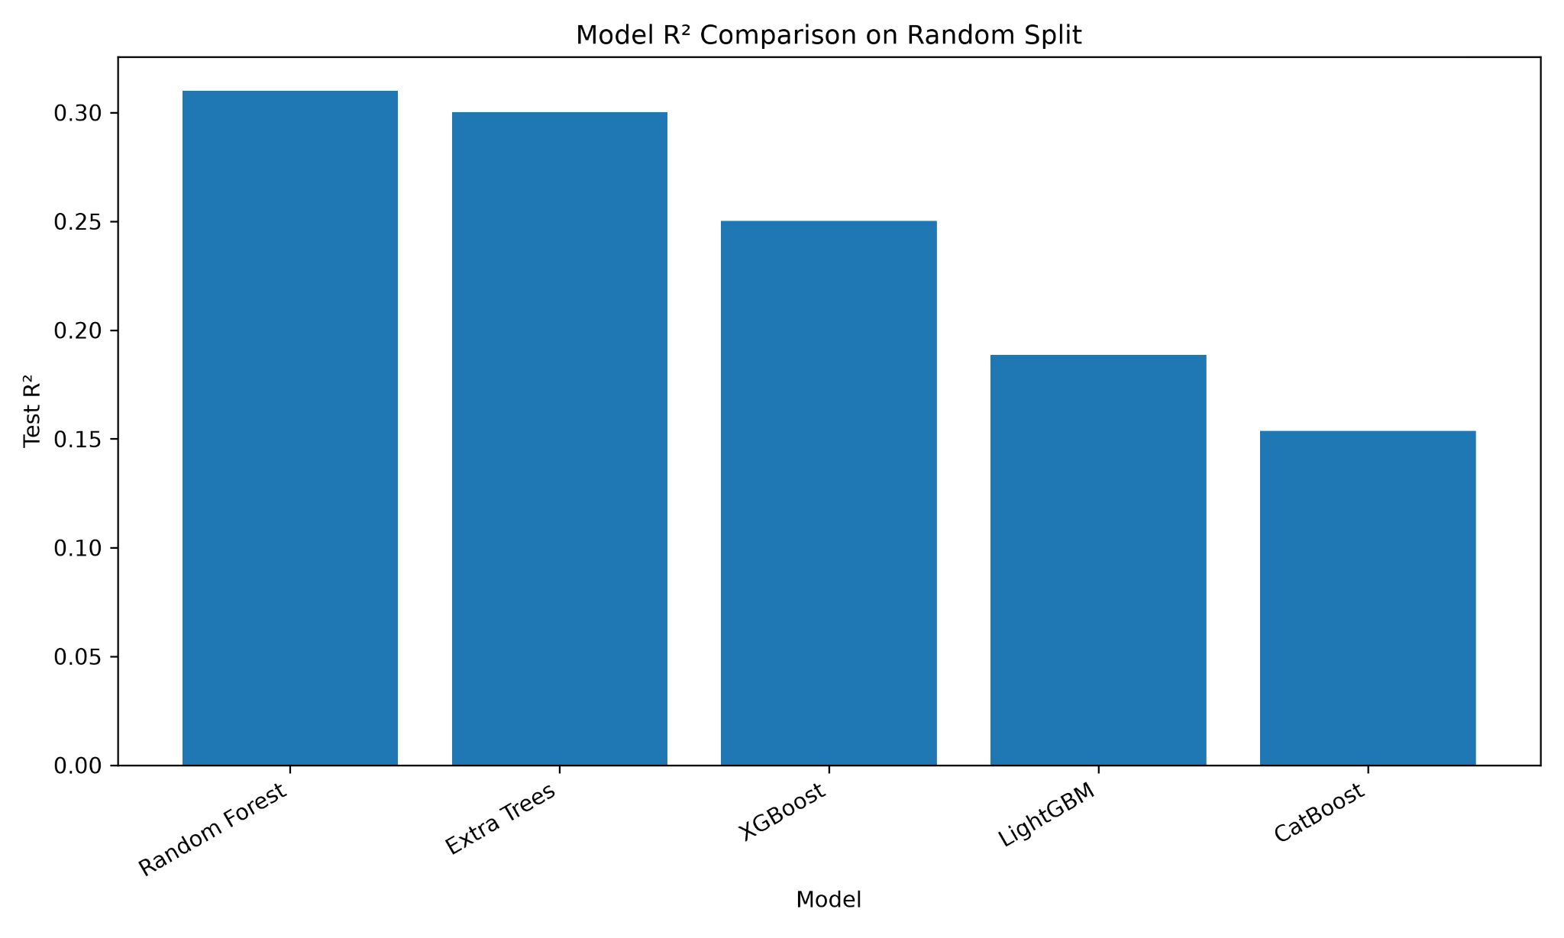
Machine Learning Model Selection & Final Model
Model Selection
Selected Model
Feature Selection
50 trees
max_depth = 25
random_state = 42
Random Forest and Extra Trees show positive R² for cold cell-line and combination settings.
Performance drops substantially for the cold-drug setting, indicating weaker extrapolation to unseen drug contexts.
COMBODRUGSEQ is the dominant feature, followed by concentration-related descriptors and molecular properties. The feature ranking suggests that drug-combination identity and molecular descriptors strongly influence prediction.

Slide 5
Robust Evaluation
Classification Metrics
Split | Precision@50 ↑ | Precision@100 ↑ | Recall@100 ↑ | nDCG@100 ↑ | Enrichment@100 ↑
Random | 0.8390 | 0.7825 | 0.1639 | 0.8120 | 7.8173
Cold Combination | 0.6417 | 0.5567 | 0.1163 | 0.5892 | 5.5611
Cold Cell Line | 0.9100 | 0.9033 | 0.0188 | 0.9172 | 9.0322
Cold Drug | 0.4367 | 0.4073 | 0.0505 | 0.4122 | 4.0710
Split | Macro-F1 ↑ | Balanced Accuracy ↑ | AUROC ↑ | AUPRC ↑ | MCC ↑
Random | 0.6455 | 0.6075 | 0.7970 | 0.4725 | 0.3686
Cold Combination | 0.5802 | 0.5621 | 0.7152 | 0.3267 | 0.2355
Cold Cell Line | 0.5918 | 0.5696 | 0.7335 | 0.3695 | 0.2733
Cold Drug | 0.5436 | 0.5385 | 0.6419 | 0.2306 | 0.1475
The model performs well under random splitting but shows reduced performance in cold-start settings, particularly for unseen drugs. This indicates strong learning of known patterns, while generalization to novel drug–combination spaces remains a key challenge

Slide 6
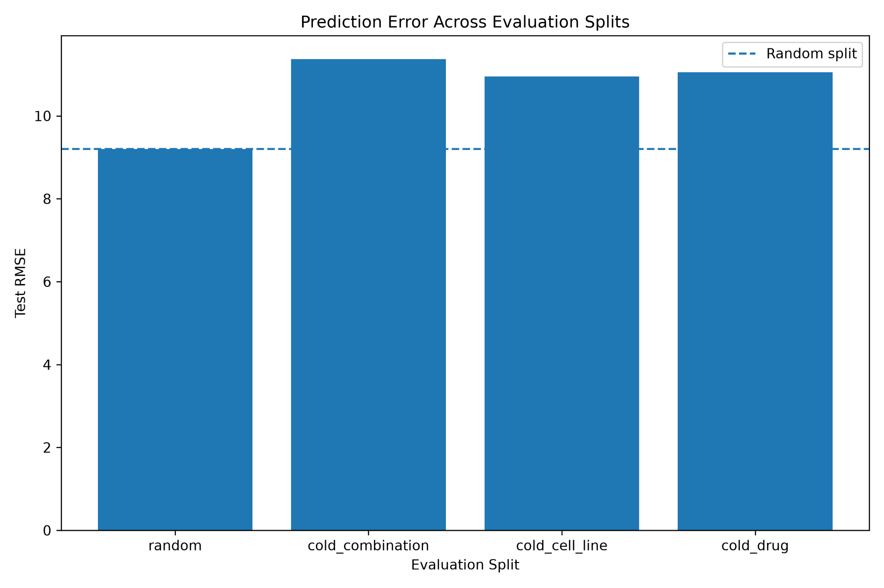
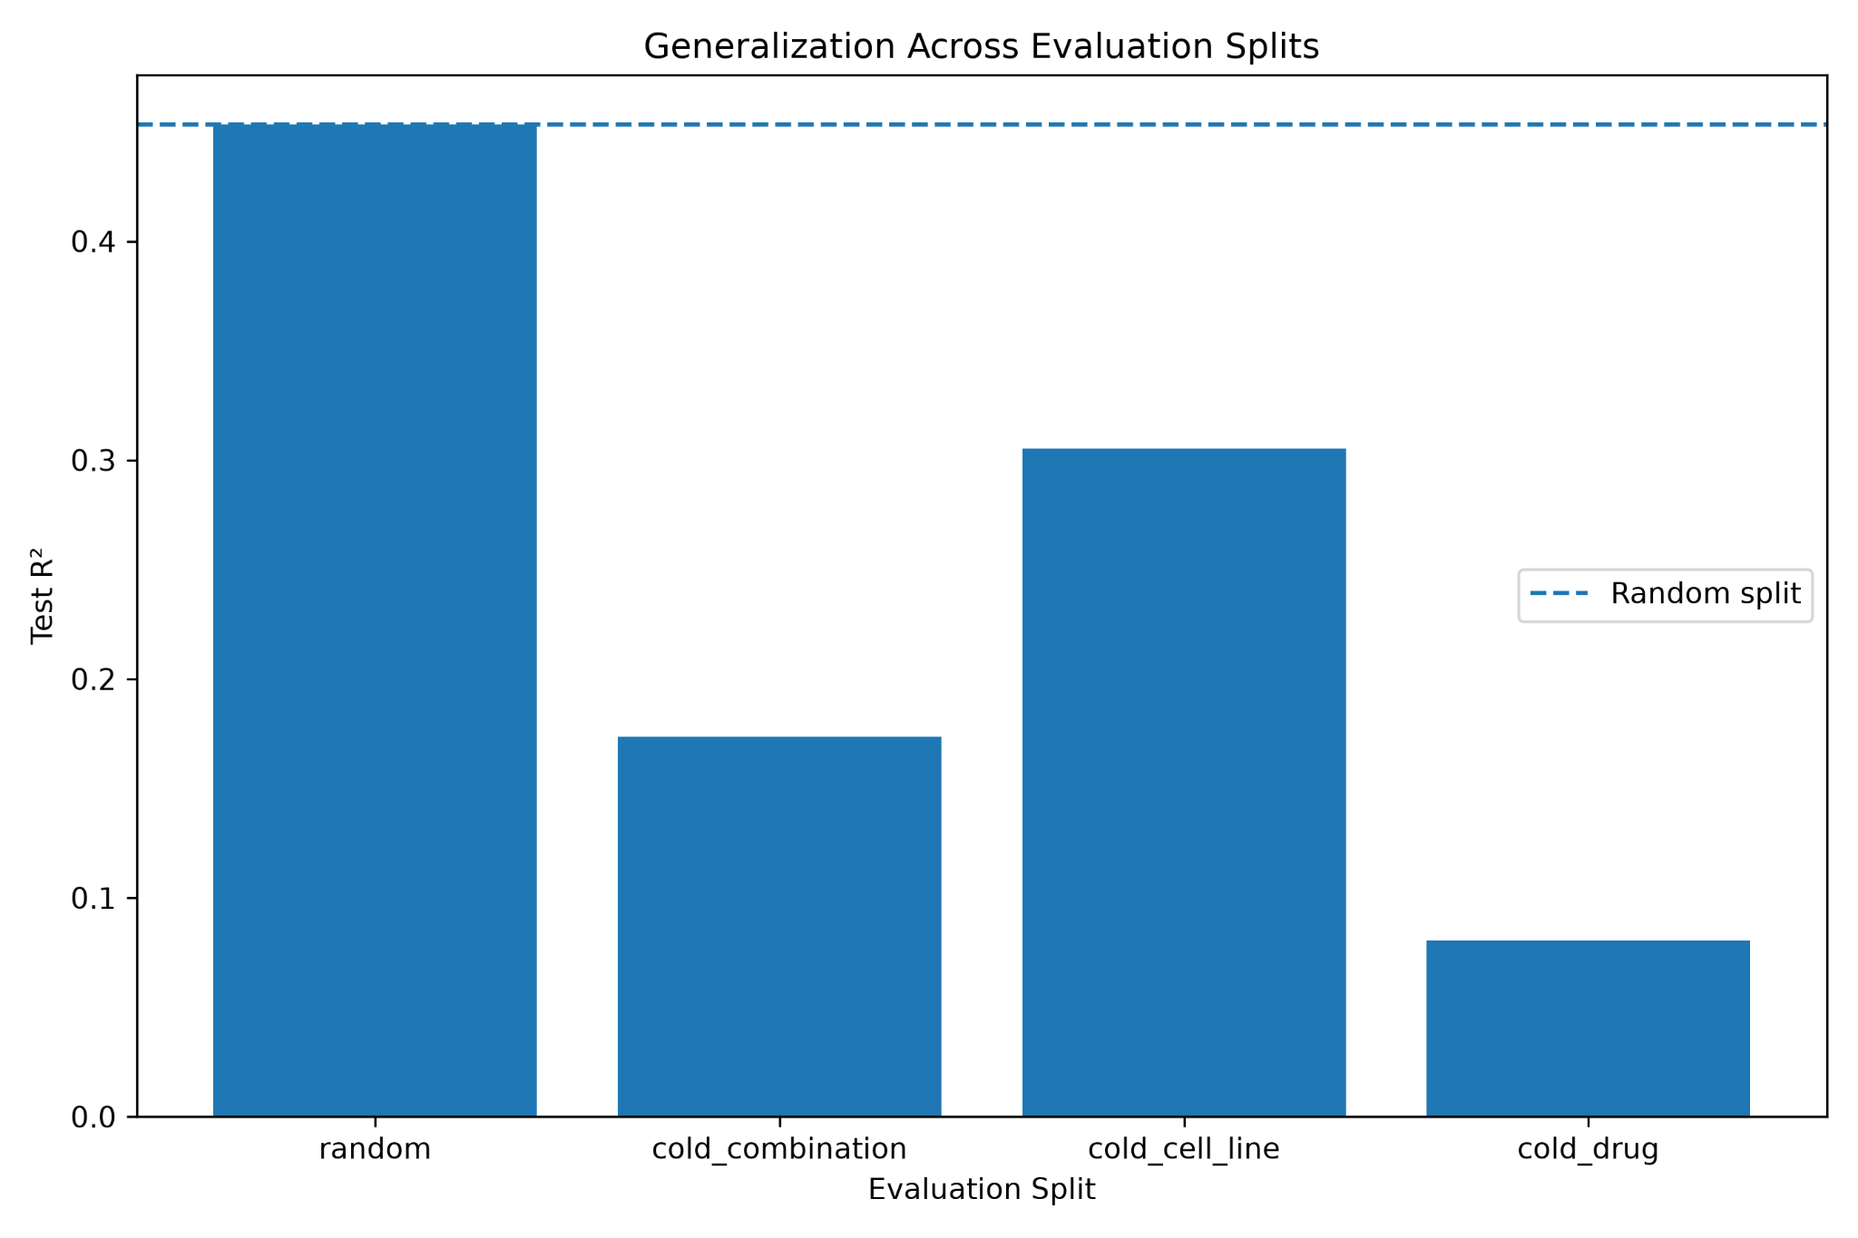
Machine Learning Model Evaluation
Generalization, data efficiency, prediction error, feature importance and model comparison
Split | MAE | MAE Gap vs Random | R² Gap vs Random
Random | 6.2009 | 0.0000 | 0.0000
Cold Combination | 7.1638 | +0.9629 | −0.2798
Cold Cell Line | 6.8105 | +0.6096 | −0.1480
Cold Drug | 7.3559 | +1.1550 | −0.3729
Random → Cold Combination → Cold Cell Line → Cold Drug
Cold Combination MAE Gap
7.1638 − 6.2009 = +0.9629
Cold Drug
7.3559 − 6.2009 = +1.1550
Cold Cell Line
6.8105 − 6.2009 = +0.6096
Largest MAE gap: Cold Drug
Key message: tree-based models provide useful predictive performance, but cold-start generalization remains challenging, especially for unseen drug settings.

Slide 7
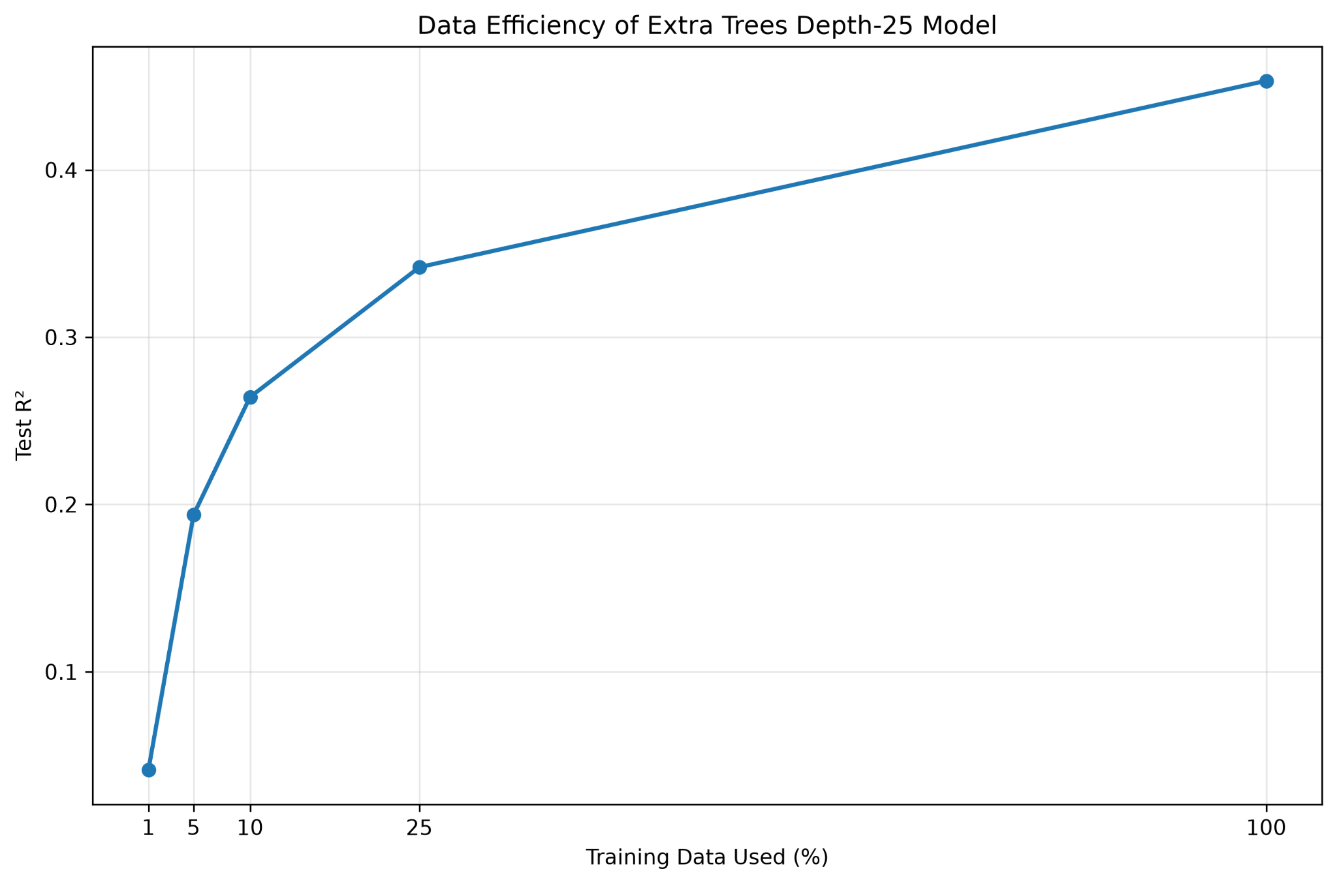
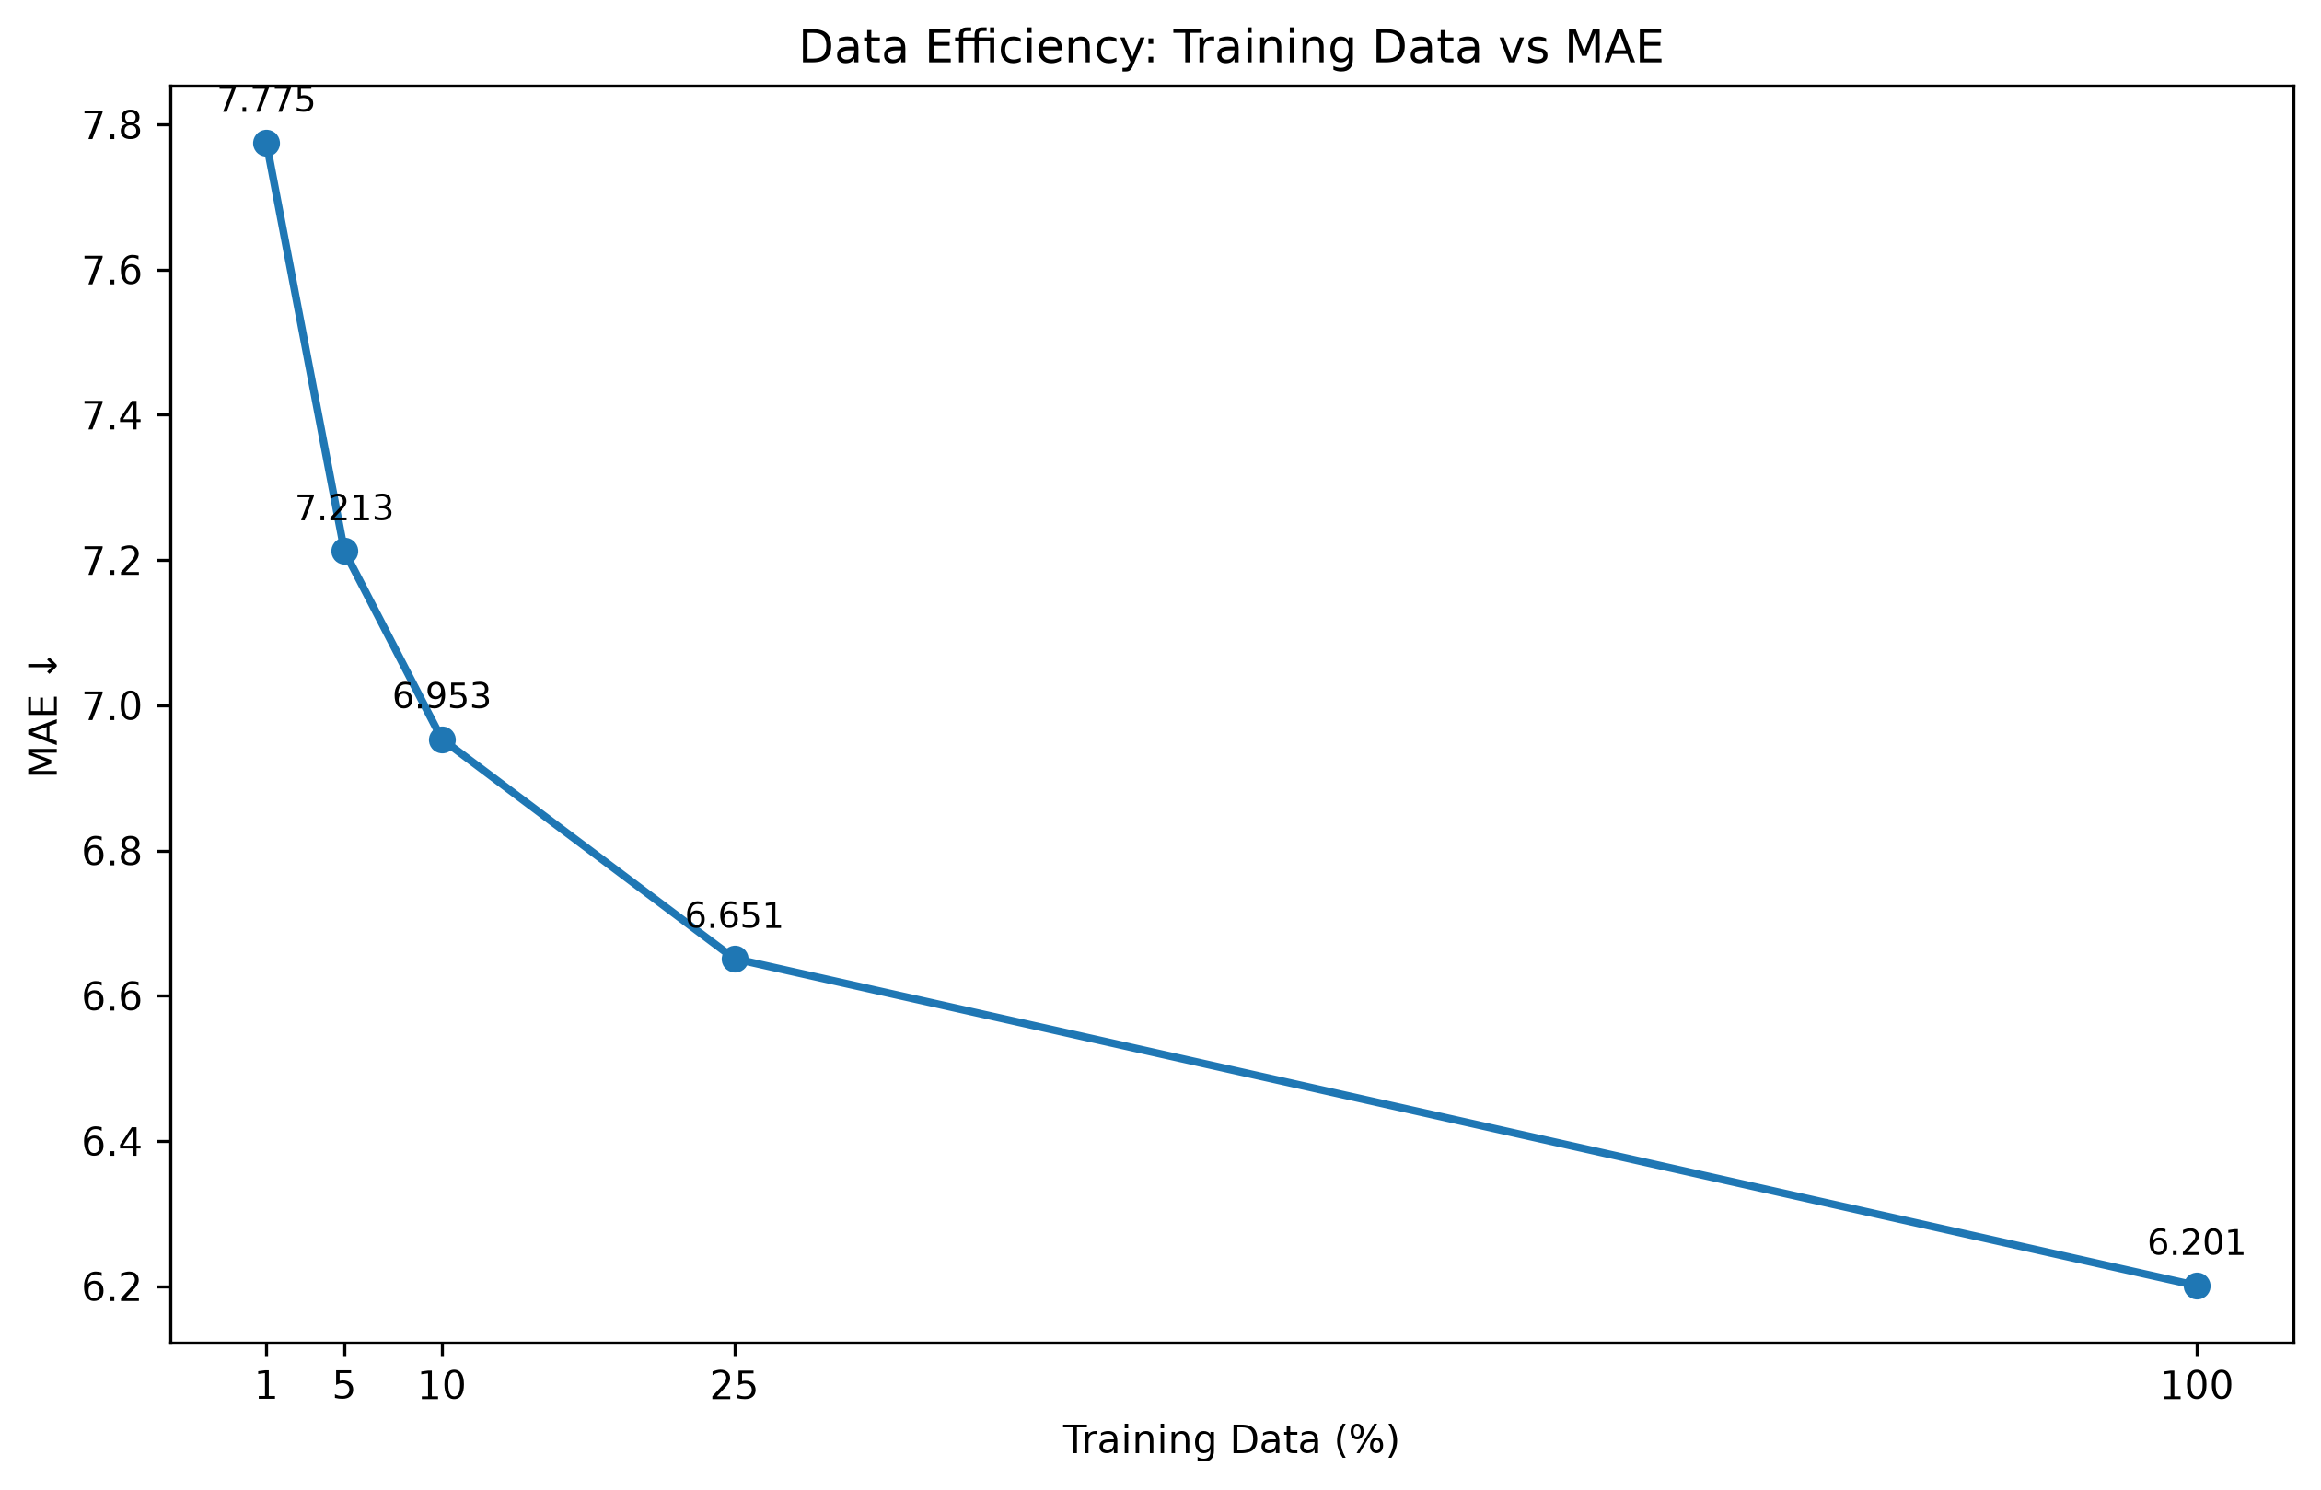
Machine Learning Model Evaluation
Generalization, data efficiency, prediction error, feature importance and model comparison
Effect of training-data size on Extra Trees prediction performance
Training data | Samples | MAE ↓ | RMSE ↓ | R² ↑
1% | 22,971 | 7.7750 | 12.1800 | 0.0413
5% | 114,857 | 7.2126 | 11.1691 | 0.1938
10% | 229,715 | 6.9535 | 10.6704 | 0.2642
25% | 574,288 | 6.6511 | 10.0917 | 0.3419
100% | 2,297,155 | 6.2009 | 9.1981 | 0.4532
The model gains most of its predictive capability from the first 10–25% of the training data.
At 25% of the data, R² reaches roughly 0.34, while the full dataset reaches about 0.45.

Slide 8
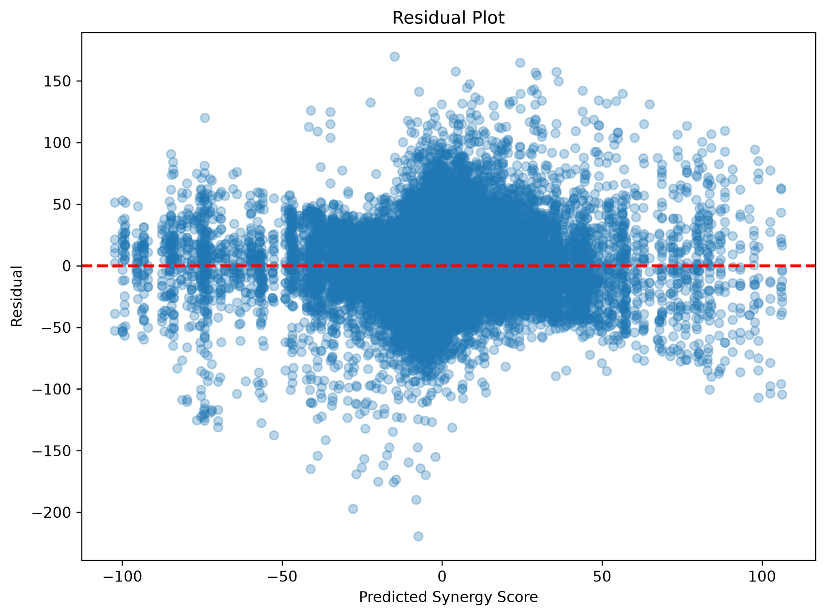
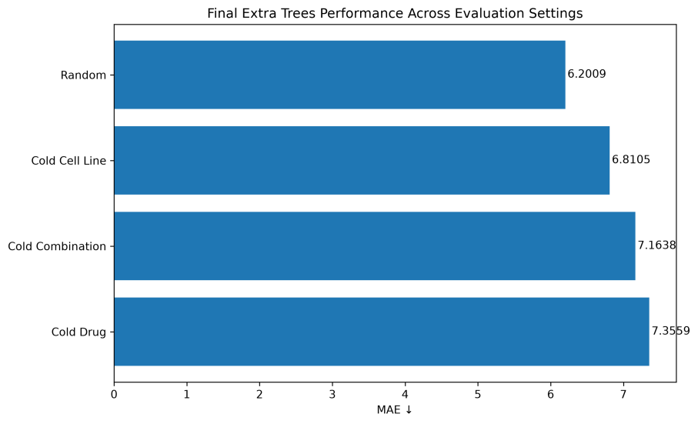
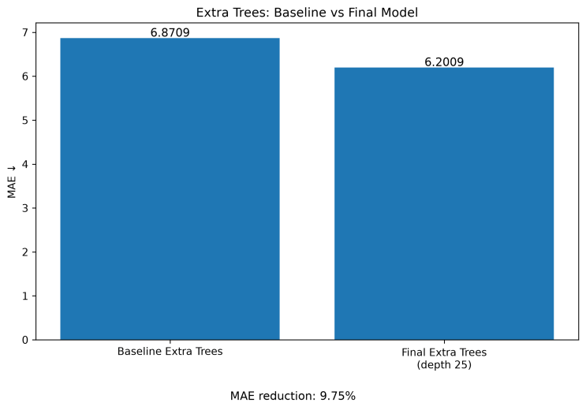
Explainability & Drug Prioritization
Model / Split | MAE ↓ | RMSE ↓ | R² ↑ | Pearson ↑ | Spearman ↑
Extra Trees — Random | 6.2009 | 9.1981 | 0.4532 | 0.6770 | 0.5395
Extra Trees — Cold Combination | 7.1638 | 11.3680 | 0.1735 | 0.4177 | 0.3815
Extra Trees — Cold Cell Line | 6.8105 | 10.9512 | 0.3052 | 0.5540 | 0.4260
Extra Trees — Cold Drug | 7.3559 | 11.0555 | 0.0804 | 0.3175 | 0.2960
SHAP analysis identifies the features driving model predictions..
Predicted scores can be used to rank drug combinations for follow-up experiments.
High Precision and Enrichment indicate that the model can concentrate promising candidates near the top of the ranking.
Interpretability provides a bridge from predictive modeling to actionable drug-discovery decisions.
Table: Regression performance of the Extra Trees model across random and cold-start evaluation settings

Slide 9
09
Overall Findings
Generalization
Performance decreases under cold-start settings, with cold-drug prediction being the most challenging.
Data efficiency
MAE falls from 7.78 → 6.20 as training data increases from 1% → 100%.
Prediction error
MAE steadily decreases as training data increases, confirming benefit from additional examples.
Features
COMBODRUGSEQ is the dominant predictive feature, with molecular and concentration descriptors also contributing.
Model choice
Targeted optimization improved Extra Trees to the final MAE of 6.20, outperforming its baseline performance

Slide 10
Impact, Limitations & Future Directions
Key Assumptions
Molecular, experimental and cell-line features capture relevant activity signals.
SCORE reliably represents drug-combination activity.
Limitations & Uncertainty
Generalization is limited for unseen drugs and out-of-distribution samples.
Dataset bias and experimental variability may affect predictions.
Methodological Risks
Data leakage and distribution shift can inflate apparent performance.
Feature association ≠ biological causation; predictions require experimental validation.
Future Directions
Richer biological & molecular representations: Integrate molecular fingerprints/GNNs with genomic, omics, target and pathway information
Uncertainty-aware active learning: Quantify prediction confidence and iteratively prioritize the most informative experiments
ML prioritizes candidates — Experimental validation remains essential
AI Acknowledgement : ChatGPT Go is used for code assistance, debugging and documentation; all scientific decisions and conclusions were validated by project team
Thank You !
Team Sanjeevani

