Slide 1
ALURU VASU
Final Project
3/21/2024 Annual Review
<number>

Slide 2
PROJECT TITLE
KEY LOGGER AND SECURITY
3/21/2024 Annual Review
<number>

Slide 3


AGENDA
S.NO | TOPICS
1 | INTRODUCTION TO KEYLOGGERS
2 | PROBLEM STATEMENT
3 | PROJECT OVERVIEW
4 | WHO ARE THE END USERS
5 | YOUR SOLUTION AND ITS VALUE PROPOSITION
6 | THE WOW IN YOUR SOLUTION
7 | MODELLING
8 | RESULTS
3/21/2024 Annual Review
<number>

Slide 4
INTRODUCTION TO KEYLOGGERS
A keylogger or keystroke logger/keyboard capturing is a form of malware or hardware that keeps track of and records our keystrokes as we type. It takes the information and sends it to a hacker using a command-and-control (C&C) server. The hacker then analyzes the keystrokes to locate usernames and passwords and uses them to hack into otherwise secure systems.
Types of Keyloggers
SOFTWARE KEYLOGGER
Software keyloggers consist of applications that have to be installed on a computer to steal keystroke data. They are the most common method hackers use to access a user’s keystrokes.
A software keylogger is put on a computer when the user downloads an infected application. Once installed, the keylogger monitors the keystrokes on the operating system you are using, checking the paths each keystroke goes through. In this way, a software keylogger can keep track of your keystrokes and record each one.

Slide 5
HARDWARE KEYLOGGERS
A hardware keylogger works much like its software counterpart. The biggest difference is hardware keyloggers have to be physically connected to the target computer to record the user's keystrokes. For this reason, it is important for an organization to carefully monitor who has access to the network and the devices connected to it.
If an unauthorized individual is allowed to use a device on the network, they could install a hardware keylogger that may run undetected until it has already collected sensitive information. After hardware keystroke loggers have finished keylogging, they store the data, which the hacker has to download from the device.

Slide 6

PROBLEM STATEMENT
In today's digital age, cybersecurity threats pose a significant risk to individuals and organizations alike. One such threat is the proliferation of keyloggers, both in the form of software and hardware, which clandestinely capture keystrokes made by users on computers and mobile devices. These keyloggers, when deployed maliciously, can compromise sensitive information, including passwords, credit card details, and confidential communications.
While keyloggers can have legitimate uses, such as monitoring employee activity or parental control, their potential for misuse underscores the importance of developing robust security measures to protect against unauthorized access and exploitation. Furthermore, the ethical and legal implications of keyloggers necessitate careful consideration to ensure compliance with privacy regulations and respect for individual rights.
3/21/2024 Annual Review
<number>

Slide 7

PROJECT OVERVIEW
A Key Logger is a tool that captures and records all user inputs with the keyboard.It means that recording every keystroke is made and buttons clicked. This information will be stored in a text file,which is a readable format.It also capable of tracking and recording the user's online activities.
For instance,if a user opens chrome and search for a image(as like "nature images"),
then in the text file it will be stored as['n''a''t''u''r''e'Key.space'i''m''a''g''e''s'Key.enter]
This comprehensive data collection provides a detailed overview of user's activities.
Make sure that use of such tools must comply with legal privacy rules and ethical guidelines.
Unauthorized use of keyloggers can lead to severe legal consequences.
3/21/2024 Annual Review
<number>

Slide 8

WHO ARE THE END USERS?
Legitimate Security Professionals: Many security professionals and IT administrators may use keyloggers as a part of their job to monitor and track activities on company devices to ensure compliance, prevent data breaches, or investigate security incidents.
Parents: Concerned parents may use keyloggers to monitor their children's online activities and ensure they are safe from online predators or engaging in appropriate behavior.
Employers: Employers may use keyloggers to monitor employees computer activities to ensure they are staying productive, following company policies, or not engaging in any activities that could harm the company's reputation or security.
Cybercriminals: Unfortunately, cybercriminals can also be end users of keyloggers, often for malicious purposes such as stealing sensitive information like login credentials, financial data, or personal information for identity theft or other nefarious activities.
3/21/2024 Annual Review
<number>

Slide 9

YOUR SOLUTION AND ITS VALUE PROPOSITION
Antivirus and Anti-malware Software: Utilizing reputable antivirus and anti-malware software can help detect and remove keyloggers and other malicious software from devices.
Encryption: Encrypting sensitive data even at rest and in transit can prevent unauthorized access including keyloggers.
Regular software update management: Keeping operating systems, applications and security software up-to-date with latest versions can help protect against known vulnerabilities that keyloggers may exploit.
User Education and Awareness: Educating users about the risks of keyloggers and other security threats, as well as providing training on safe computing practices, can help prevent installation or exposure to keyloggers.
3/21/2024 Annual Review
<number>

Slide 10

THE WOW IN YOUR SOLUTION
Multi-Layered Defense: The solution doesn't rely on a single security measure but combines multiple layers of defense, including antivirus software, firewalls, encryption, user education, access controls, and behavioral analysis. This multi-layered approach increases the effectiveness of the overall security posture.
Proactive Protection: Rather than merely reacting to security incidents after they occur, the solution emphasizes proactive measures such as regular software updates, patch management, and user awareness training. By staying ahead of potential threats, organizations can reduce the likelihood and impact of security breaches.
3/21/2024 Annual Review
<number>

Slide 11
MODELLING
IMPORT MODULES: Importing modules and libraries such as tkinter,pynput,json.
SETTING UP LOGGING: Configure logging settings to specify the format and destination of log and json files.
DEFINING KEYLOGGER FUNCTIONS: Creating function to capture and log keystrokes.
MAIN FUNCTION: This function is used to start the keylogger and keep it run indefinitely until user stops.
TESTING: Test the keylogger whether it captures keystrokes correctly or not.
DEPLOYMENT: Deploy the keylogger on target systems if necessary under legal and ethical considerations.
3/21/2024 Annual Review
<number>

Slide 12
Project link
https://github.com/AluruVasuGit/APSSDC_Final_Project.git

Slide 13
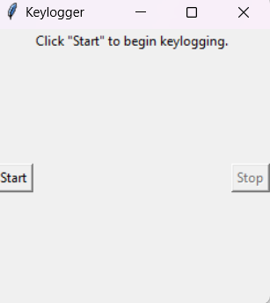
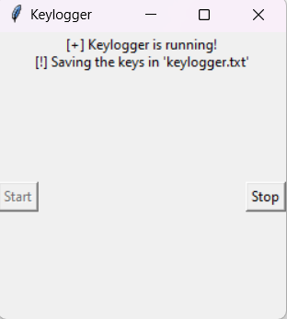
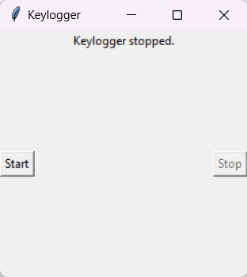
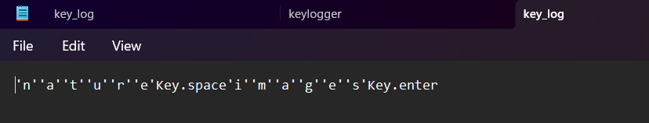
RESULTS
3/21/2024 Annual Review
<number>

