Slide 1
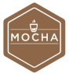









Development
Testing
Building
Deployment

Slide 2



Development
Testing
Building
Deployment
FTP Server

