Slide 1
Meta M1
Dataset configuration:
Car Insurance Data
Carlos Peña Martín & Alvar San Martín Liendo

Slide 2
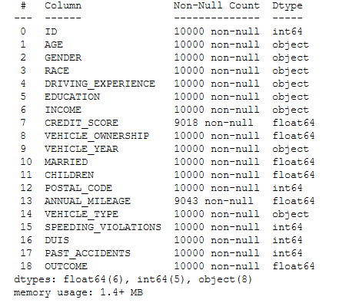
1. The dataset
The dataset chosen haves data from a insurance office in India, contains data about the costumers and a tag if the costumer claimed the insurance.
Contains exactly 10.000 instances.
Have a variety of datatypes:
Categorical: GENDER, EDUCATION, MARRIED…
Ordinal: AGE, EDUCATION
Numerical
Discrete: PAST_ACCIDENTS, DUIS…
Continuous: CREDIT_SCORE

Slide 3
2. Main tasks
Feature identification: Each column have to be defined with the correct datatype to:
Ensure integrity
Simplify the codification in the future
Data cleaning:
Unnecessary data can be deleted to sabe memory and time
Missing values must be replaced
Data visualization.

Slide 4
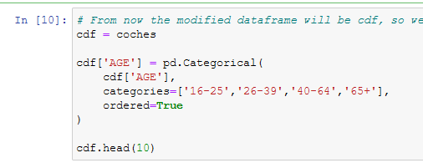
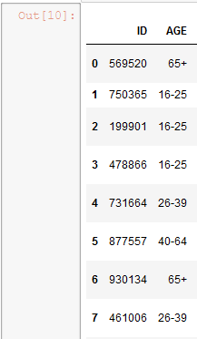
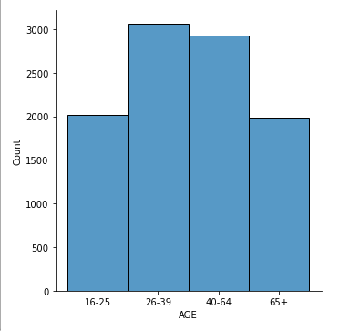
3. Feature identification
The data is analysed to find the correct type.
Example: AGE normally is a numerical feature but in this case is categorical, because the author defied ranges instead of the real age.
Age gets turned into a ordinal type so we can correctly visualize the data, otherwise we could not see the order correctly

Slide 5
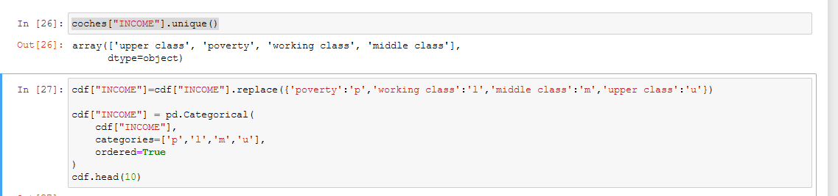
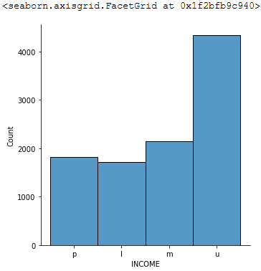
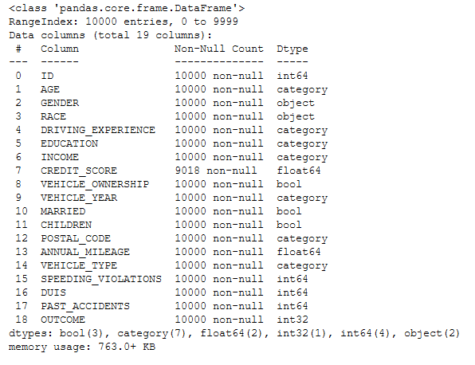
4. Data cleaning
The first case of data cleaning is the INCOME columns, there are only 4 options but a lot of memory is being used to store the whole name.
The dataset initially used 1.4MB, at the end 763KB, which is a 50% less.

Slide 6
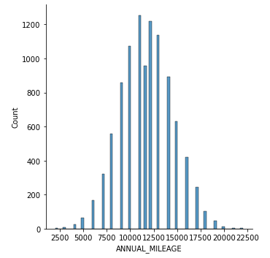
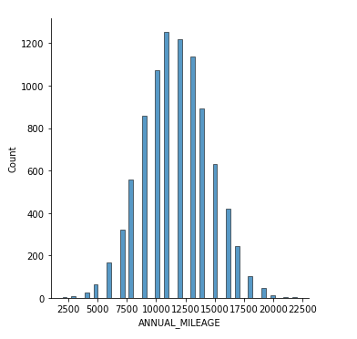
4. Data cleaning
The second part is the imputation of missing values, we have used 2 methods:
Mean
Hot-Deck by KNN
ANNUAL_MILEAGE gets missing data replaced with the mean and we can clearly see the before and after
10% of the values are in the same column, which contrast with the initial Gaussian distribution

Slide 7
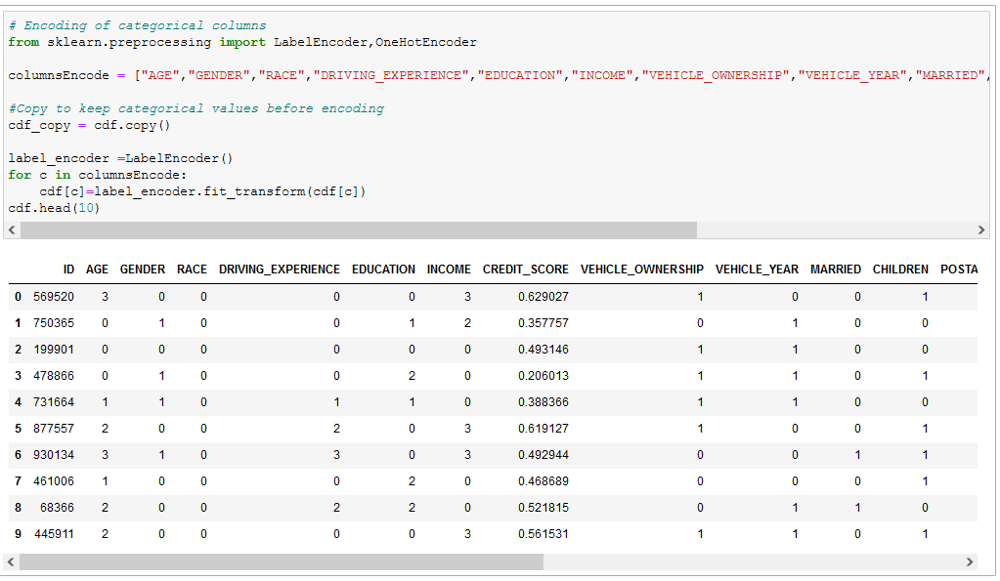
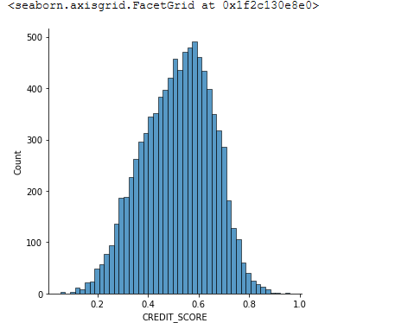
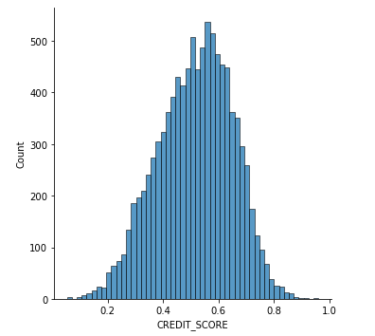
4. Data cleaning
We have also used Hot-Deck imputation, with the help of sklearn.
In this case we are using KNN with 2 neighbours to estimate the value of the CREDIT_SCORE
Previously we encode all the columns, which is possible in a single loop because the data was pre processed
The impact in the distribution is lower than the median method
Before - After

Slide 8
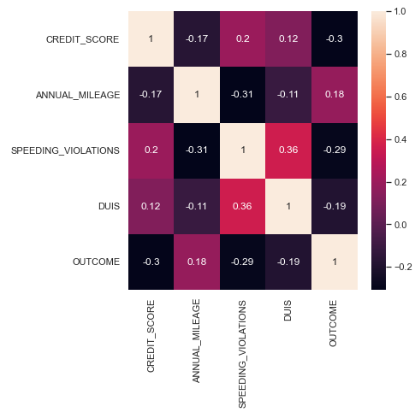
5. Data visualization
The first kind of visualization is a correlation matrix, is very important to understand the relevance of each feature, but only between the numeric features.

Slide 9
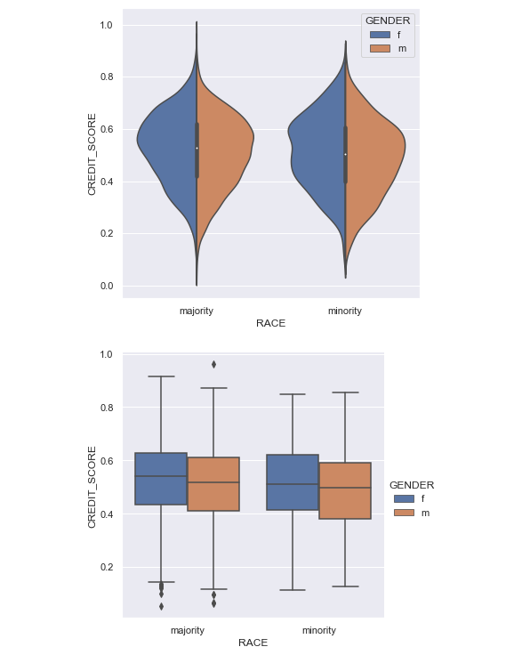
4. Data visualization
With the categorical data we can use a violinplot and boxplot to see the impact of the race, and specially the gender in the CREDIT_SCORE

Slide 10
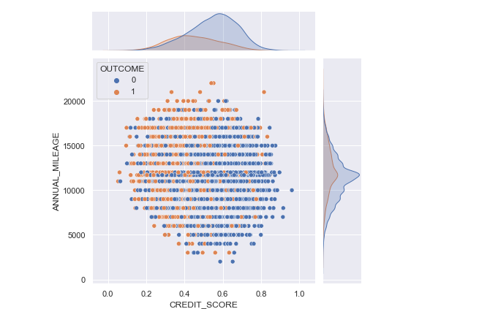
4. Data visualization
A very important visualization involves the OUTCOME, by ANNUAL_MILEAGE and CREDIT SCORE
We can notice higher insurance claims the greater the mileage and the lower the credit score

Slide 11
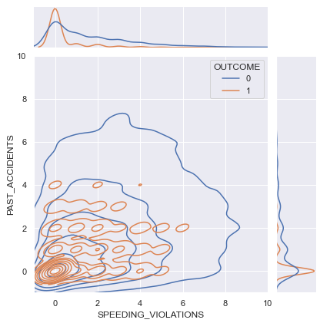
4. Data visualization
Trying to kind a relation between the PAST_ACCIDENTS and SPEEDING VIOLATIONS we can see a similar distribution but the negative outcome is related to more violations.

