Slide 1


Officer Involved Shootings
Joemichael Alvarez
Kevin Pierre

Slide 2
What is an officer involved shooting?
An officer involved shooting is the discharge of an officer’s firearm, whether intentional or not and whether on or off duty
This dataset only contains incidents where an officer discharged a firearm at another individual

Slide 3

Why does this data matter?
The FBI and CDC both admit that data on fatal shootings is incomplete.
In 2015, the Washington post began documenting officer involved shootings and concluded that over half of all fatal shootings were undocumented.

Slide 4
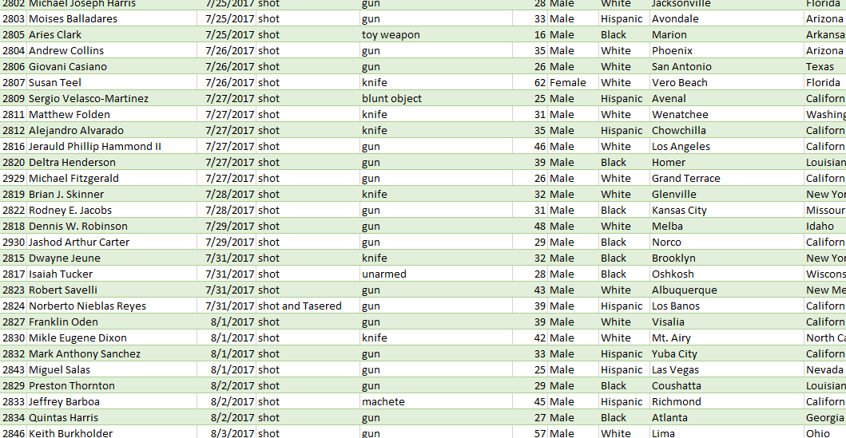
How was our data cleaned?
It was initially filtered to eliminate names labeled: TK TK (to come)
Labels under gender M/F were replaced by Male and Female
Labels under race A/B/H/O/N/W were replaced by Asian, Black, Hispanic, Other, Native American, and White respectively
While None under race was changed to Unknown

Slide 5
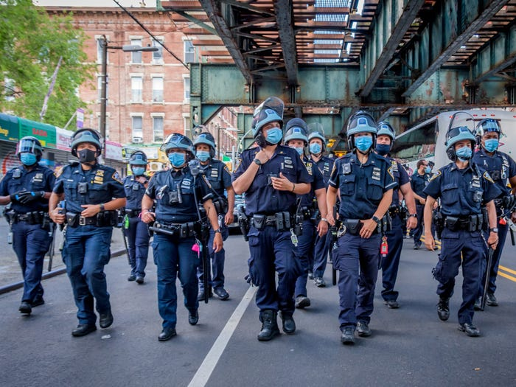
Conclusion
The data shows us several things: most people had a firearm, the average death per year is about 1,000, and the decrease of deaths over each year
Possible suggestion: Body cams might create more clarity in this data. Altering police training might result in less unarmed individuals from being shot
Unfortunately, some our data had missing names that would otherwise make the data less credible
Further investigation: How have FBI and CDC databases changed since the inception of third-party databases like this one

Slide 6
Sources
https://www.kaggle.com/datasets/mrmorj/data-police-shootings/metadata?select=fatal-police-shootings-data.csv
https://www.washingtonpost.com/graphics/investigations/police-shootings-database/
https://www.washingtonpost.com/national/how-the-washington-post-is-examining-police-shootings-in-the-united-states/2016/07/07/d9c52238-43ad-11e6-8856-f26de2537a9d_story.html

