Slide 1
Game Theory and Biotic Interactions

Slide 2
Rules of our game:
Everyone plays as a team
Each team plays against one other team
Each round, you will accumulate points representing your success
Before each round, each team can choose one of two options:
Cooperate
Betray
Do not let the other team see what your decision is before
When the referee says go, each team shows the other team their decision
You cannot change your decision after the cards are revealed
Players are then shuffled for the next round

Slide 3
Scoring:
Team 1
Cooperate
Betray
Team 1: 2 Team 2: 2 | Team 1: 3 Team 2: 0
Team 1: 0 Team 2: 3 | Team 1: 0 Team 2: 0
Cooperate
Team 2
Betray

Slide 4
Let’s pause and add a rule.

Slide 5
Additional rules:
Scores are now partially based on how many points you have
You do not have to reveal (or be honest) about how many points you have

Slide 6
Rules:
Team 1
Cooperate
Betray
Both teams: 3 | Team 1: The difference between teams’ scores
Team 2: The difference between the teams’ scores | Both teams: -1
Cooperate
Team 2
Betray

Slide 7
Let’s talk about what happened.

Slide 8
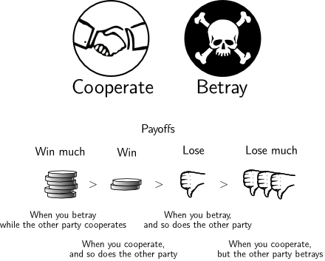
What strategy did you use the most?
Did you primarily cooperate?
Did you switch strategies at times?
Did you primarily betray?

Slide 9
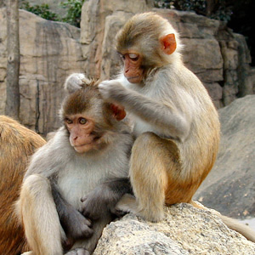
Game theory is an important concept in evolution.
Your game was called “the prisoner’s dilemma”.
Game theory isn’t just about games!
Organisms often compete with each other for food or resources
Sometimes, they learn to cooperate, and group behaviors evolve
Back scratching: cooperation!

Slide 10
Strategies in biology
Cooperation is common:
Mutualisms
Symbiosis
Group behaviors within species
Betrayal is also common:
Competition for resources
Predation
Parasitism

Slide 11
But how do your past experiences affect cooperation?
How did you treat people who betrayed you in the past?

Slide 12
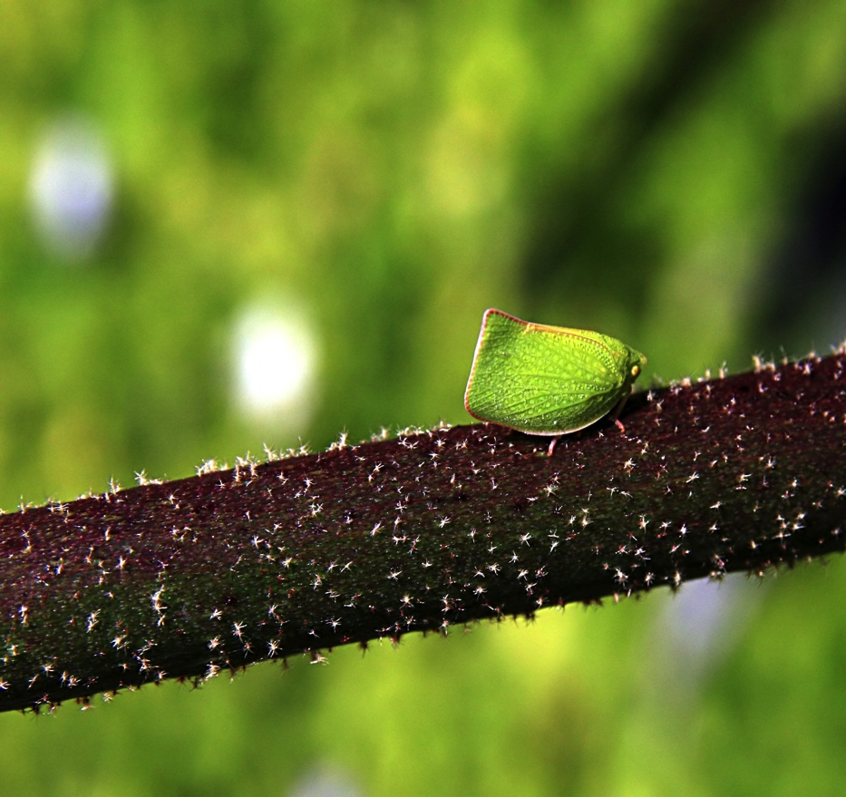
Strategies in biology
Lying happens too!
Mimicry
False signaling
Ambush predators
Collectively, these are “dishonest signals”
Cooperation often requires policing!
Non-cooperators are often punished for cheating
Wolves, primates, insects, etc.
Caution when cooperating outside of group

Slide 13
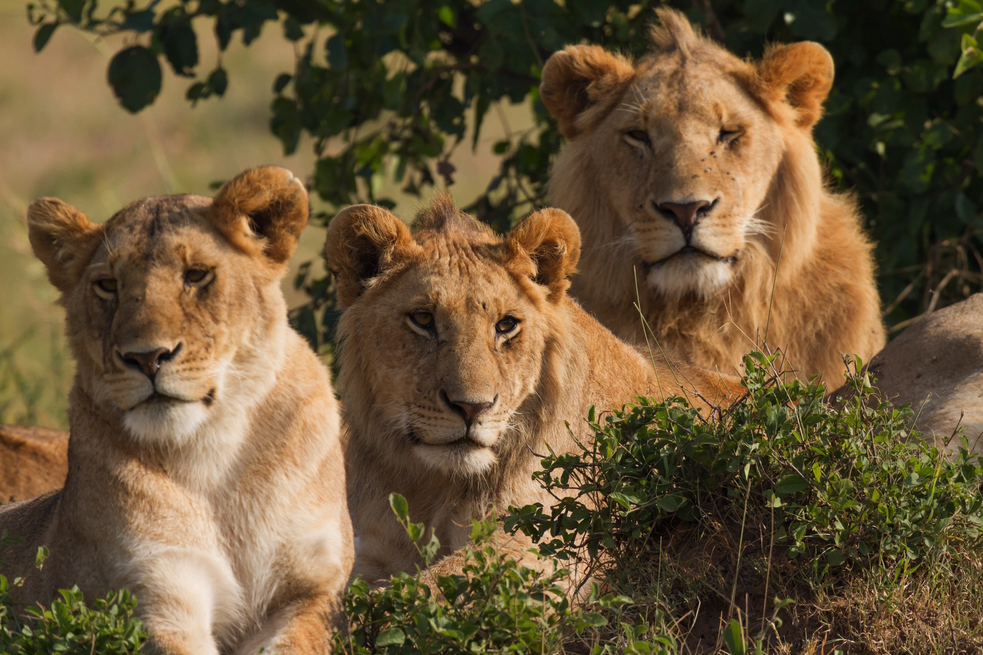
Scores in biology
Higher scores represent more resources (food, mates, etc.)
More resources translates into higher fitness
More fitness = better reproduction
Better reproduction = more players using one strategy
Environments are important in determining survival and reproduction
Abiotic environment: temperature, moisture, soil
Biotic environment: neighbors, competitors, friends

Slide 14
Optimal Strategies
The mathematically optimal strategy over time is called the Nash equilibrium
In biology, this can form an evolutionarily stable strategy, where all participants are using their optimal strategies, and natural selection removes others
What are some common strategies in your own ecosystem that seem to be stable?

Slide 15
Biotic interactions and humans
Do humans participate in biotic interactions?
How do humans change biotic interactions between other organisms?

Slide 16
Thanks for listening!

