Slide 1








[Company Name]
Report US Letter Template
[Month Year]
[Company Analysis or [Company and Peer Analysis]
Alvarez & Marsal Insight Center

Slide 2
Contents
Contents
Appendices
A | About A&M’s Insight Center | [ ]

Slide 3
Section title to go here

Slide 5

Appendix
Section title to go here

Slide 6

Need More Information?
We can add additional custom content and analysis above and beyond the quantitative data from Capital IQ. Below are some of our frequent requests:
Products and Services
Strategic Initiatives
Key Issues and Challenges
Industry/Market Overview
Management and Analyst Perspective
Recent Litigation
Activist Investor Activity
Management Overview/Bios
A&M Relationships: Who knows who
Previous A&M projects
Qualitative Information
Relationship Management Information
Specialty Research
With access to best-in-class geographic information systems (GIS) like Esri, the Insight Center offers:
Static and Interactive Mapping Services
Commercial Rent Analysis
Trade Area Competitive Analysis
Site Selection Analysis
Customer Segmentation and Density Mapping
Competitor Mapping
Market Analytics
Risk Screening
Location
Analytics
Basic and advanced service offerings are available
Client-specific SG&A assessment covering cost and staffing levels for the eight largest back office functions (e.g. HR, IT, Finance, etc.). Analysis includes top quartile, median, and bottom quartile of selected industry peer group.
SG&A
Diagnostic
Retail and non-retail options are available

Slide 7
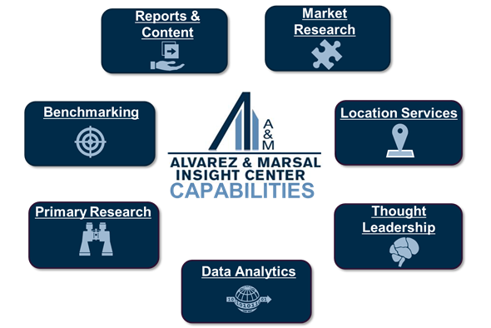
About A&M’s Insight Center
About A&M’s Insight Center
The science of facts, the art of actionable insight
Who We Are
The Insight Center is A&M’s global research team. The group was founded to adhere to one of A&M’s founding principles: “No shooting from the hip.” We provide practitioners and clients with highly relevant, industry-specific, actionable, fact-based insights derived through proprietary empirical studies and research.
Our team has diverse experience and skill sets ranging from quantitative analysis and data modeling to economics and commercial real estate to thought leadership strategy and content development.
The Insight Center has access to a wide selection of resources, including an extensive research subscription portfolio and connections to company and industry subject matter experts.
Insight Center Leadership
Andy Pfeffer – Managing Director
What We Do

Slide 8
Disclaimer
Disclaimer
This document has been prepared and compiled for informational purposes only (OR at the direction of our Client relating to the purposes set forth in a separate understanding or agreement between A&M and Client). It does not purport to contain all necessary information that may be required to evaluate any entity, industry, property, asset or transaction, regardless of how pertinent or material such information may be. A&M has not independently verified any of the underlying source data or other factual information which is contained in or provides a basis for the contents of this report.
This document may contain trade secrets or otherwise confidential information owned by A&M and is intended solely for A&M’s internal purposes and/or our intended client and is not meant to be distributed outside the firm or client parties. A&M owns all intellectual property rights in the methodologies, processes or trade secrets used by A&M to create this deliverable. Access to and use of this information is strictly limited and controlled. Any repurposing, redistribution or referencing of this document is prohibited without prior written consent of A&M and under appropriate precautions to maintain the confidentiality hereof. If you have come into possession of this content inadvertently, please forward this information to insightcenter@alvarezandmarsal.com immediately. Any reluctance to return this content to its intended audience or redistribute it without authorization will be viewed as a copyright infringement and addressed in accordance with copyright laws. © Copyright 2022 Alvarez & Marsal Holdings, LLC. All rights reserved.
In preparation of this report A&M has relied upon various sources, which may include third party proprietary information. Any syndicated materials and information provided by A&M are for internal use only and should not be distributed, published or reproduced without A&M’s prior written consent.

Slide 9

Back cover
Alvarez & Marsal Insight Center
Alvarez & Marsal Holdings, LLC. All rights reserved. ALVAREZ & MARSAL®,
® and A&M® are trademarks of Alvarez & Marsal Holdings, LLC.
© Copyright 2022

