Slide 1


ABC
June 14, 2019
SG&A Diagnostics
Alvarez & Marsal Insight Center
Client confidential; do not distribute

Slide 2
Disclaimer
This document has been prepared and compiled for informational purposes only (OR at the direction of our Client relating to the purposes set forth in a separate understanding or agreement between A&M and Client). It does not purport to contain all necessary information that may be required to evaluate any entity, industry, property, asset or transaction, regardless of how pertinent or material such information may be. A&M has not independently verified any of the underlying source data or other factual information which is contained in or provides a basis for the contents of this report.
This document contains trade secrets or otherwise confidential information owned by A&M and is intended solely for A&M’s internal purposes and/or our intended client and is not meant to be distributed outside the firm or client parties. A&M owns all intellectual property rights in the methodologies, processes or trade secrets used by A&M to create this deliverable. Access to and use of this information is strictly limited and controlled. Any repurposing, redistribution or referencing of this document is prohibited without prior written consent of A&M and under appropriate precautions to maintain the confidentiality hereof. If you have come into possession of this content inadvertently, please forward this information to insightcenter@alvarezandmarsal.com immediately. Any reluctance to return this content to its intended audience or redistribute it without authorization will be viewed as a copyright infringement and addressed in accordance with copyright laws.
© Copyright 2022 Alvarez & Marsal Holdings, LLC. All rights reserved.
In preparation of this report A&M has relied upon various sources, which may include third party proprietary information. Any syndicated materials and information provided by A&M are for internal use only and should not be distributed, published or reproduced without A&M’s prior written consent.

Slide 3
Contents
1 | Executive Summary | 3
2 | Peer Group Demographics | 6
3 | SG&A High Level Cost Comparatives: AS IS | 9
4 | Decomposed SG&A Functional Analysis | 12
5 | Appendix | 15

Slide 4

Executive Summary

Slide 5
Executive Summary: SG&A Diagnostics

Slide 6
SG&A Costs as a Percentage of Revenue by Industry
Bottom Quartile
Median
Top Quartile
SG&A cost as a percent of revenue varies widely across industries, driven by differing regulatory requirements as well as diverse operating models as well as other factors.
63.5%
61.3%
61.9%
57.4%
54.0%
55.2%
55.5%
50.1%
50.9%
41.9%
44.6%
43.7%
39.7%
37.2%
35.2%
32.0%
32.6%
33.8%
29.8%
22.4%
22.1%
25.5%
22.5%
23.7%
23.5%
22.1%
18.7%
18.1%
19.5%
20.7%
19.7%
19.5%
22.1%
16.5%
15.6%
15.9%
14.5%
13.4%
10.7%
10.6%
10.2%
9.4%
9.8%
9.9%
12.2%
7.9%
6.4%
7.4%
7.7%
5.5%
5.6%
6.2%
4.9%
Source: A&M Insight Center, analysis based on publicly reported financials; based on 20,000+ Global Companies

Slide 7
Peer Group Demographics

Slide 8
Peer Group Overview
The following companies have been selected as peers for this benchmarking analysis, and were identified based upon their common industry classification and revenue within a relative proximity range to [Cname]’s.
Company Name | SIC | SIC Primary Industry | Country | FY | Latest Revenue USD MM

Slide 9
Peer Group¹ Demographics
The gold star on each demographic characteristic bar represents [Cname]'s performance relative to the span of the peer group.
1. For all companies, financial data is sourced from publicly reported annual financials. For each company, the Financial Year used is shown on page 7.

Slide 10
SG&A High Level Cost Comparatives: AS IS

Slide 11
SG&A Cost as a Percent of Revenue¹
SG&A Cost includes - Selling General & Admin Expenses, Total is a line item in the Standard template with the following components: Equipment Expense, Salaries and Other Employee Benefits, Occupancy Expense, Insurance, Expenses, Stock-Based Compensation SG&A Exp., Net Rental Expense, Lease and Rent Expenses, Selling General & Admin Expenses, Selling and Marketing Expenses, General and Administrative Expenses, Other Rental Expense, Contingent Rentals, Sublease Income, Minimum Rental Expenses.
The SG&A high level opportunity is calculated as SG&A cost as a % of revenue gaps between and Median to Top Decile Performers times ’s Revenue.

Slide 12
SG&A vs. EBITDA Performance¹
Optimizing SG&A spend can liberate capital for more strategic leverage within operations or drive savings to the bottom line. The topmost right quadrant represents top performers, and the bottom left quadrant represents companies performing below the Median. [Cname]'s SG&A performance is within top quartile, however EBITDA is below Median keeping them from being a top performer overall.
1. The SG&A Score is the percentile ranking computed for SG&A Margin for each company within the peer group. The lower the SG&A Margin, higher the SG&A Score. The EBITDA Score is the percentile ranking computed for EBITDA Margin for each company within the peer group. The higher the EBITDA Margin, the higher the EBITDA Score.

Slide 13
Decomposed SG&A Functional Analysis

Slide 14
SG&A Decomposed Functional Costs and FTE Analysis¹
Median
Top Quartile
Based on the top-down cost allocation SG&A model detailed on pg.18 of this deck, functional costs include departmental labor, outsourcing, technology and other costs.
Functional data is estimated for companies using A&M’s top-down cost allocation model, listed on pg. 18 of this deck. Functional opportunities are calculated based on the functional cost gaps of respective functions between the company and the peers which are median to top decile performers (times revenue).

Slide 15
Estimated Opportunity Waterfall¹
Based on the top-down cost allocation SG&A model detailed on pg.18 of this deck, functional costs include departmental labor, outsourcing, technology and other costs.
Functional data is estimated for companies using A&M’s top-down cost allocation model, listed on pg. 18 of this deck. Functional opportunities are calculated based on the functional cost gaps of respective functions between the company and the peers which are median to top decile performers (times revenue).

Slide 16
Appendix

Slide 17
SG&A Functional Taxonomy
In order to create an apples-to-apples comparison across peers, the spend from peers has been aligned to a standard set of functions and processes within each SG&A category.
Finance
Transactional Processing
General Accounting & Financial Reporting
Controls
Tax & Treasury
Performance Management
Finance Function Management
Human Resources
Transactional Processing
Rewards Administration
Talent Management
Strategy and Program Design
Information Technology
Application Development & Management
IT Control & Risk Management
Infrastructure Technology Management
IT Planning and Strategy
Procurement
Sourcing Execution
Purchase Order Processing
Scheduling
Supply Data Management
Receipt Processing
Compliance Management
Supplier Management & Development
Sourcing Strategy & Analysis
Product Development Support
Functional Management & Administration
Corporate Support Services
Aviation
Communications Services
Environmental Health and Safety
Executive Office
Legal
Mergers and Acquisitions
Non-Merchandising Procurement
Strategic Planning
Travel Management
Marketing
Demand Stimulation / Lead Generation
Marketing Communications
Brand and Product Management
Marketing strategy and planning
Marketing - Function Management
Sales/Customer Service
Customer creation
Customer retention
Sales - customer service
Sales order entry
Order and Contract Management
Customer Service Operations and
Management

Slide 18
Deleted

Slide 19
Glossary
Top Quartile and Best in Class cost comparisons represent organizations operating at or above the Top Quartile (p25). Best in Class is Top Decile (p10) breakpoint of the data set and does not specifically imply top performance from an effectiveness perspective.
Selling General & Administrative Expenses ­(SG&A) are the costs that occur during the daily operations of a company and not directly related to the manufacturing of the product. These are the expenses related to the selling, promoting and delivering of a product as well as managing the company. SG&A is not assigned with the cost of goods sold as it deals with all the other factors that come with creating a product.
General and Administrative Expenses (G&A) are the overhead of the company. They are the costs that a company must incur to open the doors each day. G&A costs are more fixed than selling costs because they include rent or mortgage on buildings, utilities and insurance. G&A costs also include salaries of all non -sales personnel.
EBITDA Score is the percentile ranking computed for the EBITDA Margin for each company within the peer group. The higher the EBITDA Margin, the higher the EBITDA Score.
SG&A Score Is the percentile ranking computed for the SG&A Margin for each company within the peer group. The lower the SG&A Margin, the higher the SG&A Score.
EBITDA Score: Is the percentile rankings computed for EBITDA Margin for each company within the peer group, higher the EBITDA margin, higher the EBITDA score.
SG&A Score: Is the percentile rankings computed for SG&A Margin for each company within the peer group, lower the SG&A margin, higher the SG&A scor.

Slide 20
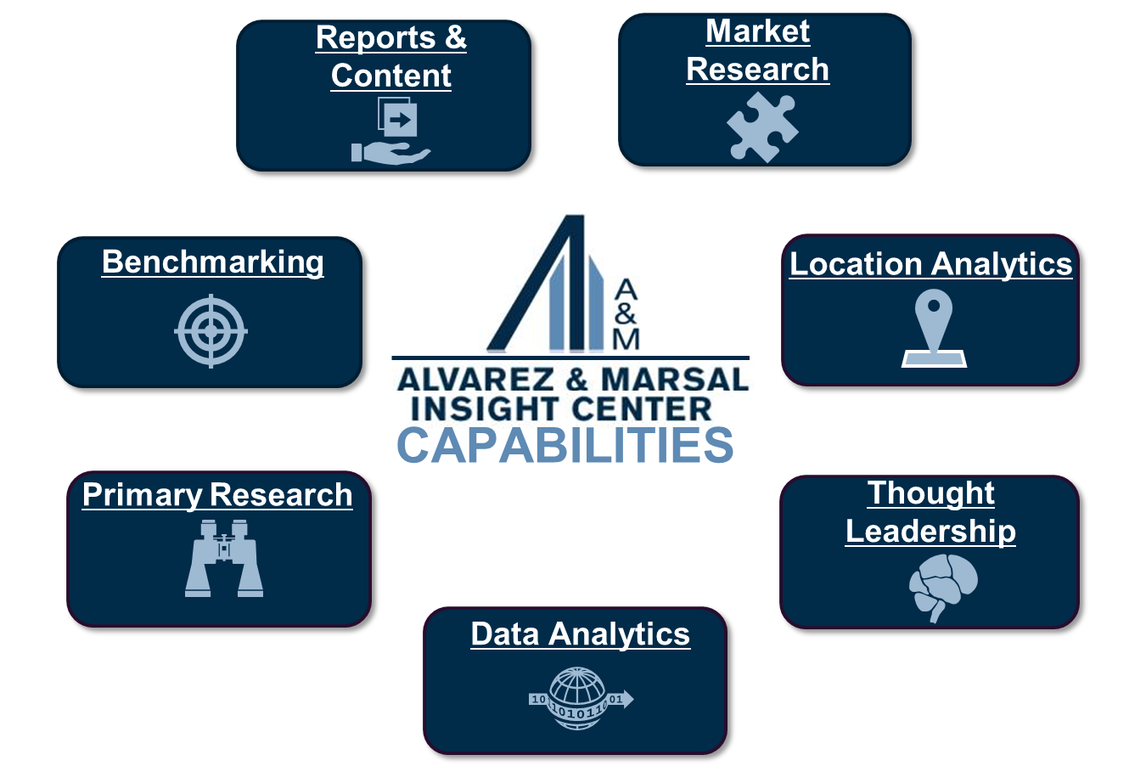
About A&M’s Insight Center
About A&M’s Insight Center
The science of facts, the art of actionable insight
Who We Are
The Insight Center is A&M’s global research team. The group was founded to adhere to one of A&M’s founding principles: “No shooting from the hip.” We provide practitioners and clients with highly relevant, industry-specific, actionable, fact-based insights derived through proprietary empirical studies and research.
Our team has diverse experience and skill sets ranging from quantitative analysis and data modeling to economics and commercial real estate to thought leadership strategy and content development.
The Insight Center has access to a wide selection of resources, including an extensive research subscription portfolio and connections to company and industry subject matter experts.
Insight Center Leadership
Andy Pfeffer – Managing Director
What We Do
Email: insightcenter@alvarezandmarsal.com
Phone: +1 404 260 4156
Insight Center Website

Slide 21

Contact the Insight Center
Contact the Insight Center
This analysis was prepared by:
Name: Sandeip Khanvilkar
Phone: +1 503.922.3548 / +1 206.348.4078
Email: skhanvilkar@alvarezandmarsal.com
Reach out or visit our Global Connect site to:
Learn more about our capabilities
Inquire about this report
Have us speak to your group
Email: insightcenter@alvarezandmarsal.com
Phone: +1 404 260 4156
Insight Center Website

Slide 22

Back cover
Alvarez & Marsal Insight Center
Alvarez & Marsal Holdings, LLC. All rights reserved. ALVAREZ & MARSAL®,
® and A&M® are trademarks of Alvarez & Marsal Holdings, LLC.
© Copyright 2022

Slide 23
Contents
Contents
1 | Executive Summary | 3
2 | Peer Group Demographics | 6
3 | SG&A High Level Cost Comparatives: AS IS | 9
4 | Appendix | 11

