Slide 1

Implementation of new features in Numjuggler
Patrick Sauvan

Slide 2
Outline
For request of F4E new capabilities have been implemented in the last version of numjuggler tool.
The features requested were:
Remove complementary operators in MCNP cell definition
Remove redundant parentheses in MCNP cell definition
Provide information relative the memory consumption of the geometry definition in MCNP

Slide 3
Numjuggler modifications
A new numjuggler module has been developed independently of original numjuggler module (only main.py module has been modified to integrate new capabilities in the tool)
The original numjuggler capabilities haven’t been changed.
The syntax for calling new capabilities is identical to original numjuggler syntax.
In line help of new features has been added in numjuggler help.

Slide 4
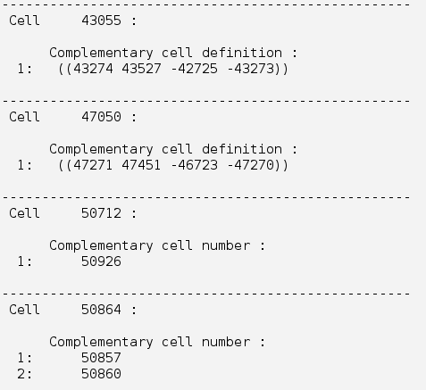
Removing complementary operator
Command line : remh keyword
numjuggler --mode remh input > output
Information on substituted operator can be obtain with the option --log filename
numjuggler --mode remh --log remhlog input > output
Log file example

Slide 5
Removing complementary operator
A complementary operator is removed only if the complementary cell is not a transformed cell
1 0 (3 : -4) 5 #10
…
10 0 like 9 but trcl=3
Operator #10 in cell 1 is not removed
Nested complementary operators are removed.
1 0 (3 : -4) 5 #2
2 0 6 -5 -7 #3
3 0 -6 : -8

Slide 6
Removing complementary operator
Complementary cell algorithm: e.g. 3 -4 : 5 9 ( 1 : 6)
Bracket the cell () ( 3 -4 : 5 9 ( 1 : 6) )
Change cell sign ( -3 4 : -5 -9 ( -1 : -6) )
Subs “:” → “)(“ “ “ → “ : “ ( -3 : 4 )( -5 : -9 ( -1 )( -6) )
Remove redundant parentheses ( -3 : 4 )( -5 : -9 -1 -6 )
The algorithm is taken from MCNP(vol. I) manual

Slide 7
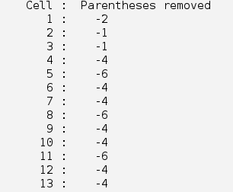
Removing redundant parentheses
Command line : remrp keyword
numjuggler --mode remrp input > output
Information on number of parenthese removed in each cell can be obtain with the option --log filename
numjuggler --mode remrp --log remrplog input > output
One parenthesis is the couple ()
Log file example

Slide 8
Removing redundant parentheses
In MCNP the presence of parenthesis in the cell definition make it complex (complex cells are treated differently vs simple cells in MCNP during transport)
2 -4 5 : simple cell
( 2 -4 5) : complex cell
2 : 4 : complex cell
Due to geometry error / MCNP bug with coincident surfaces, the transport is not exactly the same if cells are considered simple or complex.

Slide 9
Removing redundant parentheses
remrp mode has options to define how the user wants to remove the parentheses
“nochg” (default) : the characteristic (simple/complex) of the cell is preserved
“cc” : All cells are considered as complex (extra parentheses are added if needed).
“all” : All redundant parentheses are removed independently of preserving cell characteristics.
numjuggler --mode remrp -opt all input > output

Slide 10
Redundant parentheses
Redundant parentheses have the following pattern:
( ( anything ): ; : ( anything ) : ; : ( anything ) )
Redundant
( A B … only intersection … ) with A, B = ( anything) or number
Redundant

Slide 11
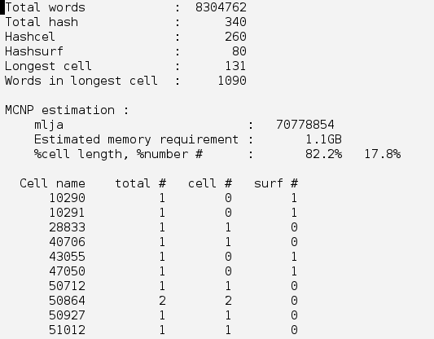
Memory information
Command line : minfo keyword
numjuggler --mode minfo input
Return information on the number of words and # operator present in the input and memory required by MCNP to store the geometry.

Slide 12
Verification
Two kinds of verification were performed.
The MCNP lja array (which store the MCNP geometry) has been written in a file after MCNP geometry processing. Arrays produced by original input file and input file processed by numjuggler were compared. Arrays were identical.
Statistical volume evaluation has been performed on the geometry of the original and modified input files. Both simulations give identical results.
These test have been applied successfully to Clite-R131031, Cmodel-R2.1-161214, and Cmodel-R171031 models.

Slide 13
Model performances
Two kinds of verification were performed.
The MCNP lja array (which store the MCNP geometry) has been written in a file after MCNP geometry processing. Arrays produced by original input file and input file processed by numjuggler were compared. Arrays were identical.
Statistical volume evaluation has been performed on the geometry of the original and modified input files. Both simulations give identical results.
These test have been applied successfully to Clite-R131031, Cmodel-R2.1-161214, and Cmodel-R171031 models.

Slide 14
Model performances
C-lite_R131031
Run_time | less < 1min |  |  | Removal of Hash |  |  | Removal of Hash + Brakets
 | No dump file exists |  |  | No dump file exists |  |  | No dump file exists
 | Total words | 191540 |  | Total words | 192818 |  | Total words | 162172
 | Total hash | 41 |  | Total hash | 0 |  | Total hash | 0
 | Hashcel | 32 |  | Hashcel | 0 |  | Hashcel | 0
 | Hashsurf | 9 |  | Hashsurf | 0 |  | Hashsurf | 0
 | Longest cell | 131 |  | Longest cell | 131 |  | Longest cell | 122
 | Words in longest cell | 1090 |  | Words in longest cell | 1090 |  | Words in longest cell | 922
 |  |  |  |  |  | Saving |  |  | Saving
 | MCNP estimation |  |  | MCNP estimation |  | memory | MCNP estimation |  | Time
 | mlja | 2873960 |  | mlja | 1363446 | 52,56% | mlja | 1146524 | 60,11%
 | Estimated memory requirement | 43.9MB |  | Estimated memory requirement | 20.8MB |  | Estimated memory requirement | 17.5MB
 | Memory % -->Words | 47,10% |  |  | 100,00% |  |  | 100,00%
 | Memory % --> # | 52,90% |  |  | 0,00% | Time |  | 0,00% | Time
cp0 w-MCNP6.1 |  | 1,1 | min |  | 1,05 | 4,55% |  | 0,95 | 13,64%

Slide 15
Model performances
C-Model_2016_v1_R2.1
Run time | less < 5min |  |  | Removal of Hash |  |  | Removal of Hash + Brakets
 | No dump file exists |  |  | No dump file exists |  |  | No dump file exists
 | Total words | 6253646 |  | Total words | 6267600 |  | Total words | 5483493
 | Total hash | 689 |  | Total hash | 0 |  | Total hash | 0
 | Hashcel | 594 |  | Hashcel | 0 |  | Hashcel | 0
 | Hashsurf | 95 |  | Hashsurf | 0 |  | Hashsurf | 0
 | Longest cell | 131 |  | Longest cell | 131 |  | Longest cell | 122
 | Words in longest cell | 1090 |  | Words in longest cell | 1090 |  | Words in longest cell | 922
 |  |  |  |  |  | Saving |  |  | Saving
 | MCNP estimation |  |  | MCNP estimation |  | memory | MCNP estimation |  | memory
 | mlja | 69354982 |  | mlja | 43918320 | 36,68% | mlja | 38420171 | 44,60%
 | Estimated memory requirement | 1.0GB |  | Estimated memory requirement | 670.1MB |  | Estimated memory requirement | 586.2MB
 | Memory % --> Words | 63,20% |  |  | 0,00% |  |  | 0,00%
 | Memory % --># | 36,80% |  |  | 100,00% | Time |  | 100,00% | Time
cp0 w-MCNP6.1 |  | 203 | min |  | 225 | -10,84% |  | 94 | 53,69%

Slide 16
Model performances
C-Model_R171031
Run time | less < 5min |  |  | Removal of Hash |  |  | Removal of Hash + Brakets
 | No dump file exists |  |  | No dump file exists |  |  | No dump file exists
 | Total words | 8304762 |  | Total words | 8316434 |  | Total words | 7209386
 | Total hash | 340 |  | Total hash | 0 |  | Total hash | 0
 | Hashcel | 260 |  | Hashcel | 0 |  | Hashcel | 0
 | Hashsurf | 80 |  | Hashsurf | 0 |  | Hashsurf | 0
 | Longest cell | 131 |  | Longest cell | 131 |  | Longest cell | 122
 | Words in longest cell | 1090 |  | Words in longest cell | 1090 |  | Words in longest cell | 922
 |  |  |  |  |  | Saving |  |  | Saving
 | MCNP estimation |  |  | MCNP estimation |  | memory | MCNP estimation |  | memory
 | mlja | 70778854 |  | mlja | 58260158 | 17,69% | mlja | 50501422 | 28,65%
 | Estimated memory requirement | 1.1GB |  | Estimated memory requirement | 889.0MB |  | Estimated memory requirement | 770.6MB
 | Memory % --> Words | 82,20% |  |  | 100,00% |  |  | 100,00%
 | Memory % --># | 17,80% |  |  | 0,00% | Time |  | 0,00% | Time
cp0 w-MCNP6.1 |  | 320 | min |  | 345 | -7,81% |  | 127,5 | 60,16%

