Slide 1
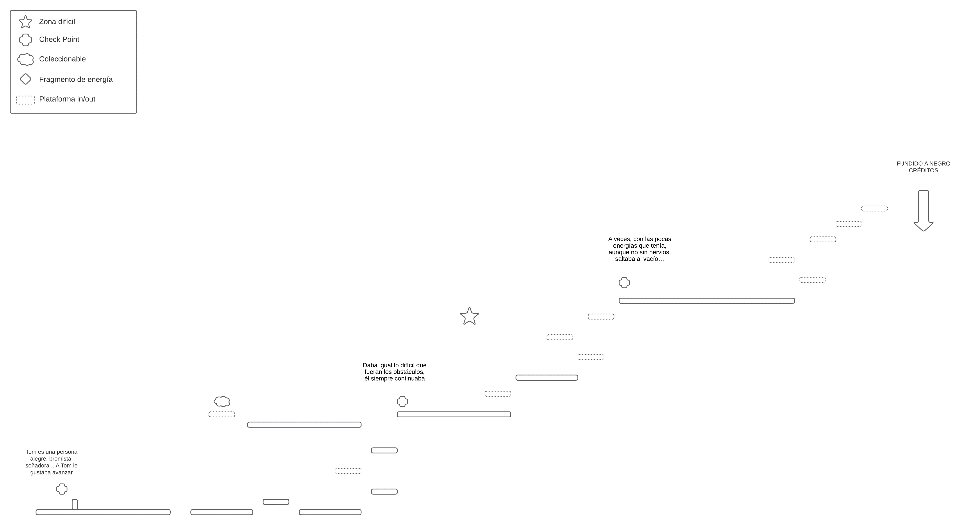
LEVEL 1

Slide 2
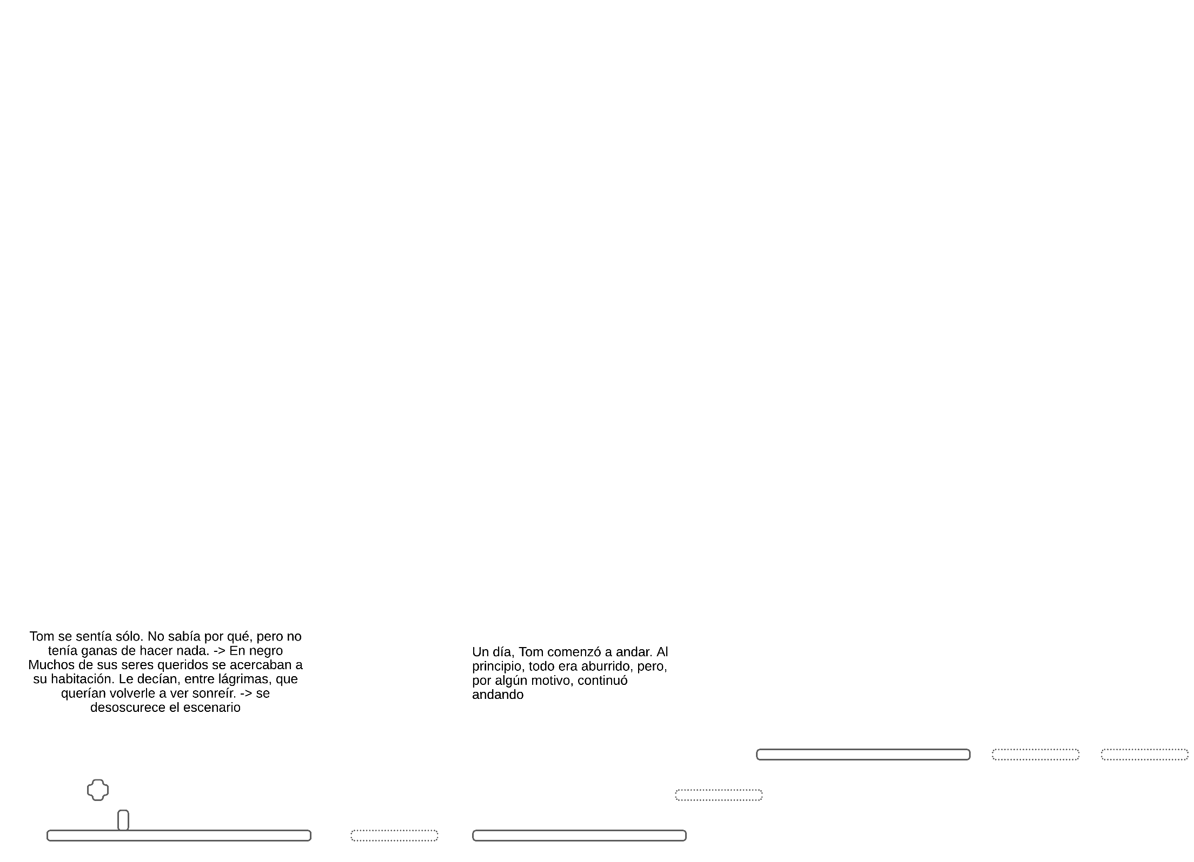
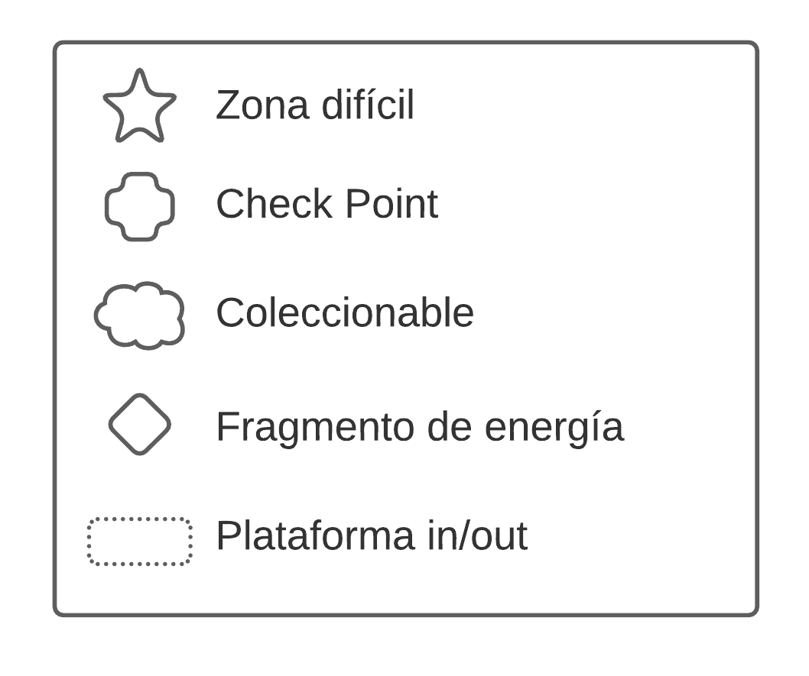
LEVEL 2 (1)

Slide 3

LEVEL 2 (2)

Slide 4
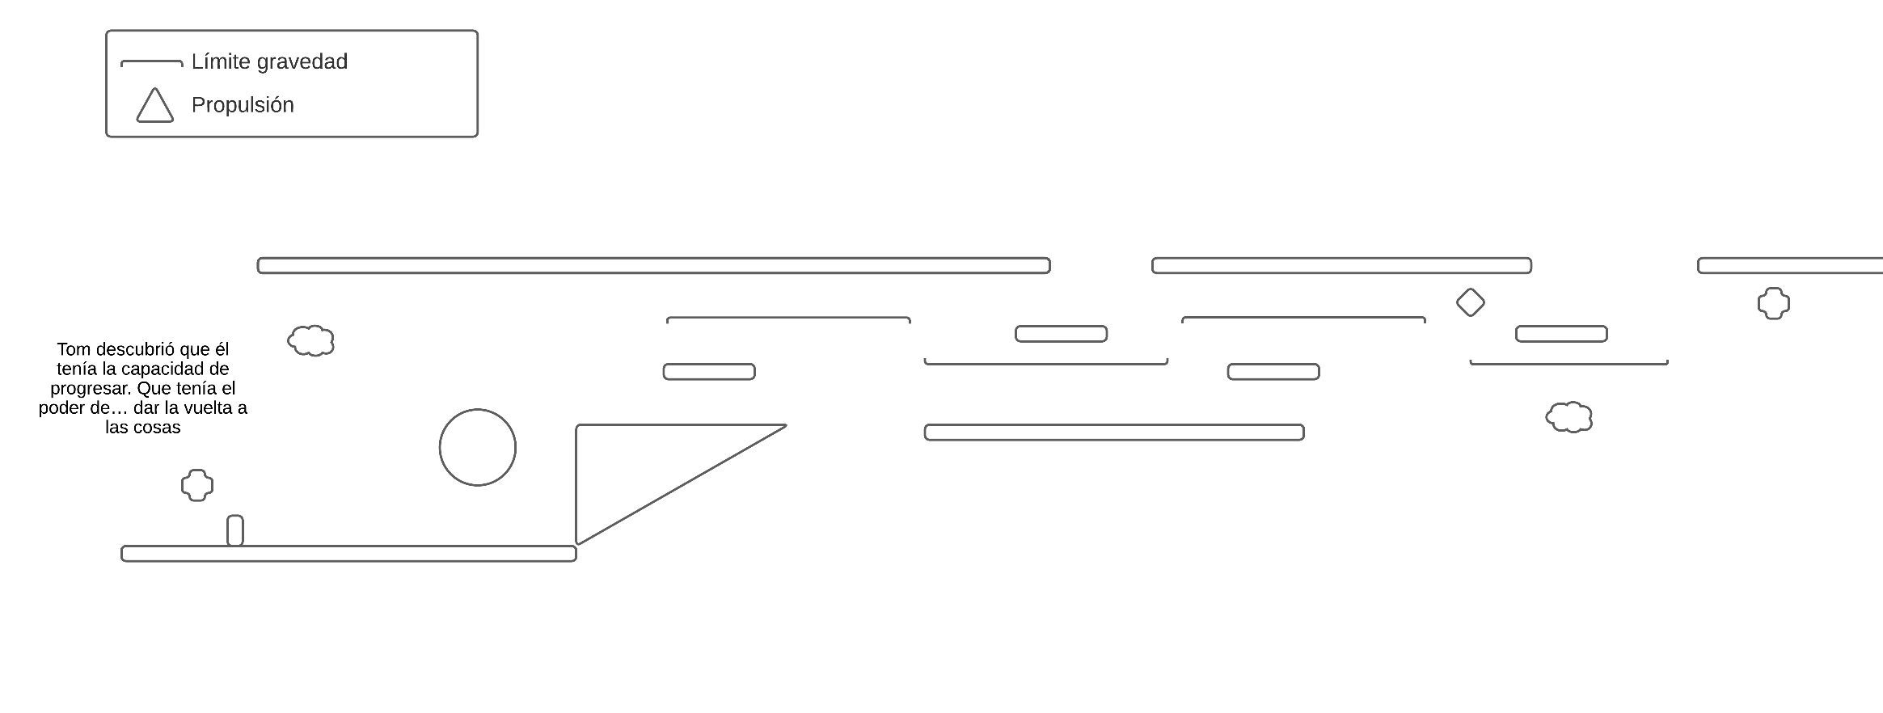
LEVEL 3 (1)

Slide 5
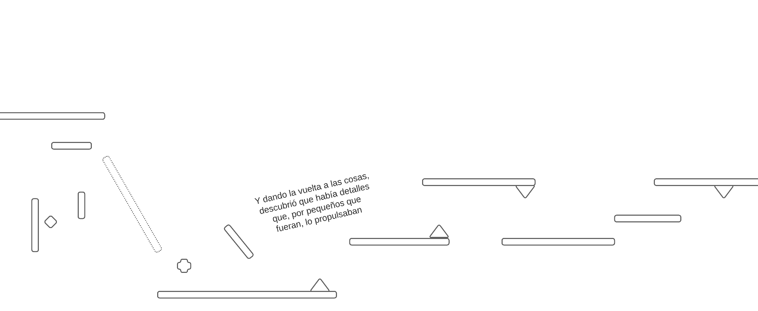

LEVEL 3 (2)

Slide 6
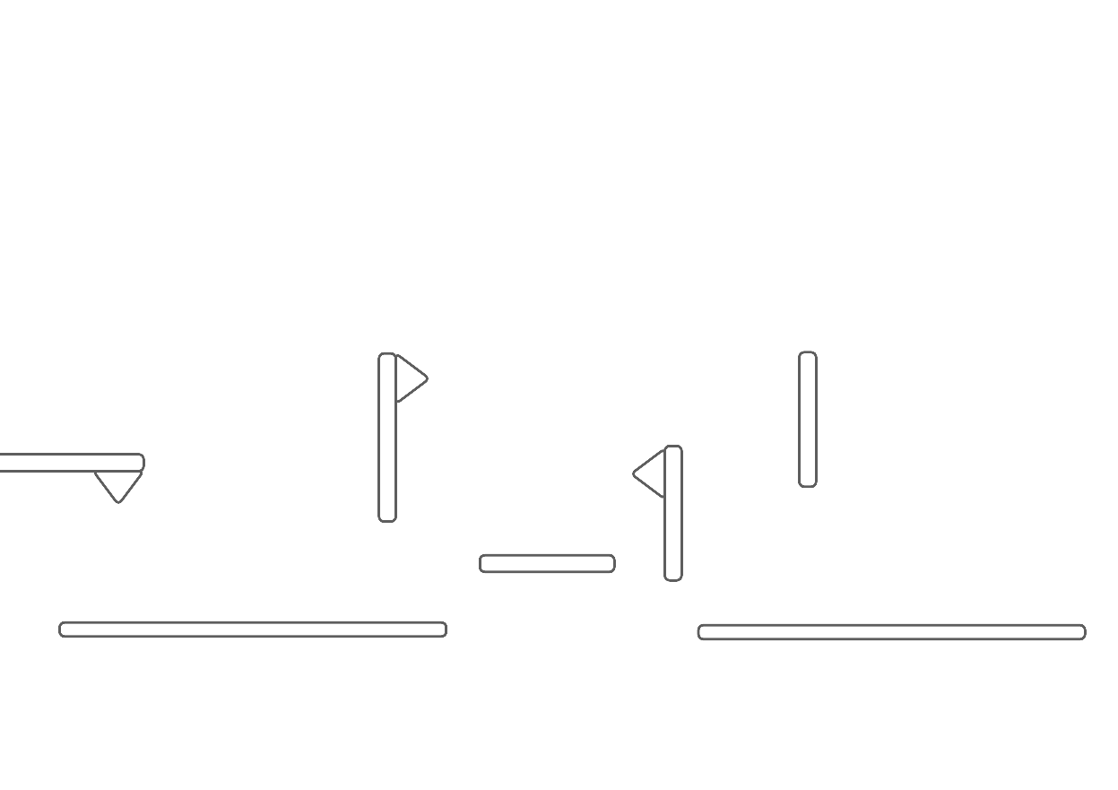
LEVEL 3 (3)

