Slide 1
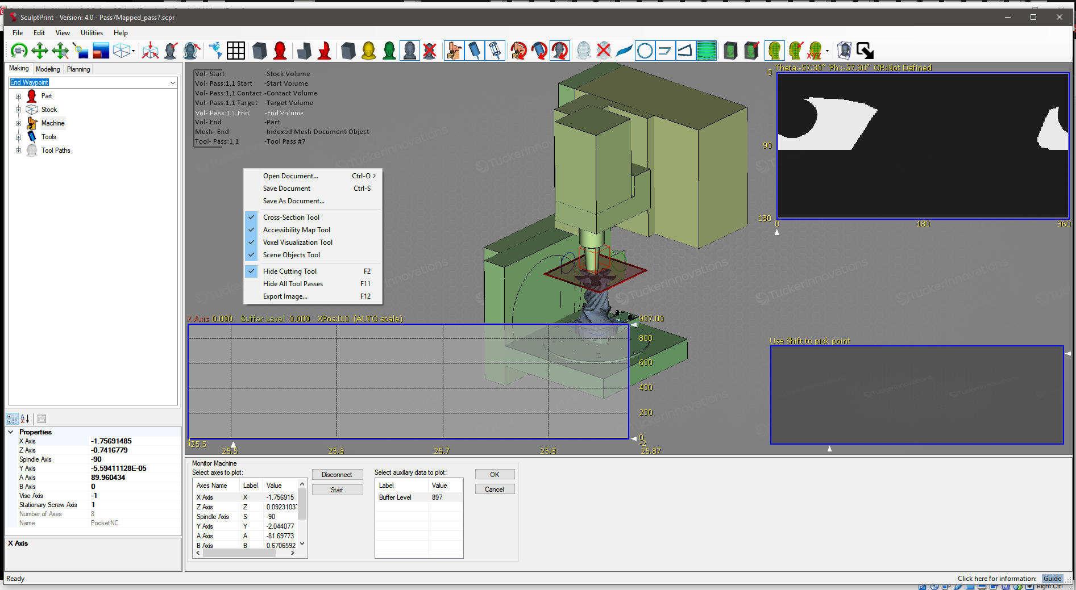
Aux Data 1 Plot
Aux Data 2 Plot
Add Aux Data Plot
Aux Data 1
Aux Data 2
…
Click and Drag to Move
Auxiliary Plot 1: Select Data
Auxiliary Plot 2: Select Data
OK
Control Machine
List of Data Items Provided from configureAuxiliary()
List of Data Items Provided from configureAuxiliary()
Cancel
User Data Text Entry 1
Export Data
User Data Text Entry 2
Execute User Python Function 1 Button
User Data Text Entry 3
Execute User Python Function 2 Button
User Data Text Entry 4
Execute User Python Function 3 Button
User Data Text Entry 5

