Slide 1

Analyzing the effect of corruption on a country's happiness index
DSO 510: Data Dawgs Jui Mathuria Rohit Kumar Simran Chandak Vivan Doshi Mansour AlMubaraki
Shahriar Rahman

Slide 2
What is the problem we are seeking to answer?
Is there a relationship between a country’s level of corruption and the overall happiness of its population?

Slide 3


Measuring the Happiness Index
🔹 Key Factors Influencing Happiness:
Perceived corruption – Trust in government & institutions
GDP per capita – Economic well-being
Social support – Availability of help in tough times
Healthy life expectancy – Overall well-being and longevity
Freedom of choice – Ability to make life decisions
Generosity – Community and charitable giving
🔹 Additional Considerations:
Mental health & emotional well-being
Work-life balance & environment
Notes:
Story Line – Hard hitting question about one happiness. Ask to check if it’s a correlation or a causation?

Slide 4
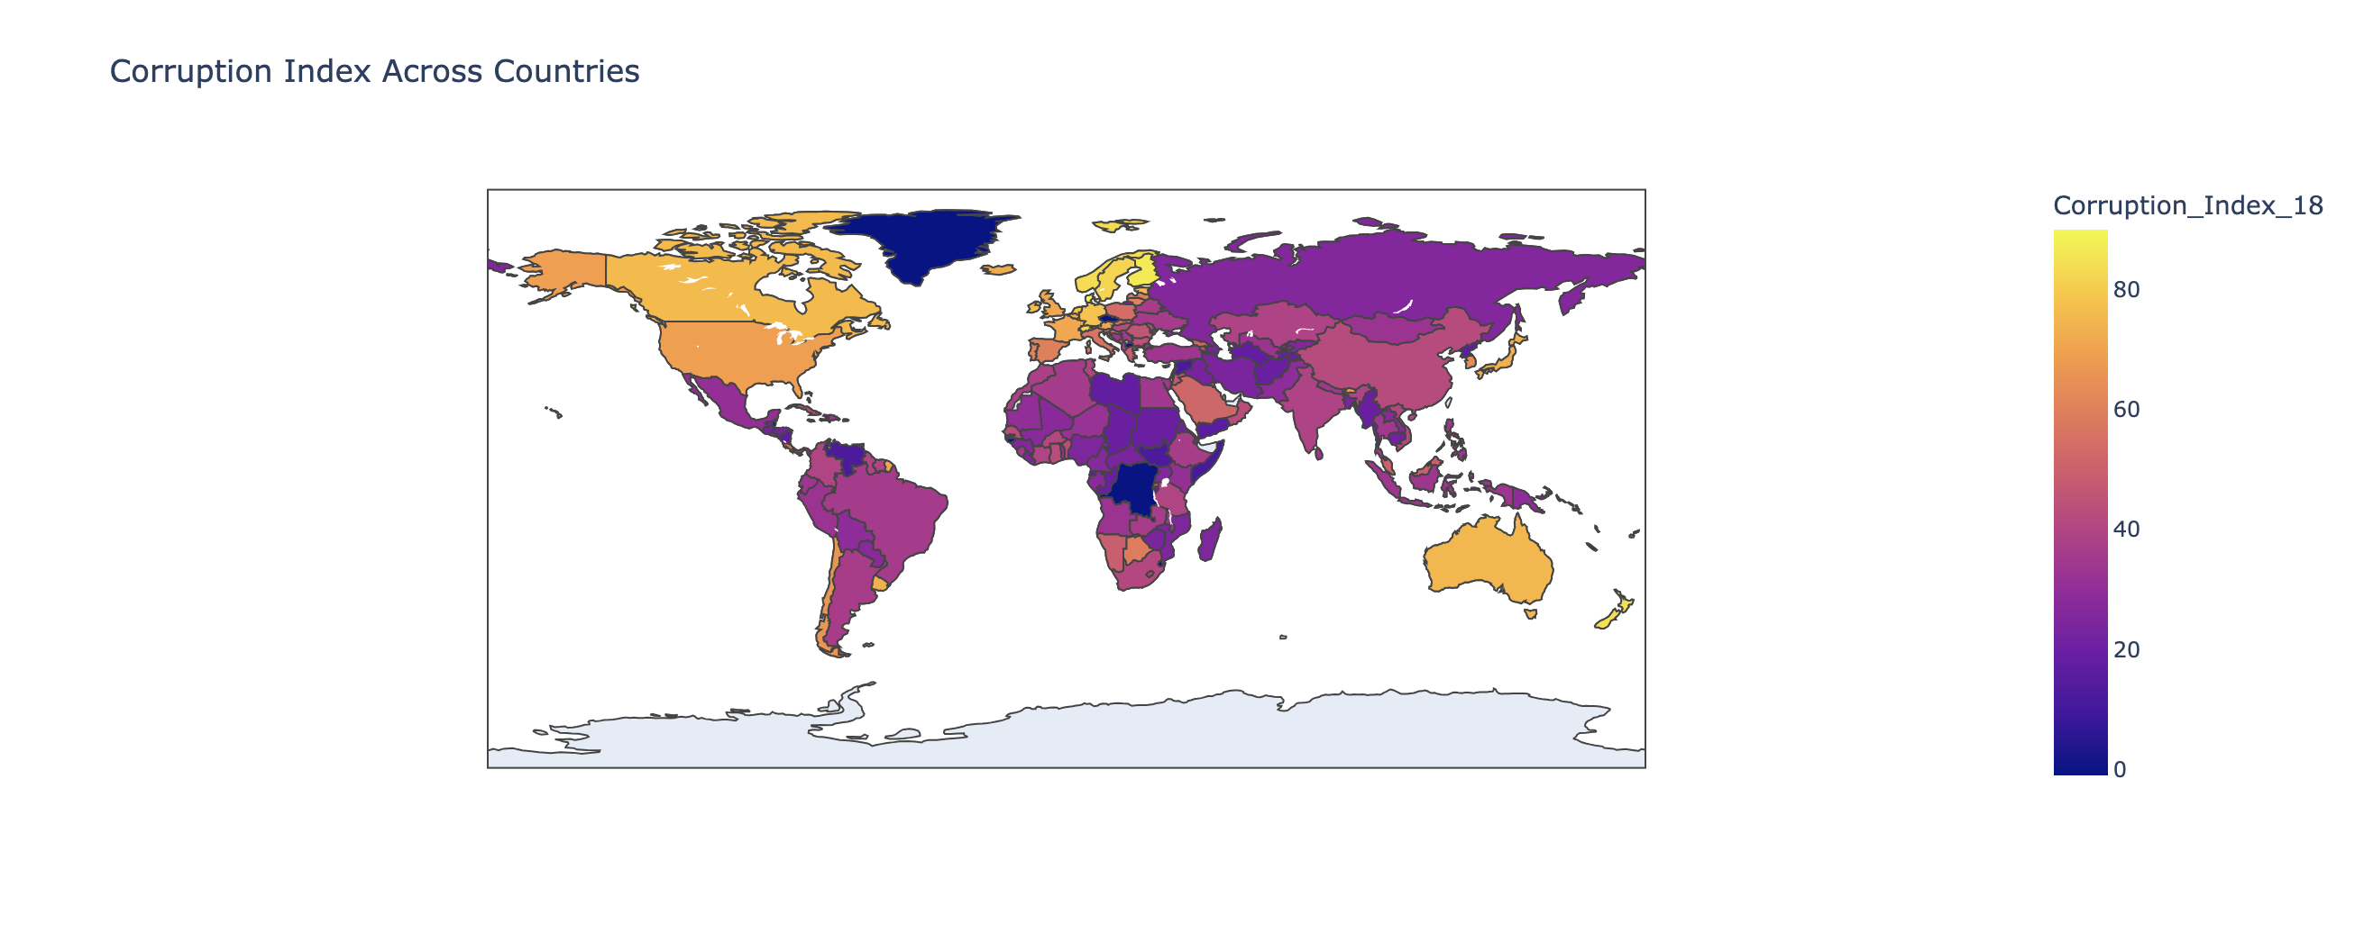
Corruption index

Slide 5
Where is the data from?
We didn’t use one dataset, we compiled data from multiple sources to create one data
Happiness data: World Happiness Report 2023
Corruption data: Transparency.org 2023 report
Safety data: www.gallup.com > analytics > The global safety report
Health data: www.who.int > data / health-safety
Hunger index: www.globalhungerindex.org > 2023 > complete report
Development index: hdr.undp.org > data center > human development index
Population: statista
GDP: Kaggle
As there were multiple sources we had to create a common country code and then merge these datasets. If a country was not present in a dataset we set it as “-1”

Slide 6
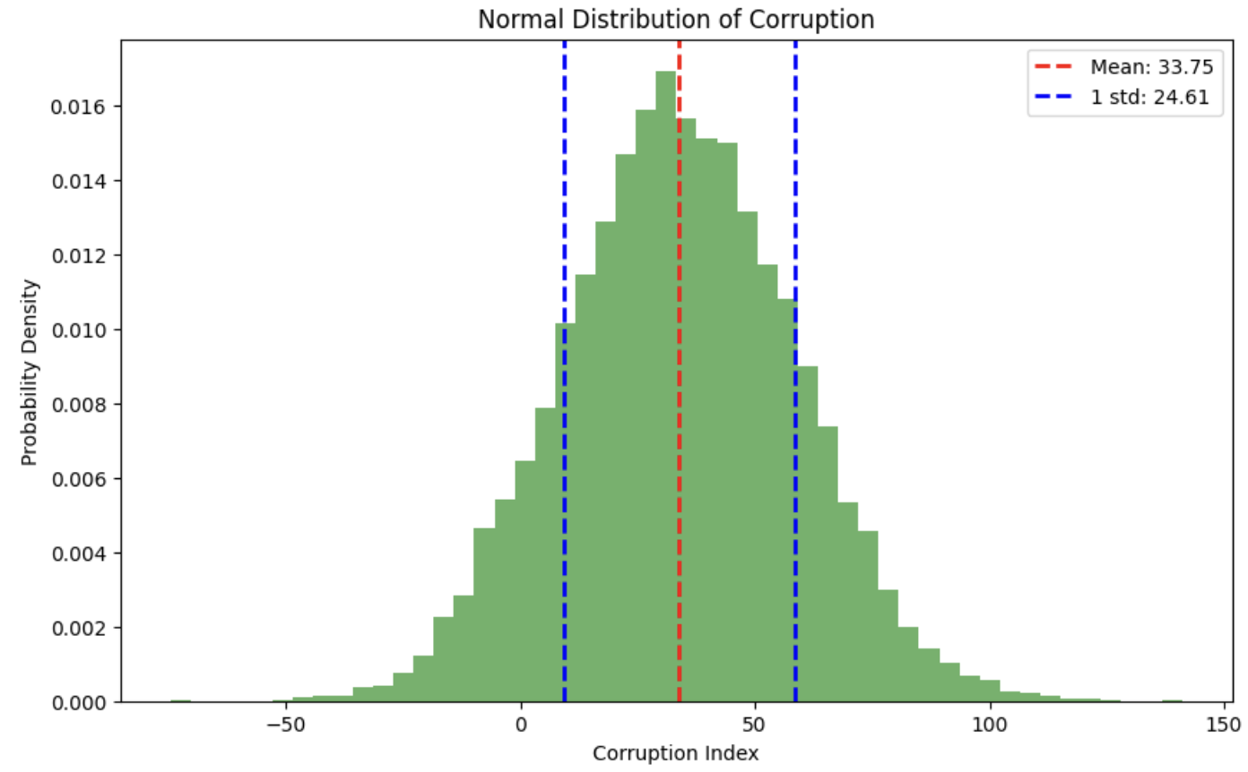
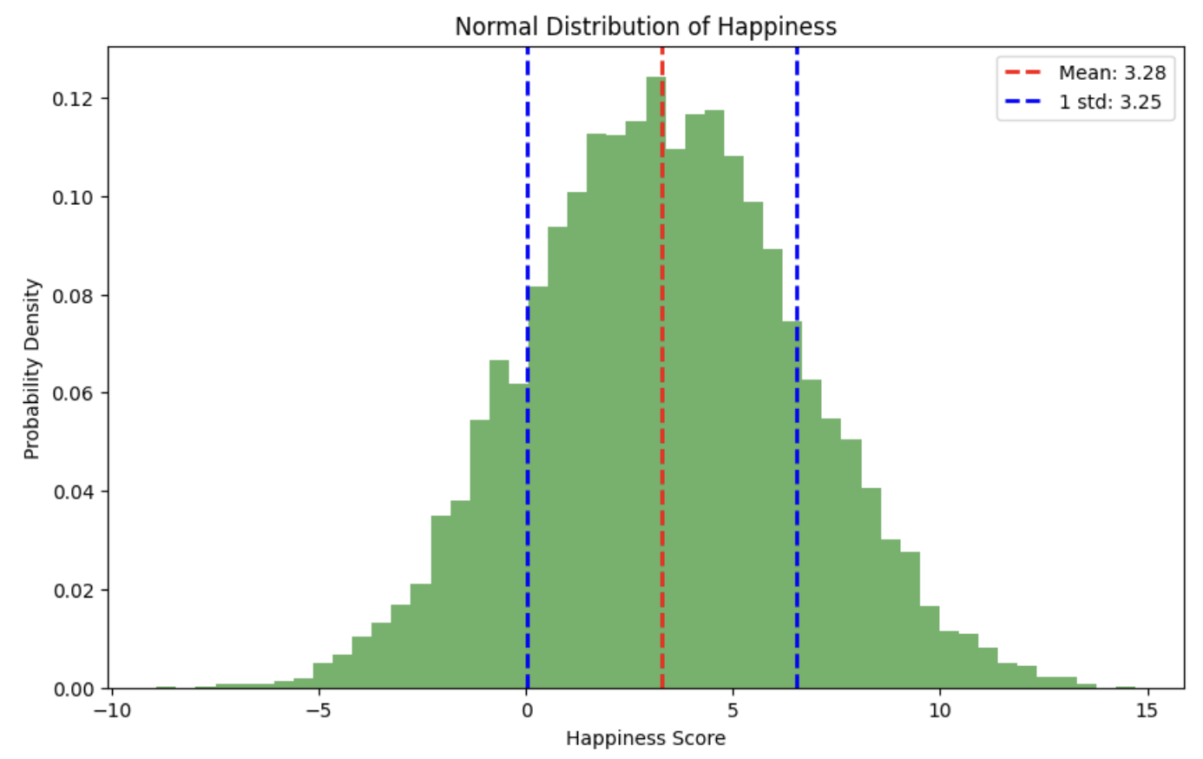
Both the graphs are slightly left-skewed suggesting that some countries experience very high corruption, which could be impacting their happiness negatively. Additionally, it could also indicate that multiple factors also known as confounders play a role in determining a nation's overall well-being.​
Do higher corruption levels correspond to lower happiness scores?

Slide 7
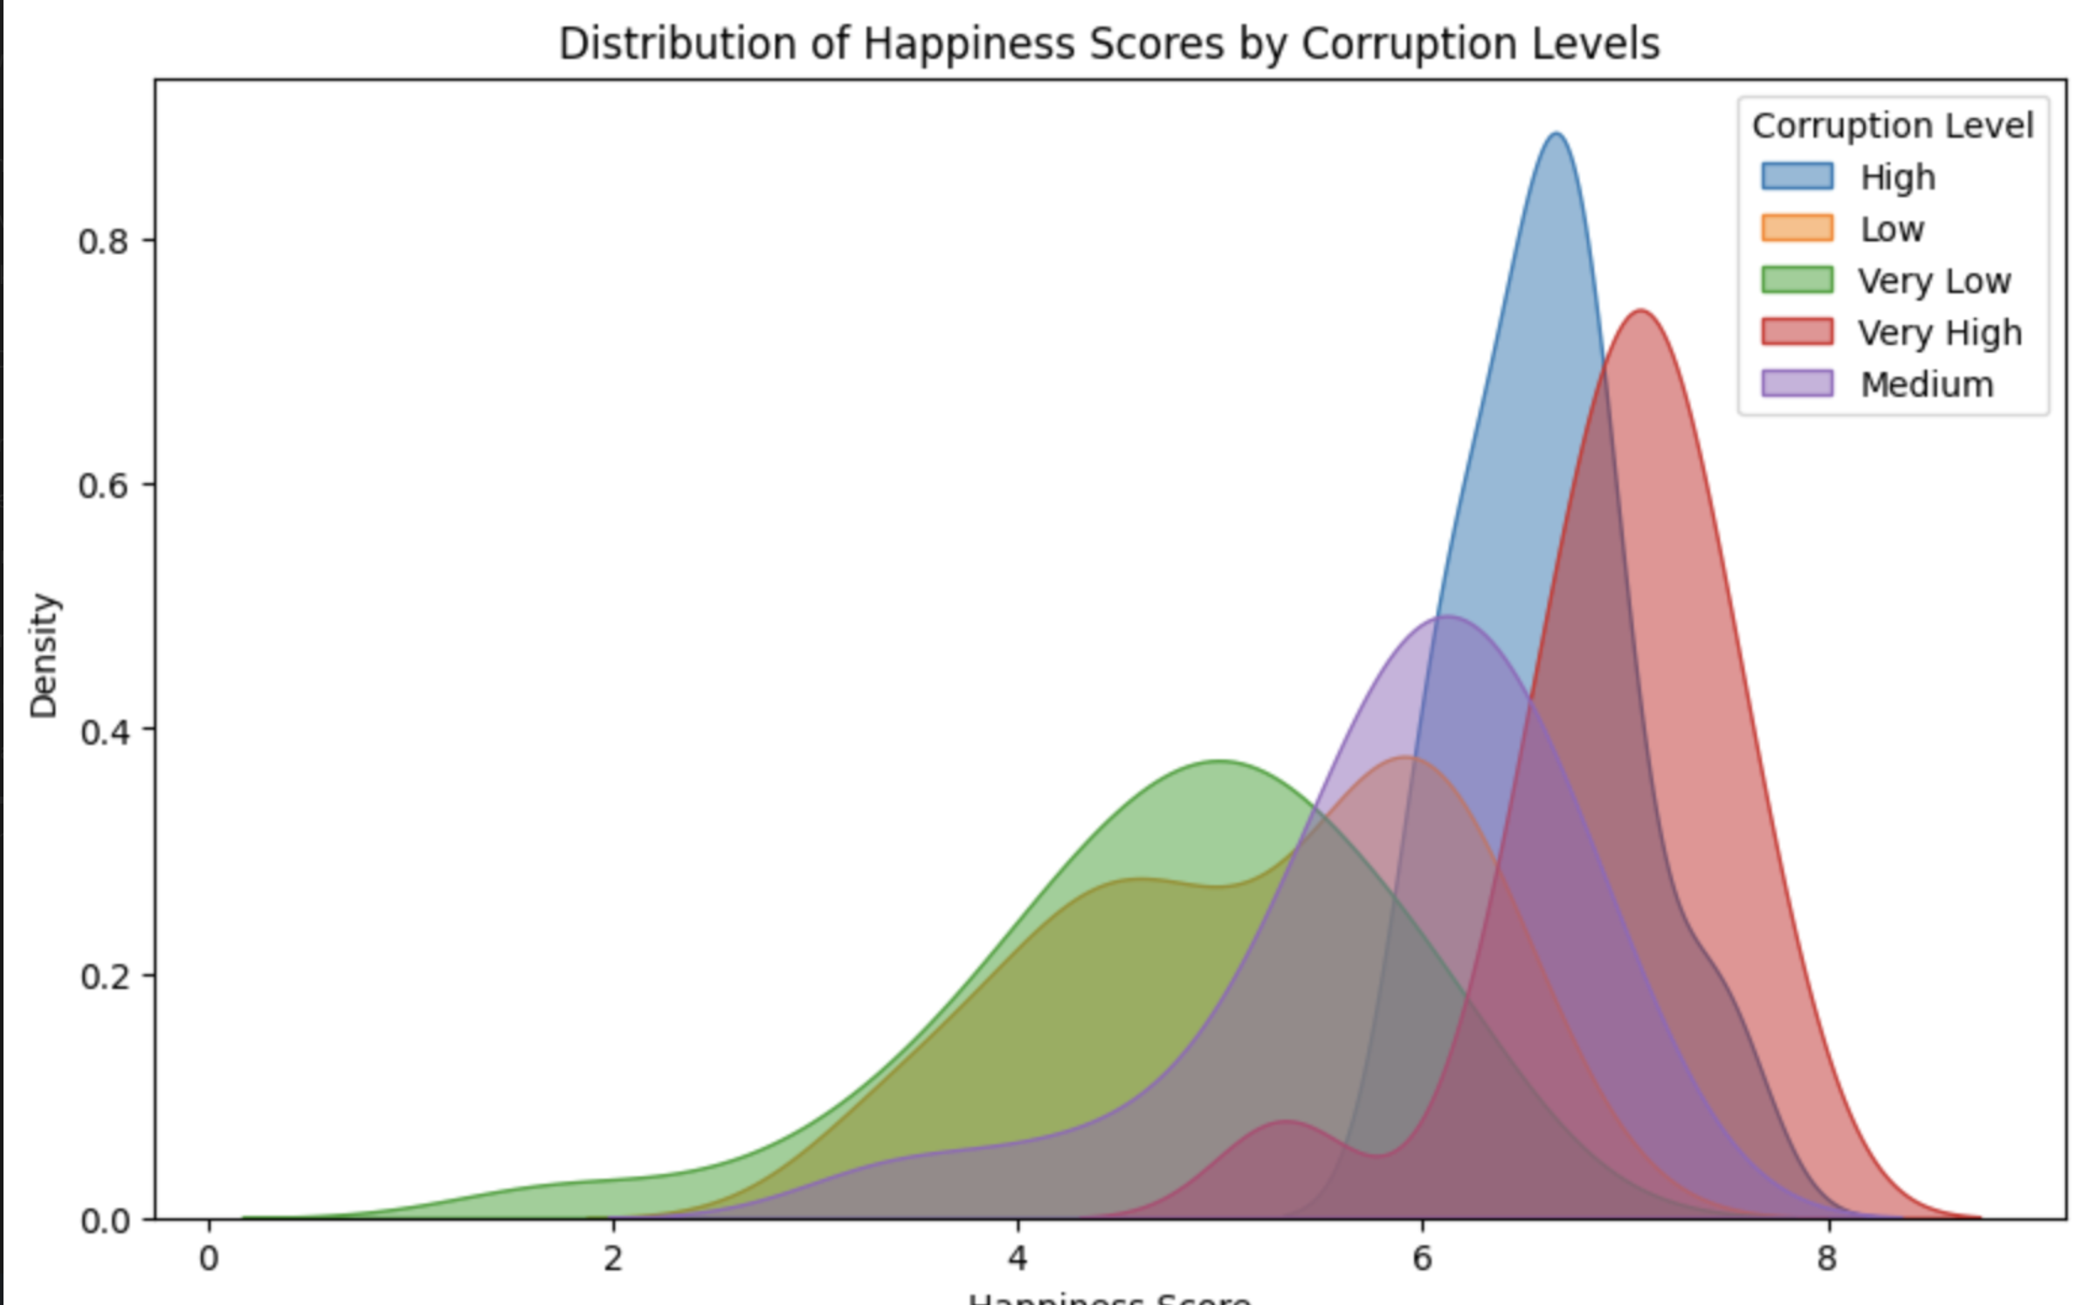
Happiness Score Distribution bifurcated by Corruption Level
Corruption level
Very high
High
Medium
Low
Very Low
Happiness Score

Slide 8
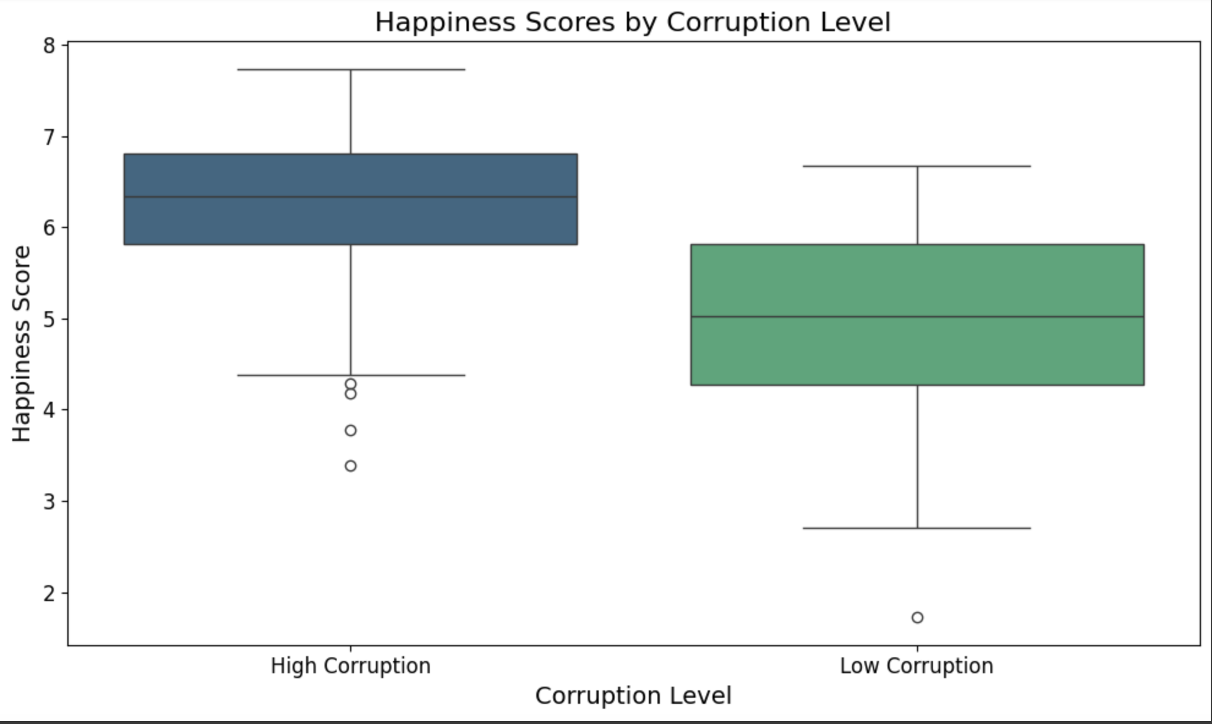
Happiness Score boxplots against Corruption Level

Slide 9
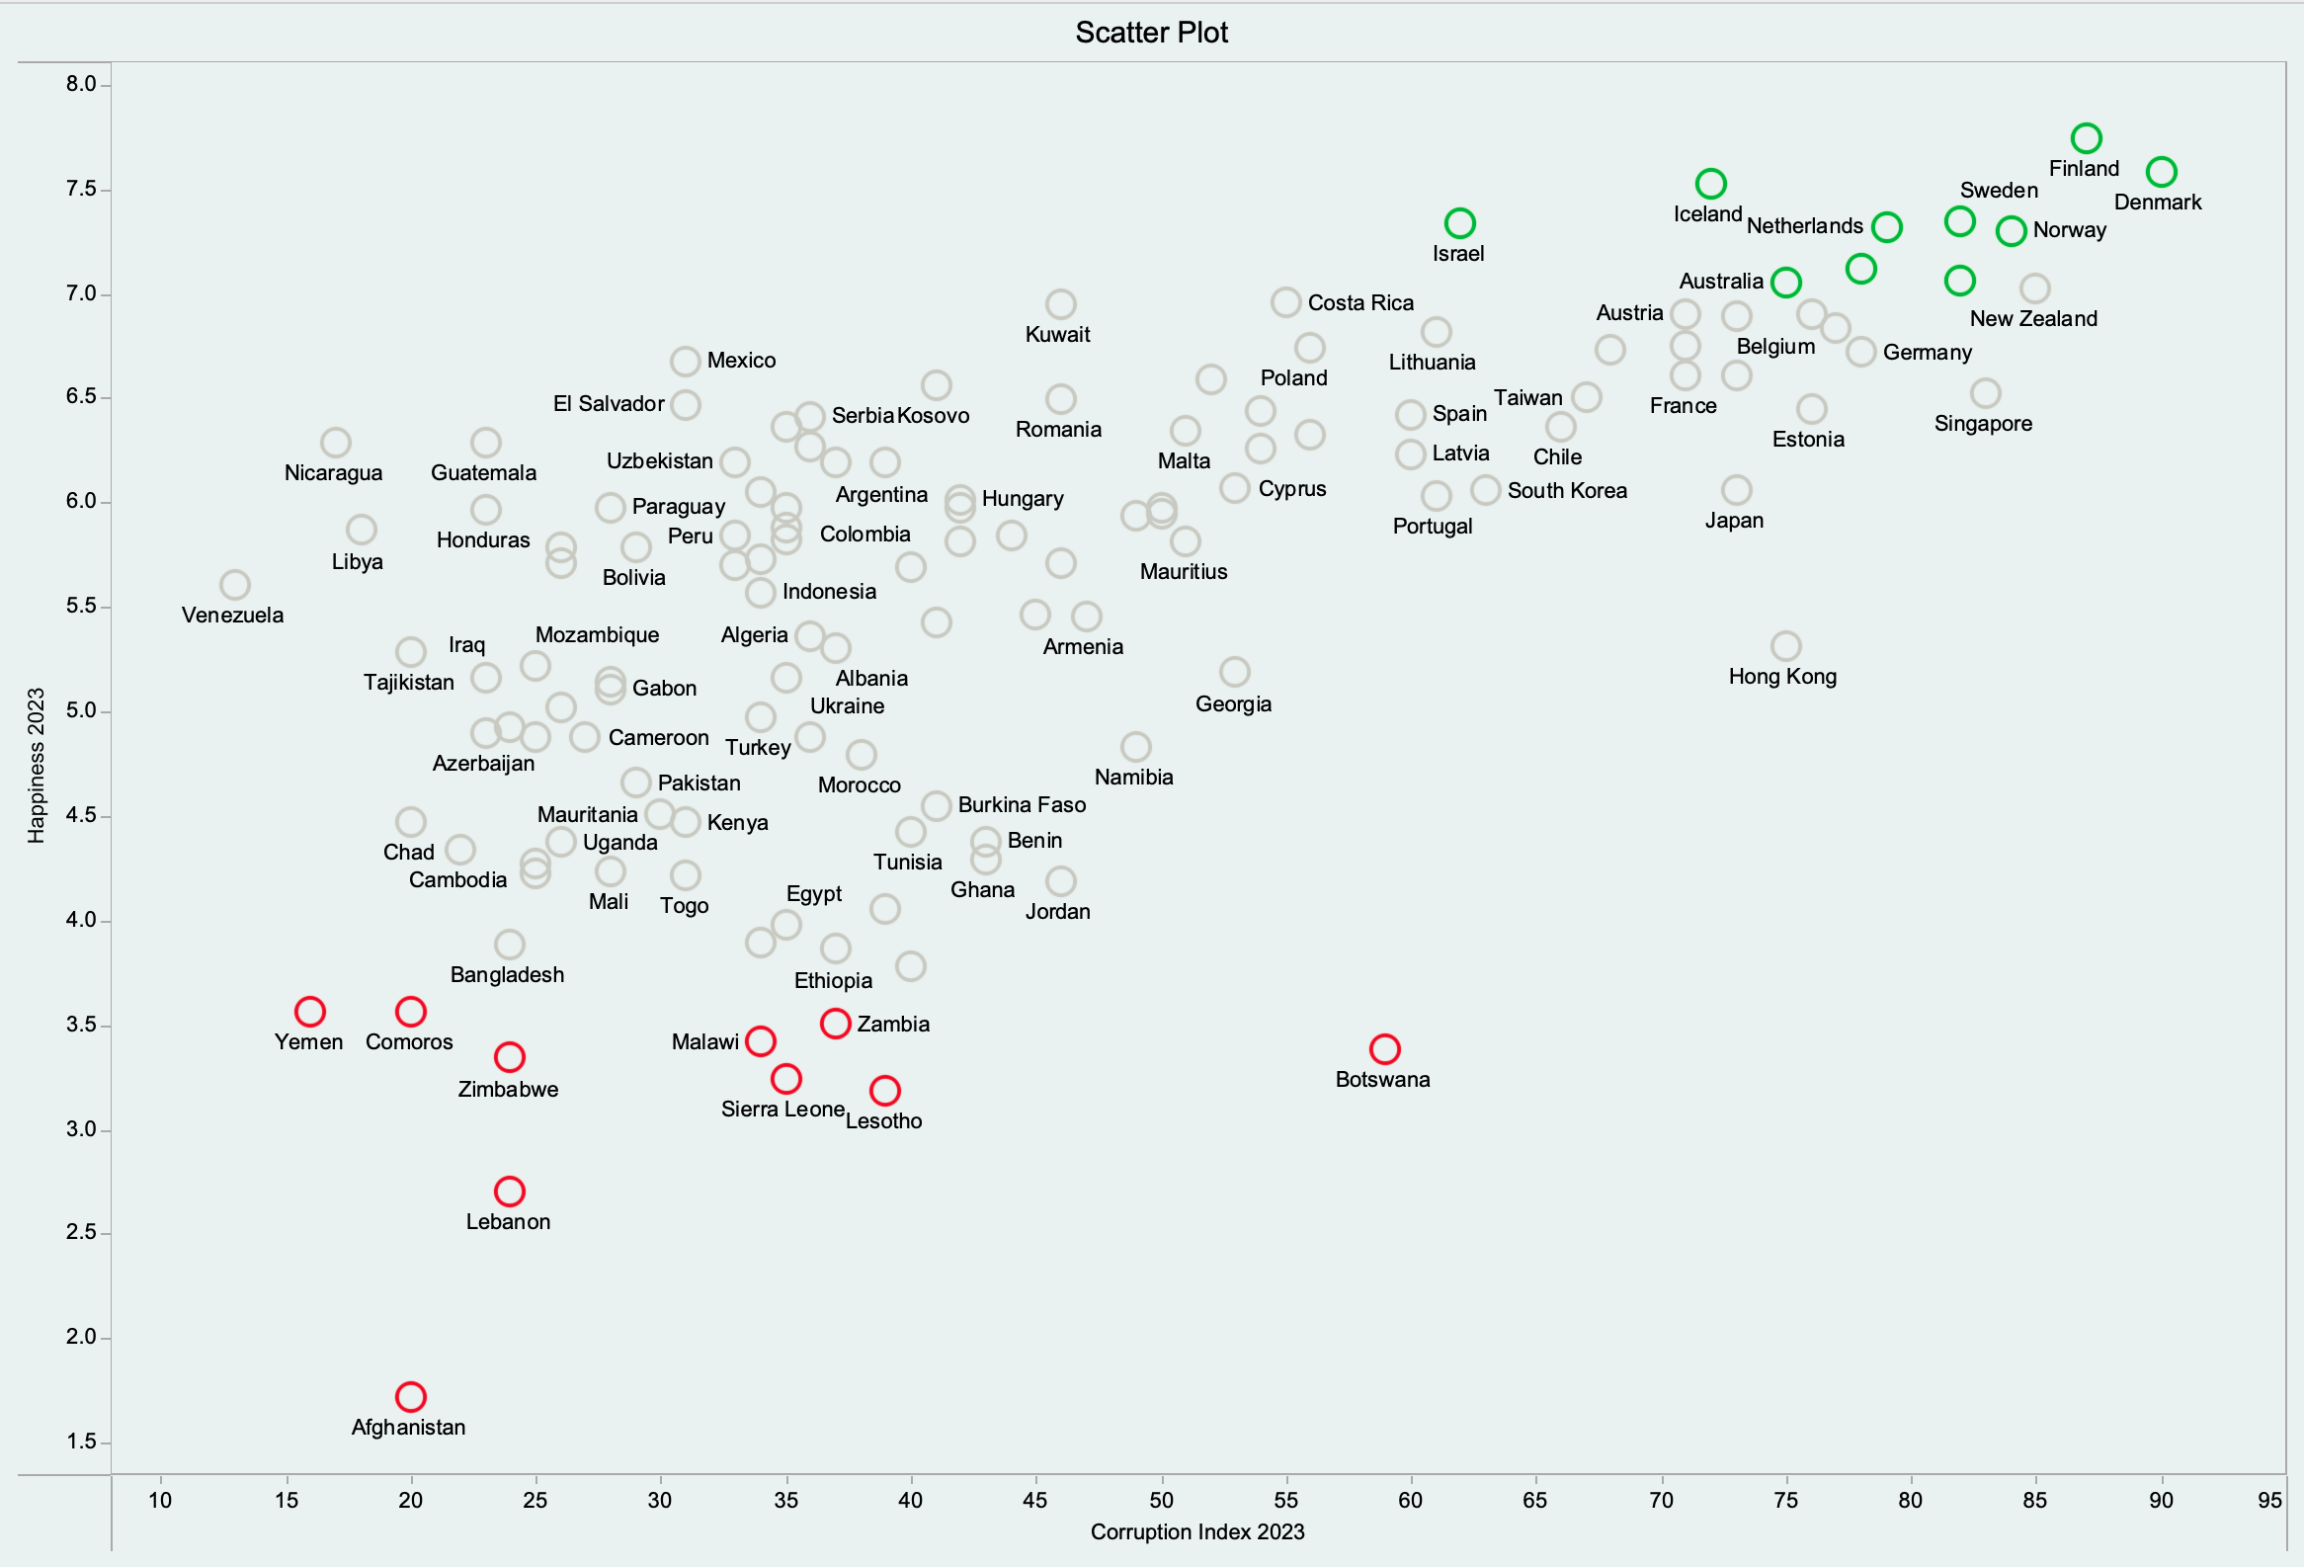
Happiness v/s Corruption index Scatter Plot

Slide 10
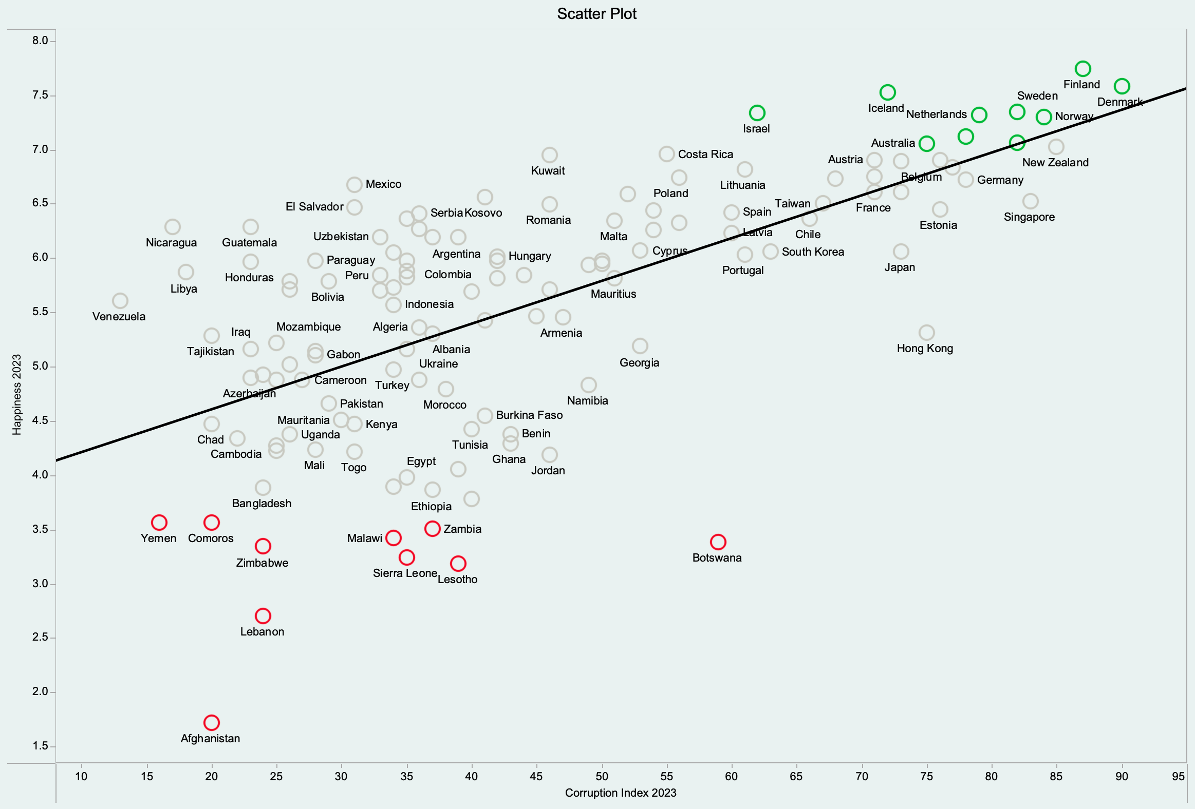
Happiness v/s Corruption index Scatter Plot​ with Regression Line

Slide 11
Corruption – Happiness Relationship
Negative Relationship
(Higher Corruption → Lower Happiness)
Positive Relationship
(Higher Corruption → Higher Happiness)
No Significant Relationship
Corruption can :
erode trust in institutions
limit economic opportunities
lead to social injustice
Countries with high corruption often experience:
poor public services
economic inequality
economic instability
In some societies, corruption may function as :
"lubricant" for bureaucracy
allowing people to bypass inefficient systems, potentially increasing happiness in the short term.
If corruption benefits the elite or those who can navigate it successfully, some groups may report higher happiness despite systemic corruption.
Other confounding factors that may have a stronger influence on happiness than corruption -
economic prosperity
cultural attitudes
health system
crime rate
social support networks

Slide 12
Confounder Variables
Income
Crime rates
Healthcare system
Literacy rates
Development level
Democracy
Global Competitiveness Index
Freedom index
Vices (drugs and alcohol)
Safety
Hunger index

Slide 13
A Perfectly Controlled Experiment?
Treatment Group
(50% randomly selected)
Introduce policies to make the country less corrupt
Control Group
(50% randomly selected)
Do not make any changes
Feasible option?
Propensity score matching
Why this is ideal and not feasible:
We cannot ethically amend societies with respect to corruption
Hard to isolate corruption as the sole factor

Slide 14
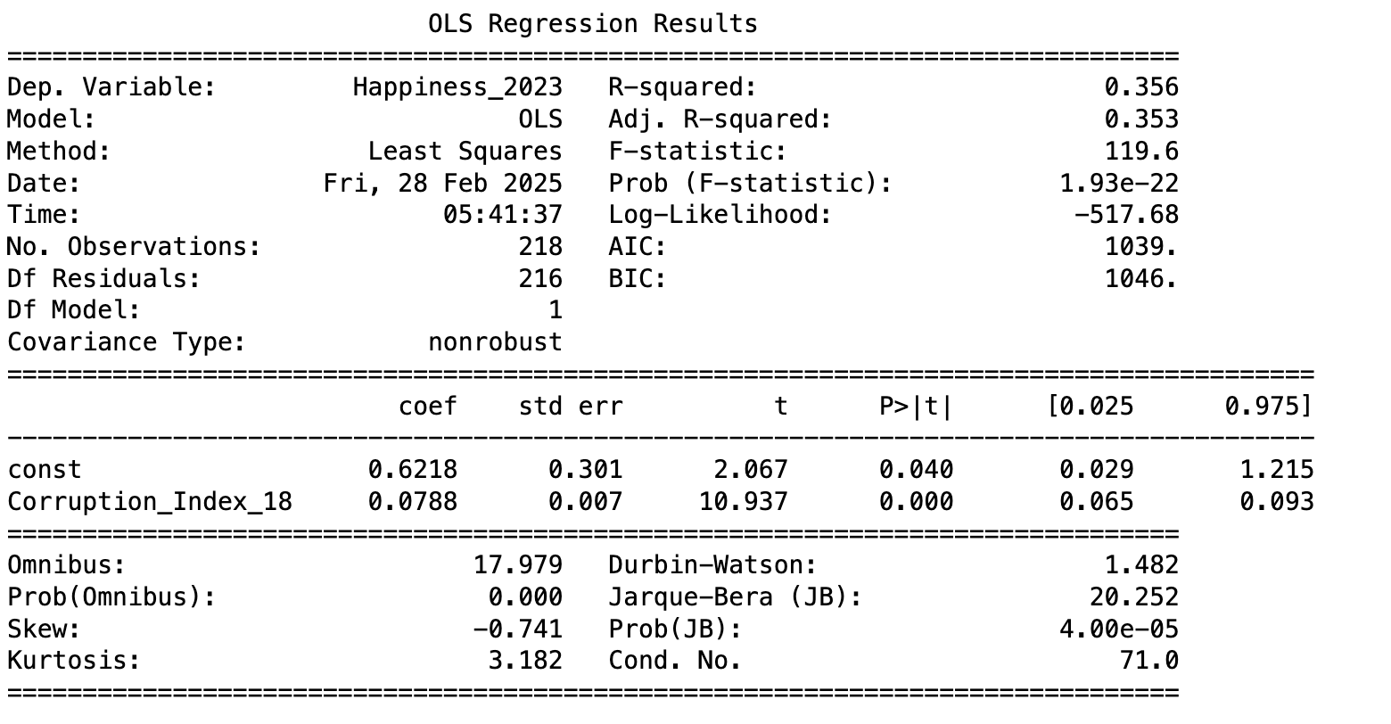
Simple linear regression
Simple Linear Regression on Happiness vs. Corruption Analysis

Slide 15
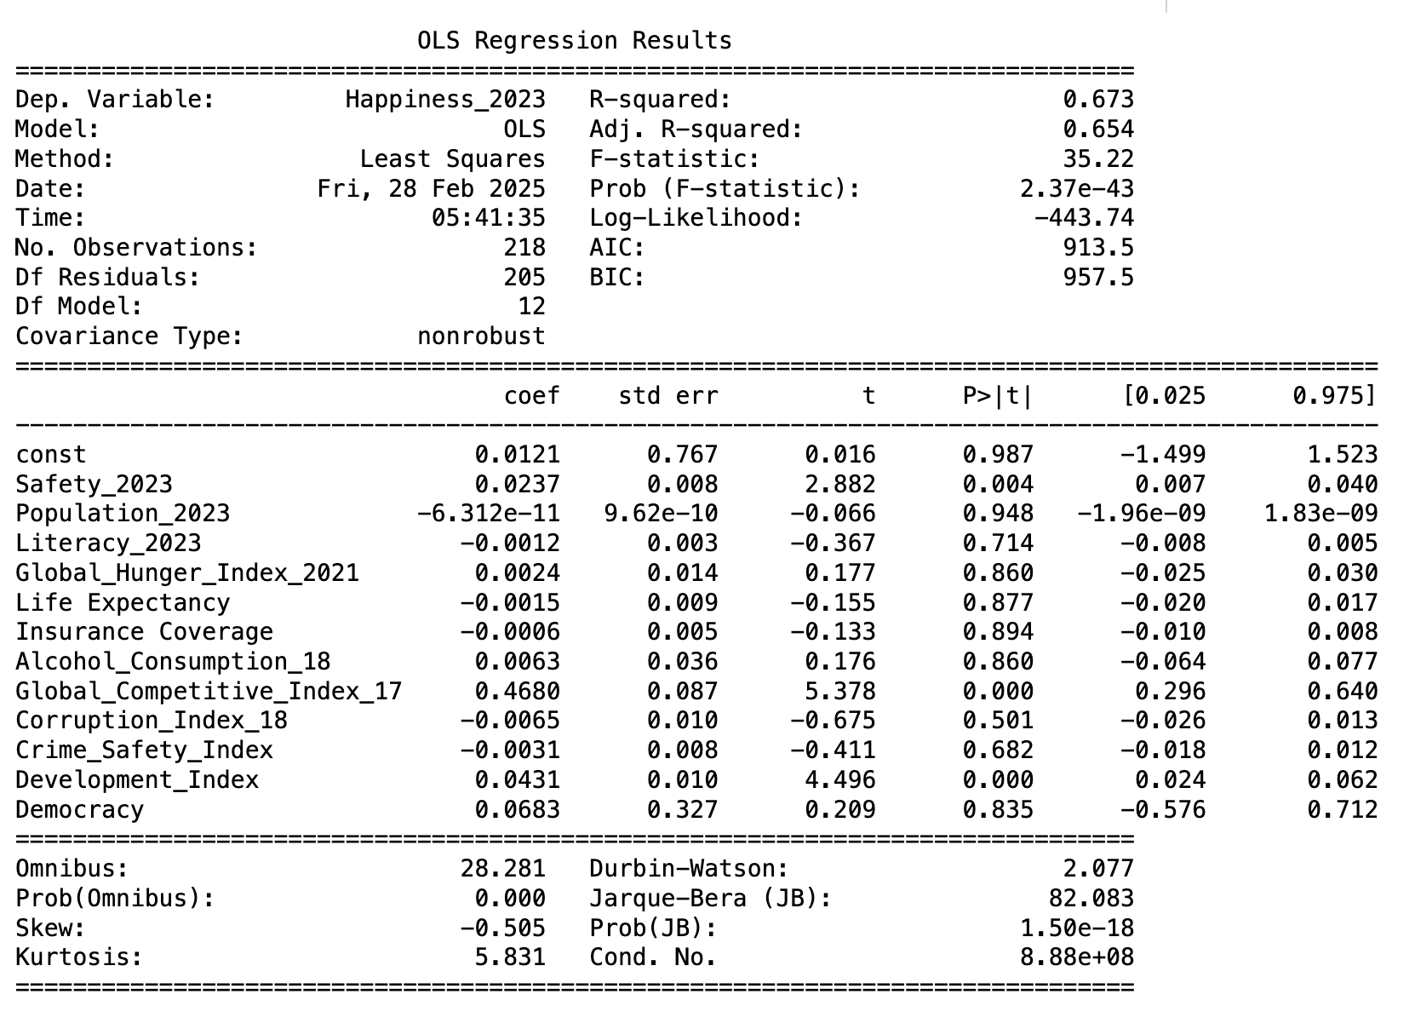
Multi Linear Regression model on Happiness Index
This model attempts to identify which societal factors most strongly predict national happiness levels.
The ones with p-values (< 0.05) are statistically significant.

Slide 16
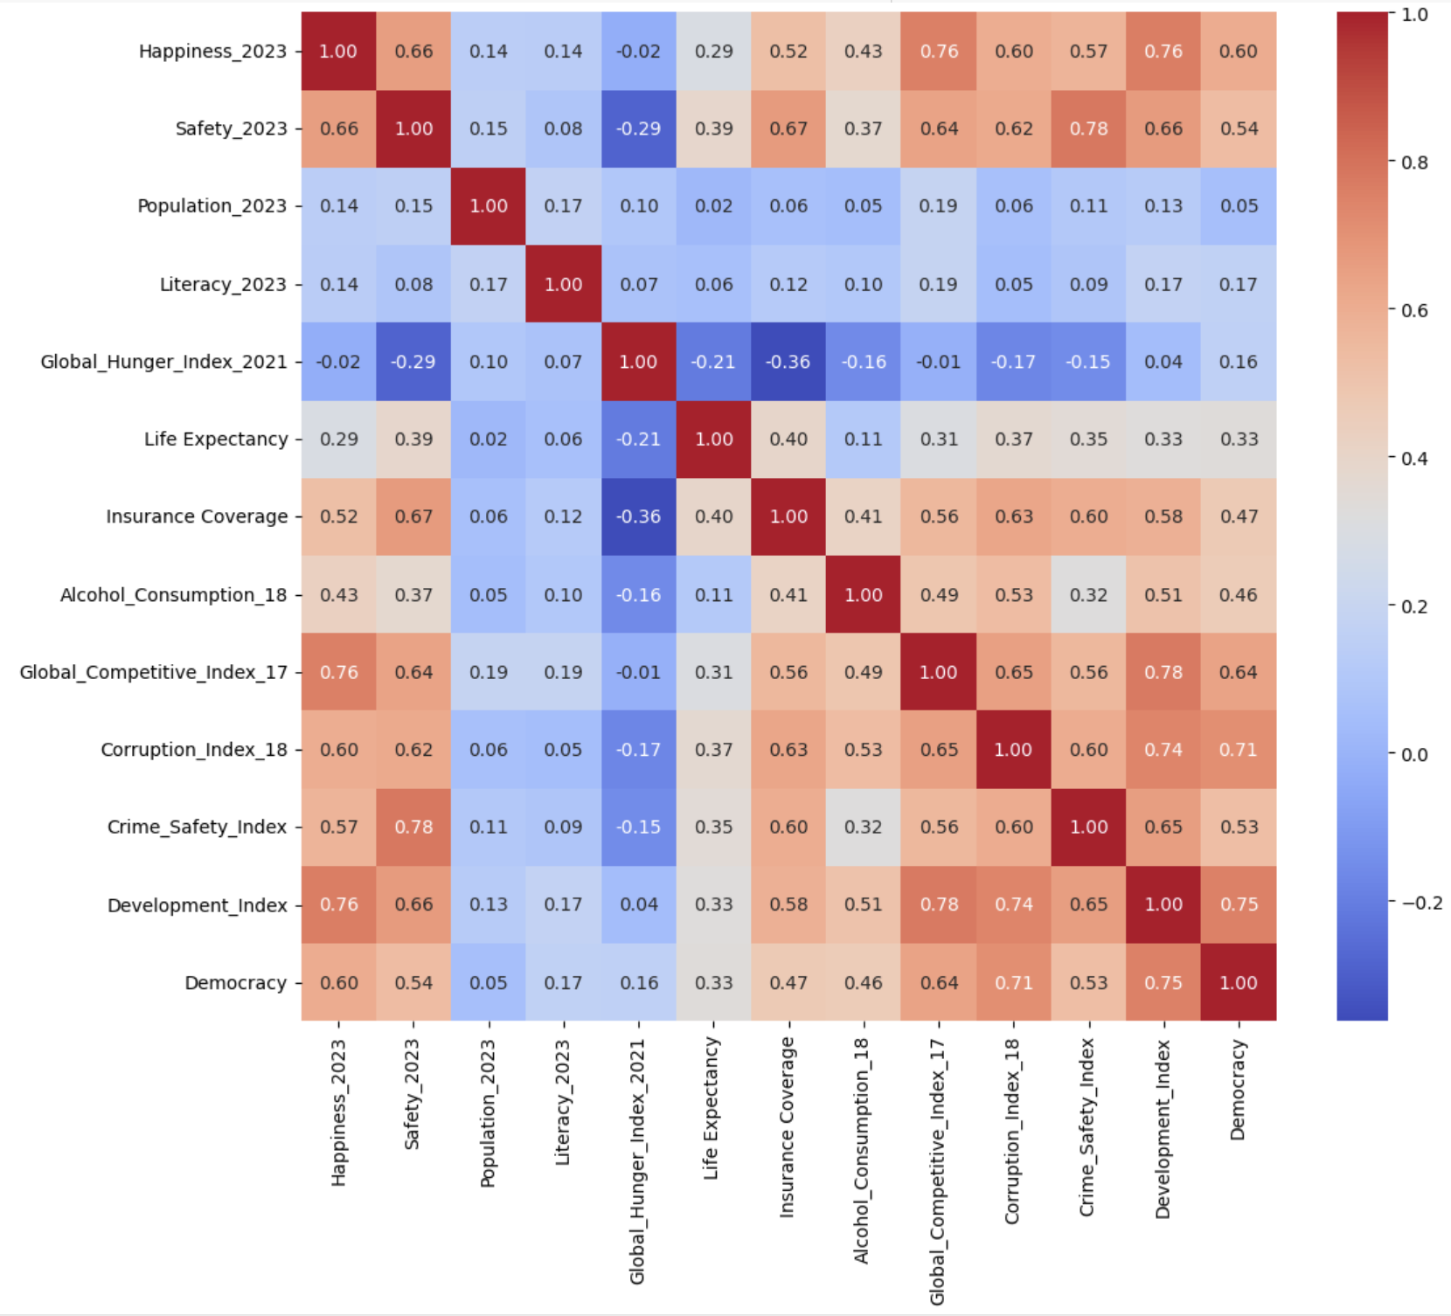
Correlation Matrix

Slide 17
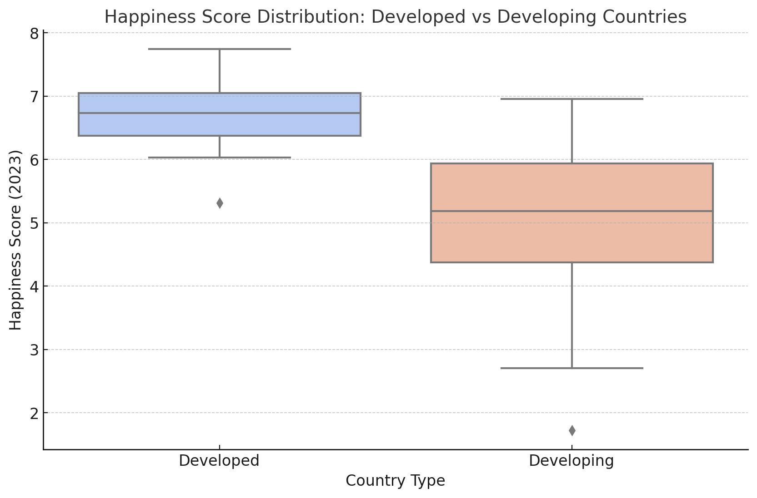
Box-plot for Developed/Non-developed countries
Developed Country Index
80th percentile = 68.92
The classification of developed nations corresponds to the top 20th percentile of happiness scores, a threshold we initially eyeballed and subsequently validated through rigorous verification.

Slide 18
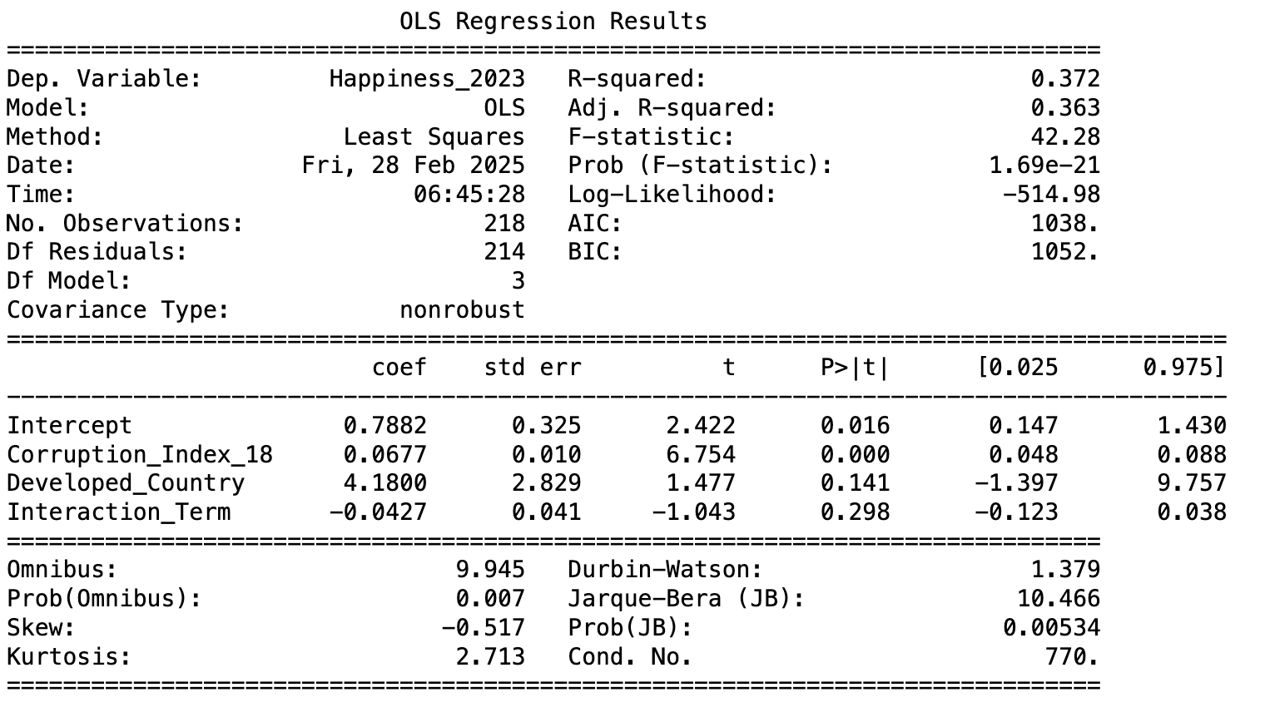
Regression model on happiness given corruption
The model is guiding us to explore the small details that shape happiness in both developed and under-developed nations.

Slide 19
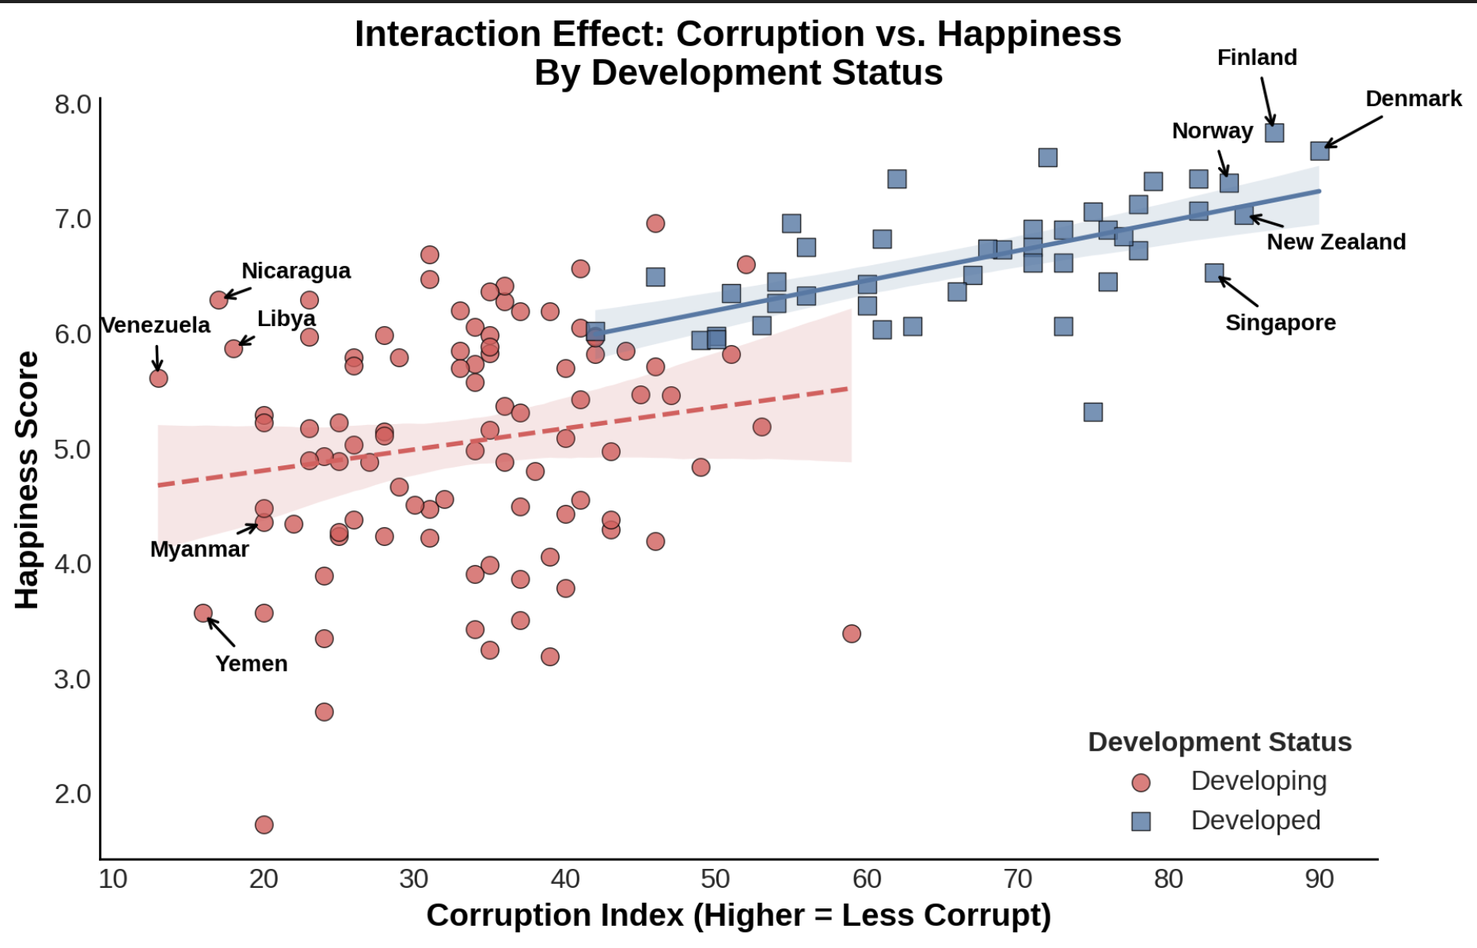
Regression trend for Developed / Developing countries
Regression Analysis
The linear trend showcases that the people living in less corrupt developed countries are more likely to be happy than the developing countries.
We have tried to visualize the same by using corruption index data along with developed flag and their interaction

Slide 20


