Slide 1

E-RAPORTO
One channel for every civic issue in Elbasan
A citizen reports with a photo and a pin. AI classifies and routes it. The citizen — not just the clerk — confirms it's actually fixed.
AI4Society Youth Innovation Hackathon · Tirana 2026
Alvi Peni · Eris Ekmekciu
Built for Bashkia Elbasan (Elbasan Municipality)
Notes:
[0:00-0:15] E-Raporto — one channel for every civic issue in Elbasan. A citizen reports with a photo and a pin, AI classifies and routes it, and the citizen — not just the clerk — confirms it's actually fixed. We're Alvi and Eris.

Slide 2



THE PROBLEM
A civic issue in Elbasan today has nowhere reliable to go
A pothole, a broken streetlight, an overflowing bin — a resident who notices it today posts it in a Facebook group, mentions it to a neighbor, or simply gives up. No reference number, no visible status, no way to know if anyone is even looking at it.
115,101
residents in Bashkia Elbasan
Albania's 3rd-largest municipality
Scattered
Untracked
Duplicated
Reports live across Facebook groups, phone calls and hallway conversations — never in one place.
No reference number, no status, no way to know if anyone is even looking at it.
Five residents report the same pothole separately — the municipality sees five unrelated tickets.
02
Notes:
[0:15-1:00] A pothole, a broken streetlight, an overflowing bin in Elbasan today has nowhere reliable to go — it gets posted in a Facebook group, mentioned to a neighbor, or the person gives up. There's no reference number, no visible status, and the same pothole becomes five unrelated tickets when five neighbors each report it separately. Elbasan is Albania's third-largest municipality — over 115,000 residents, 85.6% of them online — and none of that scattered civic energy reaches the municipality in a form it can act on. That's the urgency: this isn't a gap of care, it's a gap of channel.

Slide 3






SOLUTION + DEMO
One report, start to finish
1
2
3
4
5
Photo + pin + one sentence
AIclassifies & routes
Checked against nearby reports
Live to phone and dashboard
The citizen confirms it's fixed
No category to pick, nothing else required. Saved immediately — an AI call must never cost someone their report.
Roads & Infrastructure, 92% confidence — straight to the directorate's engineer. Below our 65% threshold, it waits for a person instead.
If neighbors already reported it, the citizen is offered a merge — not a sixth duplicate ticket.
Every change reaches both within milliseconds over one connection — no refresh button.
Not the municipality's word alone — the reporter is asked, with a photo and GPS check.
03
Notes:
[1:00-2:30] E-Raporto is a single channel connecting Elbasan's citizens straight to the municipality that owns the problem. Watch one report go all the way through. A citizen photographs a pothole on Rruga Kavaja, drops a pin, writes one sentence — nothing else required, saved immediately before anything else happens. Claude reads it, classifies it Roads and Infrastructure at ninety-two percent confidence, and routes it straight to the infrastructure directorate's engineer — because that clears our confidence threshold, this happens without waiting on a clerk. It's checked against nearby open reports; if neighbors already reported the same pothole, the citizen is offered a merge instead of a sixth ticket. Every change — status, assignment, a new duplicate found — reaches the citizen's phone and the staff dashboard within milliseconds over one live connection. And when the crew fixes it, the system doesn't take the municipality's word for it — it asks the citizen who reported it whether that's actually true. That answer, not the status label, is what we count as resolved.

Slide 4


USERS
Two real people, not invented personas
REPORTS IT
DECIDES & RUNS IT
Any resident of Elbasan
Elbasan’s Municipality Digital Platform Coordinator
Reports under a pseudonym the municipality itself can't see — so it's never held against a name in a city where everyone knows everyone. Confirms other reports. Verifies when staff say it's fixed.
The role that already exists inside Bashkia Elbasan to decide which tools the directorates adopt. Her team — six directorates, from Infrastructure to Water & Sewage — is who works the queue every day.
04
Notes:
[2:30-3:00] Two real people, not invented personas. The citizen — anyone in Elbasan with a phone, reporting under a pseudonym the municipality itself can't see. And the clerk — Arta Hoxha, the municipality's own Digital Platform Coordinator, is exactly who already decides which tools the directorates adopt, and who'd approve a pilot.

Slide 5

HOW IT WORKS
Honest AI — it proposes, a person decides
Every report is read by AI before a human sees it — with a deterministic fallback so the system never depends on one API call.
Category, priority, one-line summary
Below 65% confidence, it waits
One call classifies the report against Elbasan's own taxonomy.
Held for a person instead of auto-routed on a guess.
THREE MORE SIGNALS — EVERY ONE ONLY EVER PROPOSES
Possible duplicate
Root-cause cluster
Reused photo, Fraud Detection and Anti-Abuse System
Same problem, reported twice — distance + text overlap, scored openly.
Different reports that might share one cause — never merged, just linked.
A deterministic image match — not a claim to detect AI-generated fakes. Rate limit of posting reports/hour and detection to fraud.
05
Notes:
[3:00-3:30] Every report is read by Claude before any human sees it — category, priority, a one-line summary — with a rule-based fallback if the API is ever down. Below sixty-five percent confidence, nothing is auto-routed; it waits for a person. Three more signals run the same way — possible duplicates, clusters that might share one root cause, and photos reused across two different reports. All three only ever propose. A human always decides.

Slide 6
MARKET
Honest arithmetic, not a billion-euro guess
61
38
450+
municipalities in Albania
in Kosovo
across the Western Balkans
Every one of them runs departments, has a mostly-online population, and gets the same scattered Facebook-group reports we found in Elbasan. Nothing in E-Raporto is Elbasan-specific in code — a new municipality is a seed script: its own departments, categories, and routing rules as data, not a fork.
06
Notes:
[3:30-3:55] Albania has sixty-one municipalities, Kosovo thirty-eight, over four hundred fifty across the Western Balkans. Every one of them runs departments, has a mostly-online population, and gets the same scattered reports we found in Elbasan. Nothing about E-Raporto is Elbasan-specific in code — a new municipality is a seed script: its own departments, categories, and routing rules as data.

Slide 7


WHAT'S NEXT
From working prototype to a real pilot
NEXT 4 WEEKS
WHAT IT WILL COST · ROUGH, HONEST RANGES
Close a gap we found ourselves
Build it
~€2.5–3.5k
Testing our own app, we could file a fake Elbasan report from Tirana. Next sprint: a location check against the municipality boundary before a report is accepted — the same honest-signal pattern as our other three.
ONE-OFF
Prototype to pilot-ready — 2 people × 4 weeks
Pilot setup
~€500–1,000
ONE-OFF
Data prep, integration, staff training
Activate real push notifications
Run it
~€50–100
Already built and wired end to end — one setup step (linking a production build) turns it on.
MONTHLY
Hosting + Claude API usage at pilot volume
Maintain it
~€1.5–2.5k
PER YEAR
Updates, support, fixes
07
Notes:
[3:55-4:35] Two concrete things in the next four weeks. First — testing our own app, we found we could file a fake Elbasan report from Tirana. So next sprint: a location check against the municipality boundary before a report is accepted, the same honest-signal pattern as our other three. Second, activating the real push notifications already built and wired — one setup step we haven't run yet. To get a real pilot ready: build, around two-and-a-half to three-and-a-half thousand euros over four weeks; pilot setup, under a thousand; running it, fifty to a hundred euros a month; maintaining it, roughly two thousand a year.

Slide 8

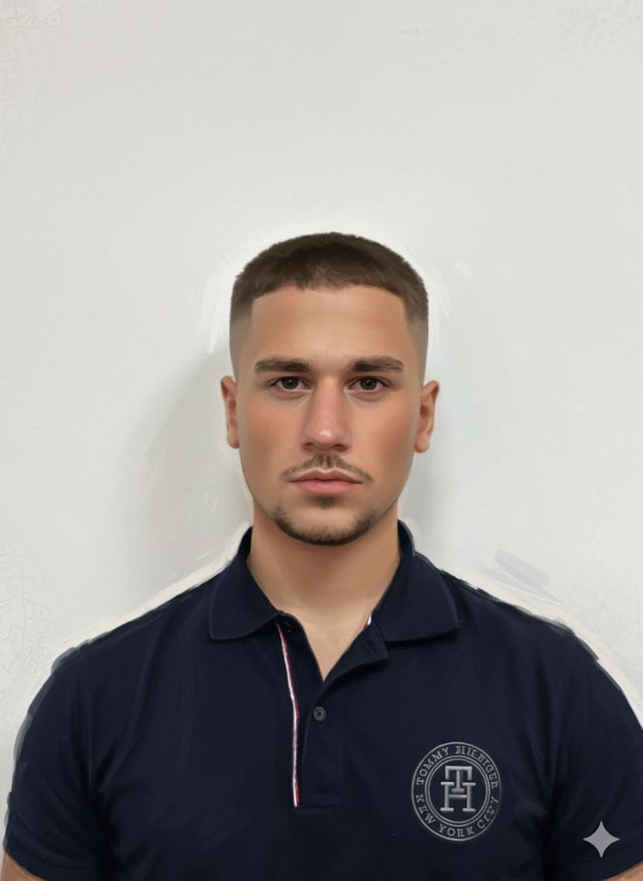

E-Raporto
Thank you
Two developers who built, tested and broke this ourselves — before asking Bashkia Elbasan to run it.
Alvi
Eris
Full-stack Developer
Full-stack Developer
AI4Society Youth Innovation Hackathon · Tirana 2026
Notes:
[4:35-4:45] Alvi and Eris. Two developers who built, tested, and broke this ourselves before asking Bashkia Elbasan to run it. Thank you. [This slide stays up during the 3-minute Q&A — see the prepared answers to the three expected questions: data privacy, no-IT-capacity municipalities, and maintenance cost.]

