Slide 1


Python Workshop.

Slide 2
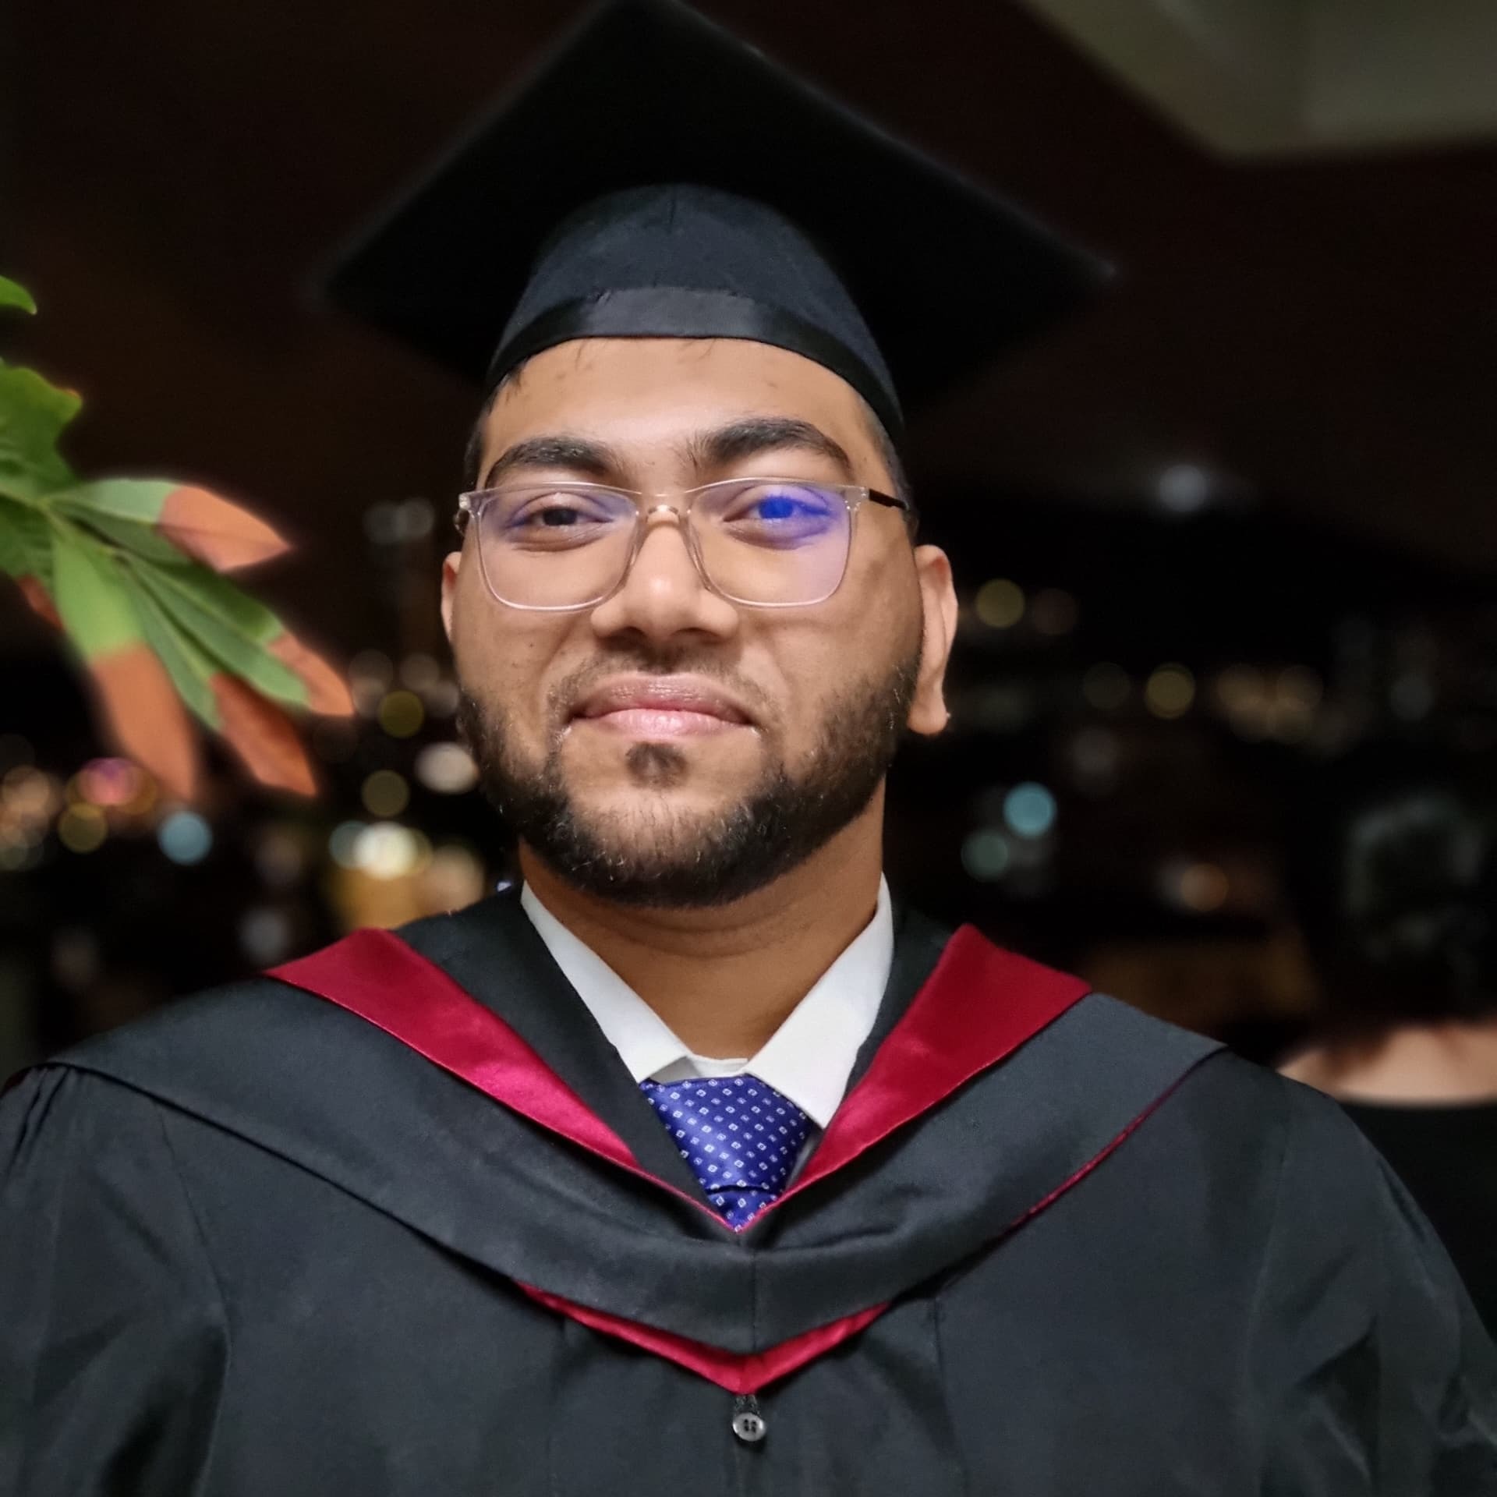
Hello! I’m Alvi Khan Chowdhury
Few things about myself:
Graduate Mechatronic Engineer, UCSI University.
BEM Graduate Member
Master of Engineering Science (Research) Student, Monash University Malaysia (Current)
IEEE Graduate Student Member 2024
IEEEXTREME Ambassador, Monash University Malaysia (Current)

Slide 3
Contents for the Session
01
Variables, Data Types, Operators
02
Conditional Statements, Loops
03
Lists, Tuples, Range Function

Slide 4
Thank you!
Email: alviavailable@gmail.com
LinkedIn: https://www.linkedin.com/in/alvi-khan-chowdhury-329247214/

