Slide 1


Machine Vision (YOLOV8) Workshop.

Slide 2

Hello! I’m Alvi Khan Chowdhury
Few things about myself:
Graduate Mechatronic Engineer, UCSI University.
BEM Graduate Member
Master of Engineering Science (Research) Student, Monash University Malaysia (Current)
IEEE Graduate Student Member 2024
IEEEXTREME Ambassador, Monash University Malaysia (Current)

Slide 3
What is YOLO?
YOLO (You Only Look Once) is a real-time object detection algorithm developed in 2015 by Joseph Redmon and Ali Farhadi. It uses a convolutional neural network (CNN) to predict bounding boxes and class probabilities of objects in images. Implemented with the Darknet framework, YOLO processes the entire image in one pass, making it faster and more efficient than two-stage detectors like R-CNN. The algorithm divides the input image into a grid, predicting the probability, bounding box coordinates, and class of objects within each cell.

Slide 4
YOLO Algorithm Steps.
01
Residual Blocks
02
Bounding Box Regression
03
Intersection Over Union (IOU)
04
Non-Maximum Suppression

Slide 5
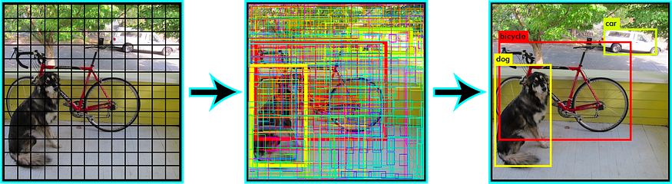
This step divides the original image into an NxN grid of equal cells (N is 13 in our case). Each cell is responsible for identifying and predicting the class of the object it covers, along with a confidence score.
01
Residual Blocks

Slide 6
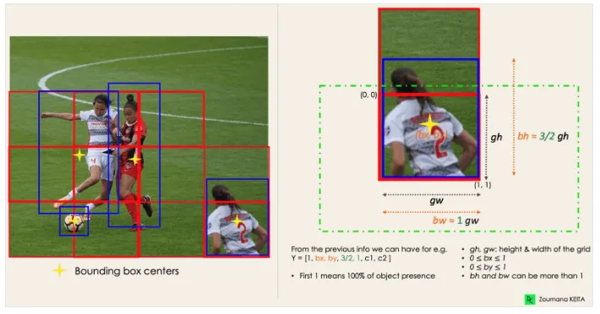
Bounding box regression predicts the coordinates of a bounding box around an object in an image. YOLO uses a single regression module to determine these attributes in the format Y = [pc, bx, by, bh, bw, c1, c2], where:
pc: Probability score of the grid cell containing an object.
bx, by: X and Y coordinates of the bounding box center relative to the grid cell.
bh, bw: Height and width of the bounding box relative to the grid cell.
c1, c2: Class probabilities for the object (e.g., Player and Ball), with flexibility for more classes based on the use case.
02 Bounding Box Regression

Slide 7
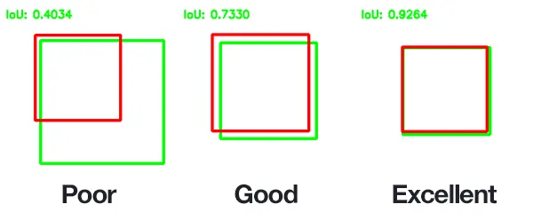
Intersection over Union (IOU) is a metric for evaluating the overlap between two bounding boxes. It measures how well the predicted bounding box matches the ground truth box. IOU is calculated by dividing the area of overlap by the area of union of the two boxes. A higher IOU indicates better detection accuracy and is commonly used to assess object detection algorithms.
03 Intersection Over Union

Slide 8
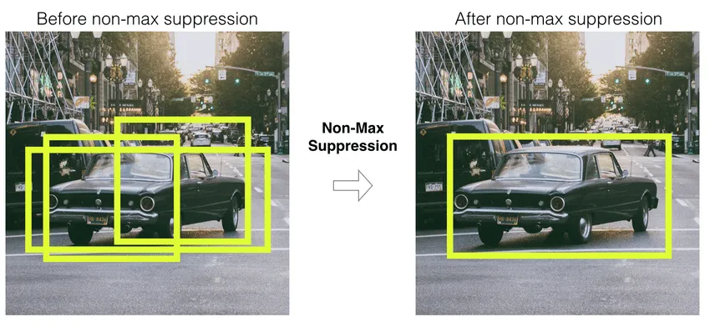
Setting an IOU threshold alone is not enough because multiple boxes can have IOU values above the threshold, which can introduce noise. Non-Maximum Suppression (NMS) helps by keeping only the boxes with the highest probability scores, reducing redundancy.
04 Non-Maximum Suppression

Slide 9
YOLOV8
YOLOV8 is the latest version of YOLO by Ultralytics. As a cutting-edge, state-of-the-art (SOTA) model, YOLOV8 builds on the success of previous versions, introducing new features and improvements for enhanced performance, flexibility, and efficiency. YOLOV8 supports a full range of vision AI tasks, including detection, segmentation, pose estimation, tracking, and classification.

Slide 10
Vision AI Tasks Supported by YOLOV8
Detection: Object detection is a task that involves identifying the location and class of objects in an image or video stream.
Segmentation: Instance segmentation goes a step further than object detection and involves identifying individual objects in an image and segmenting them from the rest of the image.
Pose Estimation: Pose estimation identifies specific points in an image, called keypoints. These keypoints can represent parts of an object like joints or landmarks. The locations of keypoints are usually given as 2D [x, y] or 3D [x, y, visible] coordinates.
Tracking: Object tracking in the realm of video analytics is a critical task that not only identifies the location and class of objects within the frame but also maintains a unique ID for each detected object as the video progresses.
Classification: Image classification involves classifying an entire image into one of a set of predefined classes.

Slide 11
Contents for the Session.
01 | Create Custom Dataset
02 | Train custom dataset using YOLOV8
03 | Validate the trained model
05 | Predict using trained custom model
06 | Q & A Session
04 | Predict for detection, segmentation and pose estimation using pretrained model

Slide 12
Important Links
YOLOV8 Github: ultralytics/ultralytics: NEW - YOLOv8 🚀 in PyTorch > ONNX > OpenVINO > CoreML > TFLite (github.com)
YOLOV8 Basic: Ultralytics YOLOv8 Modes - Ultralytics YOLO Docs

Slide 13
Thank you!
Email: alviavailable@gmail.com
LinkedIn: https://www.linkedin.com/in/alvi-khan-chowdhury-329247214/

