Slide 1
Big data analytics: final Project
Álvaro Esteban Muñoz

Slide 2
Problem description
Stress recognition
Long-term stress is known to have harmful effects in person, effects that can be physically noticed like cardiovascular diseases or sleep disturbances. Hence, developing systems for its automatic detections becomes an important task inside the field of affective computing.
Project aims
In this project, we deal with WESAD, a widely adopted standard dataset for stress detection, harnessing the distributed computing and data storage capabilities of Hadoop and Spark. Our aim is to efficiently classify the vast volume of data contained within this dataset.
BDA Final Project

Slide 3



System description
The system used for the Project was a Debian 10 machine with a Hadoop DFS in pseudo-distributed mode for data storage and YARN as a resource manager.
All the computations are done using the Apache Spark framework, namely its API for Python, PySpark.
BDA Final Project
BDA Final Project

Slide 4
Machine Specifications
Operating System | Debian 10
RAM | 4GB
Nº Processors | 2
VRAM | 256MB
HDD | 30GB
Hadoop’s version | 3.3.6
Spark’s version | 3.0.1
BDA Final Project

Slide 5
The data:
Wearable stress and affect detection (WESAD)
Data structure
Synchronized data
Feature selection
“WESAD contains data from 15 subjects during a stress-affect lab study, each one having its own dedicated folder.”*
Inside each subject’s folder a lot of information can be found. Namely this Project focuses on the synchronized data.
The synchronized data are pickle files, one per subject, containing the sampling of the measured signals synchronized with the annotated labels.
Sampled metrics are taken from two devices, one from the chest and the other one from the wrist.
All the features taken from the chest, as well as the labels, are sampled at 700Hz.
However, the sampling rate for the wrist device is always smaller and it has a different one for each feature. Hence to avoid errors for oversampling we discarded these features.
* Introducing WESAD, a Multimodal Dataset for Wearable Stress and Affect Detection. DOI: 10.24432/C57K5T
BDA Final Project
BDA Final Project

Slide 6
Synchronized data structure
SX.pkl
signal
label
subject
chest
wrist
label – true labels sampled at 700Hz
subject – subject ID
chest features – 6 features taken from the chest device sampled at 700Hz
wrist features – 4 features taken from the wrist device sampled at different frequencies (always less than 700Hz)
chest features
wrist features
BDA Final Project

Slide 7

Other considerations about the dataset
Label values
As stated in the README.md file, labels are defined as follows:
0 → not defined
1 → baseline
2 → stressed
3 → amusement
4 → meditation
5, 6, 7 → not used
ACC – multidimensional feature
The ACC feature is measured with 3 different accelerometer channels. Hence, each channel was considered as a different feature.
Data format
Data is given in pickle files, which is not very well supported by Spark, hence data is first converted to parquet before putting it on the HDFS.
BDA Final Project

Slide 8
Preprocessing pipeline
Remove unused labels
The README.md file specifies that labels from 5 to 7 are not used in this dataset. In addition, we are not interested in labels 0 (not defined) and 4 (meditation). All these labels will be removed by a user-defined transformer.
Change label’s range
Some classifiers work only with labels with a range that starts in 0 (MLP). Therefore, we change our labels range from [1, 2, 3] to [0, 1, 2].
Assemble features
Classifiers in Spark receive a vector of features as input. Hence we need to assemble all our feature columns into the same columna containing a vector of input features.
Min-max scaling
Range of values is modified to have values ranging in the Interval [0, 1]. This is because some classifiers need this range as input (NB).
BDA Final Project
BDA Final Project

Slide 9
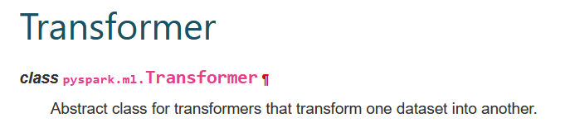
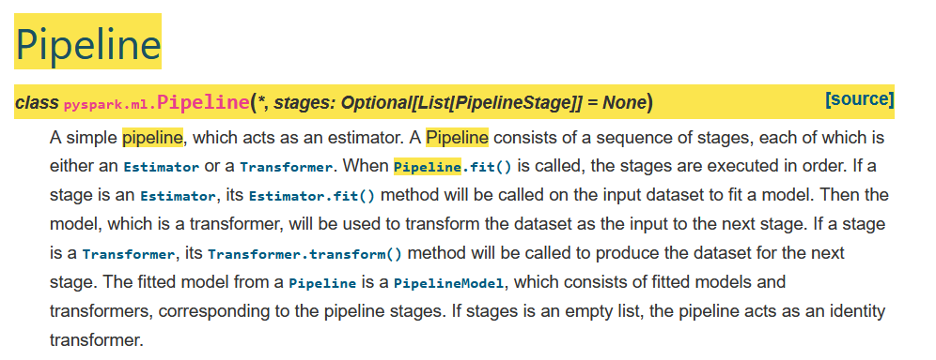
The transformer class
For the implementation of our pipeline we have created our own Transformer extending from Spark’s original class. This transformer contains all of our filters in a SQL format and will filter the passed dataset applying them.
After our transformer for the cleaning of data is created, we add it to our pipeline by just using the pipeline object from Spark. The defined stages for our pipeline will be those ones described in the previous slide.
BDA Final Project
BDA Final Project

Slide 10
Data statistics
 | ACC_1 | ACC_2 | ACC_3 | ECG | EMG | EDA | Remp | Resp | Label
count | 60807600 | 60807600 | 60807600 | 60807600 | 60807600 | 60807600 | 60807600 | 60807600 | 60807600
mean | 0.8117 | -0.0442 | -0.259 | 0.0011 | -0.003 | 4.8882 | 33.9049 | 0.0542 | 1.3347
stddev | 0.1313 | 0.1039 | 0.3322 | 0.2687 | 0.0179 | 3.5312 | 1.2169 | 4.0991 | 1.6283
min | -6.5999 | -6.5999 | -6.5999 | -1.5 | -1.5 | 0.0 | -273.15 | -50.0 | 0
max | 2.9814 | 1.609 | 4.5082 | 1.5 | 1.4643 | 22.411 | 35.778 | 38.8 | 7
Data after preprocessing is still more than 23 million samples, which is still a huge amount of data. This makes impossible for us to create graphics using the data since we would need powerful computers.
BDA Final Project

Slide 11
parametric approaches
Decision Tree
Non-Parametric approaches
Random Forest
Naive Bayes
Logistic Regression (OneVsRest)
Multilayer Perceptron
BDA Final Project
BDA Final Project

Slide 12
Results
Classifier | Accuracy | Accuracy (PAPER)
Decision Tree | 0.7626 | 0.5862
Random Forest | 0.8017 | 0.7137
Naive Bayes | 0.5312 | -
Logistic Regression | 0.5533 | -
Multilayer Perceptron | 0.5533 | -
Notice that in the original paper the best result is achieved by AdaBoost algorithm which reaches a 0.8034
BDA Final Project
BDA Final Project

Slide 13
Discussion
Why parametric approaches do not reach to non-parametric approach accuracy?
In general, non-parametric approaches work better because they do not perform any assumptions on data distributions, unlike to parametric models. However, they need much more data to be trained.
Regarding data management, we had noticed a good improvement in efficiency when loading data thanks to Hadoop and Spark, even in pseudo-distributed mode. This is because even if data is not distributed across different physical machines, parallelization can also be achieved inside a single node setup. In addition, the formats used by Hadoop and Spark are optimized for Big Data processing.
BDA Final Project
BDA Final Project

Slide 14
Possible improvements
Perform EDA using techniques for dimensionality reduction such as PCA or performing it on a small portion.
Scale the project to work on several machines using fully distributed storage.
Try other ML models.
BDA Final Project

Slide 15
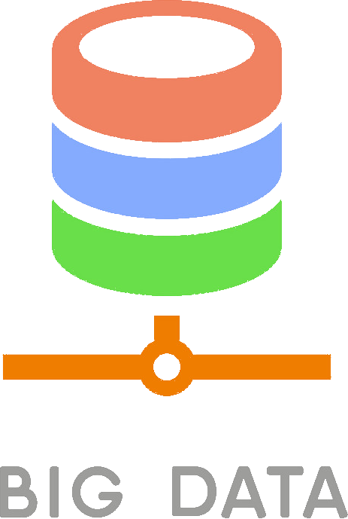
Thanks for listening

