Slide 1

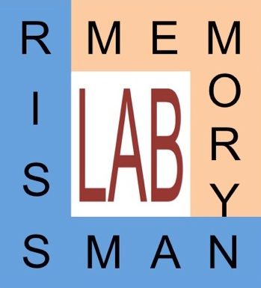

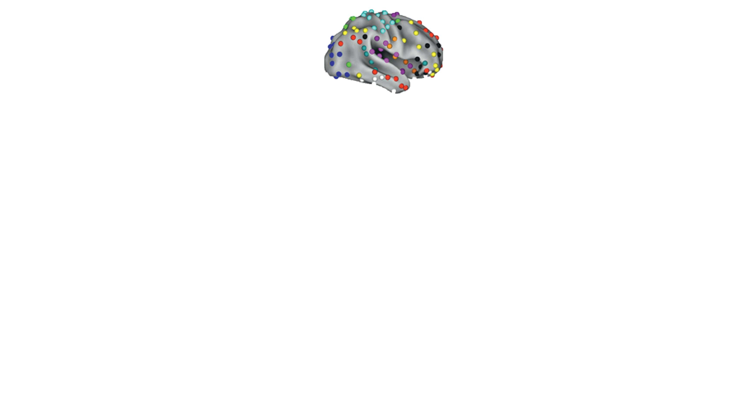

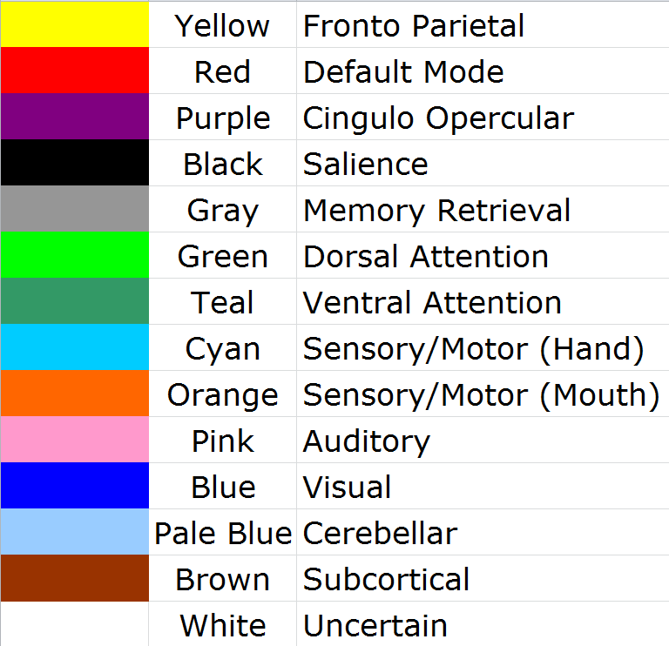
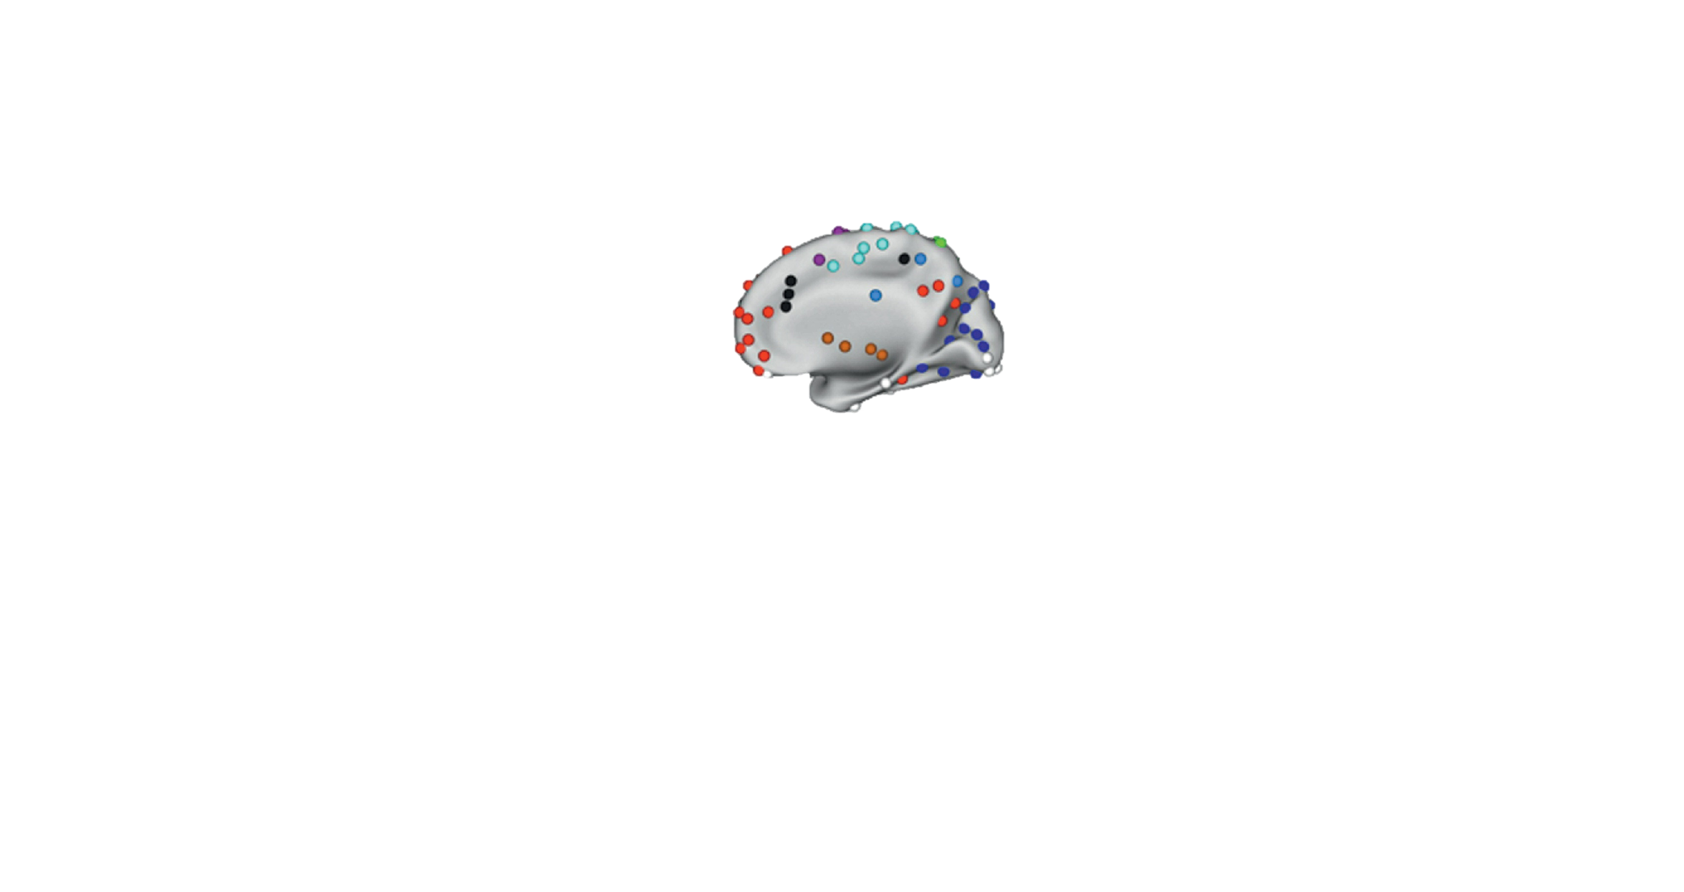
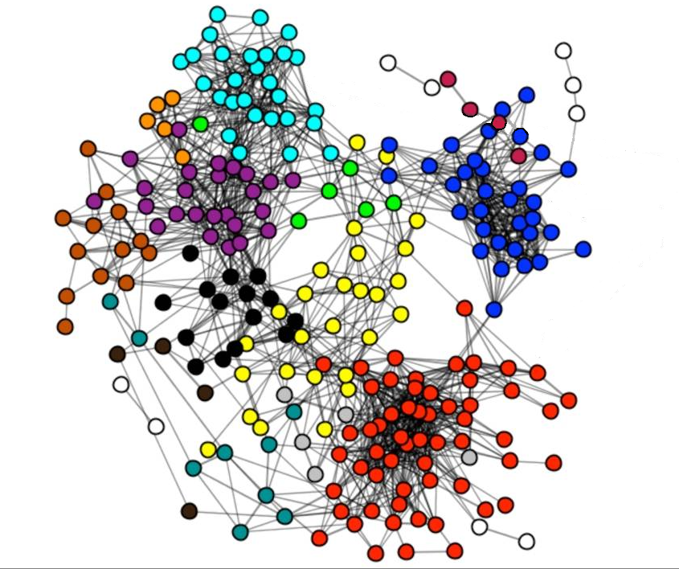
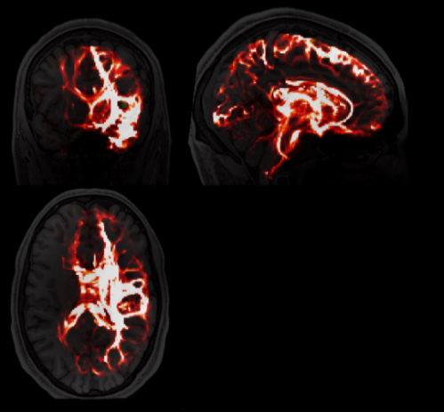
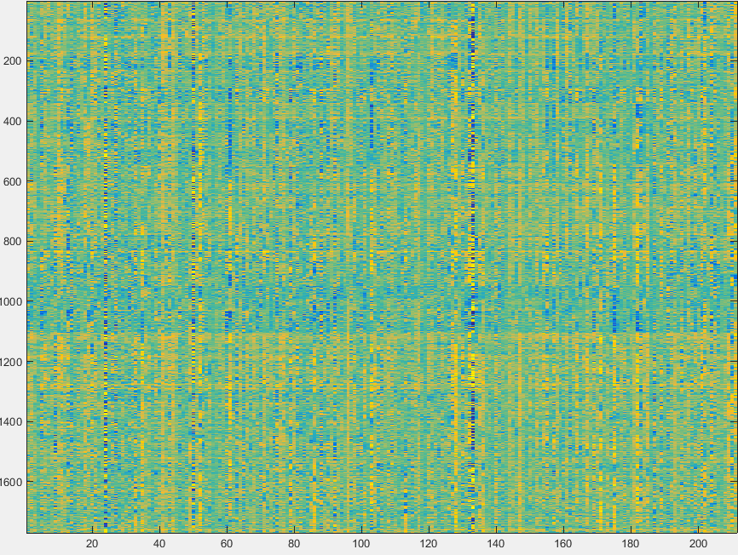
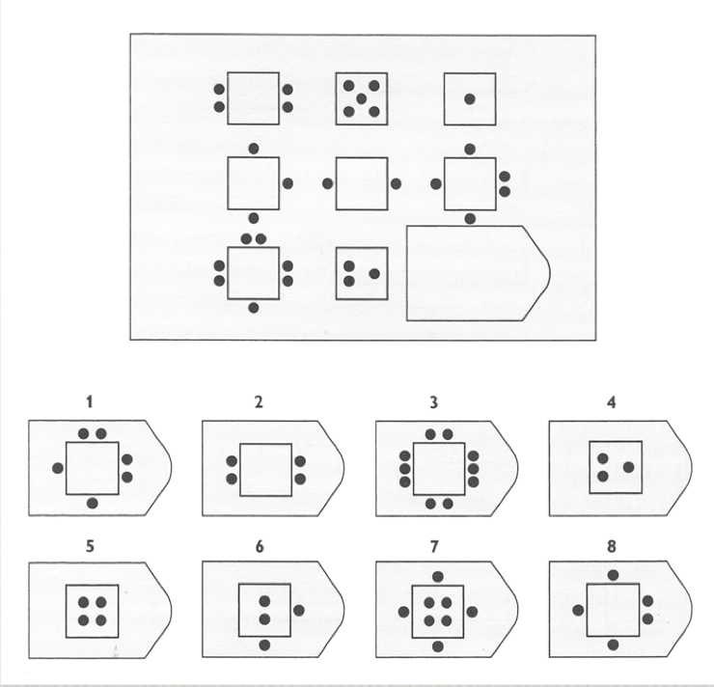

Neural Correlates of Fluid Intelligence
via Functional and Structural Network Connectivity Measures
Alvin Vuong^{1,2}, Nicco Reggente¹, Jesse Rissman^{1,3}
¹Department of Psychology, ²Department of Computer Science, ³Department of Psychiatry & Biobehavioral Sciences, University of California, Los Angeles
sf
Methods
Introduction
Results
Connectivity across regions in the brain can be characterized as either functional (FC; correlated fluctuations in brain activity as measured by fMRI data) or structural (SC; white matter pathways as measured by diffusion-weighted MRI data, dMRI).¹
Emerging studies suggest that the patterns of connectivity across brain regions that make up distinct cognitive networks can partially explain individual differences in behavioral traits.^{2,4,5}
One benchmark of fluid intelligence(FI) is the domain-invariant ability to identify and extrapolate patterns across distantly related ideas.^{1,4,5}
The Fronto-Parietal Network (FPN) and Cingulo Opercular Network (CON) have been shown to be associated with aspects of higher-order cognitive functions.⁶⁻⁸
The CON has been shown to deregulate activity in the Default Mode Network (DMN) by acting as a cognitive “switchboard”, preventing the DMN from engaging in self-referential thinking, allowing one to concentrate on the task at hand.⁷
Extending previous research⁸, we hypothesized that the SC and FC between the FPN, CON, and DMN could be predictive of a person’s intelligence.
In the present study, we train a support vector regression model using data provided by the Human Connectome Project ^{10*} (HCP) to assess the degree to which the combined inter/intra-network FC and SC of individuals’ FPN, CON, and DMN might account for variance in fluid intelligence scores.
We analyzed resting-state fMRI (rfMRI) and dMRI data from 127 HCP Subjects^{10*}.
We used 264 unique regions-of-interest (parcellated into 14 cognitive networks) that were identified in a meta-study as belonging to 14 distinct cognitive regions⁹ in both our FC and SC analyses.
rfMRI: We took the mean of all BOLD values from voxels within each ROI at each time-point. We then correlated each ROI’s mean time series to create a FC matrix for each subject.
dMRI: We used a probabilistic tractography algorithm to assess the anatomical connectedness between any pair of ROIs to create a SC matrix for each subject.
We were able to index the FC and SC matrices as a function of network-membership to create “feature sets” that we used within a support vector regression leave-one-subject out cross-validation framework. This allowed us to build a model on n-1 subjects’ feature sets and predict the n^{th} subject’s FI score.
Our feature sets were indexed and manipulated as follows:
By correlating the array of predicted PMAT scores with the matched array of subjects’ actual PMAT scores, we were able to obtain an R² value – the percent of the variance in FI that our model was able to account for.
The model’s success was selective to the inter/intra-network connectivity between the DMN and a combined Salience (Sal) & CON Network, most notably when looking at the mono-directional SC, upper 50% SC mask over FC, and multiplied FC & SC.
***
**
*
*
*
*
Each ROI was used as a “seed” to assess its anatomical connectivity with the rest of the brain, allowing us to infer the connectivity across all pairs of ROIs.
* < 0.05 ** < 0.005 *** < 0.00005
Conclusions
While network FC and SC metrics within a single network didn’t show much predictive power, DMN ←→ S & CON inter/intra-network SC accounted for a significant portion of variance, insinuating that the structural integrity across these networks is important for completing the cognitive tasks demanded by the PMAT. This metric of anatomical connectivity strength might reflect the ability of an individual to utilize the purported networks’ collaborative function.
Since we used resting state data, it is understandable that the functional connectivity across these networks had little to no predictive power. Our SC and FC interaction feature set may reflect the ability of the two networks to transform their resting activities and enter into a harmonious relationship when engaging in a task. We can’t necessarily predict the number of minutes a commuter will spend in traffic by knowing the activity of vehicles in the starting and ending locations. However, if we knew the effectiveness of the roads connecting the two locations (e.g. how many lanes are open on the 405) AND the activity of the vehicles in the starting and ending locations, we would have significantly more information. Resting state activity is analogous to the vehicles at the starting and ending locations and the SC is analogous to the number of lanes open on the 405.
The CON has been shown to be a domain-general, task-control network,⁶ while the DMN has been shown to be the opposite, whose decreased activity associates with task control.³ It has also been shown that the CON might actually be involved in causally inhibiting the DMN during tasks.⁷
Perhaps, what our results are picking up is the efficiency of the CON’s ability to inhibit the DMN, so that a subject is not distracted by any internally generated narrative that could distract them from successfully engaging in the difficult task at hand. Since other tasks may elicit a variety of motivational effects that could drive performance, it’s not necessary for this effect to translate outside of this domain-invariant test of intelligence.
Our results support the hypothesis that the structural and functional connectivity between the CON and the DMN can at least partially explain an individual’s ability to perform a complex pattern completion task such as the PMAT.
Intra- vs. Inter-Network Connectivity
Example Feature Set For N = 127 Subjects:
FC only w/in the DMN (wX_f)
sf
Within a single network (wX)
Across bi-directional two networks (amXY)
Across mono-directional two networks (aoXY)
Cognitive Task Paradigm
Raven’s Progressive Matrices
SC vs. FC
References
FI was assessed using the Penn Progressive Matrices (PMAT) test.
Subjects were presented with a series of evolving patterns. They were tasked with selecting the correct next pattern from a list of options.
The pattern completion task consisted of 24 items, arranged in order of increasing difficulty.
Colom, R. et al. (2010). Human intelligence and brain networks. Dialogues in Clinical Neuroscience, 12(4), 489-501.
Dubois, J. and Adolphs, R. (2016). Building a science of individual differences from fMRI. Trends in Cognitive Sciences, n. pag.
Basten, U. et al. (2013). Intelligence is differentially related to neural effort in the task-positive and the task-negative brain network. Intelligence, 41.5, 517-528.
Ohtani, Toshiyuki et al. (2014). Medial frontal white and gray matter contributions to general intelligence. PLoS ONE, 9.12, e112691.
Malpas, Charles B. et al. (2016). MRI correlates of general intelligence in neurotypical adults. Journal of Clinical Neuroscience, 24, 128-134.
Dosenbach, N. U. F. et al. (2007). Distinct brain networks for adaptive and stable task control in humans. Proceedings of the National Academy of Sciences, 104.26, 11073-11078.
Chen, A. C. et al. (2013). Causal interactions between fronto-parietal central executive and default-mode networks in humans. Proceedings of the National Academy of Sciences, 110.49, 19944-19949.
Cornali, C., Reggente, N., Rissman, J. (2015). The predictive power of functional network connectivity in cognitive function. Poster session presented at: Psychology Undergraduate Research Conference; 2015 May 8; Los Angeles, CA.
Power, J. D. et al. (2011). Functional network organization of the human brain. Neuron, 72.4, 665-678.
Van Essen, D.C., et al. (2013). The WU-Minn Human Connectome Project: An overview. NeuroImage, 80, 62-79.
Structural or Functional Only (s or f)
Masking the functional data to only include the values that showed either the highest or lowest structural connectivity (smof_u, smof_l)
Masking the structural data to include the values that showed either the highest or lowest functional connectivity (fmos_u, fmos_l)
Multiplying the Structural and Functional (interact)
*Data were generously provided by the Human Connectome Project (Q3 release), WU-Minn Consortium (PIs: David Van Essen &
Kamil Ugurbil; 1U54MH091657) funded by the 16 NIH Institutes and Centers that support the NIH Blueprint for Neuroscience
Research; and by the McDonnell Center for Systems Neuroscience at Washington University
Contact: Alvin Vuong <alvin.t.vuong@ucla.edu>, http://rissmanlab.psych.ucla.edu
Notes:
SPM – Statistical Parametric Mapping (analysis of brain imaging data sequences, like time series data)
FMRIB – Oxford Centre for the fMRI of the Brain
FLIRT – FMRIB‘s Linear Image Registration Tool
BEDPOSTX – Bayesian Estimation of Diffusion Parameters Obtained using Sampling Techniques (X stands for modelling Crossing Fibres)
P-FIT – Parietal-Frontal Integration Theory of Intelligence
58 Nodes in DMN = 58*57/2 total relevant ROI pairings (n*(n-1)/2)

