Slide 1


Testing React Apps
Alvin Yeo
29 Oct 2021

Slide 2
Purpose of Testing
To check whether your application always behaves as expected.
Safeguard against unwanted behavior when changing the code.
Add new features
Refactor code
Update dependencies
By writing automated tests, it gives you a lot of confidence when working on your project.
You can check if your application still working fine very quickly, without having to manually test your application, which is time consuming especially for large application.
It is more efficient in the long run.

Slide 3
React Testing
You can test React components similar to testing other JavaScript code.
Recommended tools:
Jest
React Testing Library (RTL)
React Testing Library is not an alternative to Jest.
They work together.
Every new React project comes with Jest and React Testing Library.
npx create-react-app project-name

Slide 4

Jest
A JavaScript Testing Framework maintained by Facebook.
A test runner that
Find tests
Run tests
Determine whether tests pass or fail
Jest will look for test files with any of the following popular naming conventions in src folder:
Files with .js suffix in __tests__ folders.
Files with .test.js suffix.
Files with .spec.js suffix.
Notes:
https://create-react-app.dev/docs/running-tests/

Slide 5
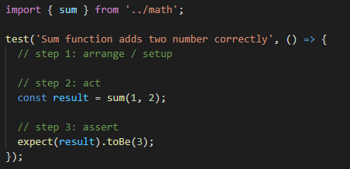
Jest
Basic test & structure (AAA Pattern)
List of matchers
https://jestjs.io/docs/using-matchers
https://jestjs.io/docs/expect
Mocking functions and modules
jest.fn : mock a function
jest.mock : mock a module
jest.spyOn : spy or mock a function
Please read Jest doc, Understanding Jest Mocks.

Slide 6

React Testing Library
A library that
creates virtual DOM for testing
provides utilities for interacting with virtual DOM.
Guiding Principle
The more your tests resemble the way your software is used, the more confidence they can give you.
https://testing-library.com/docs/guiding-principles/
RTL drives you towards best practices when it comes to testing.
It encourages testing behavior over implementation.
To test your application the way users actually use it.
It recommends finding elements by accessibility markers.
If your tests can find your elements by these accessibility markers, then so can screen readers, and it means that your application is accessible.

Slide 7
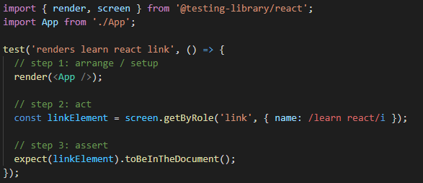


React Testing Library
Basic test
About Queries
Types of queries
Priority
List of DOM-based matchers
https://github.com/testing-library/jest-dom

Slide 8
React Testing Library
Try to use getByRole whenever possible to make sure your elements are accessible to screen readers.
List of WAI-ARIA roles:
W3C, MDN
Some elements have built-in roles, such as button, link, etc.
You can also add a role to any element like a div by just using the role attribute.
Working with Testing Library will actually make you much more aware of accessibility.
In general, if you can't find an element like a screen reader would within your tests, then your app is not friendly to screen readers.

Slide 9
React Testing Library
Useful information:
Common mistakes with React Testing Library
Test Isolation with React
Avoid Nesting when you're Testing
Why I Never Use Shallow Rendering
React Testing Library Cheatsheet
Appearance and Disappearance
Testing with React Router

Slide 10

MSW
You want to avoid making HTTP calls in your tests because
It is slow.
It is unpredictable.
Mock Service Worker is an API mocking library that uses Service Worker API to intercept actual requests.
https://mswjs.io/
Testing Library recommends using Mock Service Worker library to handle testing your HTTP calling components/utilities. (Source)
Getting started
npm install msw --save-dev
How to setup and use MSW
https://www.youtube.com/watch?v=v77fjkKQTH0

Slide 11
Debugging
Common
console.log();
Jest
Setup and Teardown
React Testing Library
screen.debug();
screen.getByRole(‘’);

Slide 12
Summary
Testing is all about testing the behavior of your application.
It's more about translating user interactions into code and making the right assertions.
Have fun!

