Slide 1
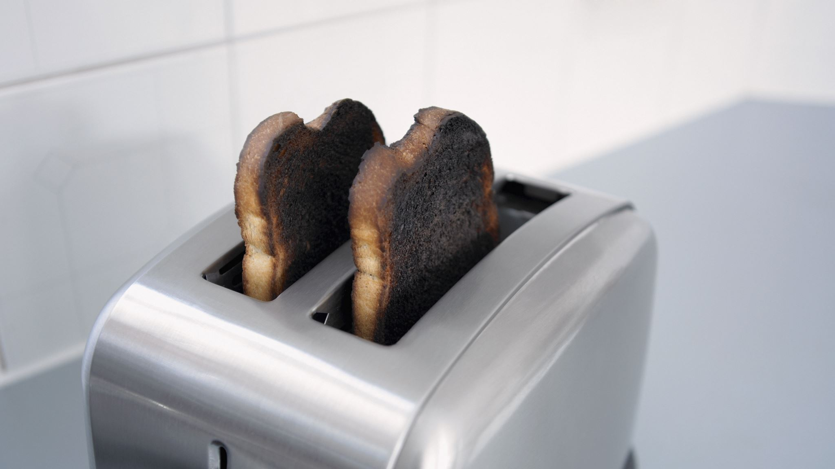
Kitchen App Unit Converter
Alvin John Tolentino (200123456)
Quing Rosete (200449566)
Taiwo Akinwale (200430975)

Slide 2
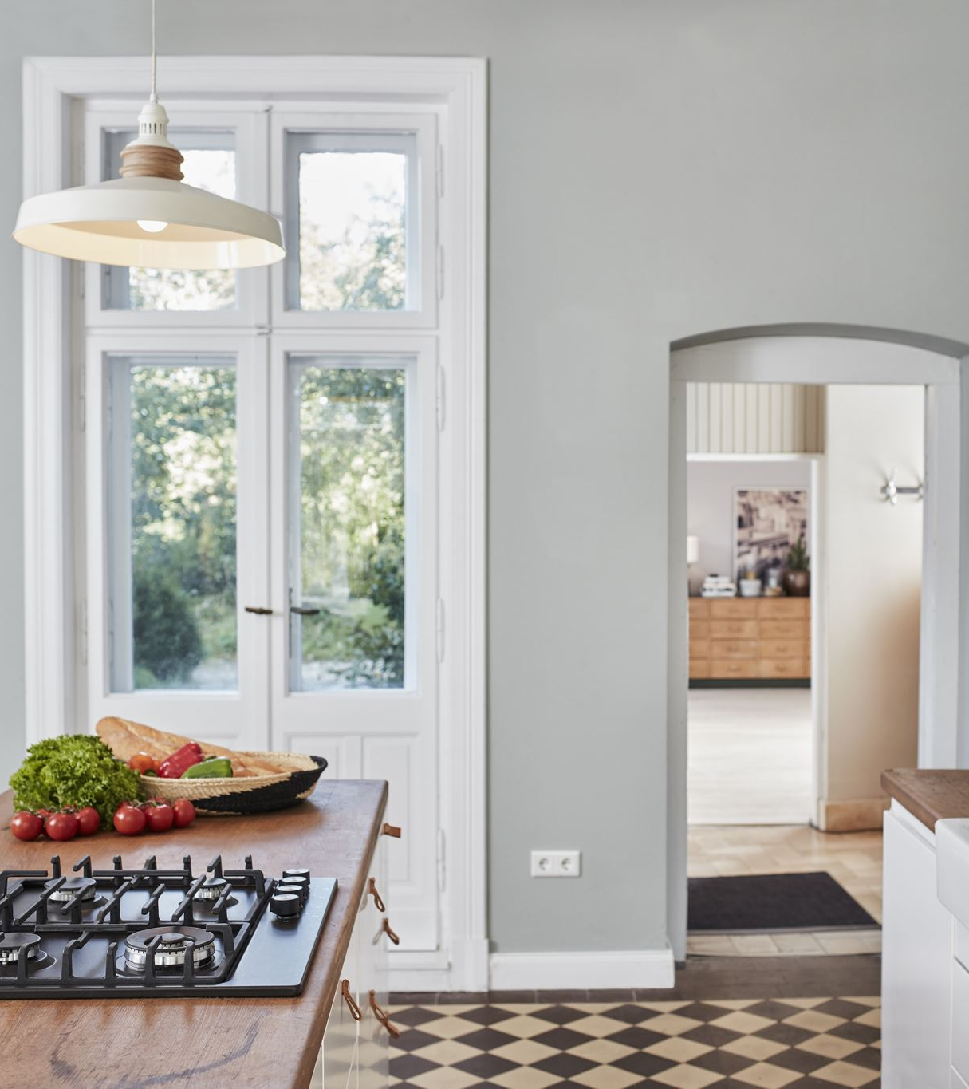
Introduction
The Kitchen App aims to assist users in managing kitchen tasks efficiently by providing functionalities like recipe management, a unit converter, and a timer. The focus of this project is the unit converter component, which allows users to convert various units of measurement commonly used in the kitchen. Accurate conversions are crucial to maintain the quality of recipes. This project started with coding and writing tests in Java at the start of June. In July, we transitioned to learning Flutter and converting our code following our weekly lab sessions.

Slide 3

Design Problem
The primary problem addressed by the unit converter is the difficulty faced by users in converting between various kitchen measurement units accurately and quickly. Inaccurate conversions can lead to incorrect ingredient proportions, affecting the quality of the recipes prepared.

Slide 4
Design Requirements
Functions:
Convert values between different units of measurement.
Allow users to select the unit they are converting from and the unit they are converting to.
Display the conversion result clearly.
Objectives:
Ensure accuracy in unit conversions.
Provide a simple and intuitive user interface.
Allow quick and easy unit selection and conversion.
Constraints:
The app must perform conversions without requiring an internet connection.
The user interface must be responsive and work on various device sizes.

Slide 5
Solution
Solution 1:
Basic user interface with text input for the value and two dropdown menus for unit selection.
Usability issues included resetting selections after each conversion.
Solution 2:
Improved UI maintaining user selections and better error handling.
Final Solution:
Refined user interface with persistent selections and comprehensive error handling.
Components: Eclipse, a map for storing conversion rates.
Feature | Solution 1 | Solution 2 | Final Solution
User Selections Persistence | No | Yes | Yes
Error Handling | Basic | Improved | Comprehensive
Usability | Low | Medium | High

Slide 6
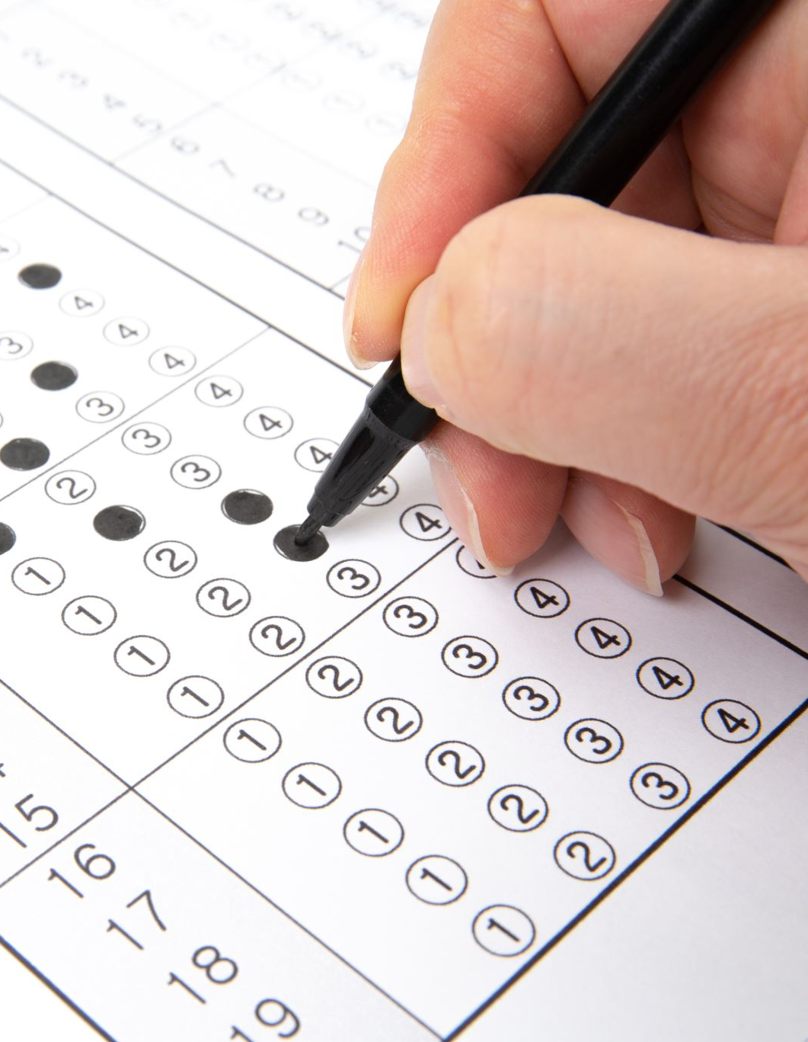
Testing Methodologies Used
Boundary Value Testing: Used to ensure the edge cases of input values (e.g., minimum and maximum values) are handled correctly.
Equivalence Class Testing: Applied by grouping similar inputs that should produce the same output to reduce the number of test cases.
Decision Tables Testing: Used to represent combinations of inputs and their corresponding outputs to ensure all possible scenarios are tested.
Use Case Testing: Testing based on user scenarios to ensure the application behaves as expected in real-world usage.

Slide 7
Testing and Demonstration
Robust Boundary Value Tests: cup to other units
Strong Normal Equivalence Tests: tablespoon to other units, teaspoon to other units
Random Analysis Tests: kg to other units, g to other units, mg to other units
Robust Worst Case Analysis Tests: l to other units, ml to other units, oz to other units
Special Value Analysis Tests: lb to other units, qt to other units
Test Requirements and Cases:
Conversion accuracy, edge cases, equivalence classes, decision tables, and use case testing.

Slide 8

Additional Tests
Recipe Tests: Ensures that recipes are loaded correctly and that ingredients and steps are displayed as expected.
Timer Tests: Verifies the functionality of the timer, including adding, starting, stopping, resetting, and deleting timers. Boundary value testing and equivalence class testing were used to validate these functionalities.

Slide 9
Gantt Chart
Task | Start date | End Date
Initial Research | May 28 | June 1
UI Design | June 1 | June 8
Backen Development | June 1 | June 15
Integration and Testing | June 15 | July 6
Extra Java/Flutter Learning | June 29 | July 6
Code Review and Bug Fixes | July 6 | July 13
Final Adjustments and Documentation | July 13 | July 20

Slide 10

Conclusion and Future Work
The unit converter component of the Kitchen App successfully achieved its design functions and objectives, ensuring accurate and user-friendly conversions. Future improvements could include adding more units and enhancing the user interface further. Additionally, implementing an account creation system where users can make groups to share recipes would be beneficial for teaching classes or simply sharing recipes with others.

