Slide 1

Apache Spark

Slide 2

INTRODUCTION TO APACHE SPARK

Slide 3
What is Spark?
Fast and In Memory Cluster Computing Engine
Efﬁcient
Usable
• General execution
graphs
• In-memory storage
• Rich APIs in Java,
Scala, Python
• Interactive shell

Slide 4
Key Concepts
Write programs in terms of transformations
on distributed datasets
Resilient Distributed Datasets
• Collections of objects spread
across a cluster, stored in RAM
or on Disk
• Built through parallel
transformations
• Automatically rebuilt on failure
Operations
• Transformations"
(e.g. map, ﬁlter,
groupBy)
• Actions"
(e.g. count, collect,
save)

Slide 5
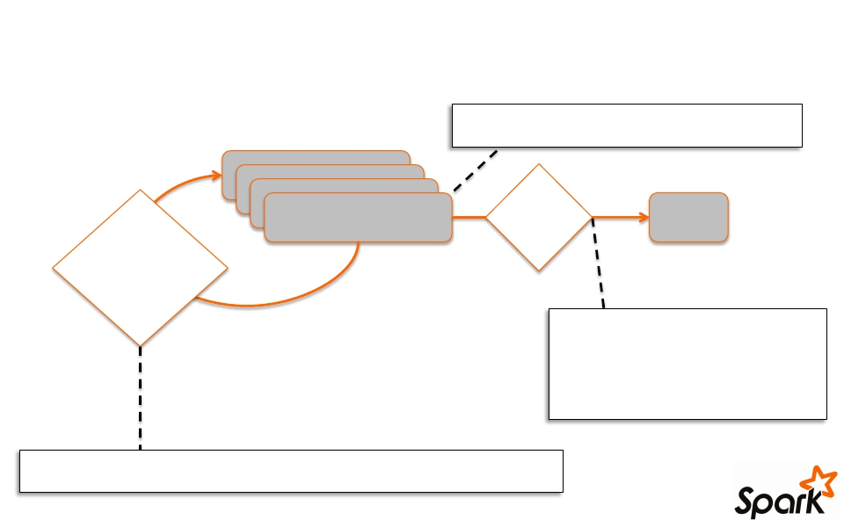
Working With RDDs
textFile = sc.textFile(”SomeFile.txt”)
RDD
Action
Value
Transformations
linesWithSpark.count()
74
linesWithSpark.first()
# Apache Spark
linesWithSpark = textFile.filter(lambda line: "Spark” in line)

Slide 6



Fault Recovery
RDDs track lineage information that can be
used to efﬁciently recompute lost data
msgs = textFile.filter(x => x.startsWith(“ERROR”))
.map(s => s.split(“\t”)(2))
HDFS File Filtered RDD Mapped RDD
ﬁlter map
(func = startsWith(…)) (func = split(...))

Slide 7



Language Support
Python
lines = sc.textFile(...)
lines.filter(lambda s: “ERROR” in s).count()
Scala
val lines = sc.textFile(...)
lines.filter(x => x.contains(“ERROR”)).count()
Java
JavaRDD<String> lines = sc.textFile(...);
lines.filter(new Function<String, Boolean>() {
Boolean call(String s) {
return s.contains(“error”);
}
}).count();
Standalone Programs
• Python, Scala, & Java
Interactive Shells
• Python & Scala
Performance
• Java & Scala are faster due
to static typing
• …but Python is often ﬁne

Slide 8
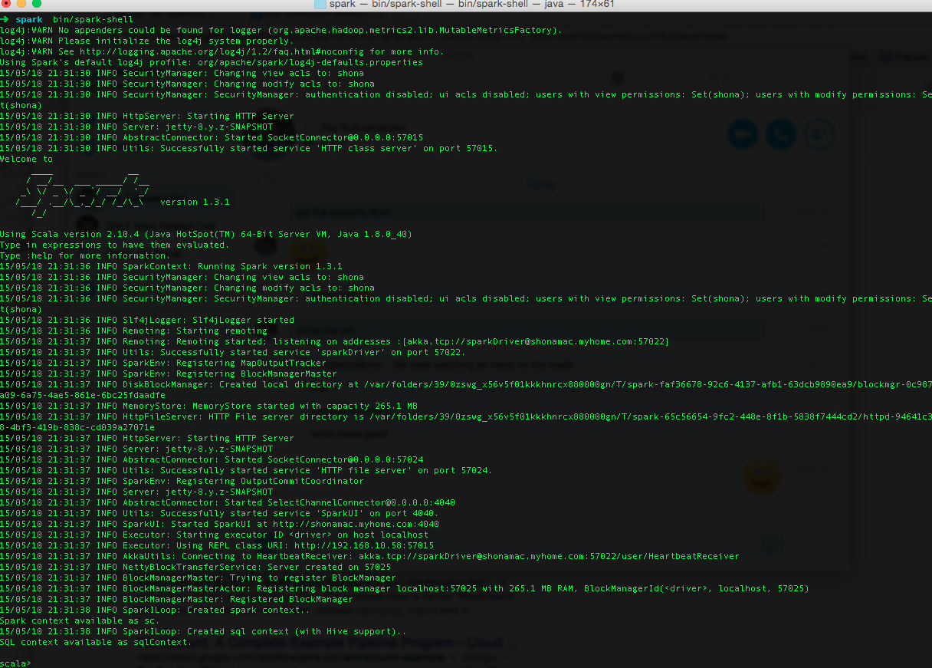
Interactive Shell
• The Fastest Way to
Learn Spark
• Available in Python
and Scala
• Runs as an application
on an existing Spark
Cluster…
• OR Can run locally

Slide 9
JOB EXECUTION

Slide 10
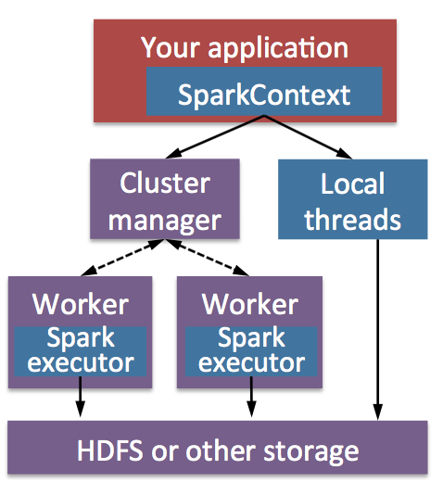
Software Components
• Spark runs as a library in your
program (1 instance per app)
• Runs tasks locally or on
cluster
– Mesos, YARN or standalone
mode
• Accesses storage systems via
Hadoop InputFormat API
– Can use HBase, HDFS, S3, …

Slide 11
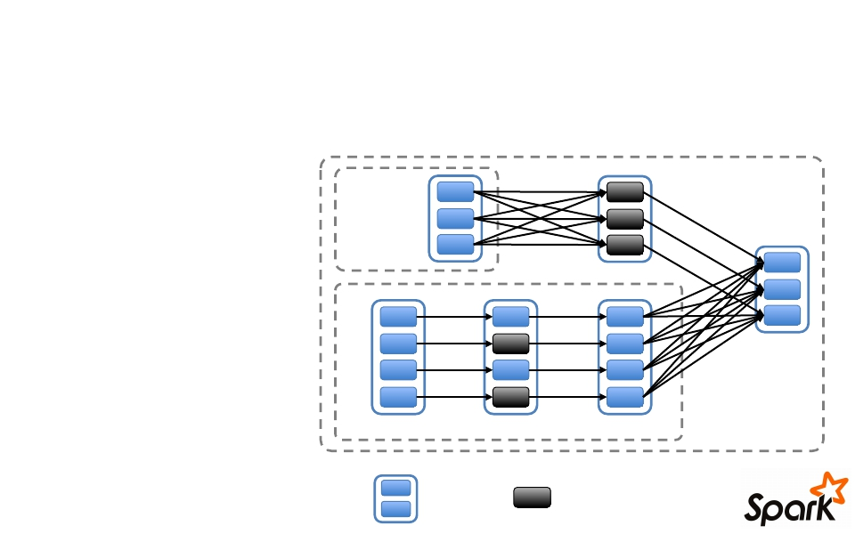
Task Scheduler
• General task
graphs
• Automatically
pipelines functions
• Data locality aware
B:
groupBy
E:
A:
Stage 1
C:
F:
D:
• Partitioning aware"
to avoid shufﬂes
join
Stage 3
Stage 2 map
ﬁlter
= RDD
= cached partition

Slide 12
Advanced Features
• Controllable partitioning
– Speed up joins against a dataset
• Controllable storage formats
– Keep data serialized for efﬁciency, replicate to
multiple nodes, cache on disk
• Shared variables: broadcasts, accumulators

Slide 13
Local Execution
• Just pass local or local[k] as master URL
• Debug using local debuggers
– For Java / Scala, just run your program in a
debugger
– For Python, use an attachable debugger (e.g.
PyDev)
• Great for development & unit tests

Slide 14
WORKING WITH SPARK

Slide 15
Using the Shell
Launching:
spark-shell
pyspark (IPYTHON)
Modes:
MASTER=local ./spark-shell
MASTER=local[2] ./spark-shell
# local, 1 thread
# local, 2 threads
MASTER=spark://host:port ./spark-shell
# cluster
MASTER=mesos://host:port ./spark-shell
# Mesos cluster

Slide 16
SparkContext
• Main entry point to Spark functionality
• Available in shell as variable sc
• In standalone programs, you’d make your
own (refer to the sample code)

Slide 17
Creating RDDs
# Turn a collection into an RDD
> sc.parallelize([1, 2, 3])
# Load text file from local FS, HDFS, or S3
> sc.textFile(“file.txt”)
> sc.textFile(“directory/*.txt”)
> sc.textFile(“hdfs://namenode:9000/path/file”)
# Use existing Hadoop InputFormat (Java/Scala only)
> sc.hadoopFile(keyClass, valClass, inputFmt, conf)

Slide 18
Basic Transformations
> nums = sc.parallelize([1, 2, 3])
# Pass each element through a function
> squares = nums.map(x => x*x)
// {1, 4, 9}
# Keep elements passing a predicate
> even = squares.filter(x => x % 2 == 0) // {4}
# Map each element to zero or more others
> nums.flatMap(x => range(x))
> # => {0, 0, 1, 0, 1, 2}

Slide 19
Basic Actions
> nums = sc.parallelize([1, 2, 3])
# Retrieve RDD contents as a local collection
> nums.collect() # => [1, 2, 3]
# Return first K elements
> nums.take(2) # => [1, 2]
# Count number of elements
> nums.count() # => 3
# Merge elements with an associative function
> nums.reduce(_ + _) # => 6
# Write elements to a text file
> nums.saveAsTextFile(“hdfs://file.txt”)

Slide 20
Working with Key-Value Pairs
Spark’s “distributed reduce” transformations operate on
RDDs of key-value pairs
Python:
pair = (a , b)
pair[0] # => a
pair[1] # => b
Scala:
val pair = (a , b)
Java:
pair._1 // => a
pair._2 // => b
Tuple2 pair = new Tuple2(a , b);
pair._1 // => a
pair._2 // => b

Slide 21
Some Key-Value Operations
> pets = sc.parallelize(
[(“cat”, 1), (“dog”, 1), (“cat”, 2)])
> pets.reduceByKey(_ + _)
# => {(cat, 3), (dog, 1)}
> pets.groupByKey() # => {(cat, [1, 2]), (dog, [1])}
> pets.sortByKey()
# => {(cat, 1), (cat, 2), (dog, 1)}
also automatically implements
reduceByKey
combiners on the map side

Slide 22
Example: Word Count
> lines = sc.textFile(“sample.text”)
> counts = lines.flatMap(line => line.split(“ ”))
.map(word => (word, 1))
.reduceByKey(_ + _)
“to”
“be”
“or”
“not”
“to”
“be”
(to, 1)
(be, 1)
(or, 1)
(not, 1)
(to, 1)
(be, 1)
“to be or”
“not to be”
(be, 2)
(not, 1)
(or, 1)
(to, 2)

Slide 23
Other Key-Value Operations
> visits = sc.parallelize([ (“index.html”, “1.2.3.4”),
(“about.html”, “3.4.5.6”),
(“index.html”, “1.3.3.1”) ])
> pageNames = sc.parallelize([ (“index.html”, “Home”),
(“about.html”, “About”) ])
> visits.join(pageNames)
# (“index.html”, (“1.2.3.4”, “Home”))
# (“index.html”, (“1.3.3.1”, “Home”))
# (“about.html”, (“3.4.5.6”, “About”))
> visits.cogroup(pageNames)
# (“index.html”, ([“1.2.3.4”, “1.3.3.1”], [“Home”]))
# (“about.html”, ([“3.4.5.6”], [“About”]))

Slide 24
Setting the Level of Parallelism
All the pair RDD operations take an optional
second parameter for number of tasks
> words.reduceByKey( _ + _, 5)
> words.groupByKey(5)
> visits.join(pageViews, 5)

Slide 25
Using Local Variables
Any external variables you use in a closure will
automatically be shipped to the cluster:
> query = sys.stdin.readline()
> pages.filter(lambda x: query in x).count()
Some caveats:
• Each task gets a new copy (updates aren’t sent back)
• Variable must be Serializable / Pickle-able
• Don’t use ﬁelds of an outer object (ships all of it!)

Slide 26
Closure Optimization
This is a problem:
class ExampleRddApp {
val param = 3.14
val log = new Log(...)
...
How to get around it:
class ExampleRddApp {
...
...
def work(rdd: RDD[Int]) {
rdd.map(x => x + param)
.reduce(...)
}
def work(rdd: RDD[Int]) {
val param_ = param
rdd.map(x => x + param_)
.reduce(...)
}
}
}

Slide 27
More RDD Operators
• map
• filter
• groupBy
• sort
• union
• join
• leftOuterJoin
• reduce
• count
• fold
• reduceByKey
• groupByKey
• cogroup
• cross
sample
take
first
partitionBy
mapWith
pipe
• rightOuterJoin
• zip
save
...

Slide 28
CREATING SPARK APPLICATIONS

Slide 29
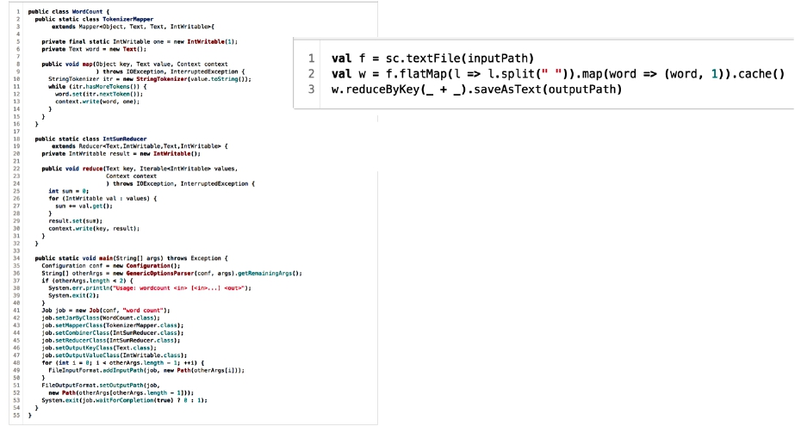
Simple Spark Apps: WordCount
WordCount in 3 lines of Spark
WordCount in 50+ lines of Java MR
53

Slide 30
Create a SparkContext
import org.apache.spark.SparkContext
import org.apache.spark.SparkContext._
val sc = new SparkContext(“url”, “name”, “sparkHome”, Seq(“app.jar”))
Scala
import org.apache.spark.api.java.JavaSparkContext;
Java
JavaSparkContext sc = new JavaSparkContext(
“masterUrl”, “name”, “sparkHome”, new String[] {“app.jar”}));
from pyspark import SparkContext
sc = SparkContext(“masterUrl”, “name”, “sparkHome”, [“library.py”]))
Python

Slide 31
Complete App
import org.apache.spark._ object WordCount { def main(args: Array[String]) { val inputFile = args(0) val outputFile = args(1) val conf = new SparkConf().setAppName("wordCount") // Create a Scala Spark Context. val sc = new SparkContext("local", "wordCount") // Load our input data. val input = sc.textFile(inputFile) // Split up into words. val words = input.flatMap(line => line.split(" ")) // Transform into word and count. val counts = words.map(word => (word, 1)).reduceByKey(_ + _)
// Save the word count back out to a text file, causing evaluation. counts.saveAsTextFile(outputFile) } }

Slide 32
Conclusion
• Spark offers a rich API to make data
analytics fast: both fast to write and fast to
run
• Achieves 100x speedups in real
applications
• Growing community with 25+ companies
contributing

