Slide 1
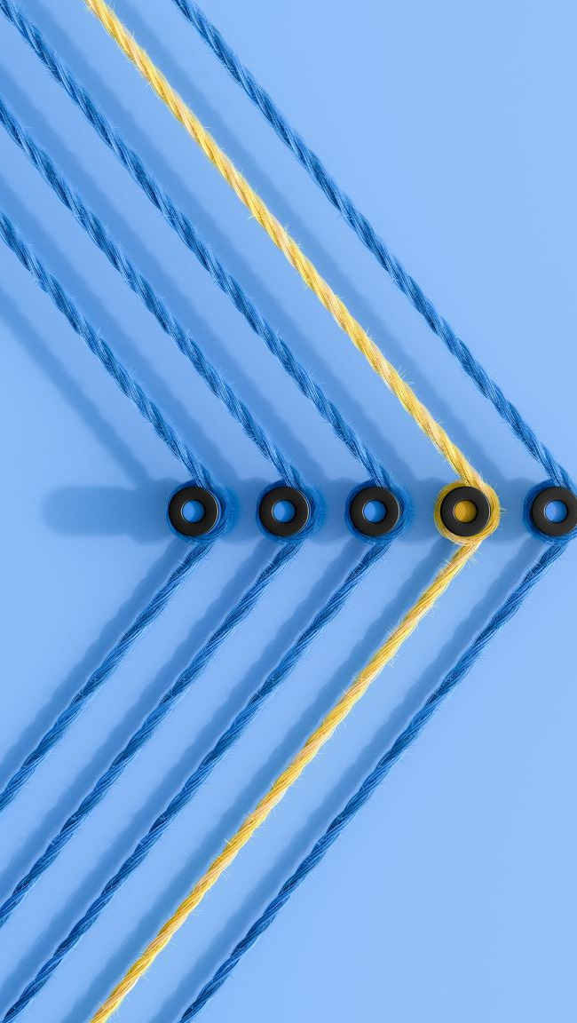
Recognizing the Sequential State of Knots for Educational Purposes.
Alvin Cassar SWD6.3A

Slide 2
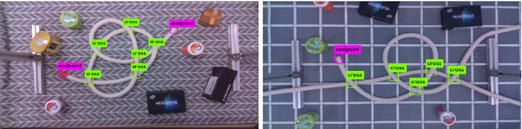
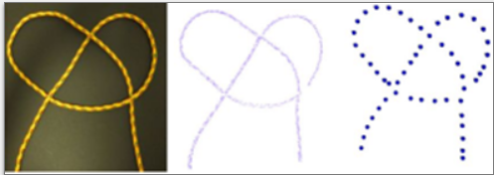

Different types of Labelling a Rope
Song et al. (2019)
Lui and Saxena (2013)
Grennen et al. (2020)

Slide 3
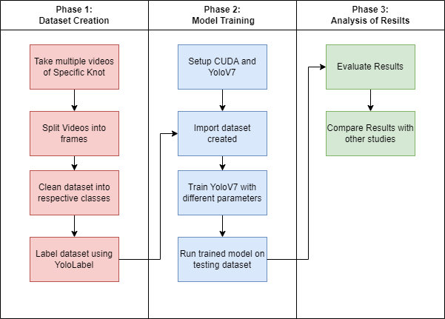
Research Pipeline

Slide 4
Data Collection
 | Train | Val | Test | Total
reef_1 | 195 | 65 | 65 | 325
reef_2 | 204 | 68 | 69 | 341
reef_3 | 188 | 62 | 64 | 314
reef_4 | 176 | 58 | 60 | 294
reef_5 | 204 | 68 | 69 | 341
 | 967 | 321 | 327 | 1615
A total of 20 videos were taken to create this dataset.
After splitting the videos, it frames it was cleaned and split into respective class.
After it was all labelled using YoloLabel.

Slide 5
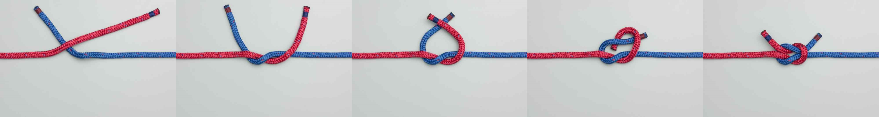
Reef 1
Reef 2
Reef 3
Reef 4
Reef 5

Slide 6
Accuracy / F1-Score / Precision
Confusion Matrix
Class | Accuracy | F1-Score | Precision
Reef 1 | 0.985 | 0.985 | 0.979
Reef 2 | 0.95 | 0.956 | 0.965
Reef 3 | 1 | 0.991 | 0.996
Reef 4 | 0.979 | 1 | 0.994
Reef 5 | 0.976 | 1 | 0.991
All | 0.976 | 0.986 | 0.985
Class | Reef 1 | Reef 2 | Reef 3 | Reef 4 | Reef 5
Reef 1 | 1.00 | 0 | 0 | 0 | 0
Reef 2 | 0 | 0.96 | 0 | 0 | 0
Reef 3 | 0 | 0 | 1.00 | 0.02 | 0
Reef 4 | 0 | 0.04 | 0 | 0.96 | 0
Reef 5 | 0 | 0 | 0 | 0 | 1.00

Slide 7
Research Questions to be Answered
What camera position is ideal for the correct recognition of steps in tying a knot?
What different model configurations are ideal for recognition of steps in tying a knot?
How does the prototype perform when utilized by 3rd parties?

Slide 8
Experiments to be done:
Comparing how the same parameters used for the Reef Knot model would do for a more complex knot (Bowline Knot).
Analysing multiple experiments where one or more variable (background, lighting, person, rope, camera angle, camera distance) are changed and reflect on what are the changes in the results.
Showing a video of the prototype to number of participants and gathering feedback by an interview.

