Slide 1

Next Hikes IT Solutions
Advanced Calculator – Python Tkinter
ALVIN FREDRICK
Alvin.frederick94@gmai.com

Slide 2
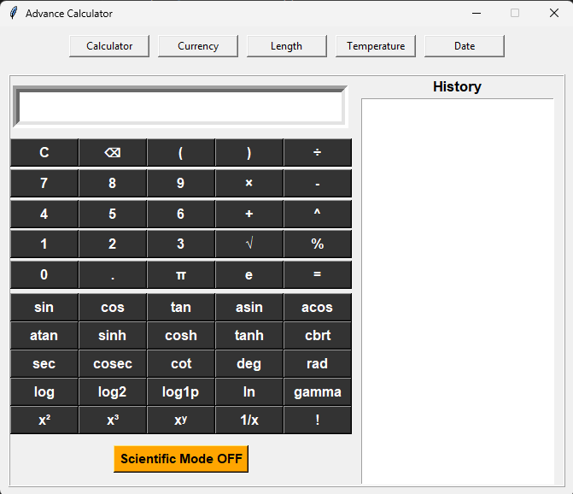
Graphical User Interface (GUI)

Slide 3
Features Overview
- Standard Calculator Functions
- Scientific Functions (Trigonometry, Logarithmic, Factorial, etc.)
- History Panel
- Multiple Converter Tools

Slide 4

Scientific Mode
- Includes sin, cos, tan, sinh, cosh, tanh
- Supports degrees, radians, powers, roots
Additional functions: gamma, log2, log1p
- Toggle ON/OFF

Slide 5
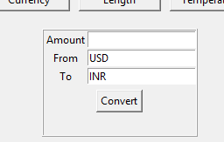
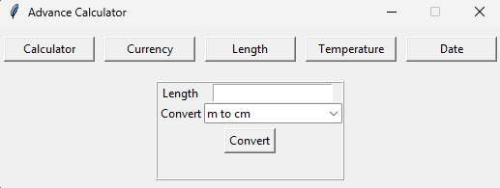
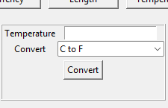
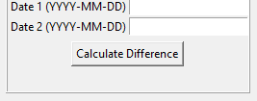
Additional Tools
- Currency Converter
- Length Converter
- Temperature Converter
- Date Difference Calculator

Slide 6
Backend Logic
- Uses String Expression Building
- Replaces math symbols with Python's eval-compatible syntax
- Uses math module functions
- Exception handling for errors

Slide 7
Reference Link
https://www.geeksforgeeks.org/python/python-simple-gui-calculator-using-tkinter/
https://www.geeksforgeeks.org/python/scientific-gui-calculator-using-tkinter-in-python/
https://dev.to/spiff/calculator-with-gui-using-python-tkinter-jpn?utm_source=chatgpt.com
https://www.freecodecamp.org/news/how-to-build-a-currency-converter-gui-with-tkinter/?utm_source=chatgpt.com
https://www.pythonguis.com/examples/currency-converter-tkinter/?utm_source=chatgpt.com
https://www.youtube.com/watch?v=glN87rNH0L8

Slide 8
Thank You

