Slide 1
Real Estate Market Analysis
NEXTHIKES IT SOLUTIONS
Exploratory Data Analysis (EDA)
Prepared by: Alvin Fredrick
Email: alvin.frederick94@gmail.com

Slide 2
Executive Summary
Analyzed real estate dataset to identify pricing trends.
  Evaluated key drivers impacting property value.
  Delivered actionable insights for business decisions.

Slide 3
Business Problem
Understanding factors influencing property prices.
  Identifying high-value features for investment focus.
  Supporting pricing strategy using data insights.

Slide 4
Dataset Overview
Includes property size, bedrooms, bathrooms, location.
  Target variable: Property Price.
  Dataset used for trend analysis and insight extraction.

Slide 5
Data Preparation & Cleaning
Handled missing values and inconsistencies.
  Validated data types and removed duplicates.
  Outlier detection using visualization techniques.

Slide 6
Exploratory Data Analysis Approach
Univariate analysis for feature distribution.
  Bivariate analysis to evaluate price relationships.
  Correlation heatmap to detect strong associations.

Slide 7
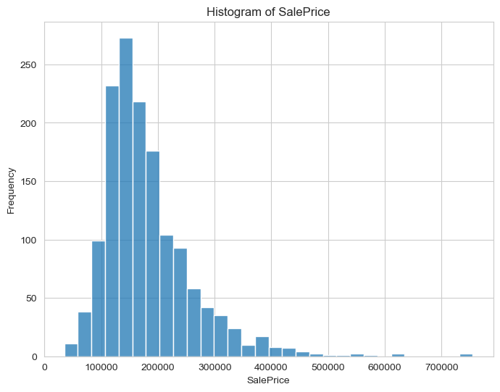
Visualization 1: Market Insight
Business Insight: This visualization highlights pricing patterns and supports strategic decision-making.

Slide 8
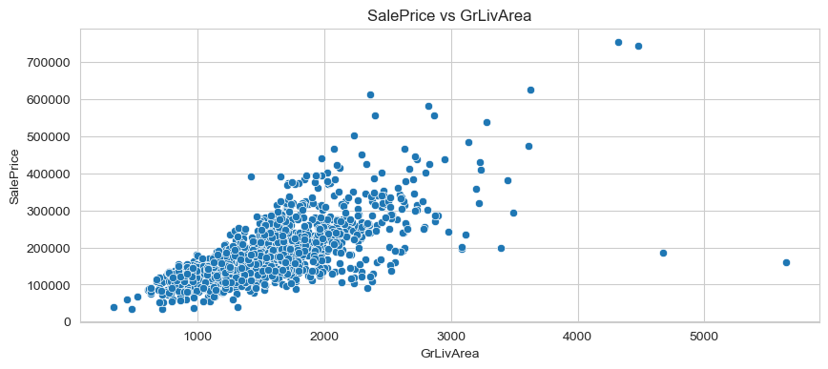
Visualization 2: Market Insight

Slide 9
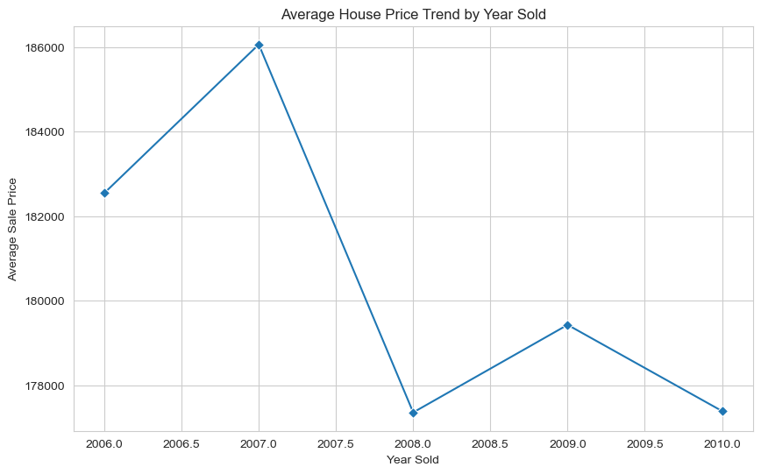
Visualization 3: Market Insight

Slide 10
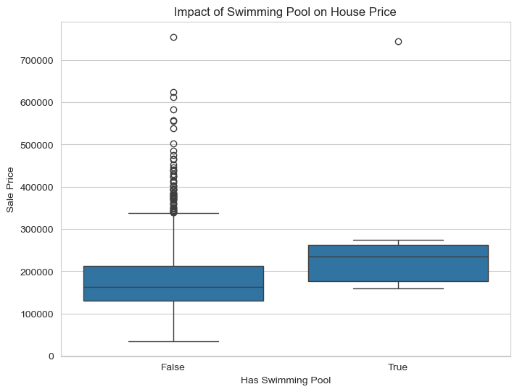
Visualization 4: Market Insight

Slide 11
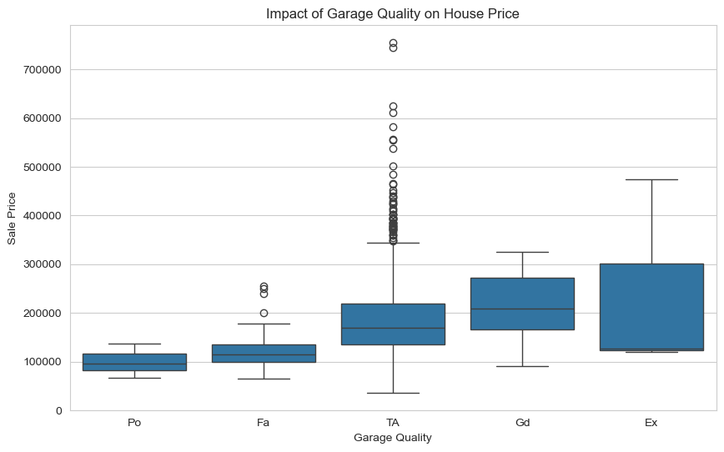
Visualization 5: Market Insight

Slide 12
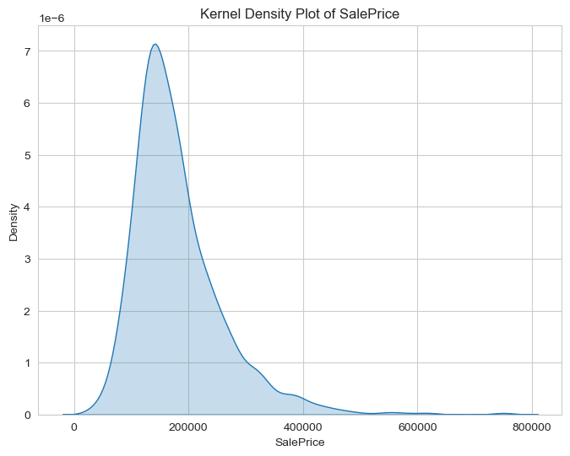
Visualization 6: Market Insight

Slide 13
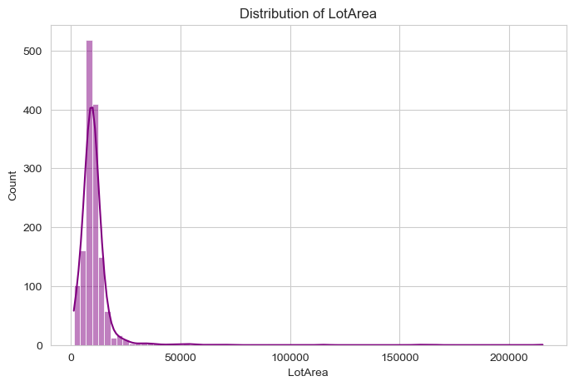
Visualization 7: Market Insight

Slide 14
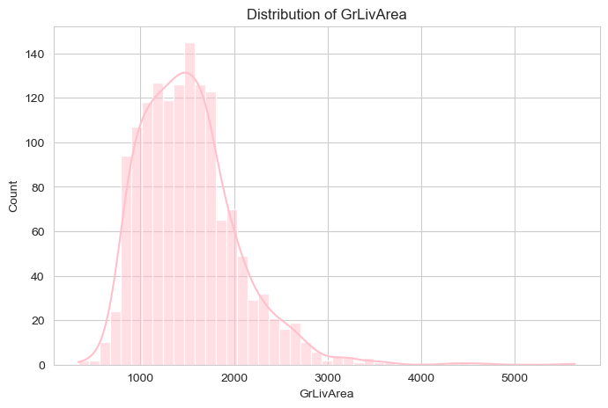
Visualization 8: Market Insight

Slide 15
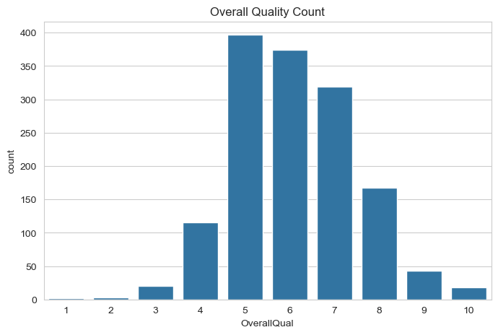
Visualization 9: Market Insight

Slide 16
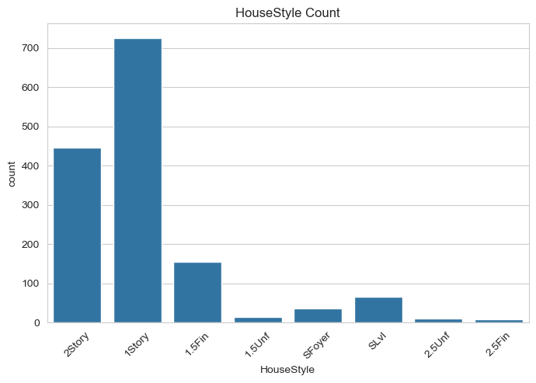
Visualization 10: Market Insight

Slide 17
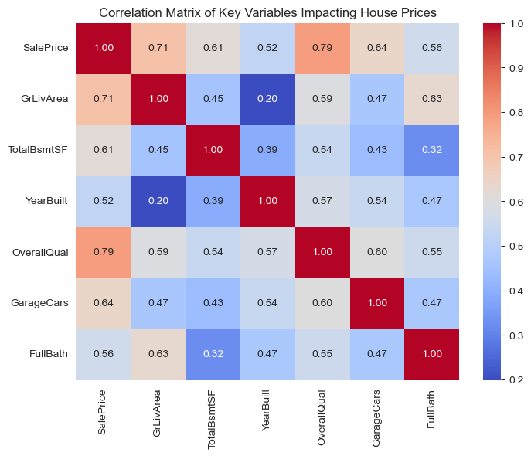
Visualization 11: Market Insight

Slide 18
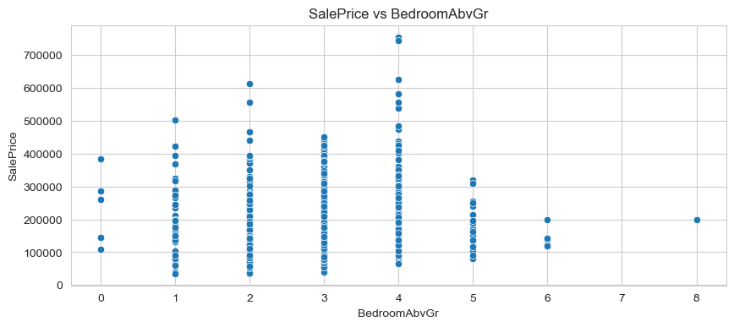
Visualization 12: Market Insight

Slide 19
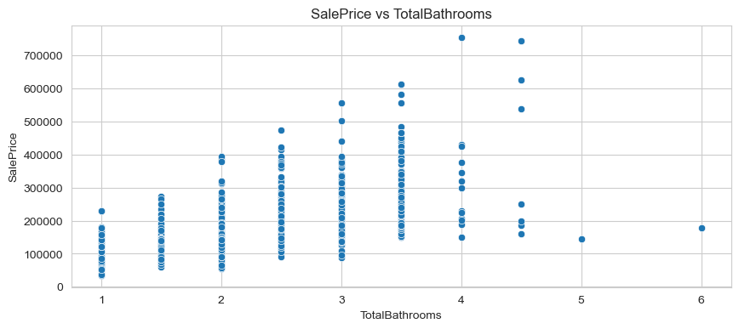
Visualization 13: Market Insight

Slide 20
Key Business Insights
Property size strongly influences pricing.
  Location significantly impacts value variation.
  Bedrooms and bathrooms positively correlate with price.
  Data-driven insights improve investment strategy.

Slide 21
Conclusion & Recommendations
EDA successfully identified major price drivers.
  Recommend predictive modeling for price forecasting.
  Use insights to guide pricing and investment strategy.
  Future Scope: Deploy ML model for automation.

