Slide 1

Prepared by Group 11
Movie Data Analysis
Debuting into the Film Industry
14 September, 2025

Slide 2
Introduction
Our project’s goal is to analyze movie data and implement techniques to determine which types of films are currently doing the best in the box office, and to assist Wamonyolo Studios decide what types of films to create.

Slide 3

Project Overview
Wamonyolo Studios has been a significant player in the camera manufacturing industry, offering top-notch camera quality. While they have seen success, they’d like to get into the film industry and are considering opening a movie studio. To ensure Wamonyolo Studios has a competitive edge in their new business venture, we have focused on 3 main areas.

Slide 4



Project Objectives
Film Production
Budgeting
Release Strategy
What movie genres are the most profitable?
What runtimes maximizes profitability?
Should Wamonyolo Studios build a new studio or acquire an existing one?
What’s the optimal production budget for maximizing ROI?
How important is the international box office for profitability?

Slide 5

Data Understanding
Data Collection:
We utilized data from different sources namely:
Box Office Mojo, IMDB, The Movie DB and The Numbers.
Data Cleaning and Preparation:
Since the data was in different formats (sql, csv, tsv), all datasets were loaded into DataFrames for uniformity and ease of analysis.
The DataFrames were merged to collate all information required for our analysis.
Missing values were also handled appropriately
Feature Engineering:
New attributes such as Profit margin and ROI were introduced to enable us to answer the business questions effectively.

Slide 6
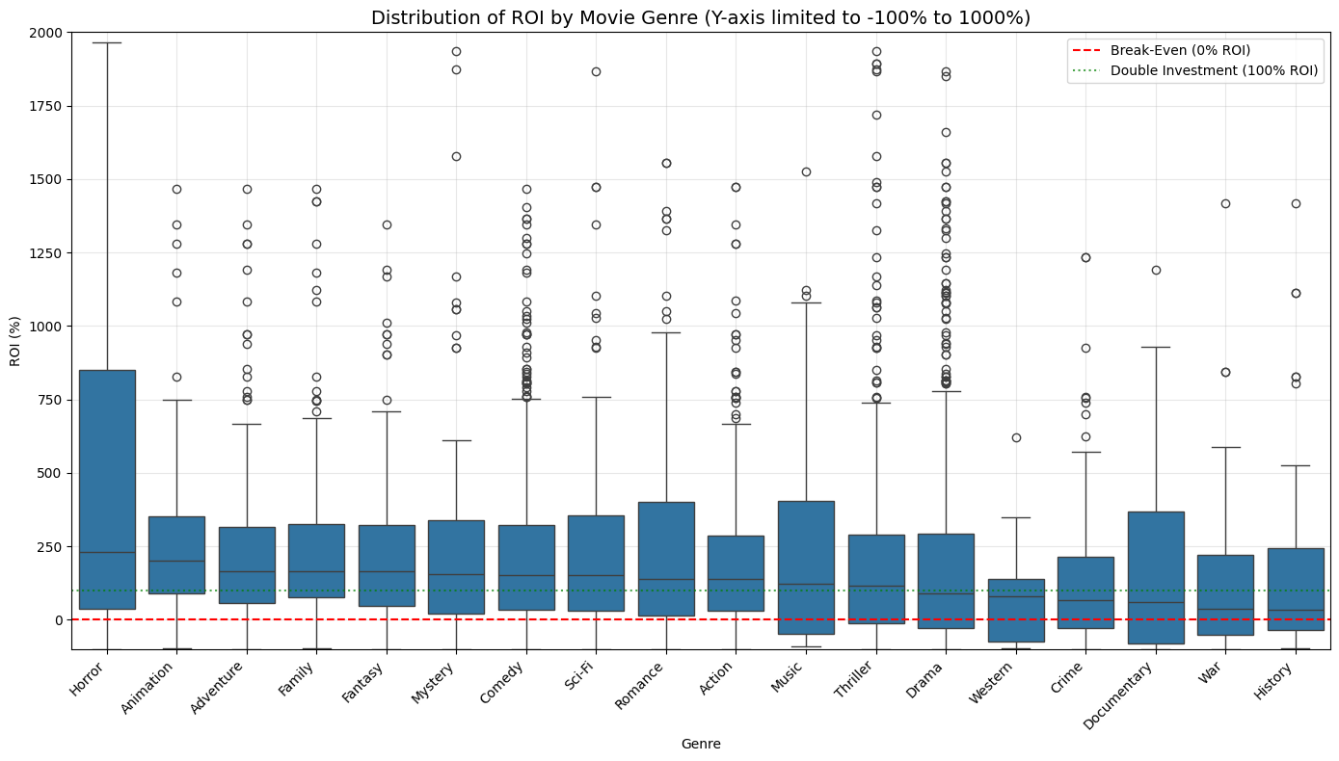
Data Analysis
Genre Performance
We analyzed Return on Investment (ROI) based on the movie genre. As indicated in the boxplot below, Horror movies had the highest ROI of about 231%, followed by Animation with about 200%.

Slide 7
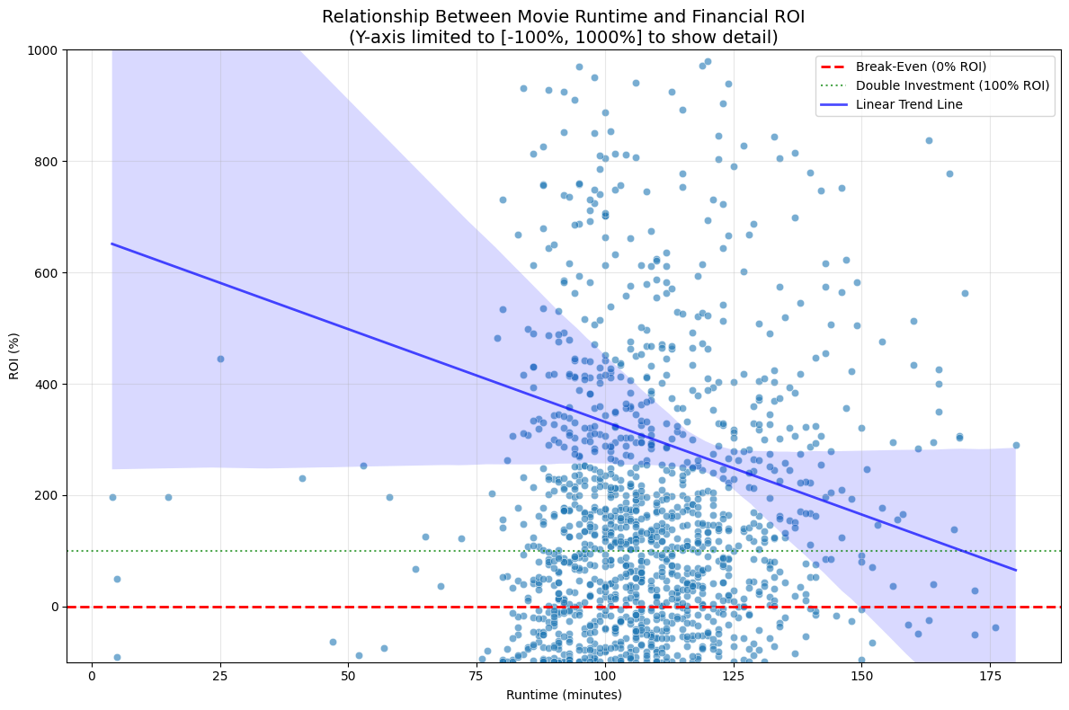
Runtime Analysis
From our analysis, we observed a relationship between movie runtime and Return on Investment.
Movies with longer runtimes (above 180 minutes) tend to have lower returns.
From the graph, there seems to be a sweet spot around 87-99 minutes where the high returns are achieved.

Slide 8
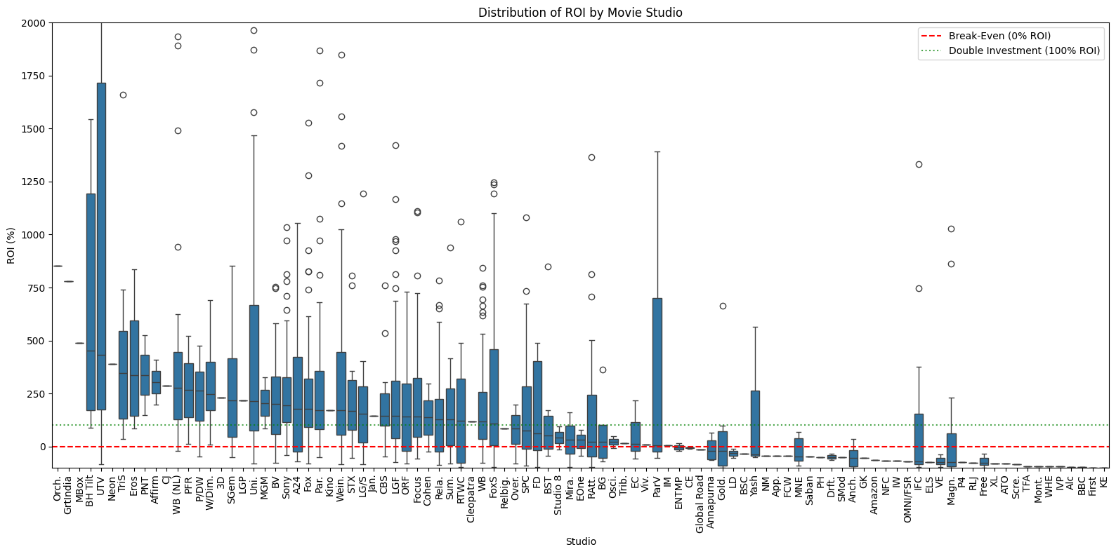
Budgeting
Studios that specialize in specific film genres seem to have higher ROI, while those that have diversified their genre portfolio achieve consistent but lower returns.
Additionally, by focusing on genres that have higher ROI, mid-budget films are likely to be profitable.

Slide 9
Release Strategy
From the analysis of the Box Office Films, it was observed that:
Movie genres have peak seasons. For example, Horror films perform best in February – March, achieving about 475% ROI.
Films released in the holiday season also deliver high returns, although there is strong competition during this period with many movie studios releasing films as well.

Slide 10

Recommendations
Film Production:
Focus initial production efforts on Horror films as they have the highest returns.
Avoid longer runtimes. Preferably, the films should run for about 87 – 99 minutes.
Budgeting:
For a start, acquire a movie studio that specializes in horror films.
Target low-to-mid ($10M – 20M) production budgets.
Once established, develop animation capabilities to diversify genre portfolio.
Release Strategy:
Create films that resonate globally, and prioritize international distribution to ensure high worldwide gross.
Consider February – March releases for horror films to maximize returns.

Slide 11
Conclusion
By conducting this analysis, our aim was not only to investigate current trends in the film industry but to offer actionable strategic and financial insights for Wamonyolo Studios as they prepare to make their debut in the film industry.

Slide 12
Team Members
Q&A
Alvin Ngeno
Alvin.ngeno@student.moringaschool.com
Faith Kanyuki
Faith.kanyuki@student.moringaschool.com
Ray Onsongo
Ray.onsongo@student.moringaschool.com
Sharon Maina
Sharon.maina1@student.moringaschool.com

Slide 13
Thank you

