Slide 1
Computer Organization 2024 Programming Assignment I
2024/3/21

Slide 2
Overview
In Chapter 2, we introduced the RISC-V Instruction Set Architecture(ISA) and the instructions of RV32.
This assignment is to write inline assembly code and run the developed code on a RISC-V ISA simulator, Spike, to evaluate the results.

Slide 3
Prerequisite
Experimental environment,
Use Ubuntu 22.04,
Install RISC-V GNU compiler toolchain(commit hash 59aab58e),
Install RISC-V ISA simulator(Spike; commit hash a22119e) and
Install RISC-V Proxy kernel(commit hash f036859)
Two methods for setup,
Install the pre-builded environment
Build from scratch
Refer to HW0 for more details.

Slide 4
Assignment
This assignment consists of 4 exercises, with total of 100 points.
Basic (20%)
Array (20%)
Matrix multiply (30%)
Matrix multiply (advanced) (30%)
For the exercises 1 and 2, the students are divided into three groups according each student’s Student ID.
Group 1: Student ID mod 3 = 1.
Group 2: Student ID mod 3 = 2.
Group 3: Student ID mod 3 = 0.
Please write your code in asm volatile(). Any modifications outside of asm volatile() are not allowed.

Slide 5
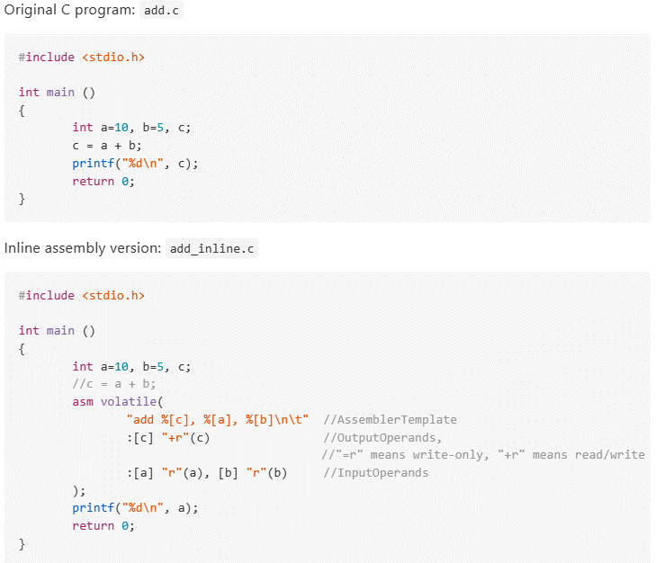
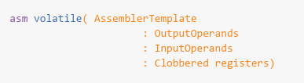
GCC Inline Assembly

Slide 6
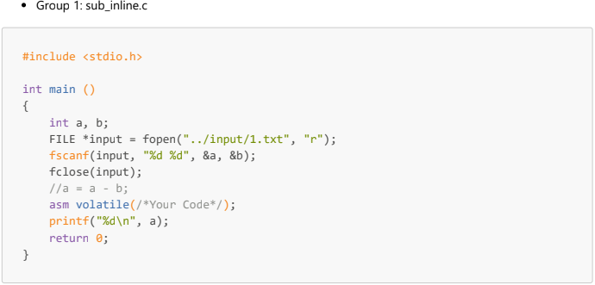
1.Basic (20%)
Please complete the code according to your group, you need to add your inline assembly code in the given C file.
Group1: Subtraction.
Group2: Multiplication.
Group3: Division.

Slide 7
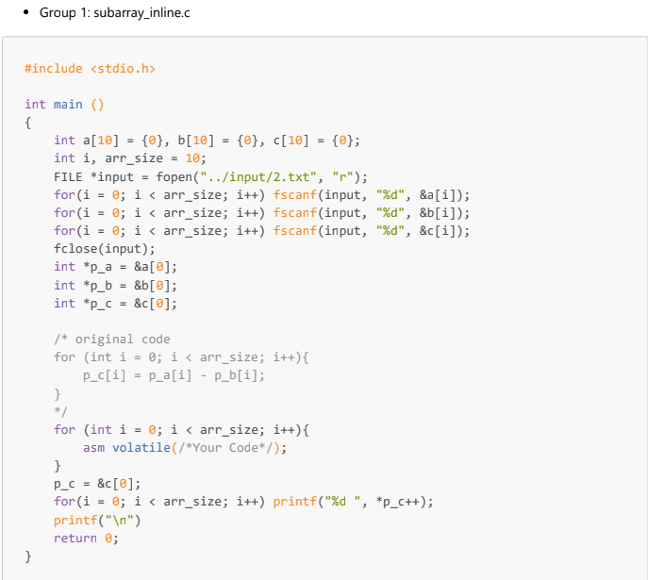
2.Array (20%)
Please complete the code according to your group, you need to add your inline assembly code in the given C file.
Group1: Subtraction.
Group2: Multiplication.
Group3: Division.

Slide 8
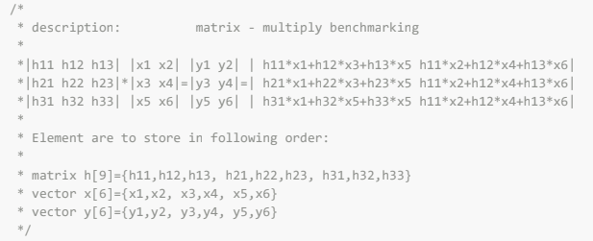
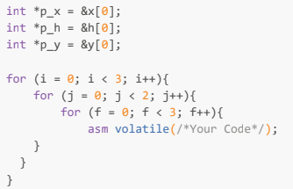
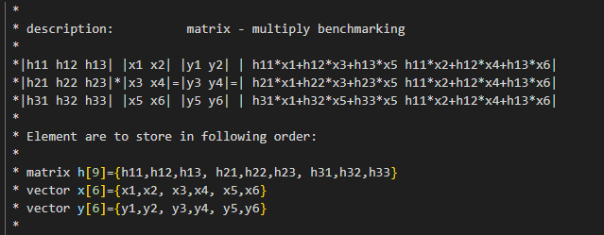
3.Matrix multiply (30%)
Please convert the loop body of the nested for-loop into the corresponding inline assembly version.

Slide 9
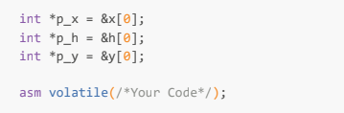
4.Matrix multiply(advanced) (30%)
Following the previous question.
The entire nested for-loop should be converted into the inline assembly code.
Exercise 3
Exercise 4

Slide 10
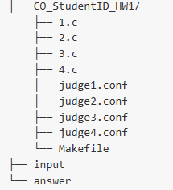
Test Your Assignment
We use local-judge to test and judge your program.
You can download the data CO2024HW1.zip from Moodle.
1.c ~ 4.c
Judge1.conf ~ judge4.conf
Makefile
Input
Answer
Beware! Modifying files other than 1.c ~ 4.c is forbidden.

Slide 11
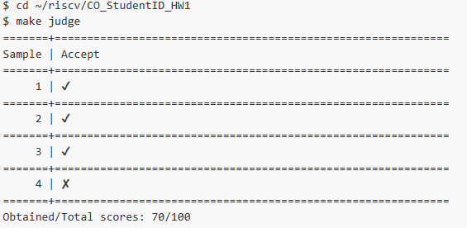
Test Your Assignment
Use the command pip3 install local-judge to download and install the local-judge.
The command make judge can be used to test all the exercises at once.

Slide 12
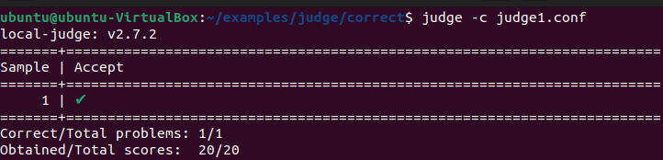
Test Your Assignment
If you want judge a specific exercise, you can use the command judge –c [CONFIG]. For example, you can check the result of the first exercise via the command judge –c judge1.conf.

Slide 13
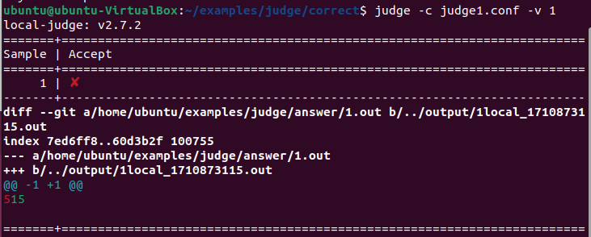
Test Your Assignment
If your code generates wrong output, you can use the parameter –v 1 while running the judge command to check the differences between your output and the correct answer.

Slide 14
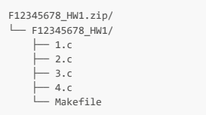
Submission
Compress your source files into a zip file.
Submit your homework to NCKU Moodle.
The file organization of your zip file should be as follows.
NOTE: Change all CO_StudentID to your student ID number, e.g., F12345678.zip. The example zip file is shown below.
Incorrect format (either the file structure or file name) will lose 10 points.

Slide 15
Submission
Office hours: Every Friday 10 a.m. to 12 p.m.
Office @ room 65704 (Advanced Systems Research Lab)
If you have any problem, please contact TA by email.
asrlab@csie.ncku.edu.tw
Email subject starts with “[Co24HW1]”
Deadline: 2024/4/10 23:59
Late submissions are limited to one week, and the score for late submissions will be reduced to 70%.
3/21 9:10
作業公布
4/10 23:59
繳交截止
4/17 23:59
補交截止

