Slide 1
Kaggle SeaLion Project
Alvin/Ray

Slide 2
Outline
* Competition Purpose
* Dataset Introduction
- Database Trip
* Solution
- Leader Board solution
- AI-Lab architecture
- Image pre-process
* AI-Lab progress
* Further work

Slide 3
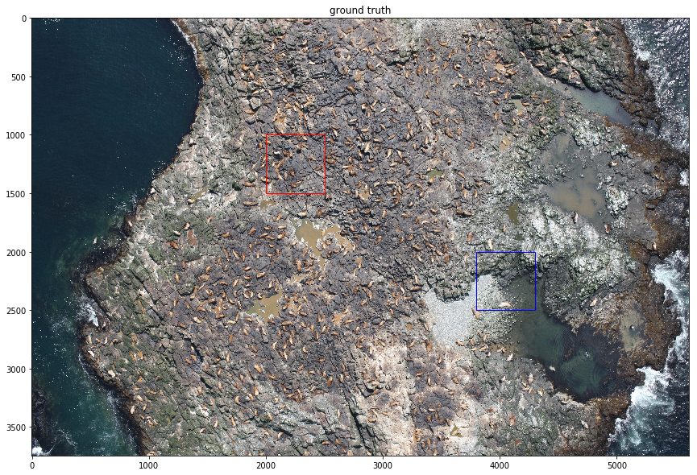
Competition Purpose

Slide 4
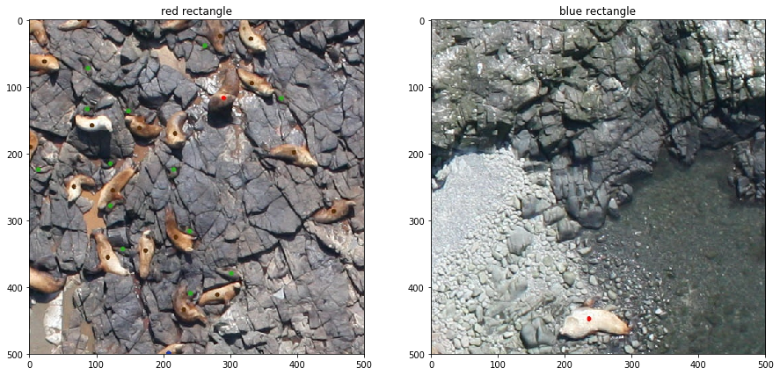
train_id | adult_males | Subadult_ males | Adult_ females | juveniles | pups
0 | 62 | 12 | 486 | 42 | 344
1 | 2 | 20 | 0 | 12 | 0
2 | 2 | 0 | 38 | 20 | 0
3 | 8 | 5 | 41 | 7 | 38
4 | 6 | 9 | 2 | 0 | 0
5 | 6 | 4 | 14 | 4 | 19
6 | 2 | 5 | 20 | 18 | 0
label mark
red: adult males
magenta: subadult males
brown: adult females
blue: juveniles
green: pups

Slide 5
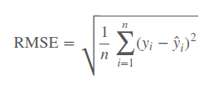
Evaluation
Your submission file should have the following format:
test_id,adult_males,subadult_males,adult_females,juveniles,pups
0,1,1,1,1,1
1,1,1,1,1,1
2,1,1,1,1,1
etc
Your submissions will be evaluated by their RMSE from the human-labelled ground truth, averaged over the columns.

Slide 6
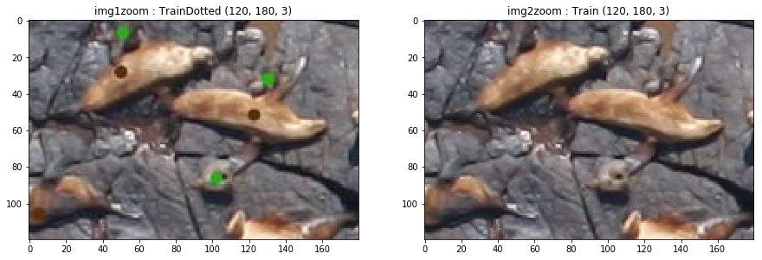
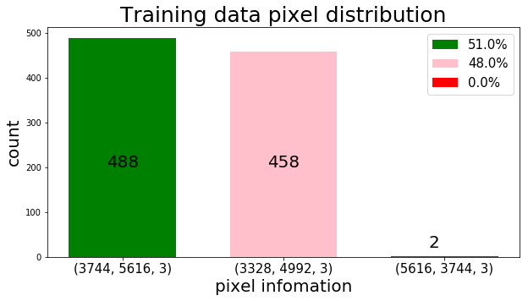
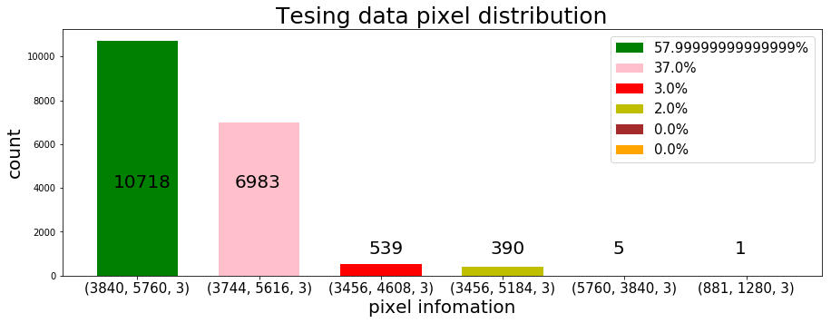
Dataset introduction storage/pixel
 | number | size
Training data | 948 | 5.86G
Training data dot | 948 | 3.95G
Testing data | 18638 | 86G

Slide 7
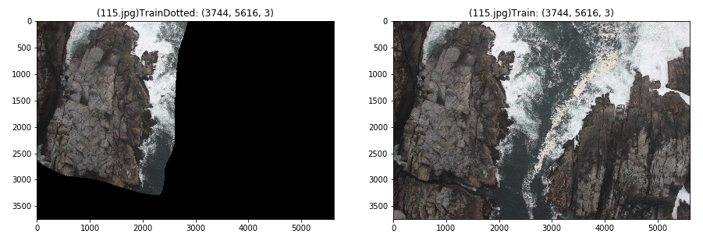
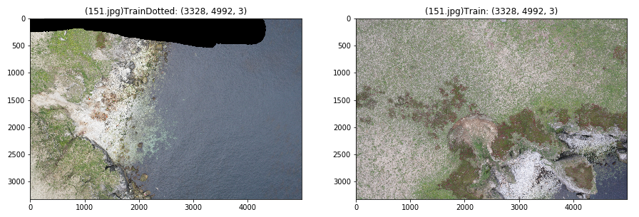
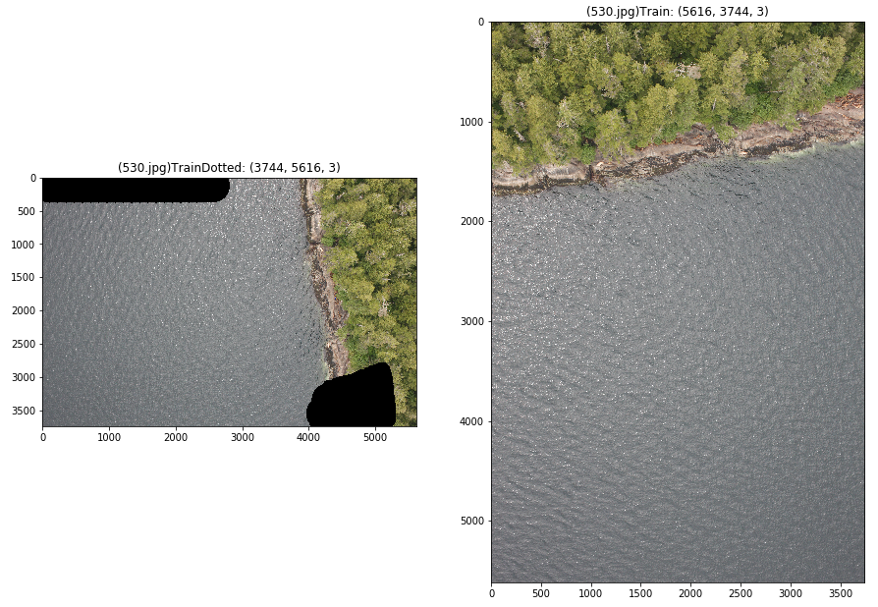
Dataset trip
Manual noise
2.Different picture
3. size not equal

Slide 8
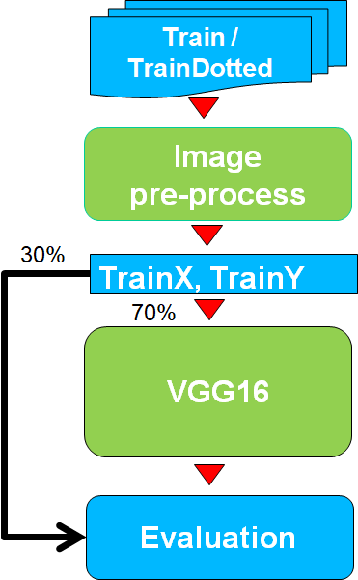
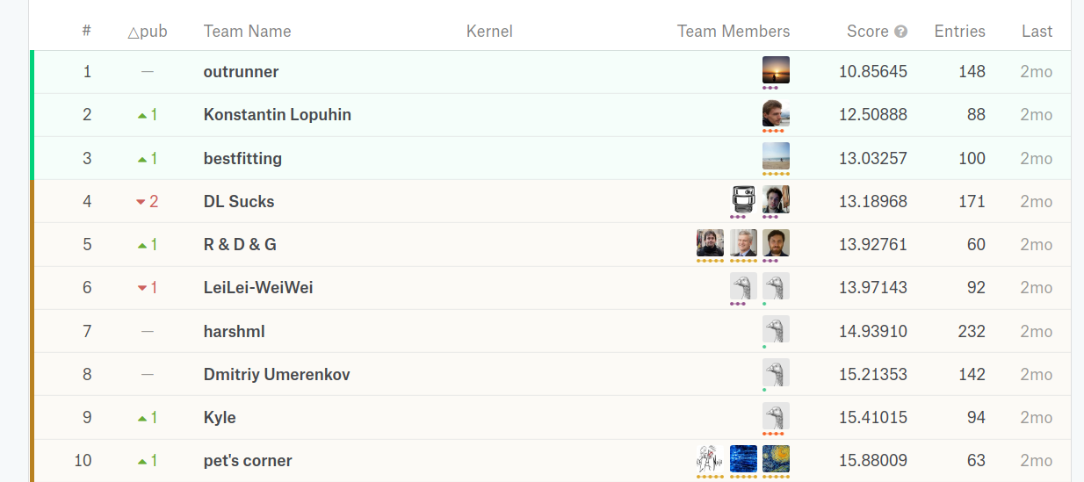
Solution Framework

Slide 9
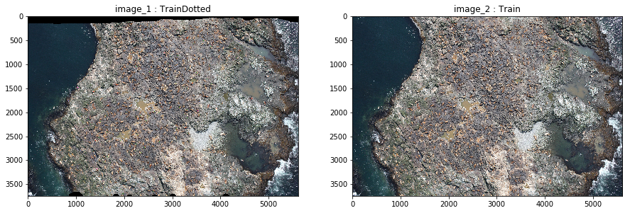
Image pre-process(image_1,image_2)
image_1: training data w/ label (folder: TrainDotted)
image_2: training data w/o label (folder: Train)
image_3: cv2_absdiff(image_1,image_2)
image_4: cv2_bitwise_or(image_3,image_3,mask)
Image_6: gray scale of image_4

Slide 10
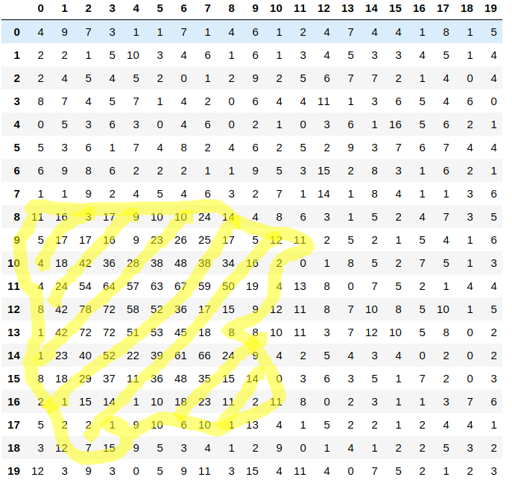
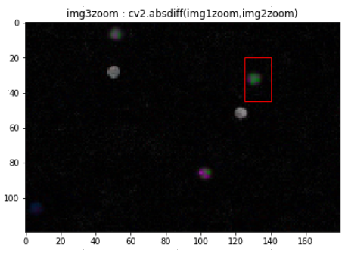
Image pre-process(image_3)
image_3: cv2_absdiff(image_1,image_2)
not 0
Slightly larger
Image_3[:,:,0]

Slide 11
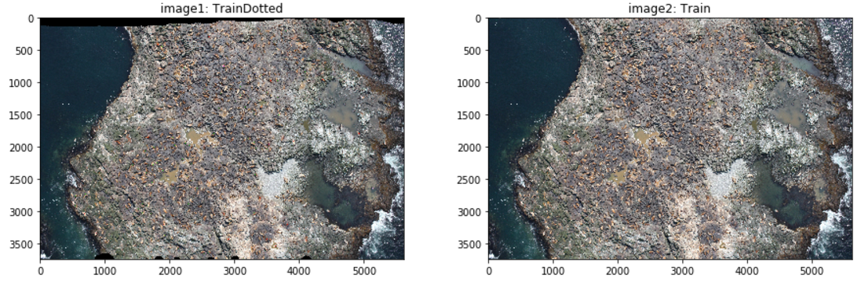
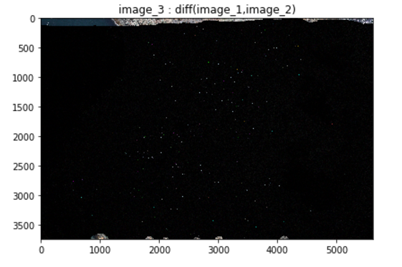
Image pre-process(image_3)
image_3: cv2_absdiff(image_1,image_2)

Slide 12
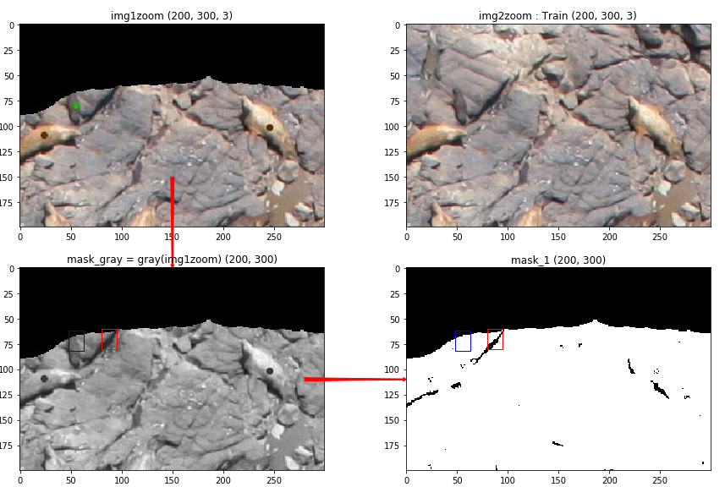
Image pre-process(image_4)
mask_1 = cv2.cvtColor(img1zoom, cv2.COLOR_BGR2GRAY)
mask_1[mask_1 < 50] = 0
mask_1[mask_1 > 0] = 255

Slide 13
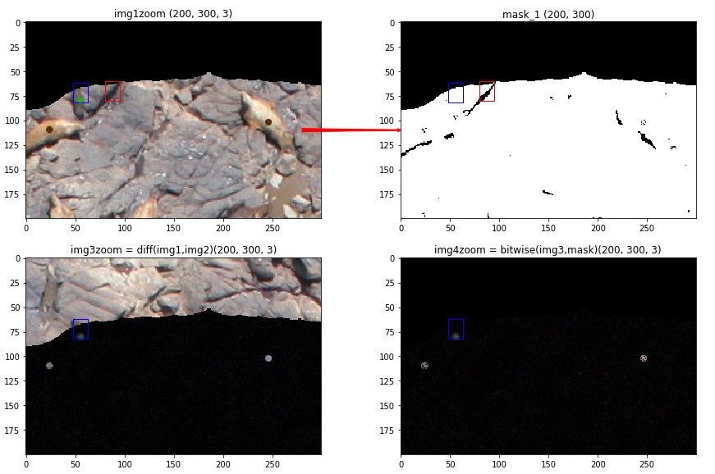
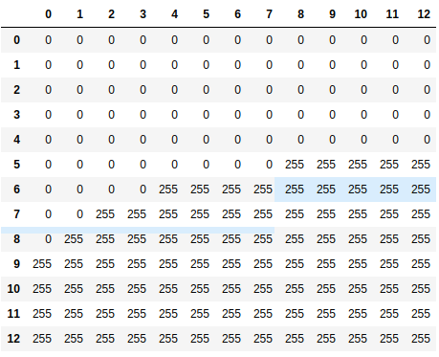
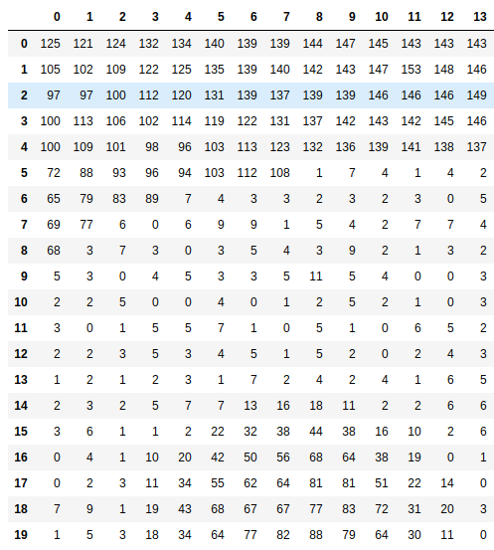
Image pre-process(image_4)
img4zoom = cv2.bitwise_or(img3zoom, img3zoom, mask=mask_1)
Using mask to let non-answer block to be black
Gray scale
threshold

Slide 14
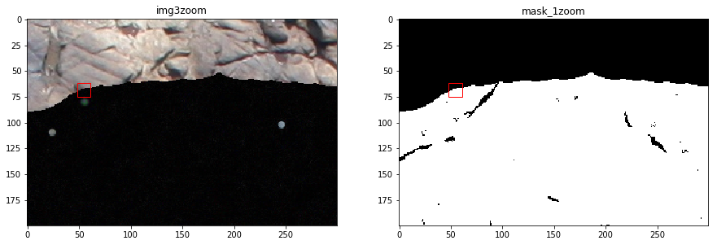
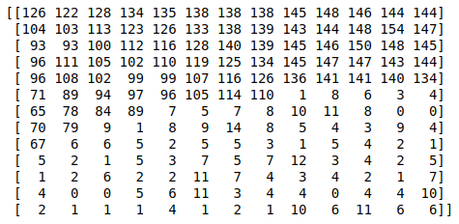
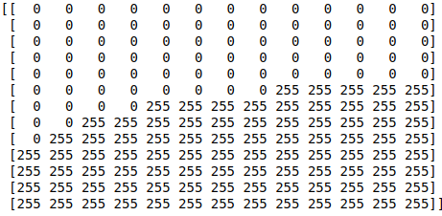
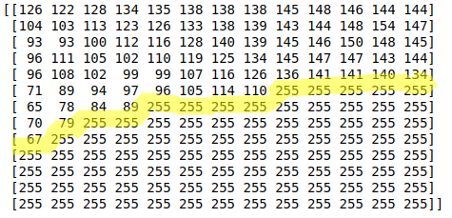
Appendix: cv2.bitwise_or w/o mask
If we do cv2.bitwise_or(A,B)
A is image_3
B is mask_1
=
=
bitwise_or

Slide 15
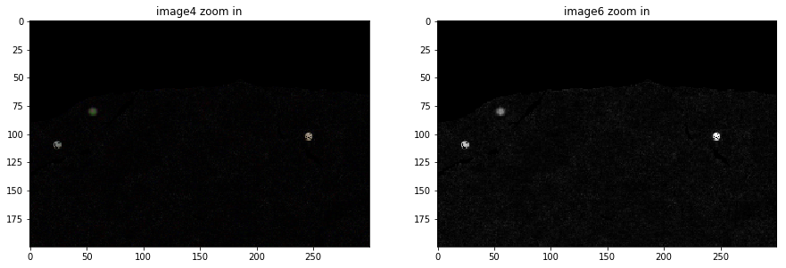
Image pre-process(image_6)
Image_3 = cv2_absdiff(image_1,image_2) => [3744,5616,3]
Image_4 = cv2.bitwise_or(image_3,image_3,mask) => [3744,5616,3]
image_6 = np.max(image_4,axis=2) => [3744,4616]
The purpose for this step is to do gary scale for next blob-detection

Slide 16
Find location of ground truth
blobs = skimage.feature.blob_log(image_6,
min_sigma=3, max_sigma=7, num_sigma=1, threshold=0.05)
Blob Detection
Blobs are bright on dark or dark on bright regions in an image. In this example, blobs are detected using 3 algorithms. The image used in this case is the Hubble eXtreme Deep Field. Each bright dot in the image is a star or a galaxy.
Laplacian of Gaussian (LoG)
This is the most accurate and slowest approach. It computes the Laplacian of Gaussian images with successively increasing standard deviation and stacks them up in a cube. Blobs are local maximas in this cube. Detecting larger blobs is especially slower because of larger kernel sizes during convolution. Only bright blobs on dark backgrounds are detected. See skimage.feature.blob_log() for usage.
Difference of Gaussian (DoG)
This is a faster approximation of LoG approach. In this case the image is blurred with increasing standard deviations and the difference between two successively blurred images are stacked up in a cube. This method suffers from the same disadvantage as LoG approach for detecting larger blobs. Blobs are again assumed to be bright on dark. See skimage.feature.blob_dog() for usage.
Determinant of Hessian (DoH)
This is the fastest approach. It detects blobs by finding maximas in the matrix of the Determinant of Hessian of the image. The detection speed is independent of the size of blobs as internally the implementation uses box filters instead of convolutions. Bright on dark as well as dark on bright blobs are detected. The downside is that small blobs (<3px) are not detected accurately. See skimage.feature.blob_doh() for usage.

Slide 17
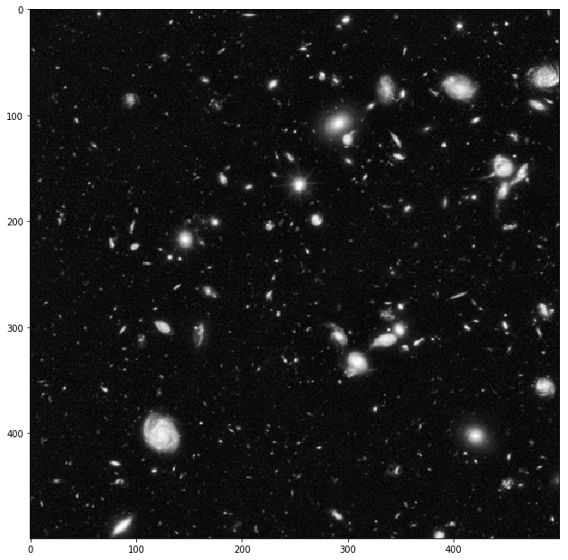
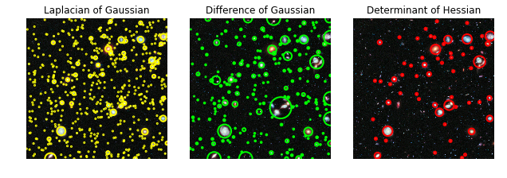

Slide 18
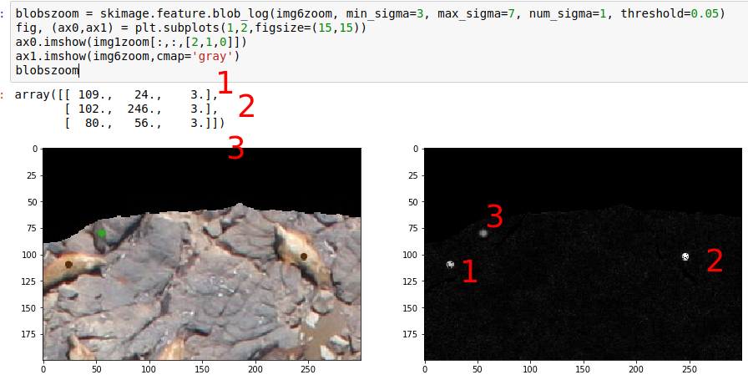

Slide 19
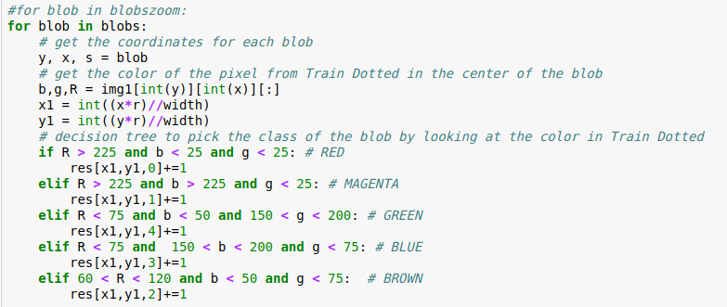
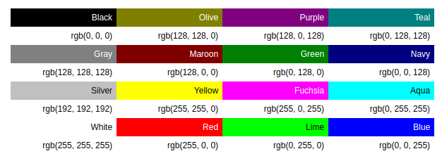
Setup TrainY
label mark
red: adult males
magenta: subadult males
brown: adult females
blue: juveniles
green: pups
trainY.append(res[i,j,:])

Slide 20
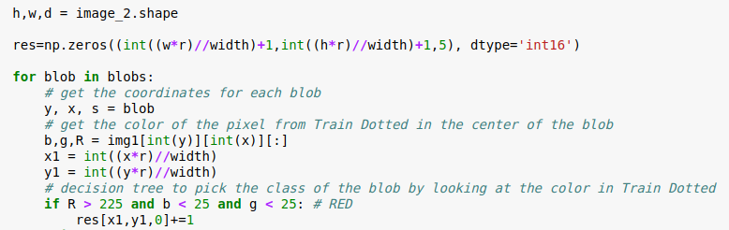
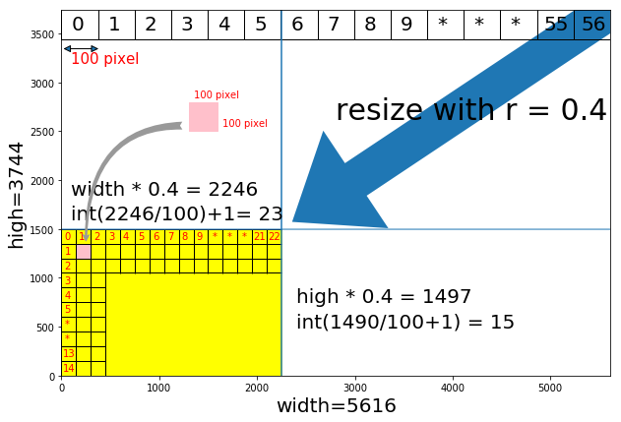
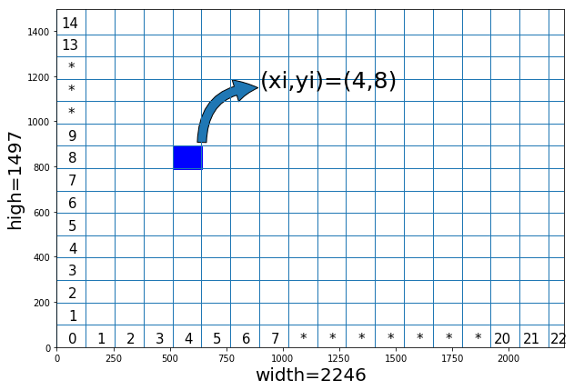
What is x1,y1

Slide 21
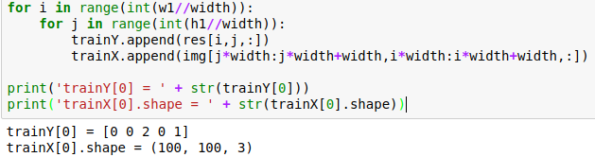
Format of Training/Testing Data
23
15
When i=4,j=8
j*width = 8*100 = 800
j*width+width = 900
i*width = 4*100 = 400
i*width+width = 500
Img[800:900, 400:500, :]
....
....
....
....
....
trainY[307] (21,13) = [0 0 0 0 0]
In this picture,
training data will be
In this picture,
Label data will be
trainX[0] (0,0) = (100, 100, 3)
trainX[1] (0,1) = (100, 100, 3)
trainX[2] (0,2) = (100, 100, 3)
trainX[3] (0,3) = (100, 100, 3)
....
....
....
....
....
trainX[307] (21,13) = (100, 100, 3)
trainY[0] (0,0) = [0 0 2 0 1]
trainY[1] (0,1) = [0 0 0 0 0]
trainY[2] (0,2) = [0 0 0 0 0]
trainY[3] (0,3) = [0 0 0 0 0]
14X22=308

Slide 22
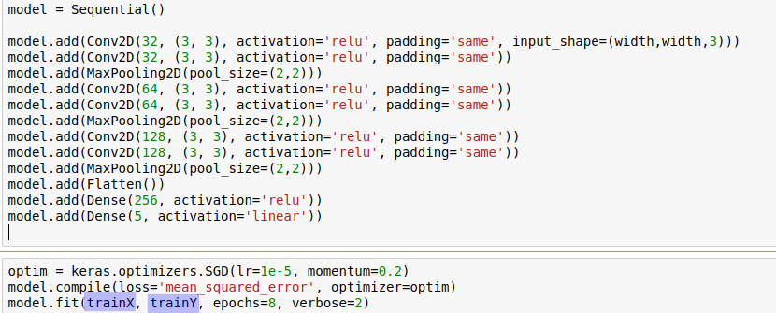
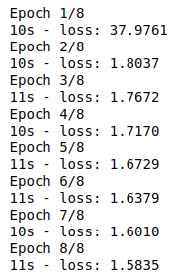
Use Keras VGG model to train SeaLion

Slide 23
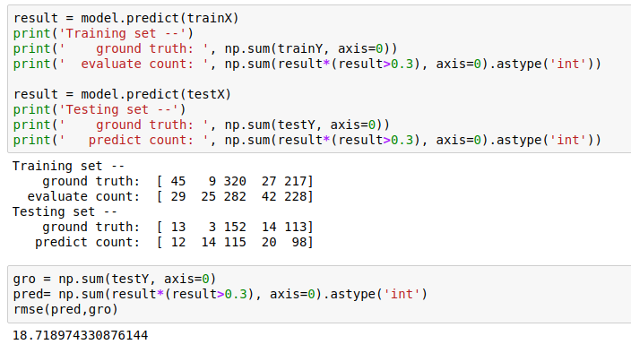
Use Keras VGG model to evaluate SeaLion

