Slide 1
Cardiac cycle and heart sound

Slide 2
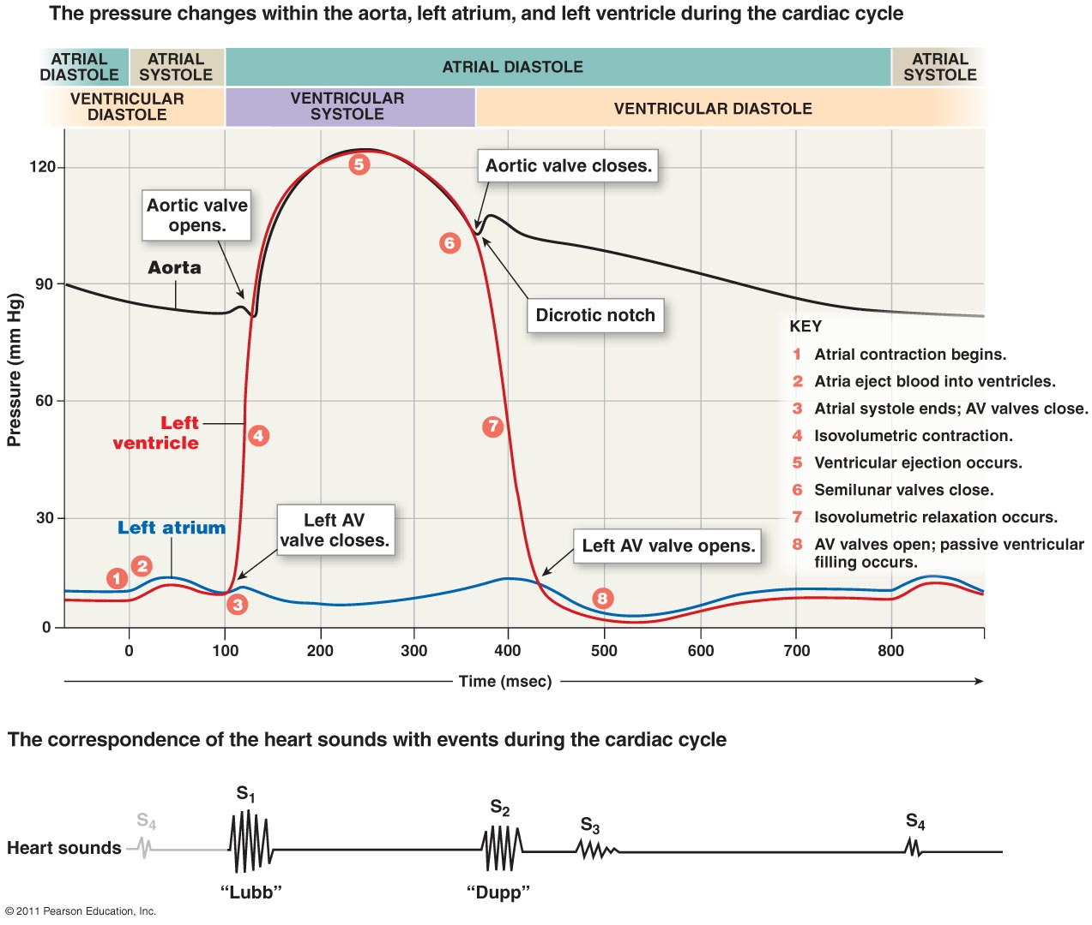

Slide 3
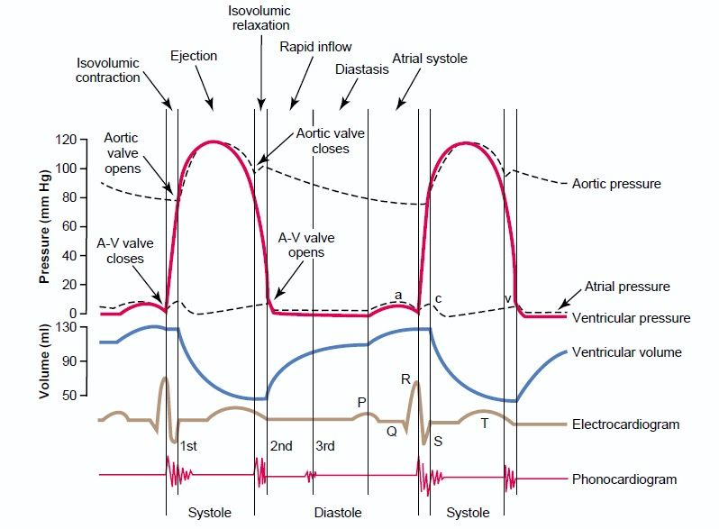

Slide 4
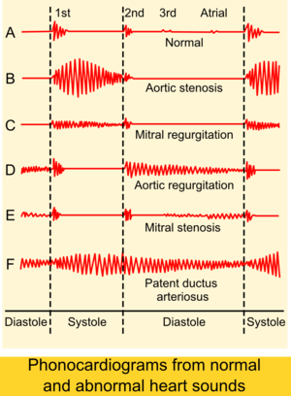

Slide 5
Q&A

Slide 6
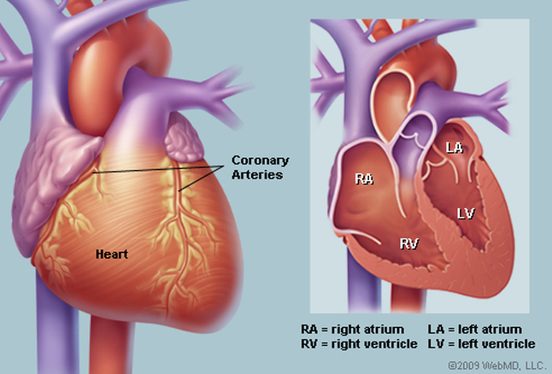
Anatomy

Slide 7
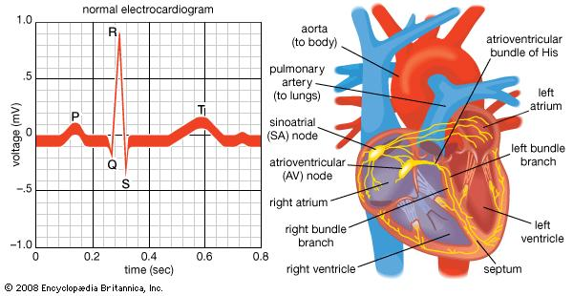
ECG

Slide 8
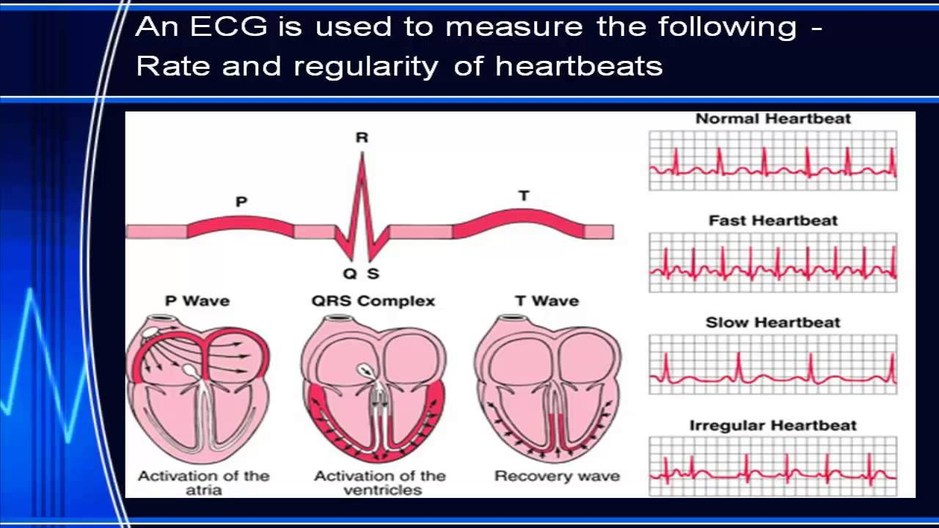
ECG

Slide 9
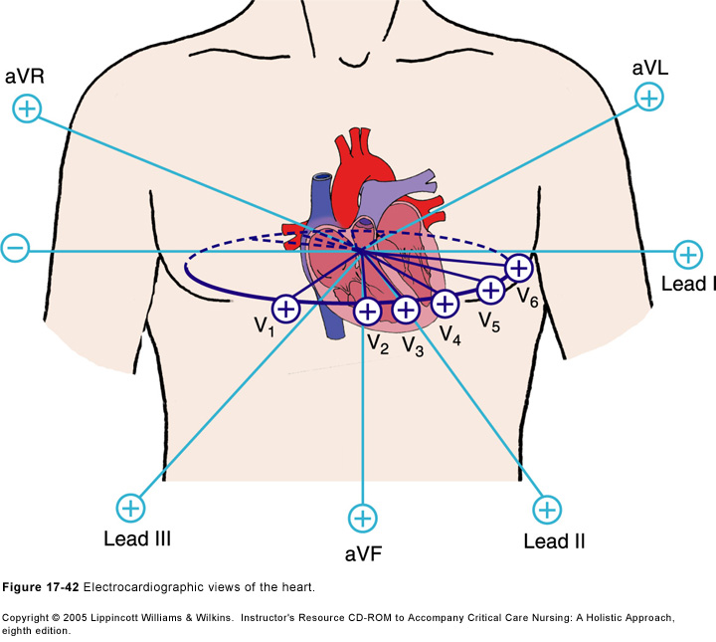
ECG

Slide 10
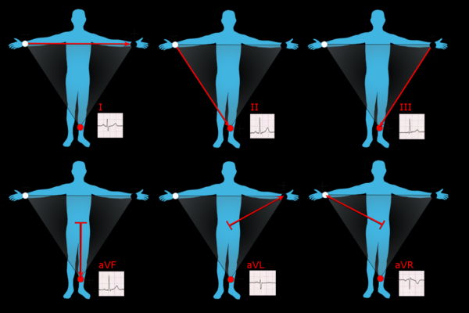
ECG

Slide 11
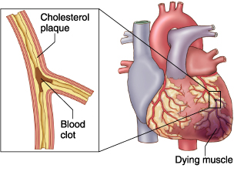
Myocardial infarction

Slide 12
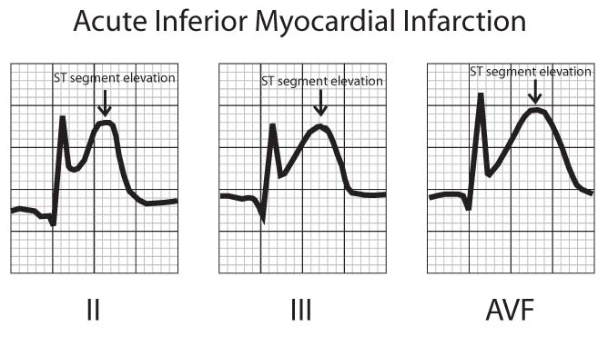
Myocardial infarction (ST elevation)

Slide 13
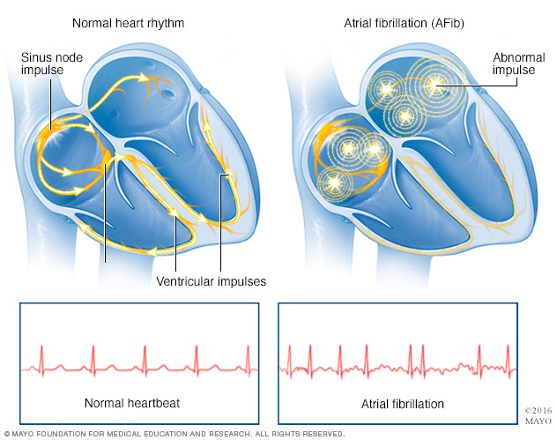
Af

Slide 14
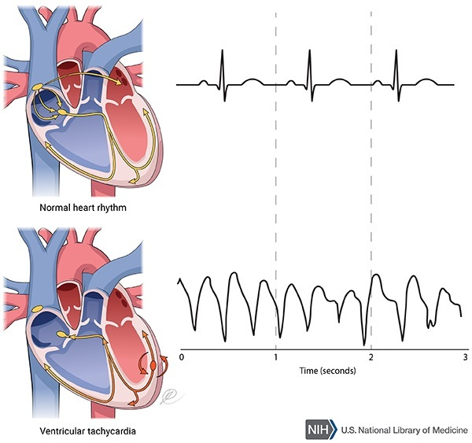
VT

Slide 15
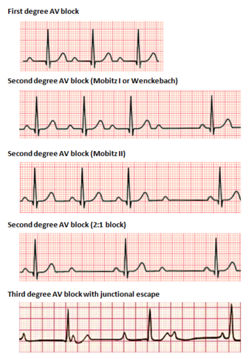
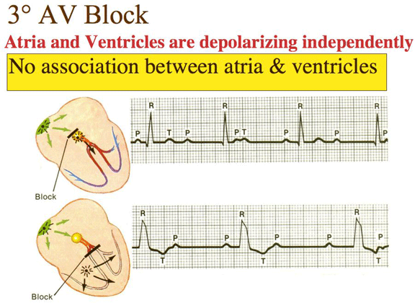
AV block

Slide 16
 | Inotropic | Chronotropic | Dromotropic
Definition | Affects the force of cardiac contraction | Affects the heart rate | Affects conduction velocity through the conducting tissues of the heart
Classification | Positive Inotropic – strengthens the force of cardiac contraction Negative Inotropic – weakens the force of cardiac contraction | Positive chronotropic – accelerates the heart rate Negative chronotropic – slows down the heart rate | Positive dromotropic – speeds up the conduction Negative dromotropic - slows down the conduction
Examples | Positive Inotropic – dopamine, adrenaline, etc. Negative Inotropic – labetalol and propanolol | Positive chronotropic – Adernaline Negative chronotropic – digoxin | Positive dromotropic – phenytoin Negative dromotropic - verapamil
Origin of word | From Greek in-, meaning fibre or sinew) | From chrono-, meaning time, and tropos, "a turn" | From the Greek word "dromos", meaning running, a course, a race

