Slide 1
Data Analysis for Onset Detection
Alvin/Johnny

Slide 2
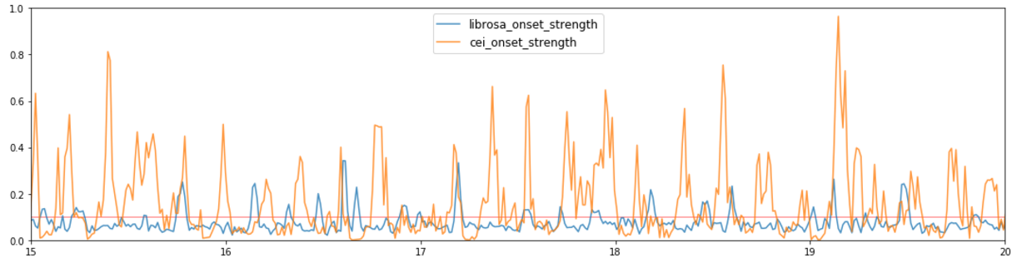
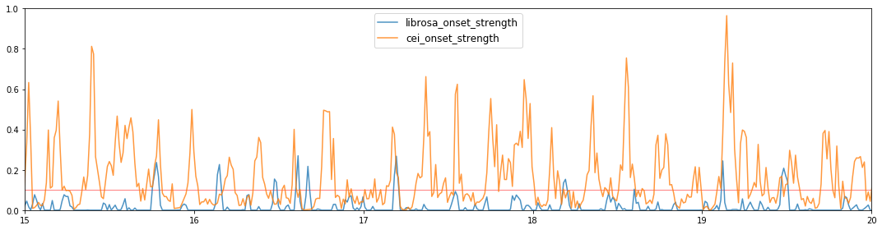
Onset strength output is different from librosa
onset_env = librosa.onset.onset_strength(y=audio_raw_data, sr=sr,fmax=22000, n_mels=128)
onset_env = librosa.onset.onset_strength(y=audio_raw_data, sr=sr,aggregate=np.median)

Slide 3
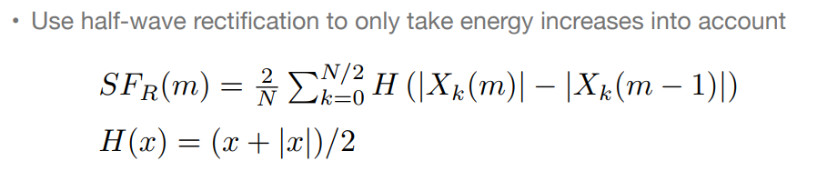
http://www.nyu.edu/classes/bello/MIR_files/3-novelty.pdf
K=N/2
K=2
K=1
K=0
m=0
m=1
m=2
m=total frame
num_frame = trainYA.shape[1]
trainX_sid = trainX[sid*num_frame:sid*num_frame+num_frame,0:n_of_freq_bins]
trainXPD = np.diff(trainX_sid,axis=0)
trainXPDH = np.maximum(np.zeros(trainXPD.shape),trainXPD)

Slide 4
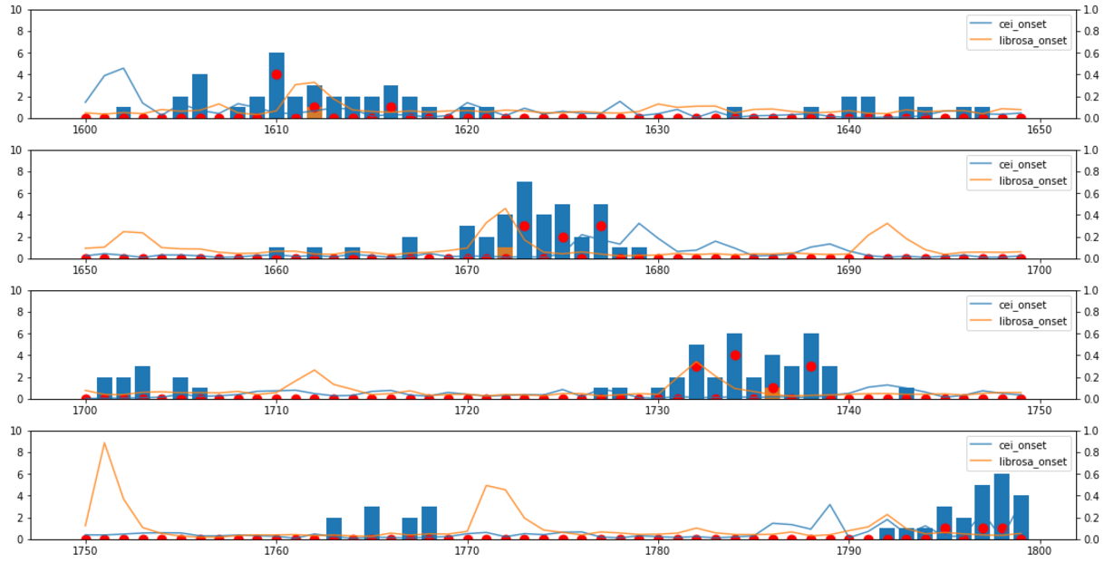
Label Distribution librosa onset_strength match better
precision: 0.8132 - recall: 0.6653
val_precision: 0.3823 - val_recall: 0.3017

Slide 5
Conclusion
Librosa onset_strength is different from cei implementation
Librosa onset_strength match user labeling output better
Basically, cei implementation is not wrong, maybe there is another tips i don’t know
CEI LSTM model get the following result, maybe more data could improve P/R value
precision: 0.8132 - recall: 0.6653
val_precision: 0.3823 - val_recall: 0.3017
Trainging song 16, testing song 4.

