Slide 1
FFT, STFT and Wavelet 101
Notes:
05/26/14
1
05/26/14
1
05/26/14
1
05/26/14
1
05/26/14
1

Slide 2
Outline
Nyquist-Shannon Sampling Theorem
Fourier Transform
DTFT, DFT and FFT
STFT
CWT and DWT
Notes:
05/26/14
2
05/26/14
2

Slide 3
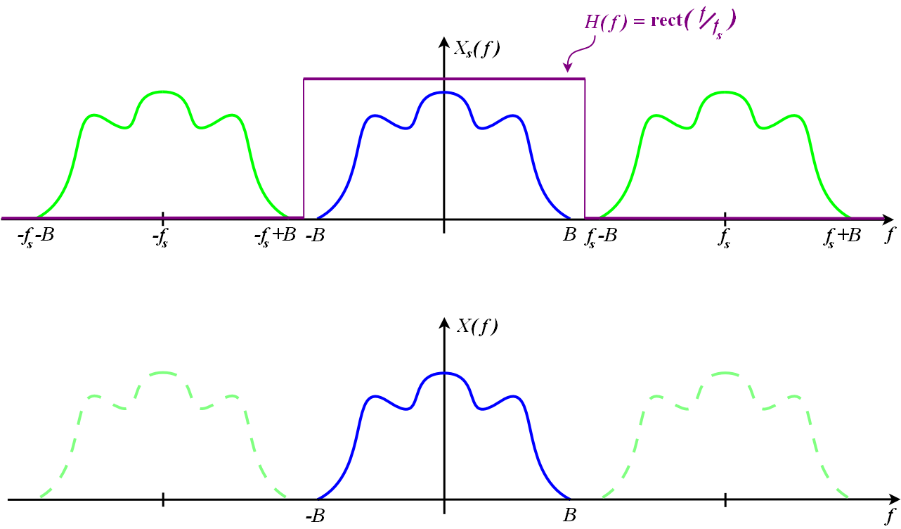
Nyquist-Shannon Sampling Theorem
sample-rate fs >= 2B samples/second (Hz)
e.g. 44.1kHz
Notes:
05/26/14
3
05/26/14
3

Slide 4
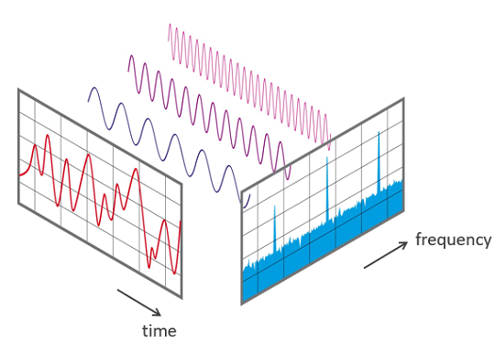
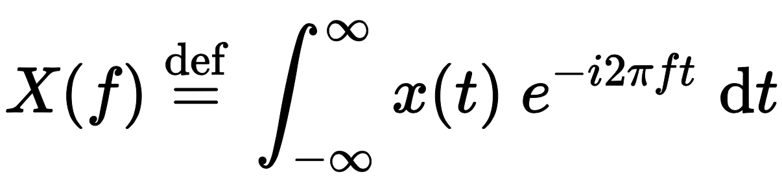
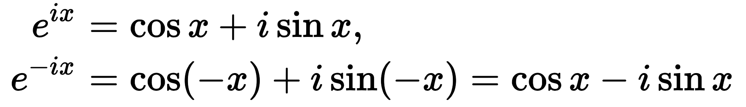
Fourier Transform
Notes:
05/26/14
4
05/26/14
4

Slide 5
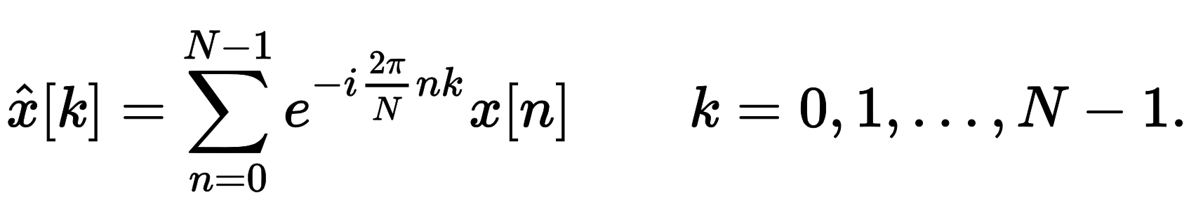
DTFT, DFT and FFT
(X) DTFT: for continuous input.
(O) DFT:
(O) FFT: fast DFT for 2^n input
Notes:
05/26/14
5
05/26/14
5

Slide 6
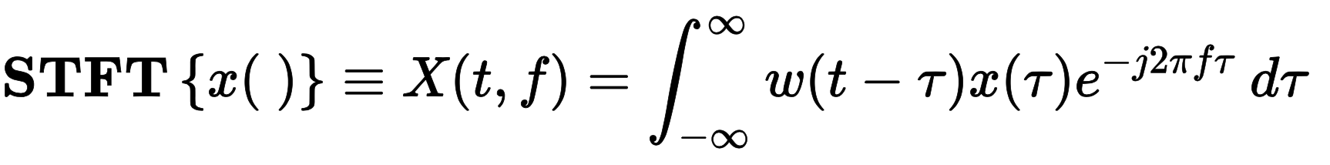
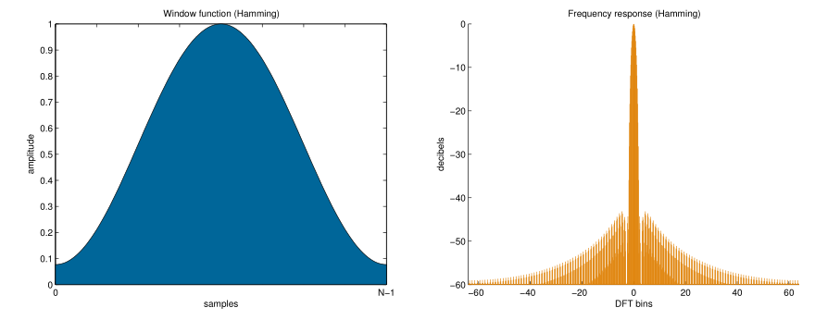
STFT
Notes:
05/26/14
6
05/26/14
6

Slide 7
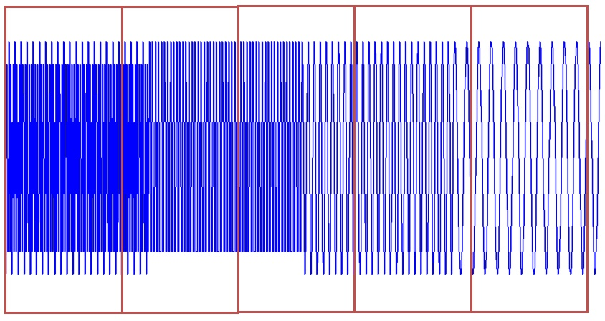
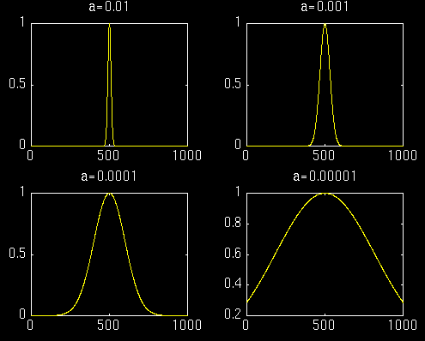
STFT
時間上間隔
Notes:
05/26/14
7
05/26/14
7

Slide 8
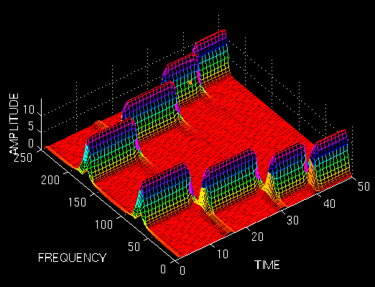
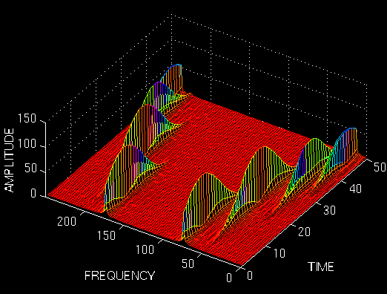
STFT
Narrow window
=good time resolution
=poor frequency resolution
對於時變非穩定訊號，
高頻適合小窗
低頻適合大窗
Notes:
05/26/14
8
05/26/14
8

Slide 9

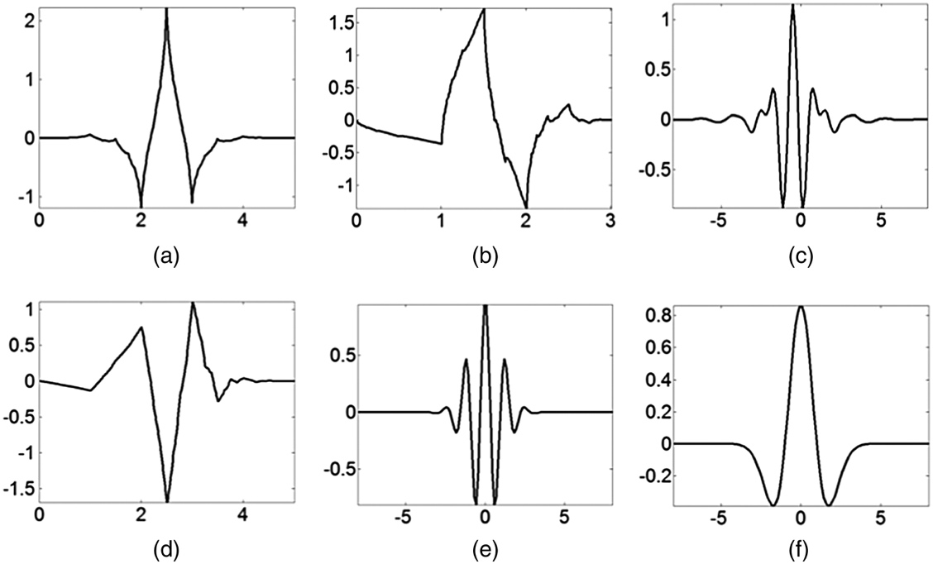
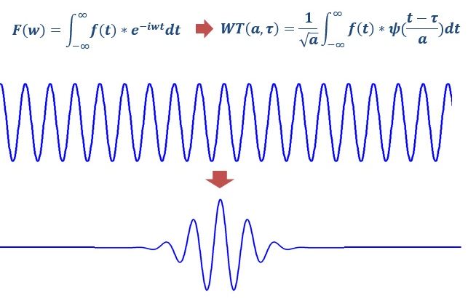
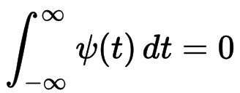
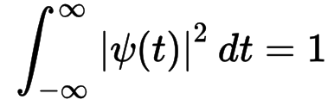
CWT
Notes:
05/26/14
9
05/26/14
9

Slide 10
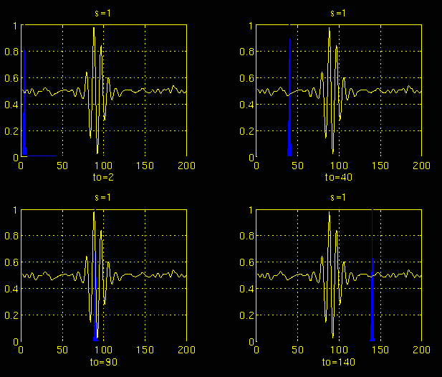

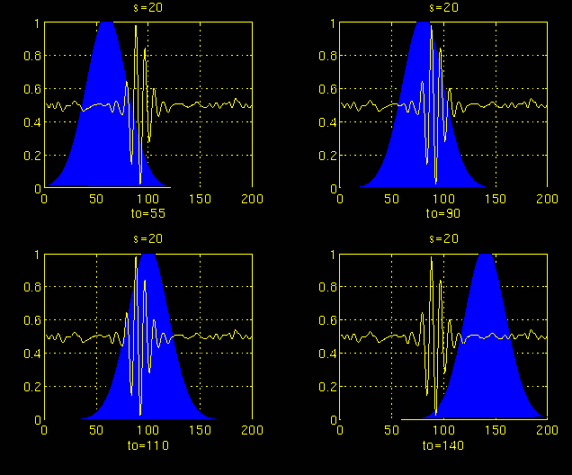
CWT
Notes:
05/26/14
10
05/26/14
10

Slide 11
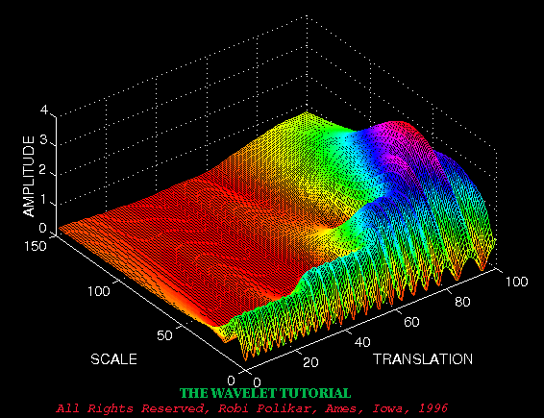
CWT
Notes:
05/26/14
11
05/26/14
11

Slide 12
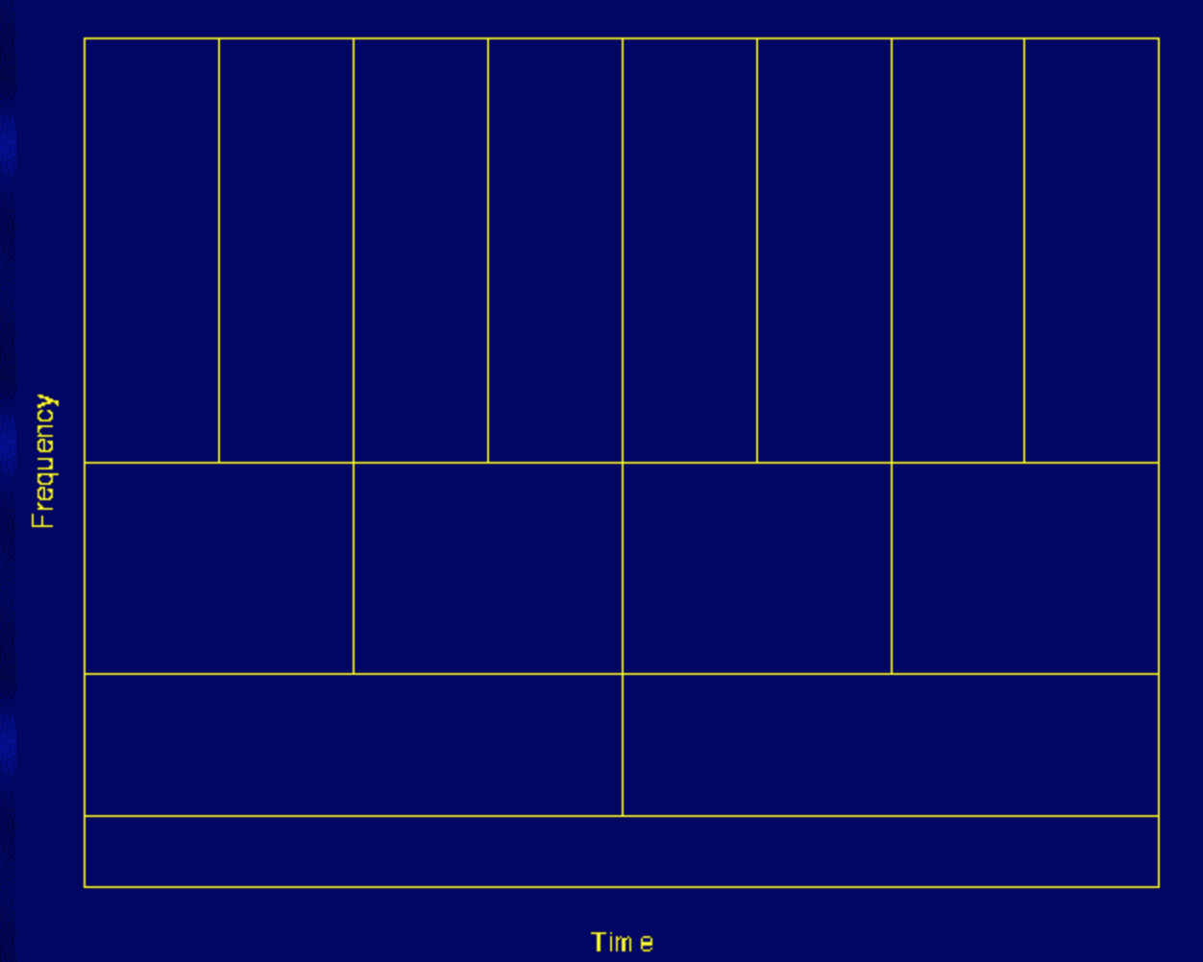
CWT
Notes:
05/26/14
12
05/26/14
12

Slide 13
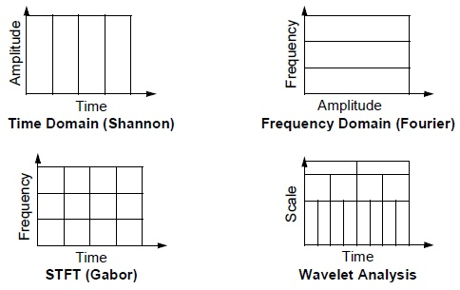
CWT
Notes:
05/26/14
13
05/26/14
13

Slide 14
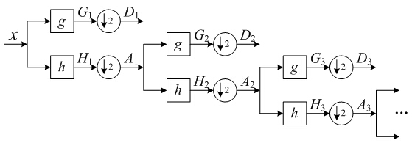
DWT
pywt:
CWT: 21 wavelets
DWT: 106 wavelets
Notes:
05/26/14
14
05/26/14
14

Slide 15
補充資料
1. FFT
https://dsp.stackexchange.com/questions/741/why-should-i-zero-pad-a-signal-before-taking-the-fourier-transform
http://www.bitweenie.com/listings/fft-zero-padding/
2. wavelet
http://users.rowan.edu/~polikar/WAVELETS/WTtutorial.html
https://www.zhihu.com/question/22864189
http://blog.csdn.net/jbb0523/article/details/42554693
http://blog.csdn.net/jbb0523/article/details/42470103
3. API
https://pywavelets.readthedocs.io/en/latest/ref/index.html
https://librosa.github.io/librosa/index.html

