Slide 1
Support Vector Machine (SVM)
Alvin

Slide 3
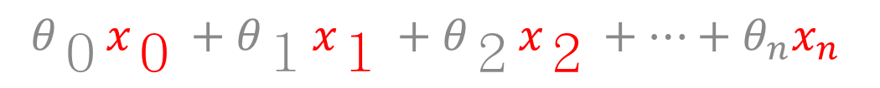

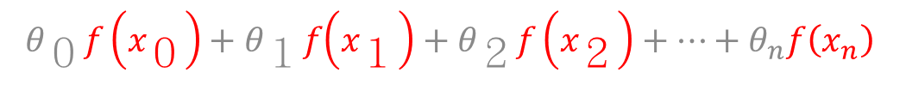
Linear Kernel
$$f\left(x\right)=x$$
$$θ_{０}f\left(x_{０}\right)+θ_{１}f\left(x_{１}\right)+θ_{２}f\left(x_{２}\right)+⋯+θ_{n}f\left(x_{n}\right)$$
$$θ_{０}x_{０}+θ_{１}x_{１}+θ_{２}x_{２}+⋯+θ_{n}x_{n}$$

Slide 4
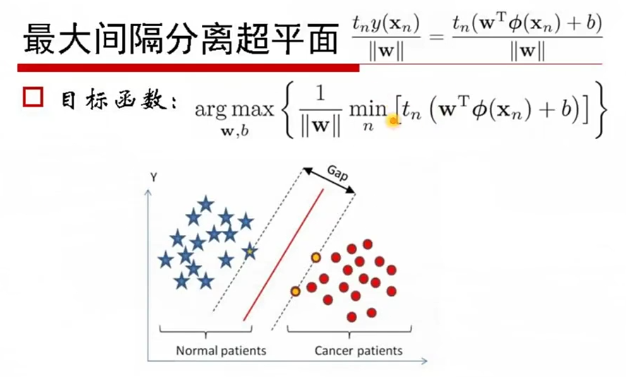
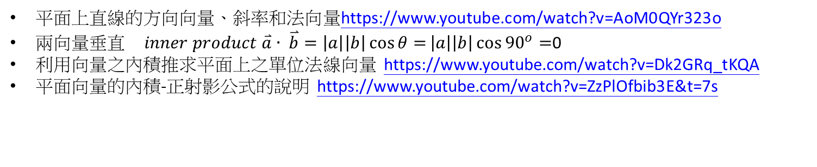
平面上直線的方向向量、斜率和法向量https://www.youtube.com/watch?v=AoM0QYr323o
兩向量垂直 $inner product \overset{⃑}{a}∙ \overset{⃑}{b}=\left|a\right|\left|b\right|\cos{θ=}\left|a\right|\left|b\right|\cos{{90}^{o}=}$0
利用向量之內積推求平面上之單位法線向量 https://www.youtube.com/watch?v=Dk2GRq_tKQA
平面向量的內積-正射影公式的說明 https://www.youtube.com/watch?v=ZzPlOfbib3E&t=7s

Slide 5
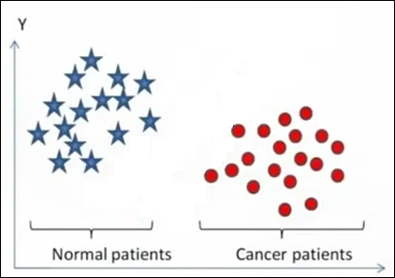
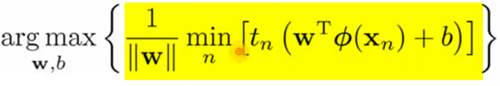
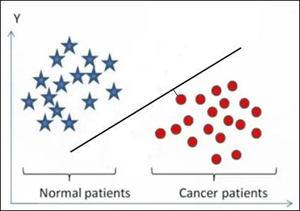
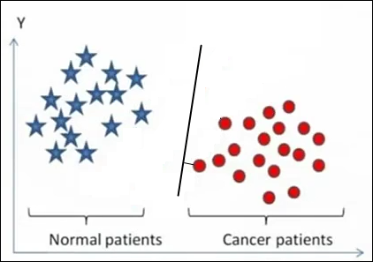
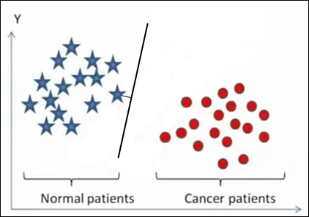
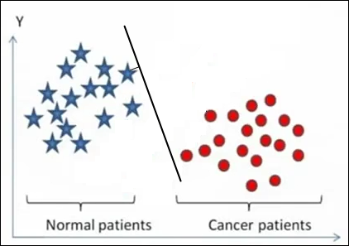
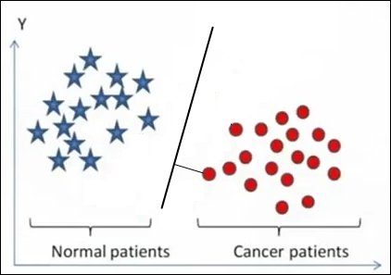
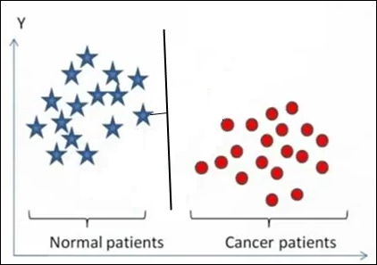
















$$x_{9}$$
$$x_{5}$$
$$x_{2}$$
$$x_{8}$$
$$\underset{w,b}{argmax}\left\{\frac{1}{\left\|w\right\|}\left[t_{5}\left(w^{T}∅\left(x_{5}\right)+b\right)\right]\right\}$$
$$\underset{w,b}{argmax}\left\{\frac{1}{\left\|w\right\|}\left[t_{8}\left(w^{T}∅\left(x_{8}\right)+b\right)\right]\right\}$$
$$\underset{w,b}{argmax}\left\{\frac{1}{\left\|w\right\|}\left[t_{2}\left(w^{T}∅\left(x_{2}\right)+b\right)\right]\right\}$$
$$x_{5}$$
$$x_{2}$$
$$x_{8}$$
$$\underset{w,b}{argmax}\left\{\frac{1}{\left\|w\right\|}\left[t_{9}\left(w^{T}∅\left(x_{9}\right)+b\right)\right]\right\}$$
$$\underset{w,b}{argmax}\left\{\frac{1}{\left\|w\right\|}\left[t_{8}\left(w^{T}∅\left(x_{8}\right)+b\right)\right]\right\}$$
$$\underset{w,b}{argmax}\left\{\frac{1}{\left\|w\right\|}\left[t_{2}\left(w^{T}∅\left(x_{2}\right)+b\right)\right]\right\}$$
$$x_{9}$$
$$x_{2}$$
$$x_{8}$$

