Slide 1
Progress MidiLoc Backend
Status update for mentor
Repo: fridoustin/LocationWeb_Midi — Branch: debug
October 03, 2025

Slide 2
Context & Goal
Project: MidiLoc Backend (Next.js API Routes)
Goal: API rapi, scalable, aman
Scope: Auth, Dashboard, KPLT/ULOK, Wilayah

Slide 3
Repo & Branch Focus
Fokus: branch debug, folder app/api
Implemented (debug): dashboard, signUp, progress (placeholder)
Referensi di main: login, me, kplt, ulok, wilayah

Slide 4
API Surface Overview (Non-teknis)
Auth: Login, Sign Up, Me
Dashboard: ringkasan data
KPLT & ULOK: alur approval/update
Wilayah: data master region
Progress: telemetry placeholder

Slide 5
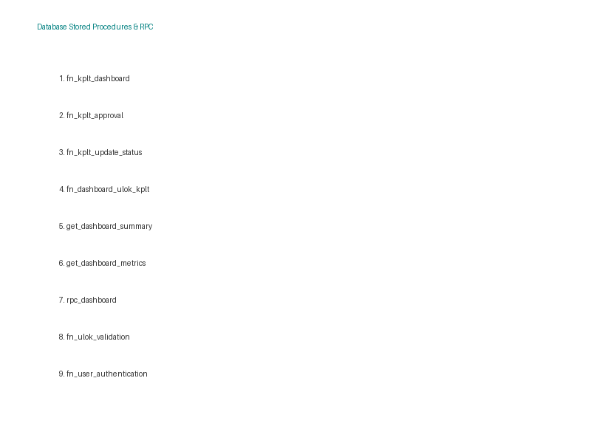
Stored Procedures & RPC
Peran: logika bisnis di DB (konsisten & cepat)
Contoh: fn_kplt_*, get_dashboard_*, rpc_dashboard
Digunakan oleh API untuk read/write aman

Slide 6
Progress Highlights (debug)
dashboard/route.ts: agregasi dashboard
signUp/route.ts: registrasi + validasi
progress/route.ts: placeholder (0 byte)
Konsolidasi pola akses via RPC

Slide 7
Aktivitas yang Sudah Dilakukan
Struktur modular App Router
Implementasi endpoint core (Dashboard, Sign Up)
Penyiapan endpoint Progress
Review integrasi ke prosedur DB

Slide 8
Dampak bagi Stakeholder
Development lebih cepat & terukur
Data reliabel via prosedur DB
Keamanan: minim raw query, akses terkendali

Slide 9
Demo Alur (contoh)
Sign Up: input user → hasil validasi
Dashboard: filter sederhana → ringkasan metrik

Slide 10
Risiko & Mitigasi
Ketergantungan SP: dokumentasi kontrak
Perbedaan branch: rencana sinkronisasi
Validasi/error handling: guardrail bertahap

Slide 11
Appendix — Links (referensi)
Dashboard (debug):
https://github.com/fridoustin/LocationWeb_Midi/blob/debug/app/api/dashboard/route.ts
Sign Up (debug):
https://github.com/fridoustin/LocationWeb_Midi/blob/debug/app/api/signUp/route.ts
Progress (debug):
https://github.com/fridoustin/LocationWeb_Midi/blob/debug/app/api/progress/route.ts
Login (main):
https://github.com/fridoustin/LocationWeb_Midi/blob/main/app/api/login/route.ts
Me (main):
https://github.com/fridoustin/LocationWeb_Midi/blob/main/app/api/me/route.ts
KPLT (main):
https://github.com/fridoustin/LocationWeb_Midi/blob/main/app/api/kplt/route.ts
https://github.com/fridoustin/LocationWeb_Midi/tree/main/app/api/kplt/%5Bid%5D
ULOK (main):
https://github.com/fridoustin/LocationWeb_Midi/blob/main/app/api/ulok/route.ts
https://github.com/fridoustin/LocationWeb_Midi/tree/main/app/api/ulok/%5Bid%5D
Wilayah (main):
https://github.com/fridoustin/LocationWeb_Midi/blob/main/app/api/wilayah/route.ts

