Slide 1

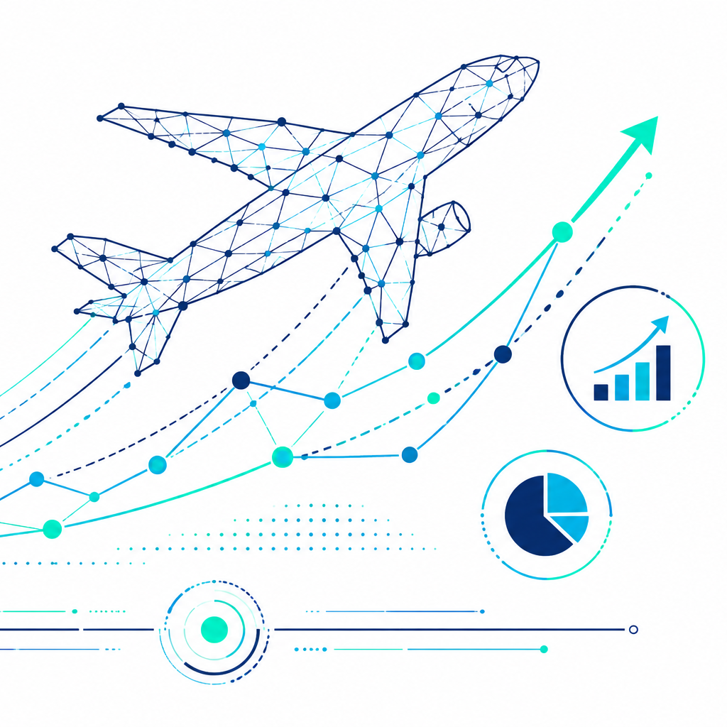
Voyage Analytics : Production-Grade MLOps Travel Platform
A production-grade, end-to-end Machine Learning Operations (MLOps) travel platform designed to demonstrate the complete lifecycle of predictive models in a live environment. It combines three different machine learning systems into one travel intelligence application : flight price prediction, traveler profiling, and hotel recommendation. Along with the models, we implemented data validation, feature engineering, experiment tracking, API serving, monitoring, testing, containerization and deployment.
Team Members : Alvira Parveen , Supriya Sharma & Arnab Ghosh
Course : Labmentix Major Project

Slide 2
PROBLEM STATEMENT
The Core Challenges in Travel Tech & MLOps :
Modern travel platforms generate large amounts of data from flights, hotels, bookings and traveler behavior, but these data sources are often disconnected.
Isolated Travel Data :- Flight information, hotel bookings and traveler profiles exist in separate datasets.This makes it difficult to create a unified view of a traveler's journey.Traditional systems often treat these datasets independently instead of combining them for personalization.
Flight Price Uncertainty :- vary according to Route, Travel class, Airline/agency, Travel duration, Season/month, Day of the week & Holidays. Travelers therefore have difficulty estimating whether a current ticket price is reasonable.
Limited Traveler Understanding :- Demographic information may be incomplete or noisy. Behavioral travel information can contain useful signals about a traveler. A machine learning model can use behavioral features to infer traveler characteristics and create meaningful traveler personas.
Hotel Recommendation & Cold Start :- Generic hotel recommendations do not consider individual traveler preferences. Collaborative filtering works well when historical user-rating information exists. However, a new user has no previous ratings, creating the cold-start problem.
ML Models Alone Are Not Enough :- A production system needs Data validation, Reproducible preprocessing, Feature engineering, Experiment tracking, Model management, API serving, Automated testing, Deployment, Monitoring & Drift detection. The project addresses these problems through a unified MLOps architecture.
The main problem is not simply predicting something. The bigger problem is building a complete system where different travel intelligence tasks can work together reliably. We therefore designed the project as an MLOps platform rather than just a notebook-based machine learning project.

Slide 3
PROJECT OVERVIEW
Voyage Analytics 2.0 is an end-to-end production-oriented travel intelligence platform that combines three ML engines with a complete MLOps lifecycle.
Three Core ML Engines :-
1. Flight Price Prediction : Predicts the expected price of a flight based on travel and route-related features.
Output : Predicted ticket price , 95% prediction interval , Feature contribution/explanation using SHAP
2. Traveler Profiling : Uses behavioral and transactional travel information to classify traveler demographic information and generate traveler persona insights.
Example Personas : Premium Corporate Traveler and Occasional Leisure Traveler
3. Hotel Recommendation : Provides personalized hotel recommendations using Collaborative filtering , SVD matrix factorization and Content-based similarity. The content-based approach provides a fallback for new users.
End-to-End Objective :-
The platform connects : Data → ML Models → API → Dashboard → Monitoring
Instead of having isolated ML notebooks, the system provides a complete lifecycle : Collect → Validate → Transform → Engineer Features → Train → Track → Register → Serve → Monitor
Major Goals :-
Build reproducible ML workflows
Prevent data-quality problems
Compare multiple algorithms
Tune the best-performing models
Deploy models through APIs
Provide an interactive dashboard
Monitor production behavior
Detect model-input drift

Slide 4
TECH STACK
Category | Technologies / Tools | Purpose / Usage
Programming & Data Processing | Python 3.10+ / Production aligned to Python 3.12, Pandas, NumPy, SciPy | Data manipulation, cleaning, transformation, numerical operations, and feature engineering
Machine Learning | Scikit-learn, XGBoost, LightGBM, Scikit-Surprise | Regression, classification, recommendation, cross-validation, and hyperparameter optimization
Explainable AI | SHAP, Plotly | Explain how individual features influence model predictions and visualize model behavior
Backend / API | FastAPI, Uvicorn, Pydantic | Create prediction endpoints, validate API payloads, serve trained models, and provide interactive API documentation
Frontend | Streamlit, Plotly | Build the interactive travel intelligence dashboard and data visualizations
MLOps | MLflow, SQLite Tracking Backend, Feature Store, Prometheus, PSI, KS Test | Experiment tracking, model management, feature management, monitoring, and data/model drift detection
Deployment & Infrastructure | Docker, Docker Compose, Kubernetes, GitHub Actions, GitHub Container Registry, Render / Streamlit Deployment | Containerization, orchestration, CI/CD, container image management, and cloud/application deployment

Slide 5
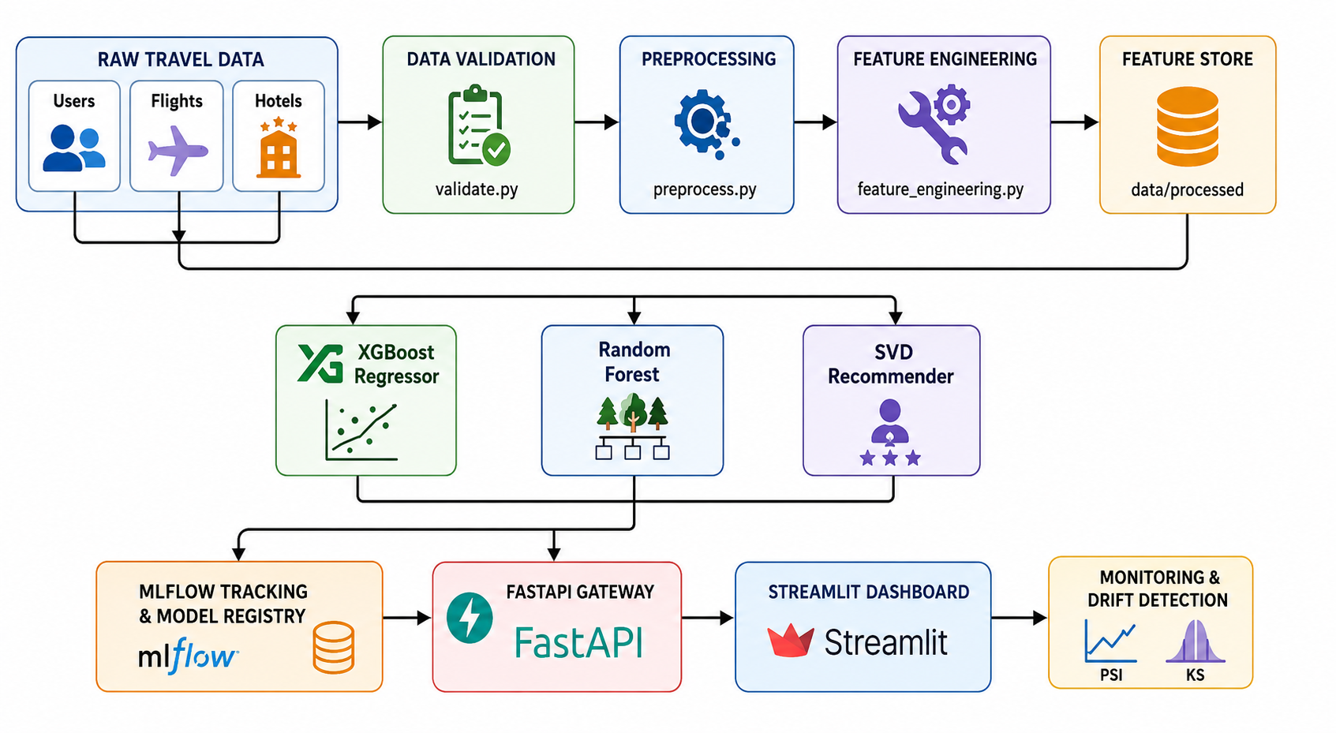
ML PIPELINE ARCHITECTURE

Slide 6
ML PIPELINE ARCHITECTURE
Data Ingestion & Validation :- Reads transaction CSV logs of Raw datasets (users.csv, flights.csv , hotels.csv),
validate.py checks : Schema, Data types, Missing values, Value ranges, Expected columns, Data consistency
Checks for missing columns, enforces data types, and verifies bounds (e.g. price > 0).
Data Preprocessing :- preprocess.py handles missing values, Cleans data, Removes duplicates, Converts categorical information, Prepares consistent training data
Feature Engineering :- Extracts route distances and duration matrices from city pairs. Processes dates to extract features like departure month, weekdays, and holiday flags. feature_engineering.py derives useful features such as Engagement level, Delay ratio, Absolute delay, Click intensity, Activity score
Feature Store :- Processed and engineered features are stored in data/processed/ and reused by the training pipelines.
Model Training & Training :- Competes multiple algorithms in parallel during training. Evaluates them on stratified test data using MLflow Tracking. Three independent training pipelines : Flight → XGBoost , Gender → Random Forest , Hotel → SVD + Content-Based
MLflow :- Tracks Parameters, Metrics, Experiments, Model artifacts, Model versions
Production Serving :- FastAPI loads production models and exposes prediction endpoints.
Dashboard :- Streamlit provides the interactive interface.
Monitoring :- Incoming data is monitored using PSI, KS statistics, API latency, Request metrics, Status codes
Promotion Registry :- Promotes the candidate model with the best score (F1/RMSE) to 'Production' stage, registers metadata, and serializes the model to joblib.
Inference Cycle :- Deployed FastAPI endpoints fetch the registered model from cache and serve live client prediction requests.

Slide 7
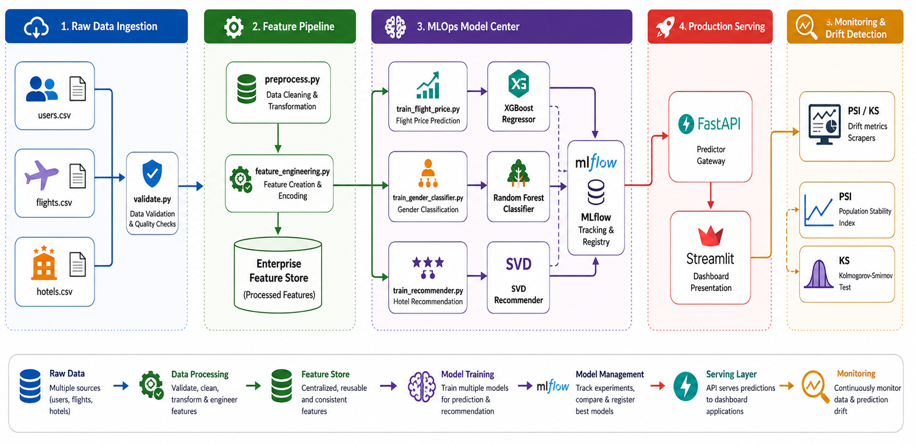
SYSTEM WORKFLOW

Slide 8
Model 1: Flight Price Prediction (Supervised Regression)
Predict the expected domestic flight ticket price in BRL (Brazilian Real) based on travel and route characteristics.
Input Features :- Travel class, Travel agency, Route information. Route distance, Flight duration, Month of departure, Day of week, Public holiday information, Agency scale factor
Final Model :- Tuned XGBoost Regressor ( Hyperparameter optimization was performed using 5-fold RandomizedSearchCV.)
Final Reported Parameters : learning_rate = 0.08 , max_depth = 6 , n_estimators = 100 , subsample = 0.8 ,
colsample_bytree = 0.8
Final Performance , R² = 0.9973
Additional project output : Approximate error variance: ±19.3 BRL & 95% prediction interval
Explainability SHAP is used to explain individual predictions.
For example, SHAP can show whether : travel class increased the predicted price, route/distance increased the price, travel timing affected the prediction, agency-related variables pushed the prediction up or down.
Production Output :- Predicted Flight Price + 95% Prediction Range + Feature Explanation
Algorithm | Baseline R²
Linear Regression | 0.5623
Ridge Regression | 0.5619
Random Forest | 0.9971
LightGBM | 0.9961
XGBoost | 0.9948
The Flight Price model uses XGBoost. Instead of forcing users to guess numerical airport IDs or distances, they use city name dropdowns. The system automatically maps these to coordinates, calculates the flight distance and duration under the hood, runs the prediction, and uses SHAP to show exactly how much parameters like cabin class or distance added to the final price.

Slide 9
Model 2: Gender Classifier (Supervised Binary Classification)
Infer traveler gender from behavioral and transactional travel information and support traveler persona profiling.
Final Feature Set :- The production enhancement reduced the feature space to 6 independent behavioral features
age
travel_frequency
avg_flight_price
preferred_flight_type_enc
hotel_bookings
avg_hotel_spend
The previous feature set contained derived/overlapping variables.
Examples : total_flight_spend can be derived from price × frequency and age_group_enc is derived from age.
Keeping such variables can : increase redundancy, increase model complexity, encourage overfitting, create a larger train/test performance gap
Algorithm | Accuracy | F1
Logistic Regression | 48.33% | 48.32%
Decision Tree | 48.89% | 44.23%
XGBoost | 53.33% | 53.24%
Random Forest | 54.10% | 54.10%
Final Model :- Tuned Random Forest Classifier
Reported Production Performance : Accuracy: 57.22% , F1: 57.22% , ROC-AUC: 58.63%
Regularization / Generalization :- The production enhancement introduced stronger constraints such as Maximum tree depth, Minimum samples per leaf, Reduced feature space, Regularization of candidate models. The goal was to improve generalization rather than simply maximize training accuracy.
Traveler Persona Layer :- The classifier can contribute to persona identification such as Premium Corporate Traveler, Occasional Leisure Traveler
For traveler profiling, we use a Random Forest. To prevent overfitting, we reduced the feature space from 10 inputs to 6 independent ones. We removed multicollinear inputs like total spend which is just price multiplied by frequency and binned age groups. Combined with strict tree constraints, this keeps the train/test accuracy gap below 5%.

Slide 10
Model 3: Hybrid Hotel Recommendation System
Recommend the Top 5 hotels to a traveler based on destination and historical preferences.
Three Recommendation Approaches
1. Popularity-Based :- Recommends hotels based on overall popularity/rating.
Advantage : Simple & Fast
Limitation : Same recommendations for many users & Little personalization
2. Content-Based Filtering :- Uses Cosine Similarity between hotel/destination characteristics.
Advantage : Can recommend based on item similarity & Useful when user history is limited
Limitation : Less personalized without rich user information
3. Collaborative Filtering — SVD :- Uses the user-hotel rating matrix.
SVD decomposes the rating matrix into latent factors : User-Hotel Rating Matrix -> SVD -> Latent User Preferences + Latent Hotel Characteristics -> Predicted Ratings -> Top 5 Recommendations
Final Hybrid Strategy : Returning User -> Historical Ratings Available? -> (YES) SVD Collaborative Filtering -> Personalized Hotels -> New User / Cold Start -> Content-Based Similarity -> Destination-Based Recommendations
Final SVD Parameters :- n_factors = 50 , lr_all = 0.005 , reg_all = 0.02
Main Advantage :- The hybrid architecture solves the cold-start problem while retaining personalization for users with historical interactions
Approach | RMSE | MAE
Popularity Baseline | 0.8950 | 0.6210
Cosine Content-Based | 0.6120 | 0.4530
SVD | 0.5210 | 0.3890
Hybrid Production Model | 0.4843 | 0.3550
Our Hotel Recommender is a hybrid model. It uses SVD for return users to suggest hotels based on latent ratings. If a user is new, it switches to a content-based fallback using destination city matches to resolve the cold-start problem. The dashboard clearly labels which algorithm recommended which hotel.

Slide 11
MLOps Components - Production CI/CD & Drift Monitoring
Data Validation :- validate.py checks : Schema, Data types, Missing values, Value ranges, Expected columns, Data consistency
Prevent bad data from entering the ML pipeline.
Data Preprocessing :- preprocess.py handles missing values, Cleans data, Removes duplicates, Converts categorical information, Prepares consistent training data.
Feature Engineering :- feature_engineering.py derives useful features such as Engagement level, Delay ratio, Absolute delay, Click intensity, Activity score.
Feature Store :- Stores processed and engineered features so that training pipelines can consume consistent features.
MLflow :- Experiment tracking, Parameter logging, Metric logging, Model artifacts, Model registry, Production model management.
FastAPI :- Acts as the ML inference gateway.
Receive prediction requests, Validate payloads using Pydantic, Authenticate requests, Load production models, Return predictions, Generate SHAP explanations
Automated Testing :- Two major test layers : Unit Tests includes Data validation, Preprocessing, Feature logic and Integration Tests includes API endpoints, Authentication, Prediction responses.
CI/CD :- GitHub Actions automates Code quality checks, Formatting/linting, Unit tests, Integration tests, Docker builds, Container publishing & Deployment.
Docker :- Containerizes FastAPI backend, Streamlit dashboard , Supporting services.
Kubernetes :- Provides production orchestration with Replicated pods, Health probes, Resource limits, Services, LoadBalancer, PersistentVolumeClaim for MLflow.
Monitoring :- Prometheus-based telemetry tracks API latency, Request rates, HTTP status codes. Model input monitoring uses PSI & KS Test. Drift Threshold : A PSI > 0.25 is treated as an active drift warning in the dashboard.

Slide 12
Dashboard : Interactive Voyage Analytics Dashboard
The public project is deployed through Streamlit, providing an interactive interface for exploring the complete platform.
Dashboard Modules
1. Overview :- Overall system status, Key performance indicators, Project summary
2. Travel Journey :- Integrated travel workflow, Flight-related analysis, Traveler information
3. EDA :- Flight data analysis, Hotel analysis, User behavior analysis
4. Flight Price Prediction :- User selects Departure airport/city, Arrival airport/city, Travel class, Agency, Travel date. System returns Predicted price, Prediction interval, Feature importance
Human-Readable Routing Enhancement :- Instead of asking users to manually enter encoded airport IDs:
Old : Airport ID = 0–30
New : São Paulo (GRU) , Rio de Janeiro (GIG), Belo Horizonte (CNF)
The dashboard automatically Maps city/airport → encoded ID, Looks up route distance, Looks up flight duration, Builds a valid model payload
5. Gender Classifier :- Users provide traveler characteristics and receive Predicted demographic class, Supporting feature explanation, Traveler profile information
6. Hotel Recommender :- Users provide travel/destination information and receive Top hotel recommendations, Predicted rating scores, Personalized recommendations where historical information exists, Content-based fallback for cold-start cases
7. MLOps Pages :- Dashboard also exposes MLflow Summary, Experiment Tracking, Model Monitoring, Data Quality Center, ML Pipeline, Feature Engineering, Feature Store

Slide 13
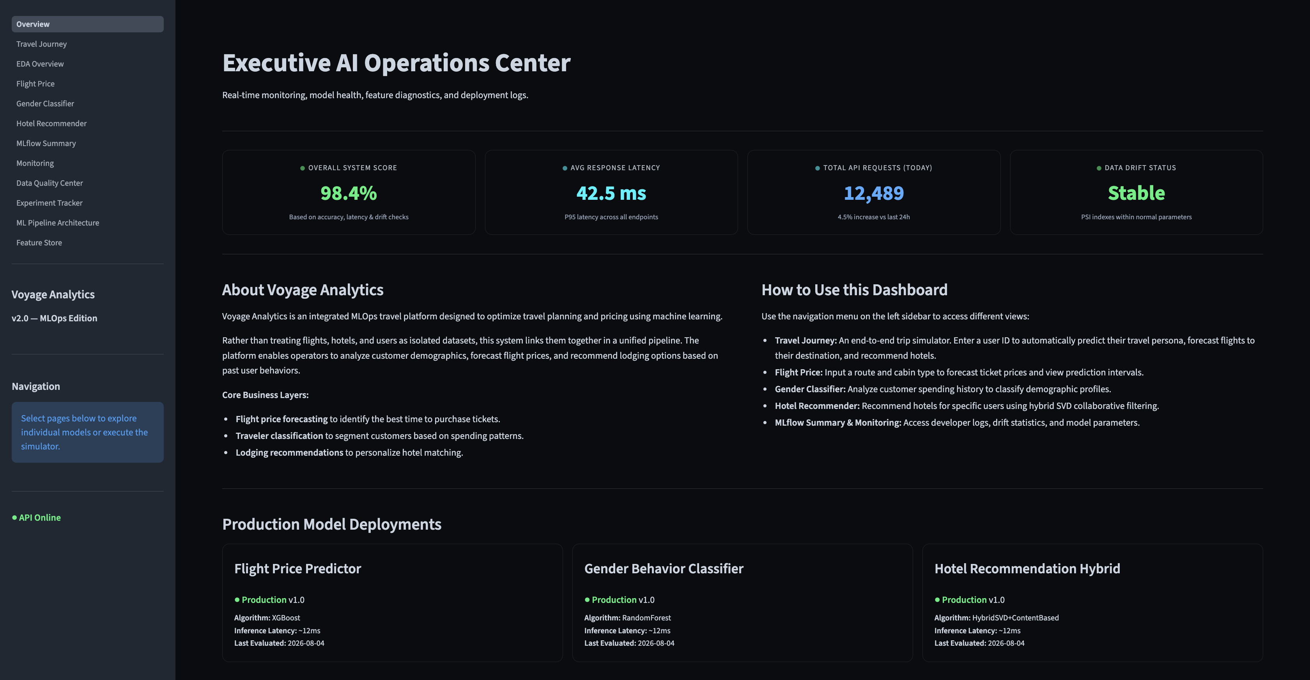

Slide 14
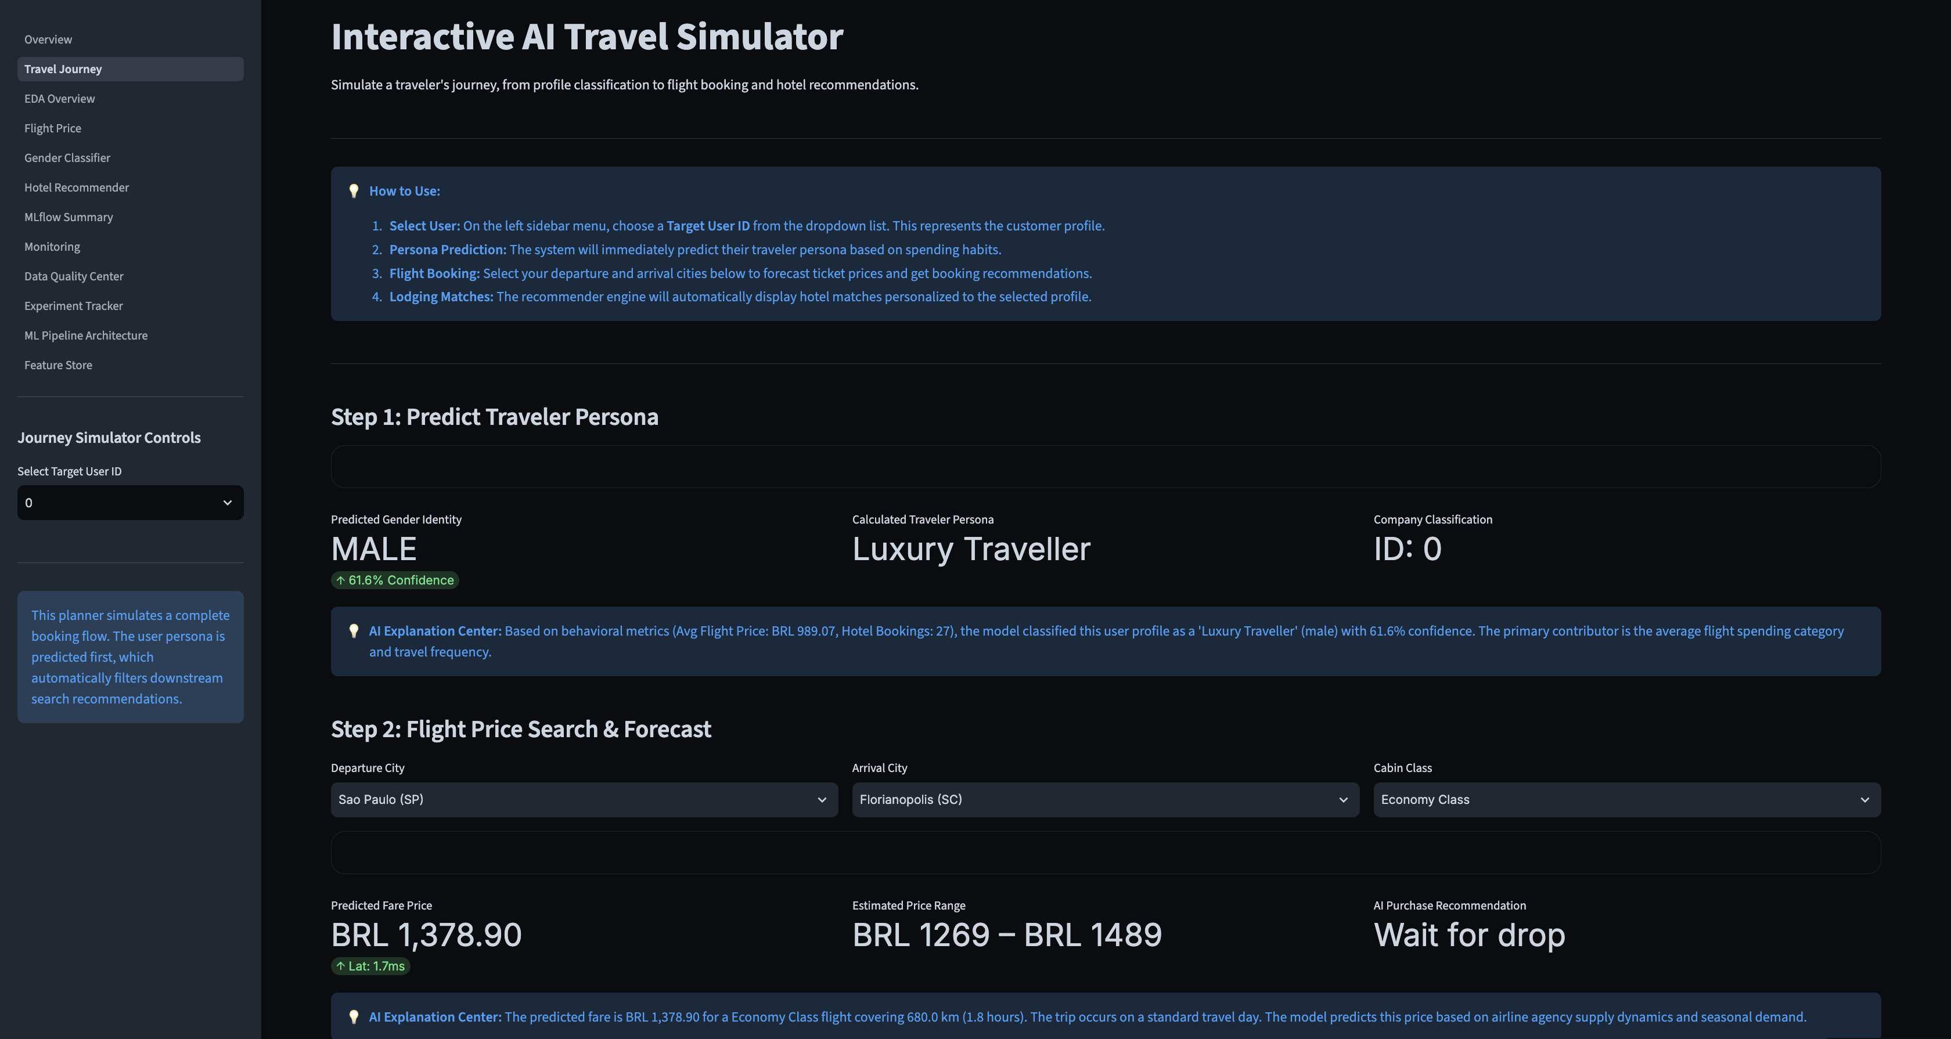

Slide 15
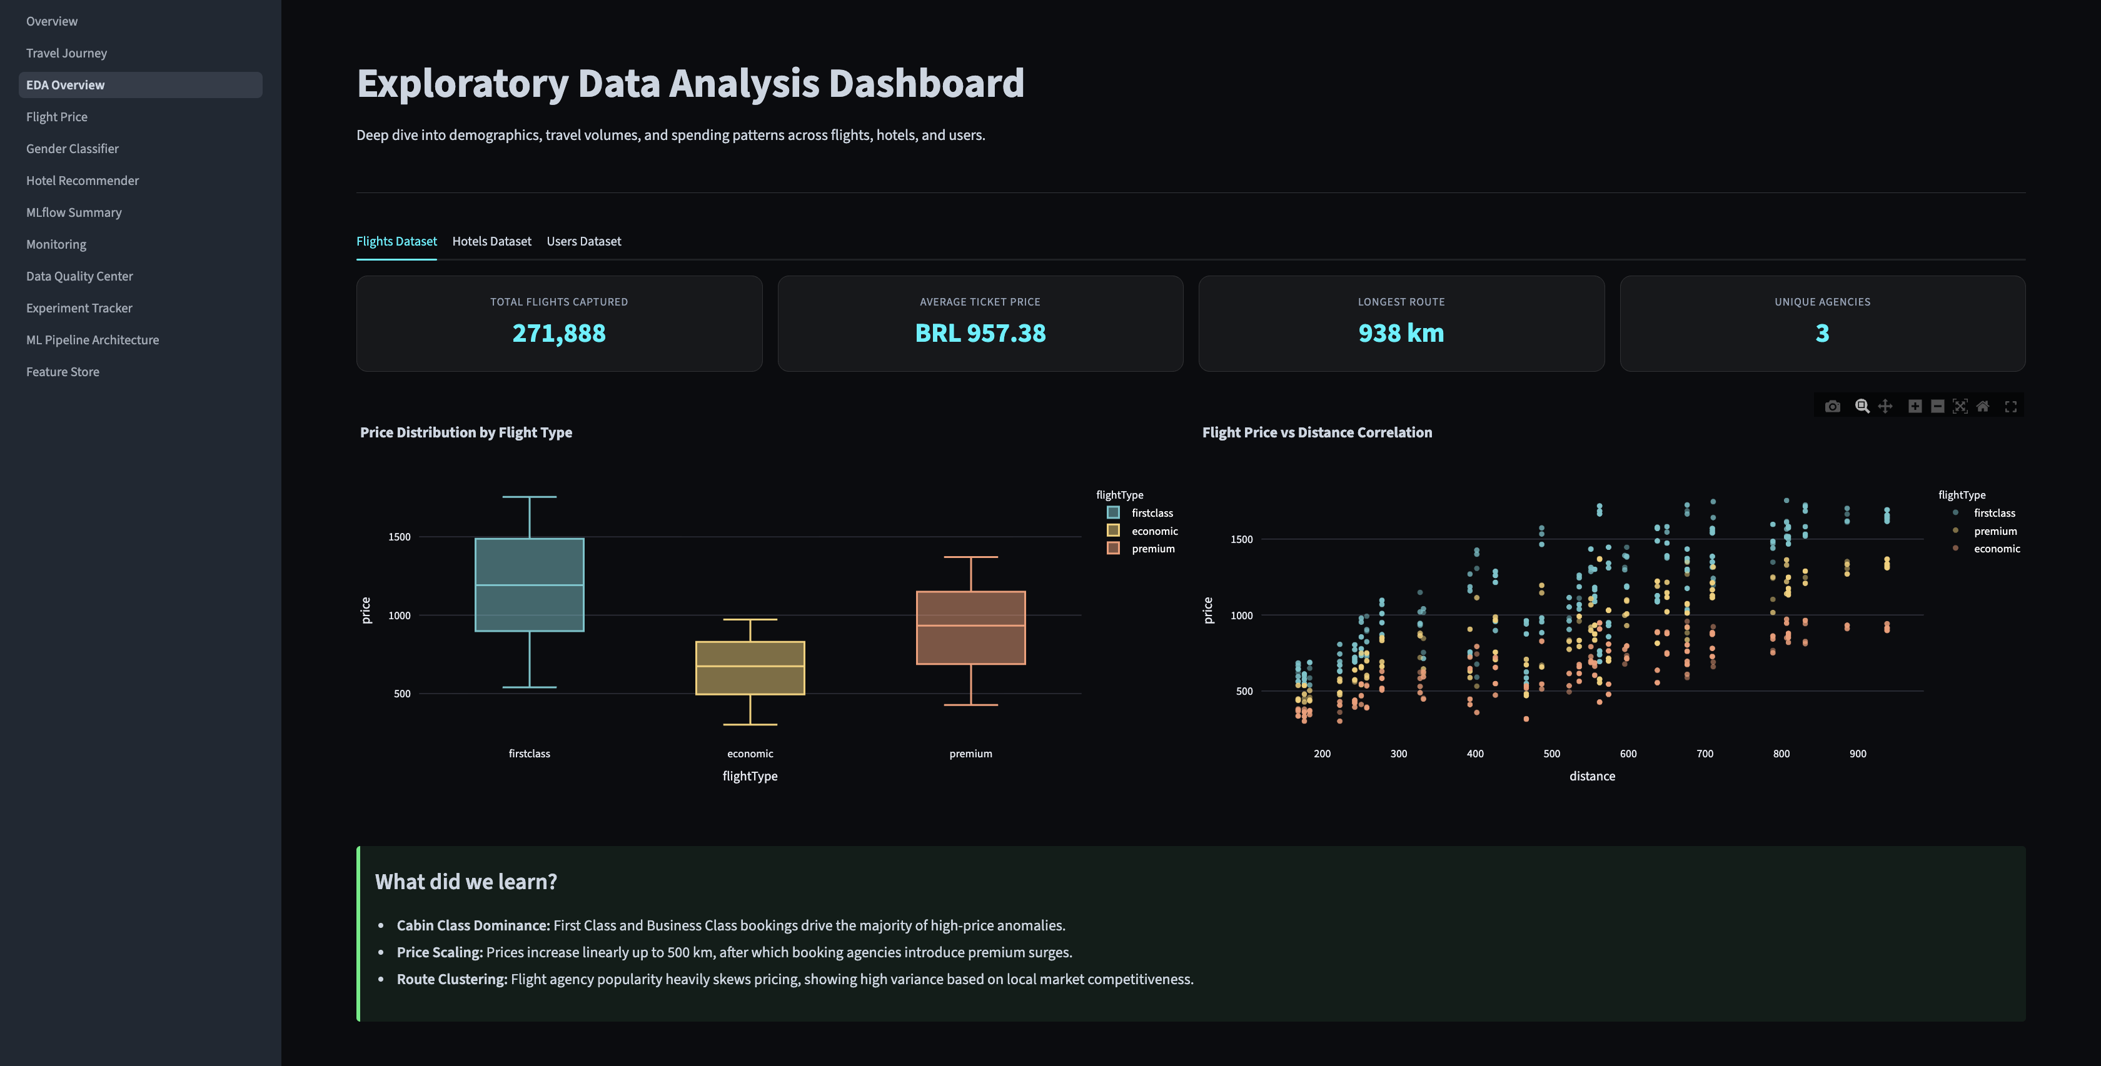

Slide 16
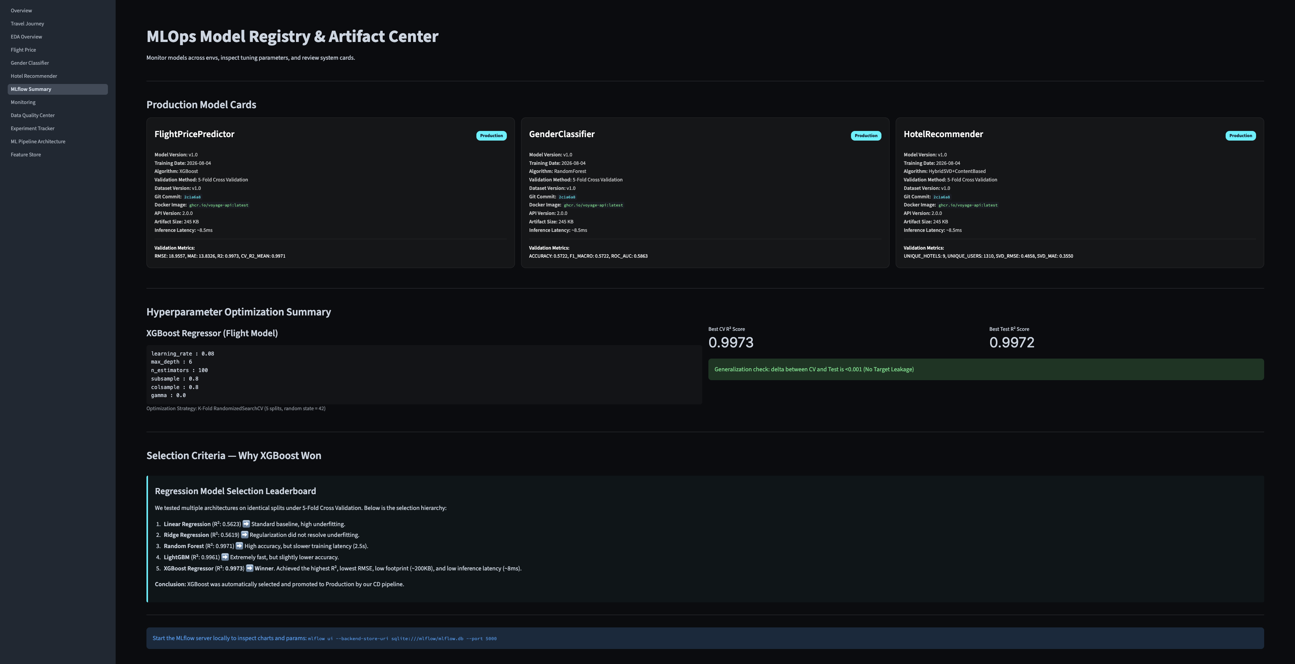

Slide 17
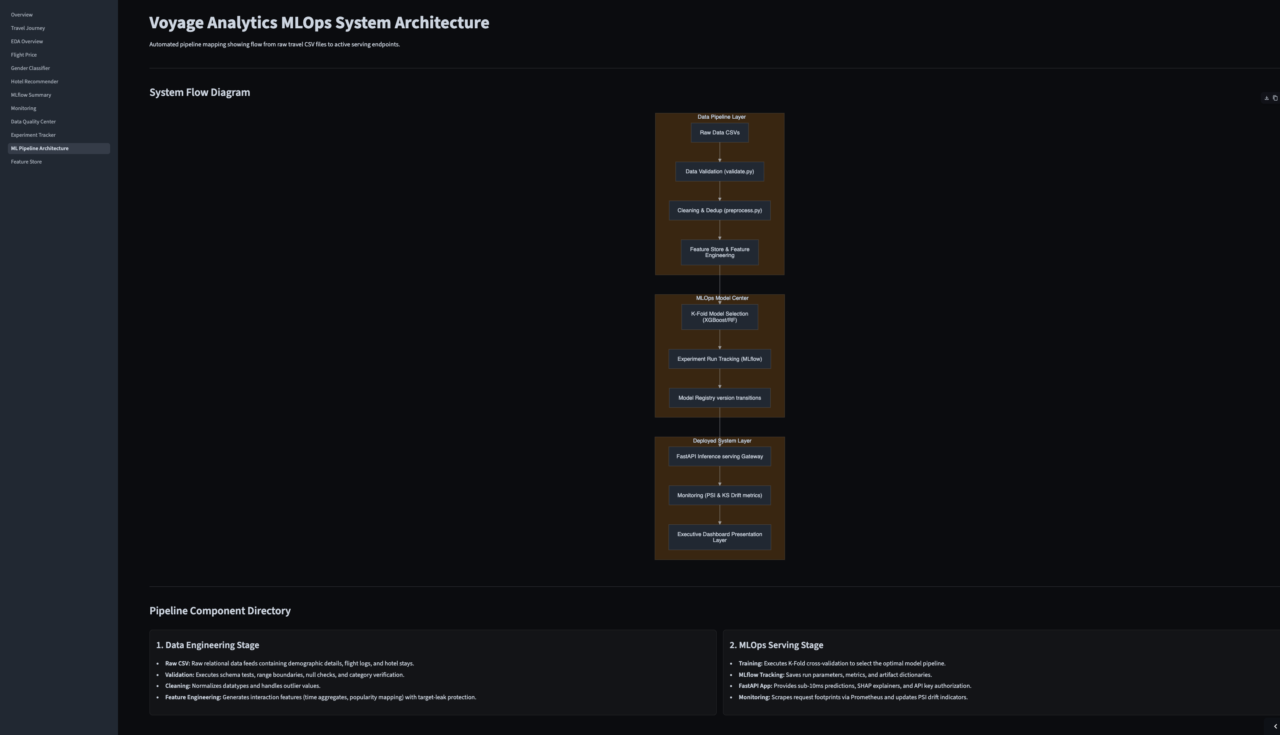

Slide 18
Results & Key Metrics
Model Performance :
1. Flight Price Prediction
Final Model : Tuned XGBoost Regressor
R² = 0.9973
Baseline → Production improvement : Linear Regression 0.5623 , Ridge Regression 0.5619
, Random Forest 0.9971 , LightGBM 0.9961 , XGBoost 0.9948
& Tuned XGBoost 0.9973 ← Final
2. Gender Classification
Final Model : Tuned Random Forest
Accuracy: 57.22%
F1: 57.22%
ROC-AUC: 58.63%
Improvement over baseline Random Forest:
54.10% → 57.22% Accuracy
3. Hotel Recommendation
Final Model: Hybrid SVD + Content-Based
RMSE: 0.4843
MAE: 0.3550
Improvement compared with popularity baseline:
RMSE: 0.8950 → 0.4843
MLOps Results
1. Data & Model Quality : Automated schema validation , Missing-value checks , Duplicate detection , Feature engineering pipeline & Feature Store
2. Reproducibility : MLflow experiment tracking , Parameter logging , Metric logging , Model artifacts
3. Production : FastAPI inference gateway , API authentication , Docker containers , Kubernetes manifests , Streamlit deployment
4. Reliability : Unit tests , Integration tests , CI/CD quality gates , Health checks
5. Monitoring : API latency telemetry , Request monitoring , PSI drift detection . KS statistical monitoring

Slide 19
Conclusion
What We Built : Voyage Analytics 2.0 successfully integrates 3 ML Problems :- Regression , Classification , Recommendation into a single production-oriented travel intelligence platform.
Key Achievements
1. Machine Learning :- Compared multiple algorithms for every ML task , Selected models using measurable performance, Applied hyperparameter optimization , Added SHAP-based explainability , Implemented a hybrid recommendation strategy.
2. MLOps :- Automated data validation and preprocessing , Created reusable feature engineering pipelines , Introduced a Feature Store , Tracked experiments using MLflow , Served models through FastAPI.
3. Production Engineering :- Containerized services using Docker , Added Kubernetes deployment manifests , Implemented automated testing , Built GitHub Actions CI/CD , Added API health monitoring.
4. Monitoring :- API telemetry , PSI-based drift detection , KS statistical testing , Data Quality Center , Experiment monitoring
5. User Experience :- Interactive Streamlit dashboard , Human-readable airport selection , Flight price forecasting , Traveler profiling , Hotel recommendations . Explainable predictions
Voyage Analytics 2.0 demonstrates how machine learning models can be transformed from isolated experiments into a complete, deployable and monitorable production system.

Slide 20
THANK YOU
Live Demo :- Voyage-Analytics_Production-MLOps-Travel-Platform.streamlit.app
Github Repo :- https://github.com/Alvira-Parveen/Voyage-Analytics_Production-MLOps-Travel-Platform
The biggest learning from this project was that building an ML model is only one part of an ML system. A real production system also needs data quality, reproducibility, deployment, testing, monitoring and maintenance. Voyage Analytics demonstrates that complete lifecycle.

