Slide 1
Four Months' Notice
Turning El Niño into a dengue early-warning alarm for ASEAN
A freely available climate index gives ASEAN health offices months of warning before a dengue season turns severe. We turn that lag into a two-condition alert rule that any provincial health office can run today, with no model, no code and no paid data.
Team Swallowgank · Institut Teknologi Sepuluh Nopember · Indonesia
SDG 3 HEALTH
SDG 13 CLIMATE
SDG 6 WATER
All charts built in SAP Analytics Cloud.

Slide 2
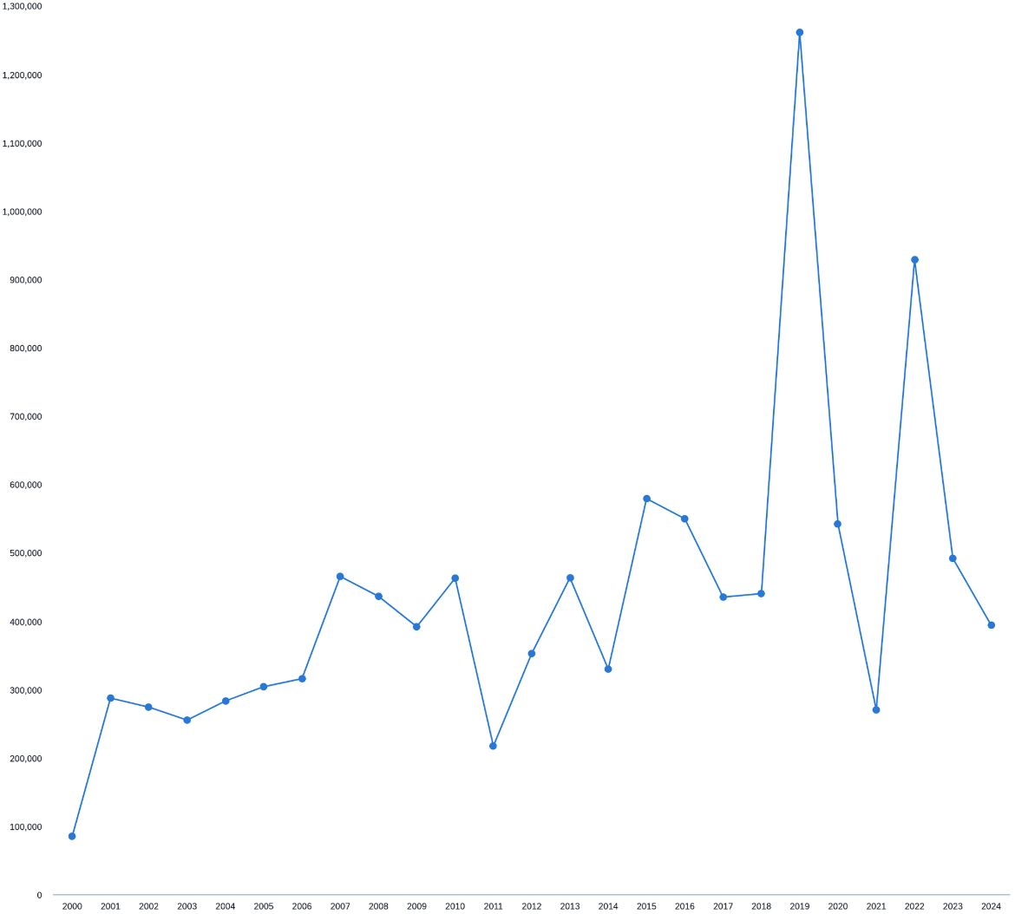
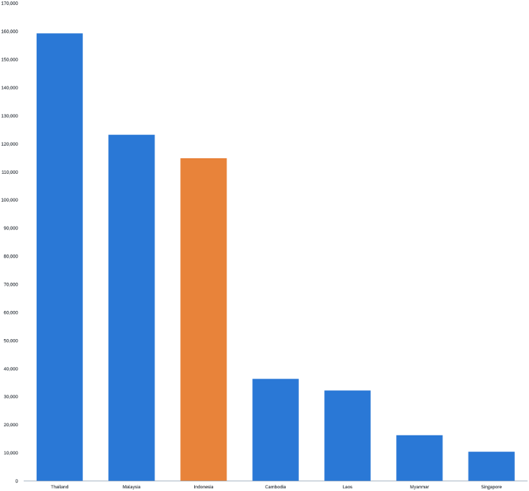
The problem: Dengue is ASEAN's fastest-moving climate-sensitive disease
1.26M
368k
Cases in 2019
Vietnam
The worst year in our nine-country panel
Latest complete year
220k
9.6M
Philippines
Added cases worldwide
Latest complete year
Estimated from the 2023–24 El Niño (Tian et al., 2025)
Outbreaks are still fought reactively, only once cases surge.
ASEAN dengue cases, 2000–2024
Cases by country, latest complete year
The burden is large, rising and spiky. Spikes are what an alarm can catch; a trend line is not something a health office can act on.
Source: OpenDengue V1.3, national totals, complete-reporting years only. We do not claim a 2023–24 record, because our panel is incomplete for Vietnam and the Philippines after 2022.

Slide 3
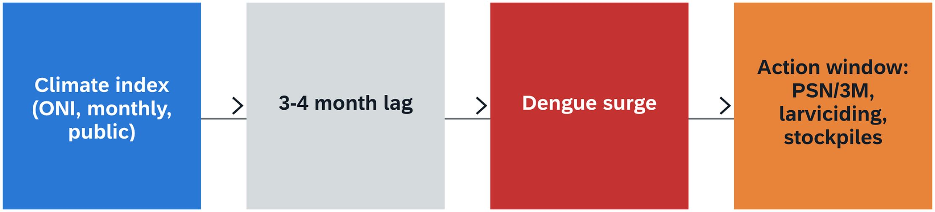
The question: Climate data arrives months before patients do
"Can a freely available climate index tell a health office how bad the coming season will be, early enough to act?"
SDG Target 3.3
SDG Target 13.1
SDG Target 6.1
End the epidemics of neglected tropical diseases, of which dengue is one
Strengthen resilience and adaptive capacity to climate-related hazards
Safe water for all. Where piped water is absent, households store it, and Aedes breeds in the store
ASEAN priority: Dengue sits under ASEAN Health Cluster 2, Responding to All Hazards and Emerging Threats, whose ASEAN Dengue Day statements ask member states for earlier and better coordinated action.
From public index to public action
Climate index (ONI, monthly, public) → 3–4 month lag → Dengue surge → Action window: PSN/3M, larviciding, stockpiles
What would make us wrong:
Signal is only the wet season (answered p. 7)
Rule was tuned on its own test years (answered p. 12)
Our innovation angle does not hold (answered p. 14)

Slide 4
Data & method: Nine open datasets, one monthly panel, zero paid sources
Dengue cases
Dengue × climate panel
OpenDengue V1.3 — 70,397 rows — 10 countries, 1955–2025
55,329 rows — province-month, lags pre-computed
Temperature & rainfall
ONI El Niño index
CCKP, ERA5 — 9,000 rows — monthly, 1950–2024
NOAA CPC — 918 rows — monthly, 1950–2026
Water & sanitation
Population & Flood
WHO/UNICEF JMP — 8,692 rows — 2000–2024
BPS Indonesia — 140 rows · GHSL — 30,348 rows — 836 cities, 1975–2030
175k
9
Rows in joined panel
Countries with monthly data
212
0
Provinces covered
Paid or login-only sources
Method: monthly national series 2010+; lagged correlations 0–4 months; anomalies — the seasonal cycle is removed before we accept any correlation; a two-condition trigger rule; out-of-sample test on unseen years; WHO/PAHO endemic-channel benchmark. All charts built in SAP Analytics Cloud.
Source: Nine sources, all public: OpenDengue · World Bank CCKP (ERA5) · NOAA CPC · WHO/UNICEF JMP · BPS · GHSL · SIPSN KLHK · BNPB. No licence, no login, no cost.

Slide 5
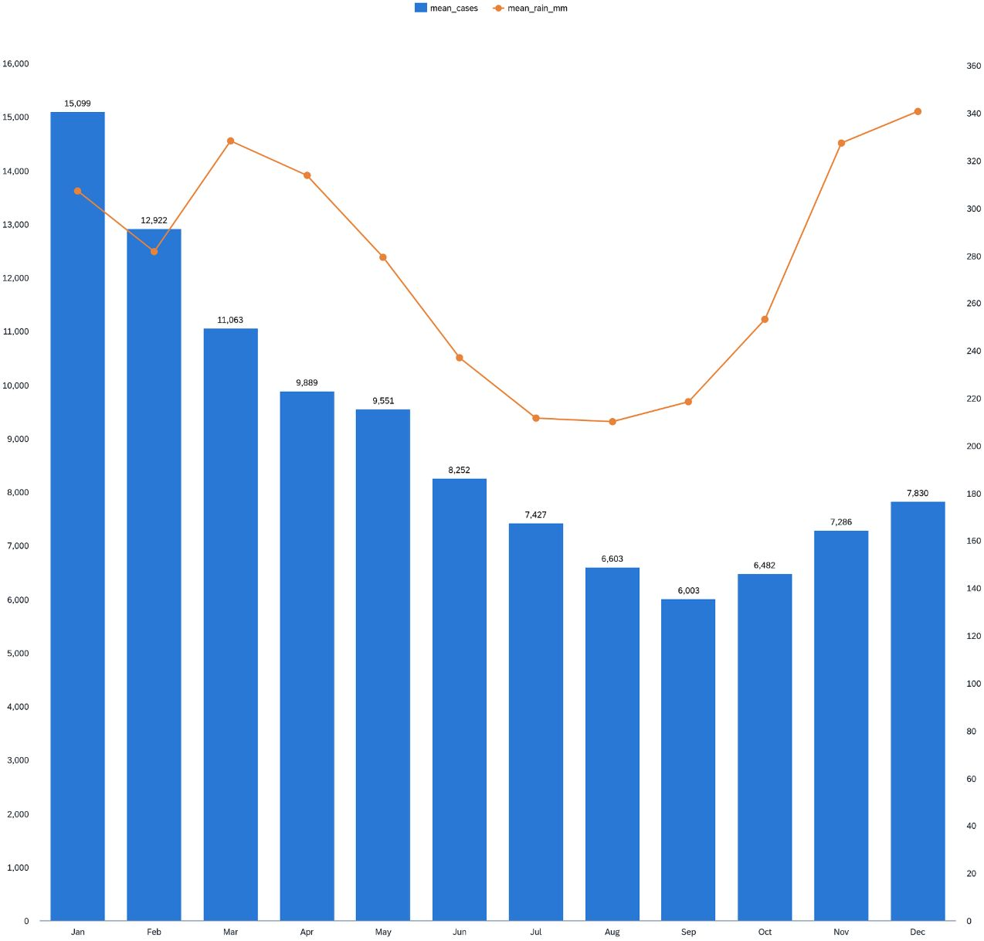
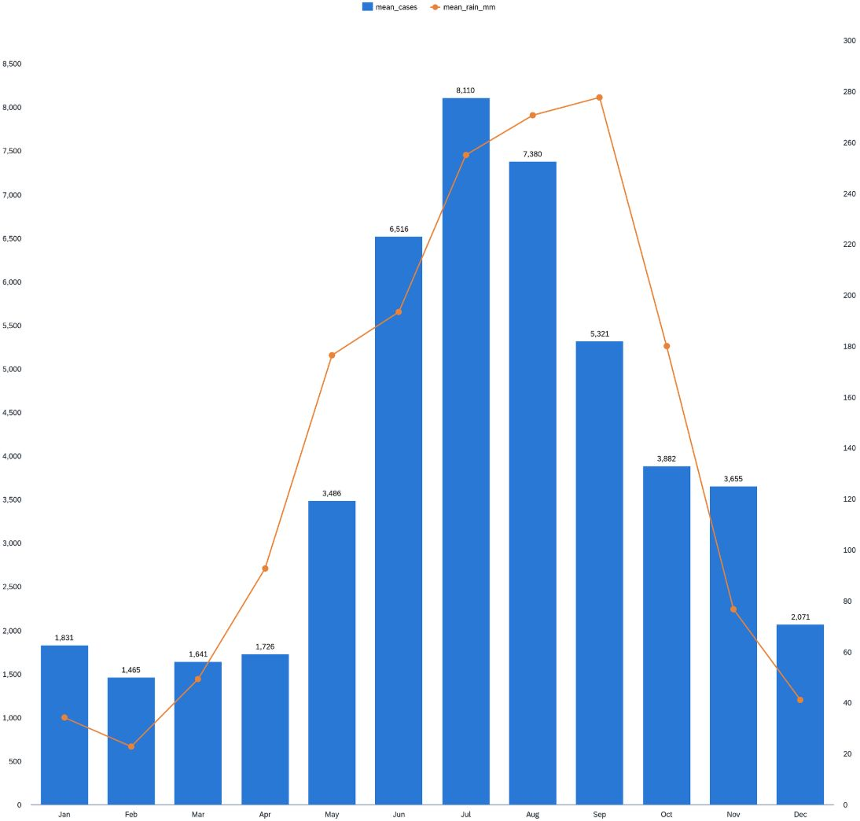
Analysis 1 · The season: Dengue has a calendar, and it is not the same one everywhere
Indonesia
Thailand
One disease
Peaks Jan–Apr, right after the December rainfall peak. Jan 15,099 cases/month vs Sep 6,003 = 2.5×
Climbs with the onset of the wet season and peaks Jun–Sep. Jul 8,110 vs Feb 1,465 = 5.5×
Two calendars in opposite halves of the year
Indonesia: cases vs rainfall by month
Thailand: cases vs rainfall by month
A regional alarm has to be local in its timing.
Rainfall alone cannot set the date: Thailand's rain peaks in September, two months after its cases. Something earlier in the chain is doing the work.
Source: national monthly means, complete years only (IDN 2010–2023, THA 2010–2022).

Slide 6

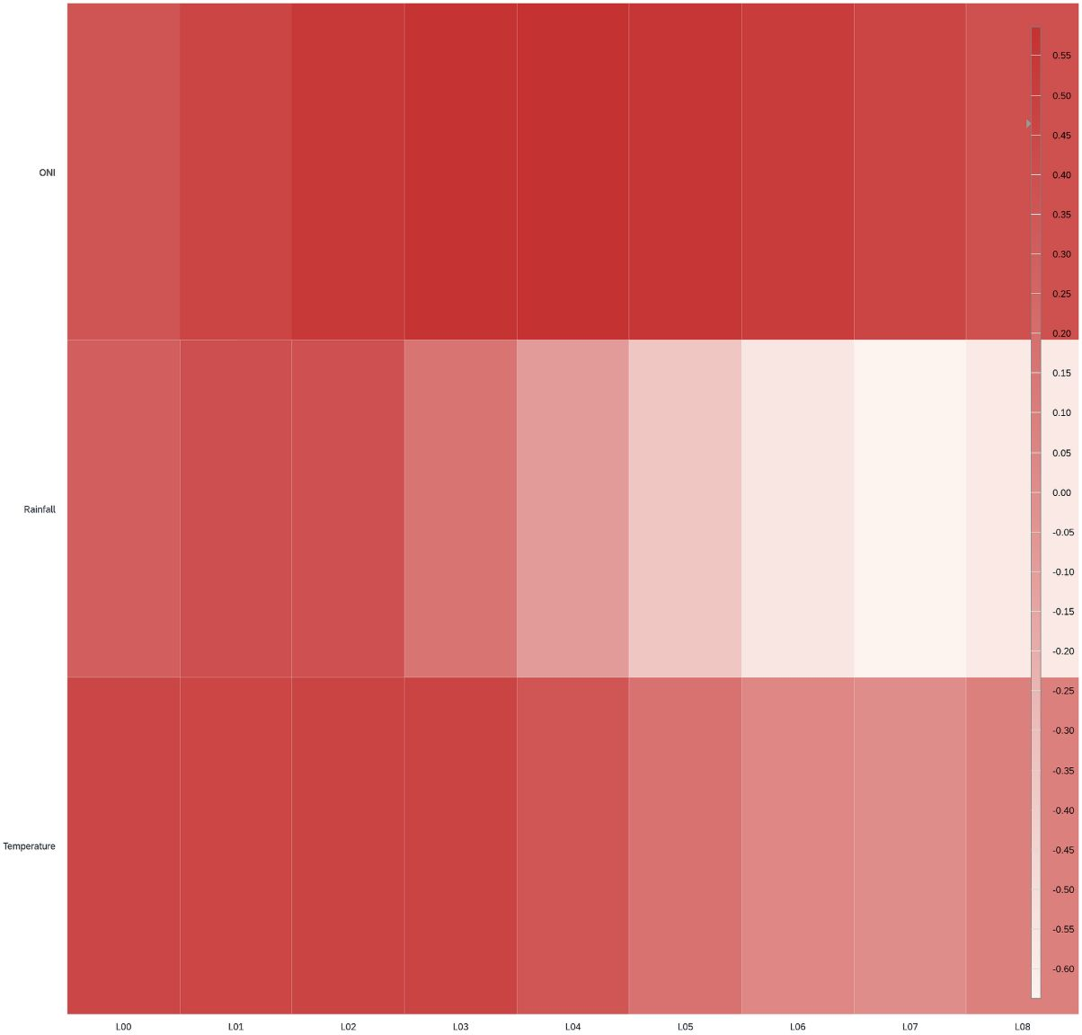
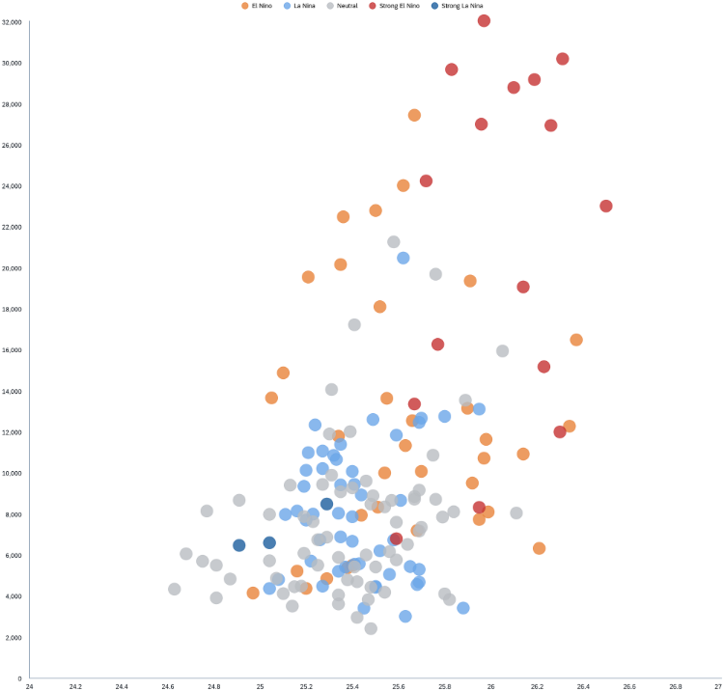
Analysis 2 · The lag: The climate signal arrives 1–4 months before the cases
Indonesia — ONI (El Niño)
Indonesia — Temperature
Indonesia — Rainfall
Lag 4 mo, r = +0.59
Lag 3 mo, r = +0.47
Lag 1 mo, r = +0.40
Thailand — Temperature
Thailand — Rainfall
Lag 3 mo, r = +0.57
Same mo, r = +0.48
Correlation by predictor and lag
Temperature (lag 2) vs cases, Indonesia
The lag is the opportunity: it is the time a health office has to act.
Every predictor peaks at a lag of one month or more, so none of them is a coincident symptom. The best one, ONI, is also the one published earliest and freely.
Source: monthly national series, 2010+ (n = 172 months, Indonesia).

Slide 7
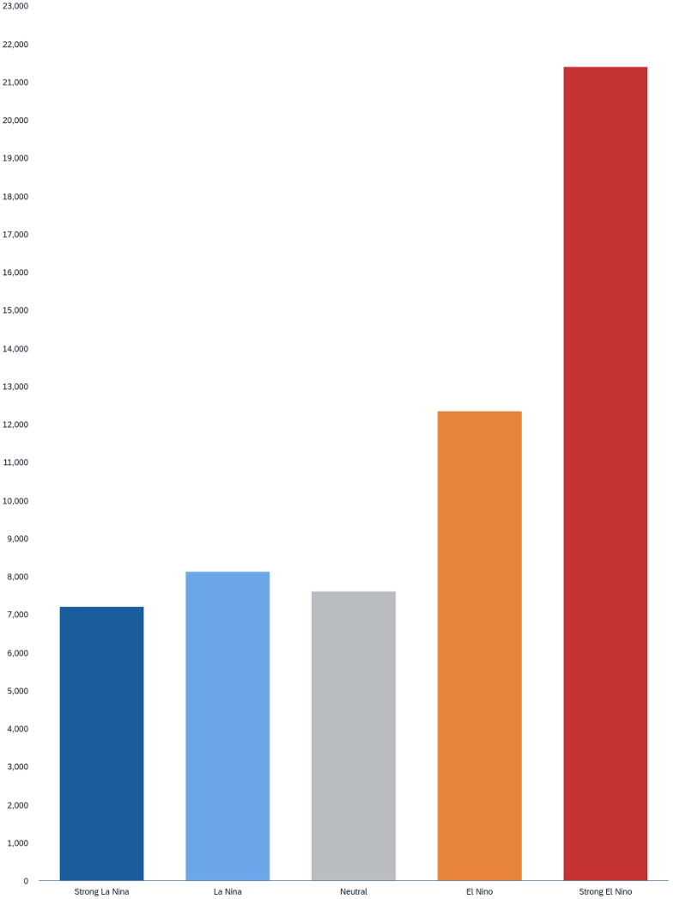
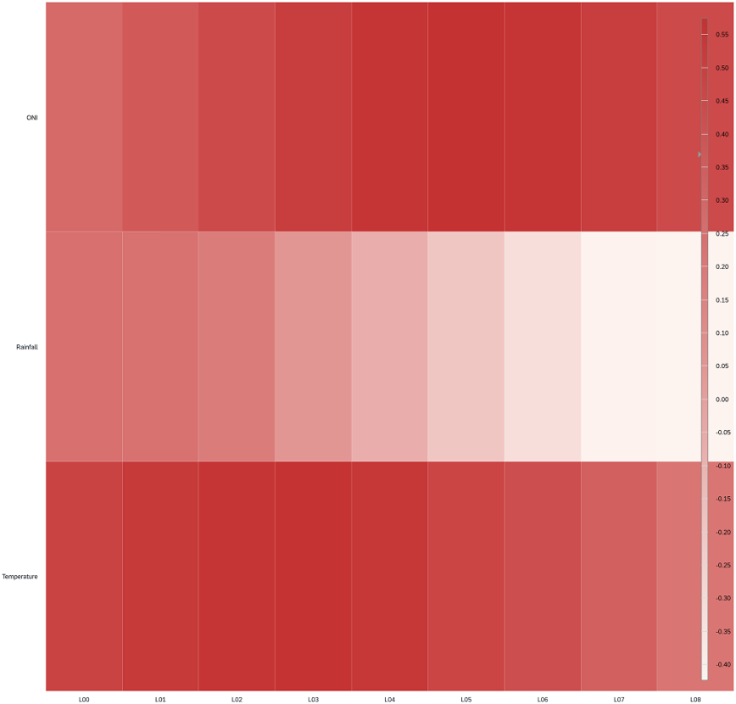
Analysis 3 · The strongest signal: A strong El Niño nearly triples Indonesia's monthly dengue burden
2.8×
+0.56
Burden multiplier
ONI correlation
21,383 vs 7,597 cases per month, grouped by the ENSO phase four months earlier
With the seasonal cycle removed — not merely seasonality
33/34
70/77
Indonesian provinces
Thai provinces
Cases run higher in El Niño months (sign test p = 2×10⁻⁹)
Cases run higher in El Niño months
The grouping uses the ENSO phase four months earlier, so this is a forecast rather than hindsight. Rainfall does not survive the same test, falling from +0.40 to +0.24, and we report that.
Mean monthly cases by ENSO phase (lag 4)
Same signal, seasonality removed
Strong El Niño: 21,383 cases/month
Source: 172 months, Indonesia 2010–2024 · NOAA CPC definition: El Niño = ONI ≥ 0.5. We claim early-warning feasibility, not causation.

Slide 8
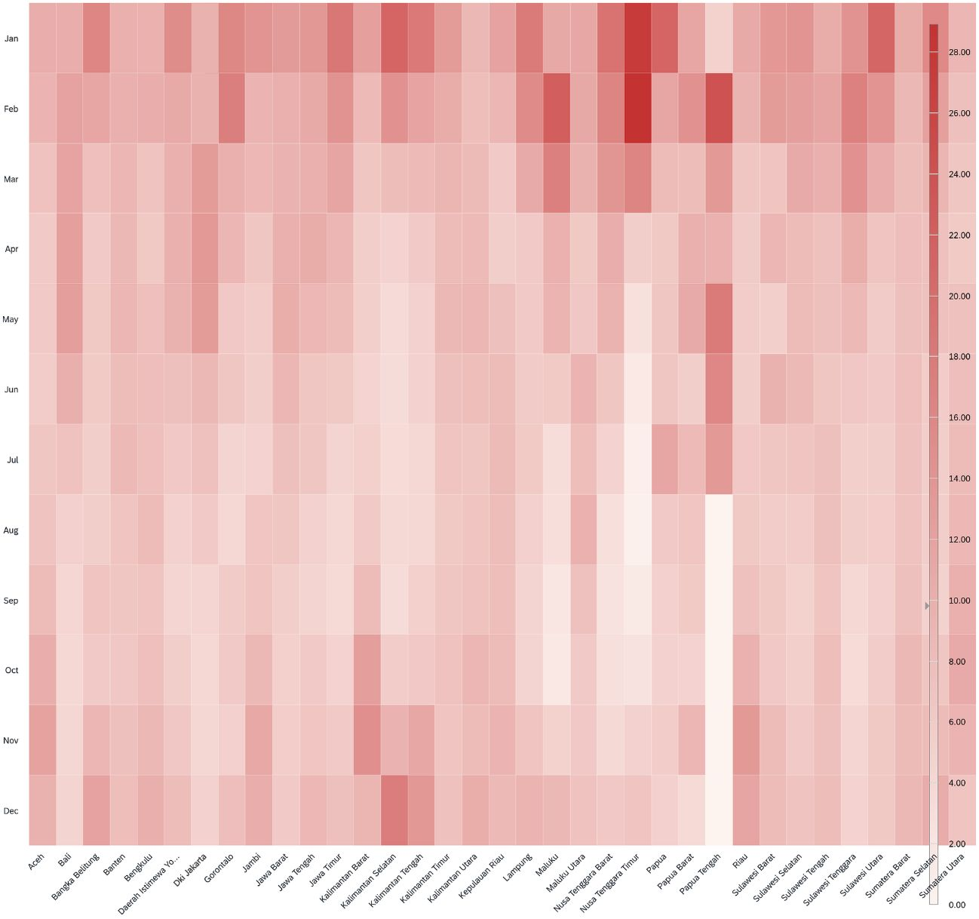
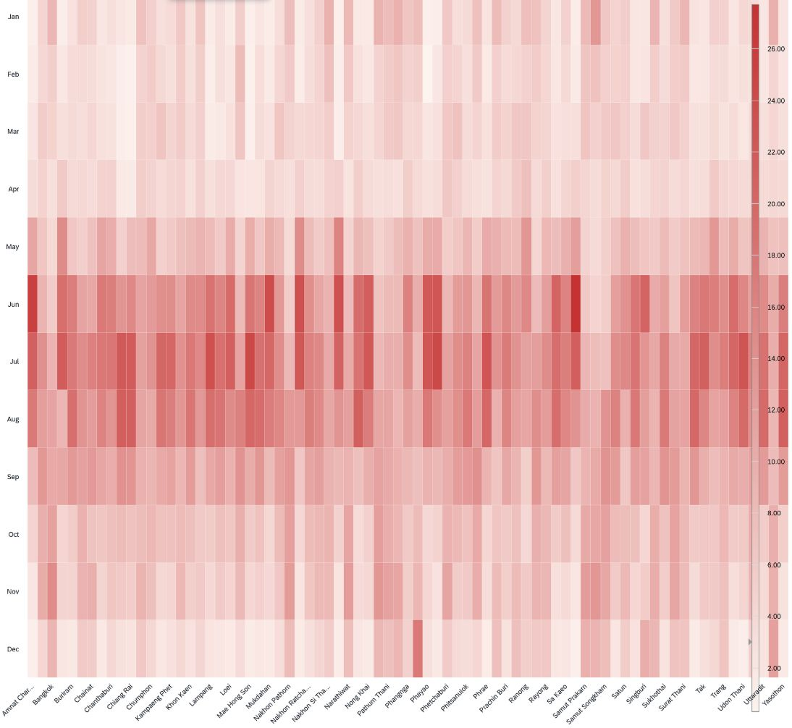
Analysis 4 · Where and when: The alarm must be set province by province
Indonesia
Thailand
The implication
20 of 35 provinces peak in January, 8 in February, but Bali peaks in May and North Kalimantan in December
38 of 77 provinces peak in July, 16 in August
A single national alert date would be wrong for a third of Indonesia
Indonesia: share of annual cases by month
Thailand: share of annual cases by month
Same colour scale, same twelve rows. Only the calendar moves.
This is why the rule carries a month condition as well as a climate one. The index says how bad; the province's own calendar says when.
Source: share of annual cases by calendar month, per province.

Slide 9

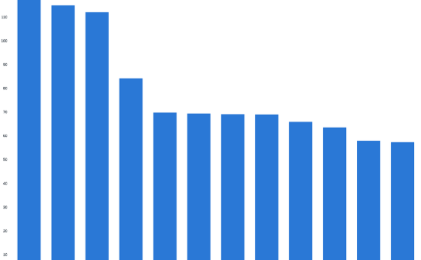
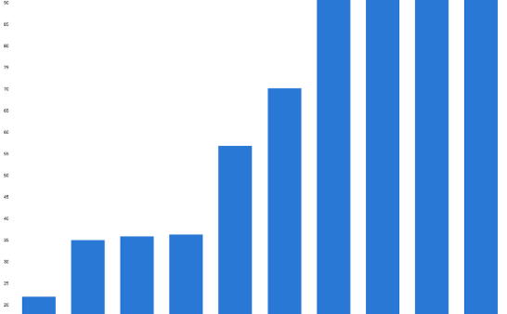
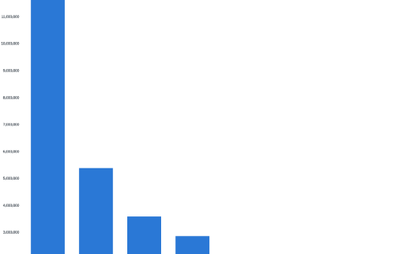
Analysis 5 · Who is hit hardest: The same alarm, aimed at the most exposed places
Highest incidence 2018–2020
Water storage risk
Flood-zone exposure
Bali 134, North Kalimantan 115, East Kalimantan 112 per 100k — that is 14× the lowest province (Papua, 9)
Indonesia has the lowest piped-water access in ASEAN at 21.8% (JMP 2024). Households therefore store water, and stored water breeds Aedes
12.9 million people in Bangkok and 1.7 million in Jakarta live in the 1-in-100-year flood zone
We use these three layers to target the alarm, not to explain the disease. The one place we tried to explain it, the claim failed (p. 14).
Incidence per 100k, 2018–2020
Piped water access, ASEAN
Flood-zone population, top cities
Sources: BPS denominators, 2018–2020 only, the only years with official provincial denominators · WHO/UNICEF JMP · GHSL. We never rank regions using raw case counts.

Slide 10
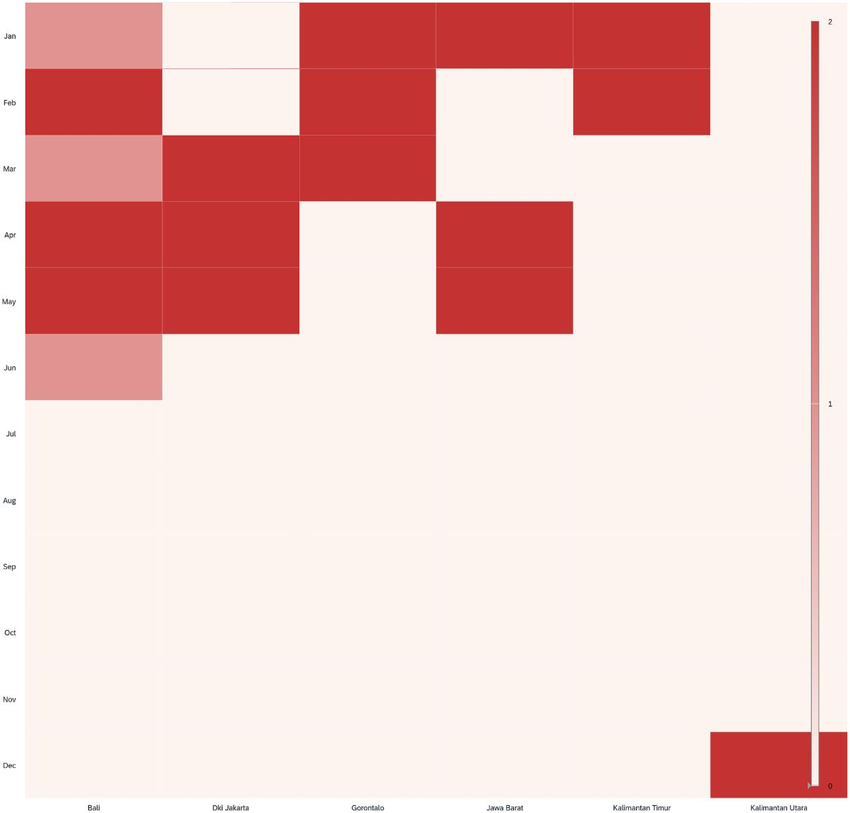
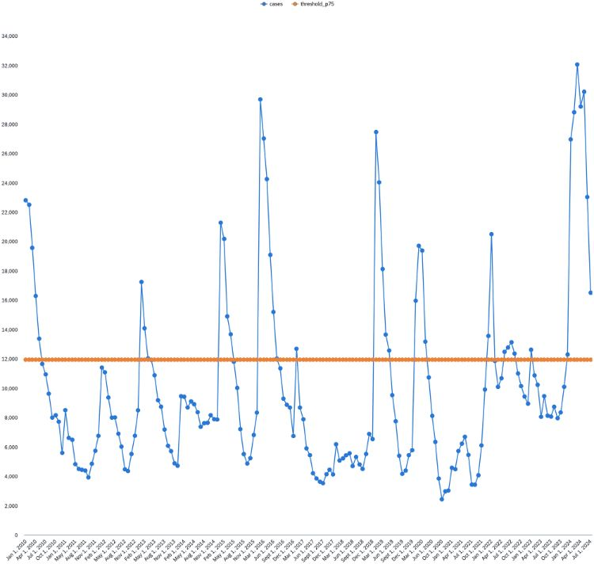
Synthesis: From signal to schedule: a risk calendar every health office can read
Three states per province
El Niño index
Peak, Watch and Normal — derived from each province's own case history
Sets how severe the coming peak will be
Province calendar
Real lead times
Sets when the peak arrives
Every El Niño episode since 2009: 0–3 months on observed ONI, longer still on NOAA and BMKG forecast ONI
Risk calendar, six priority provinces
Cases vs the P75 outbreak threshold
Two public numbers, one page, no model to maintain.
The threshold is the WHO-style P75 of the province's own history, not a number we picked. Everything above the orange line is what the alarm is trying to anticipate.
Source: 5 El Niño episodes, 2009–2024. The alarm predicts how severe the coming season will be; it does not shift its start date.

Slide 11

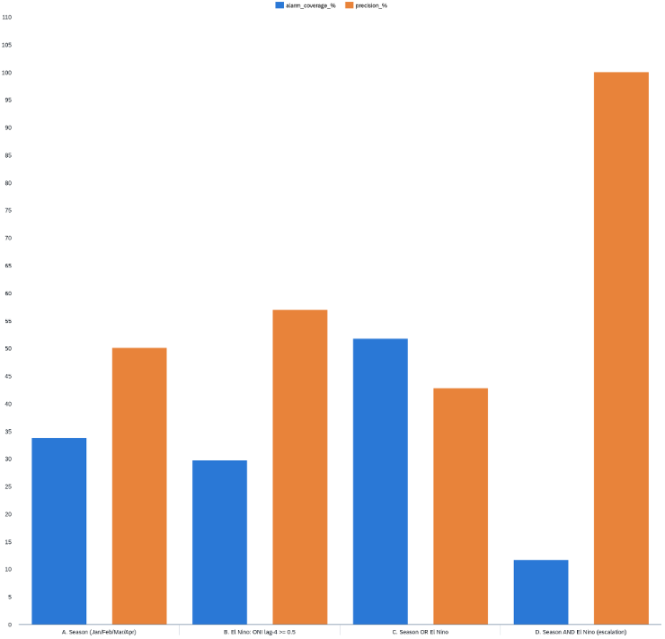
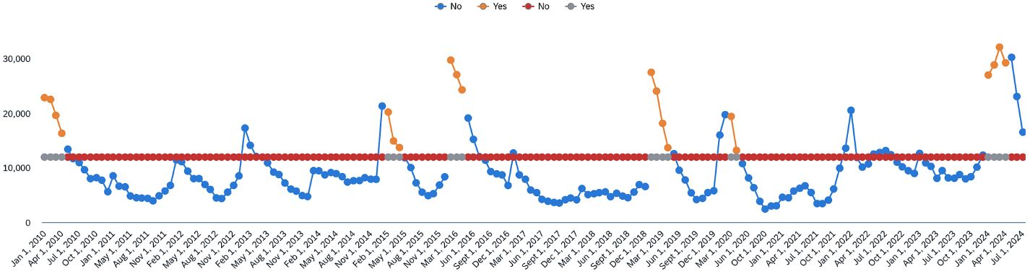
The solution: Two conditions. No model. No code.
"If the month is Jan–Apr AND ONI four months ago was ≥ 0.5 → raise alert"
11.6%
100%
4×
Months that fire the alert
Precision
Lift over base rate
Every alert in a top-quartile month
Both inputs are public and free: NOAA publishes ONI monthly, the calendar comes from the office's own records. It runs in a spreadsheet, a WhatsApp broadcast or the SAC page. Where a statistical forecast needs a trained model and a data team, a provincial office can start this next week.
Precision vs alert frequency, four rules
When the rule fired, 2010–2024
Source: Indonesia 2010–2024, 172 months · the ONI ≥ 0.5 threshold is NOAA's own El Niño definition, not a value we tuned.

Slide 12

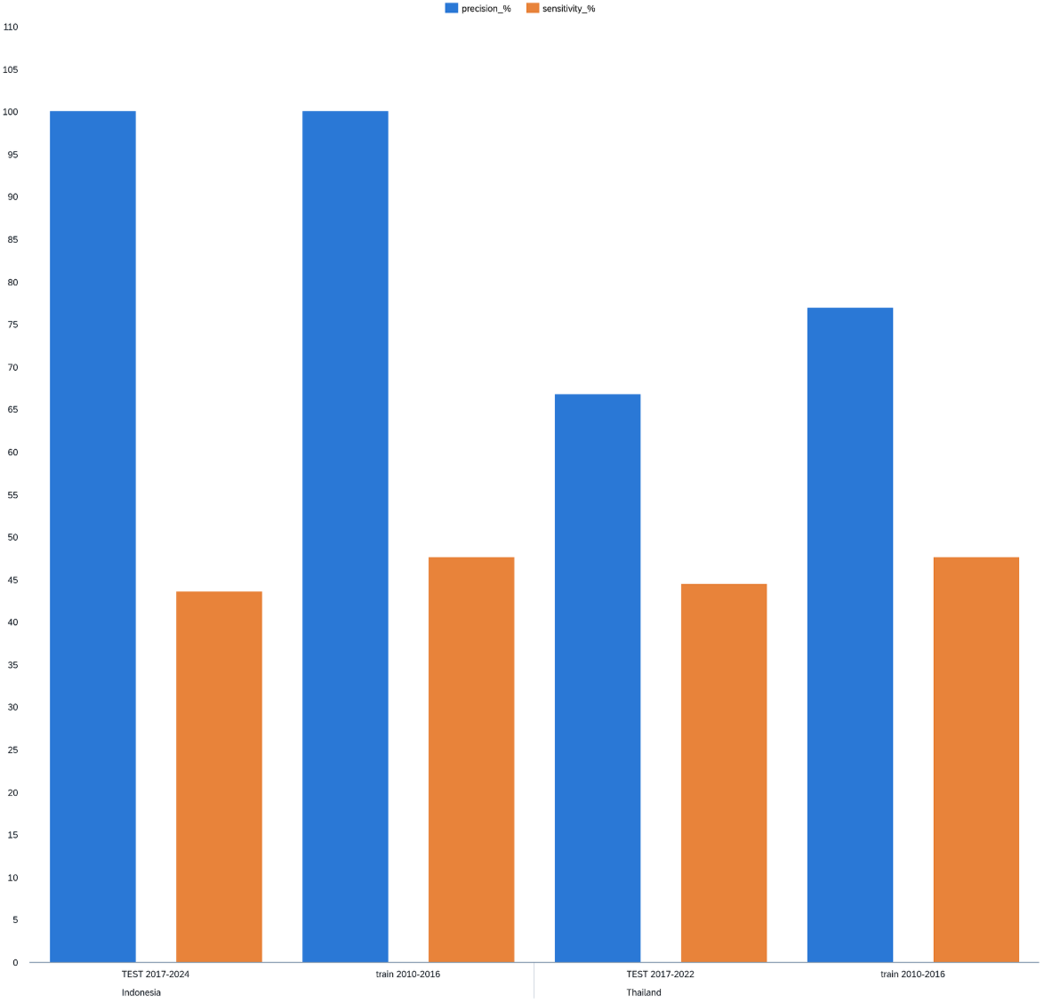
Viability: We tried to break our own rule. It held.
Out-of-sample test
WHO/PAHO endemic-channel benchmark
Rule built on 2010–2016, tested blind on 2017–2024 → precision still 100%, sensitivity 44%, lift 3.9
Specificity 91% and lift 2.5. All of the value comes from the El Niño condition rather than from the season
Published EWS comparison
Thailand replication
Published dengue early-warning systems report PPV 43–86% (17-system review). We reach a comparable PPV using monthly data and no statistical model
Replicates in Thailand with its own best predictor (temperature anomaly, lag 2): lift 2.7
Train vs blind test, Indonesia and Thailand
How we compare to published EWS — sensitivity % / PPV %
System | Sensitivity % | PPV %
17 published EWS (range, Baharom et al. 2022) | 50–100 | 43–86
EWARS-csd Colombia (Schlesinger et al. 2024) | 97 | 75
WHO/TDR EWARS Mexico (Cárdenas et al. 2021) | 100 | 83
Rule D vs P75 (blind test, this deck) | 44 | 100
Rule D vs endemic channel (this deck) | 29 | 30
Adoption in three phases: 1 Bali, N. & E. Kalimantan pilot → 2 all 38 provinces → 3 ASEAN peers. Cost: open data, monthly refresh, existing staff. No new licence and no new headcount.
We report the endemic-channel row even though it is our worst result. It is the harder benchmark, and hiding it would be the kind of selective reporting this deck argues against.
We chose precision over sensitivity: a repeated false alarm is the fastest way to make a health office stop trusting the system. This rule is an escalation layer on top of routine surveillance, not a replacement.

Slide 13
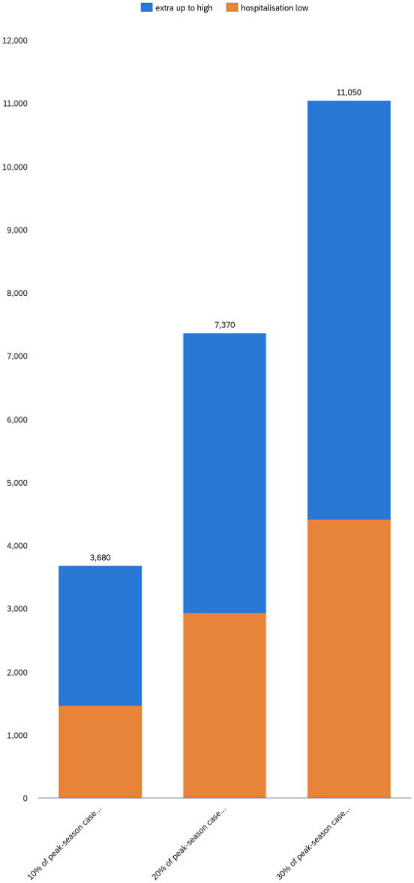
Impact · Indonesia alone: Acting 4–8 weeks earlier is worth US$1.5–3.7 million a year
4,656
44%
$1.5–3.7M
Cases/year prevented
Jan–Apr share
Avoided cost/year
Under the most conservative scenario
Of Indonesia's 104,753 average annual cases (complete years 2015–2023)
At US$316–791/case hospitalisation cost (Rp 24–59 billion)
Prevent just 10% of peak-season cases (an assumption, not a finding) = 4,656 cases/year. For scale, dengue costs Indonesia US$381–681M/year (Nadjib 2019; Wilastonegoro 2020).
Avoided cost by scenario
Lead time, every El Niño episode since 2009
Episode | Alarm | Cases cross P75 | Lead
2009/10 | Dec 2009 | Jan 2010 | 1 month
2014/16 | Feb 2015 | Feb 2015 | 0
2018/19 | Jan 2019 | Jan 2019 | 0
2019/20 | Mar 2020 | Mar 2020 | 0
2023/24 | Sep 2023 | Dec 2023 | 3 months
The lead time is observed, not assumed. Three of five episodes gave zero months on observed ONI, and we print that. The value comes from the two that did not, and from the fact that NOAA and BMKG publish a forecast ONI months ahead of the observed one, on which the same rule fires earlier still.
Sources: cost per case from peer-reviewed Indonesian studies; case counts from our own panel. The cheapest anchor (US$90/episode) still gives US$0.42M, so we have not chosen the most flattering figure.

Slide 14

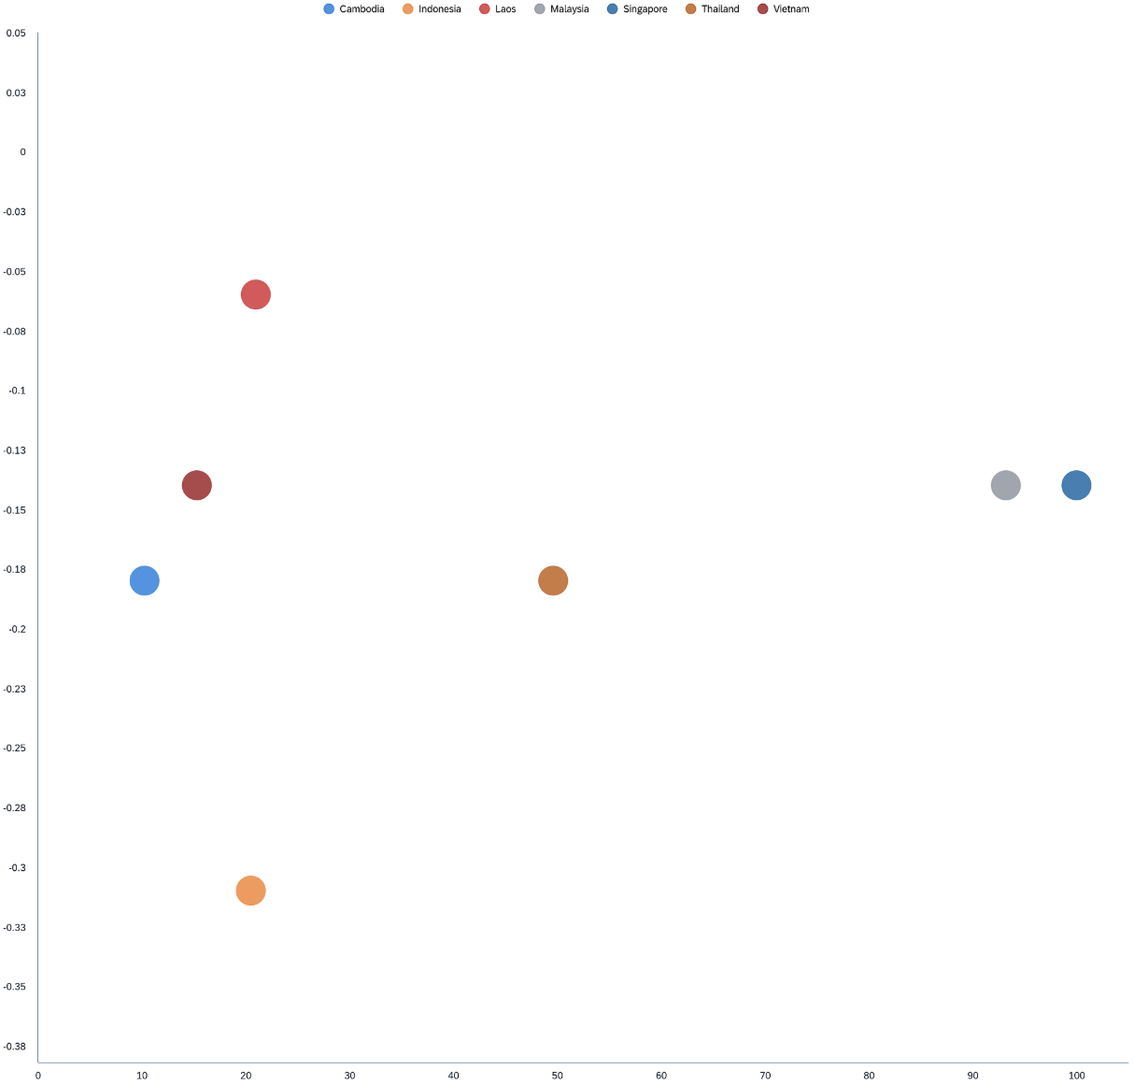
Limits & data ethics: What we tested and threw away
Falsified innovation angle
Incomplete 2023–24 panel
Incidence years limited
"Drought × water access" looked promising (r = −0.31) but collapsed after controlling for El Niño (partial r = −0.15) and showed no moderation by piped access (ρ = +0.34, p = 0.46, n = 7). We dropped the claim.
We do not claim a 2023–24 record, because our panel is incomplete for Vietnam and the Philippines after 2022.
Incidence only for 2018–2020, the only years with official BPS denominators. Elsewhere we use raw counts and never rank regions by them.
Flood association reversal
Correlation ≠ causation
Flood and disaster records look correlated with dengue (r = +0.66) until the counts are divided by population, at which point the association reverses (r = −0.14). We report the null.
This is an early-warning claim, and the mechanism is cited from the literature.
No relationship (ρ = +0.34, p = 0.46, n = 7)
A rule that survives its own falsification tests is worth more to a health office than a larger claim that has never been tested.
This page is not an apology. We tested our own best idea, it failed the test, and we removed it.

Slide 15


The product: Pawang: the rule, delivered on the first of every month
Pawang is the Indonesian and Malay word for someone who claims to know the weather months ahead. This one shows its working: a single SAC page that a district officer opens on the 1st, together with an automatic WhatsApp advisory. It escalates; it never declares an emergency.
The digital layer does the fetching, not the deciding. SAC refreshes the NOAA ONI feed and the office's own case calendar on a schedule, and SAC Smart Predict runs beside the rule as a second opinion. The alert itself remains the two-condition rule, which can be audited by hand, so no one has to trust a model they cannot inspect.
What Bali opens on 1 October 2026: ALERT — Jan–Apr 2027. ONI in Sep 2026 was +1.3 (≥ 0.5). Expect a top-quartile season. Act now, not in January.
When the rule fired, 2010–2024
Who does what
District health office (gov't)
Ministry of Health · BMKG (gov't)
Reads the advisory; moves PSN/3M, larviciding and stockpiles forward into the alerted window
Own the monthly refresh; BMKG's forecast ONI stretches the notice past four months
Jumantik cadres (NGO & community)
Cloud & telco partners (private)
Larval checks and household messaging concentrated in the alerted months instead of spread thin all year
Host the SAC tenant and the broadcast; one analyst-hour a month, no data team
Scales by swapping one input: Thailand already validates with its own predictor (temperature anomaly, lag 2, lift 2.7). Any ASEAN member repeats the fit on its own records.
The rule is the engine, not a feature of the product. Strip the dashboard away and a health office can still run Pawang on paper.

Slide 16
References 1/2: Data sources
OpenDengue V1.3
World Bank Climate Change Knowledge Portal
doi:10.6084/m9.figshare.24259573.v4
ERA5 0.25° monthly temperature and precipitation
NOAA Climate Prediction Center
WHO/UNICEF Joint Monitoring Programme
Oceanic Niño Index (ONI v5)
Water Supply, Sanitation and Hygiene, 2025 update
BPS-Statistics Indonesia
European Commission JRC
Provincial population, WebAPI
Global Human Settlement Layer (GHS-UCDB R2019A)
SIPSN, Ministry of Environment and Forestry, Indonesia
BNPB
Indonesian Disaster Data and Information (DIBI)
Method reference: Hussain-Alkhateeb L, et al. (2017). Early warning and response system (EWARS) for dengue outbreaks: operational guide. WHO/TDR technical document — no DOI assigned; the peer-reviewed description is Hussain-Alkhateeb 2018 on the next page.
Climate and dengue
Tian Y, et al. (2025) Nat Commun doi:10.1038/s41467-025-63655-0
Djaafara B, et al. (2026) PLOS Negl Trop Dis doi:10.1371/journal.pntd.0014135
Mokhtar S, et al. (2024) Environ Res doi:10.1016/j.envres.2024.119830
Sutriyawan A, et al. (2025) J Popul Soc Stud doi:10.25133/jpssv342026.028
Lowe R, et al. (2021) Lancet Planet Health doi:10.1016/S2542-5196(20)30292-8
Gibb R, et al. (2023) Nat Commun doi:10.1038/s41467-023-43954-0
Wang Y, et al. (2022) Environ Int doi:10.1016/j.envint.2022.107518
Choi Y, et al. (2016) BMC Public Health doi:10.1186/s12889-016-2923-2
Polrob P, et al. (2025) BMC Public Health doi:10.1186/s12889-025-25420-2

Slide 17

References 2/2: Early-warning systems, cost, and validation
Early-warning systems
Hussain-Alkhateeb L, et al. (2018) PLOS ONE doi:10.1371/journal.pone.0196811
Baharom M, et al. (2022) Risk Manag Healthc Policy doi:10.2147/RMHP.S361106
Benitez-Valladares D, et al. (2021) PLOS Negl Trop Dis doi:10.1371/journal.pntd.0009261
Cárdenas R, et al. (2022) BMC Infect Dis doi:10.1186/s12879-022-07197-6
Schlesinger P, et al. (2024) Front Public Health doi:10.3389/fpubh.2024.1323618
Quan TM, et al. (2026) Sci One Health doi:10.1016/j.soh.2026.100159
Burden, cost, and validation
Nadjib M, et al. (2019) PLOS Negl Trop Dis doi:10.1371/journal.pntd.0007038
Wilastonegoro NN, et al. (2020) Am J Trop Med Hyg doi:10.4269/ajtmh.19-0855
Shepard DS, et al. (2013) PLOS Negl Trop Dis doi:10.1371/journal.pntd.0002055
Shepard DS, et al. (2016) Lancet Infect Dis doi:10.1016/S1473-3099(16)00146-8
Sasmono RT, et al. (2026) IJID Regions doi:10.1016/j.ijregi.2026.100860
Childs ML, et al. (2025) PNAS doi:10.1073/pnas.2512350122
Reference pages — excluded from the 15-page limit per the official storyboard requirements. Every DOI was resolved against Crossref.

