Slide 1
Explore Zomato restaurants dataset in the city of Noida

Slide 2
Introduction
Noida, short for New Okhla Industrial Development Authority, is a planned city located in Gautam Buddh Nagar district of the Indian state of Uttar Pradesh. It is a satellite city of Delhi and is a part of the National Capital Region of India. As per provisional reports of Census of India, the population of Noida in 2011 was 642,381. The official language of Noida and the one that is most widely spoken is Hindi. With its diverse culture, comes diverse food items. There are many restaurants in Noida, each belonging to different categories like Chinese, Italian, French etc.
So as part of this project , we will list and visualize all major parts of Noida City .

Slide 3
Objectives
Questions that can be asked using the above mentioned datasets
Which places In Noida have some of the finest Restaurants?
Which Places in Noida have Restaurants with Lowest rating?
Which place in Noida is suitable for a Foodie?
Which place in Noida is not suitable for a Foodie?
What are the best places in Noida for Chinese Restaurant?
Which places in Noida have highest rated Chinese Restaurants?

Slide 4
Data
For this project we need the following data:
Noida Restaurants data that contains list Locality, Restaurant name, Rating along with their latitude and longitude.
Data Source: zomatoKaggle
Description: This data set contains the required information which we will use to explore various localities of Noida city.
Nearby places in each locality of Noida city.
Data Source: FourSquareAPI
Description: By using this API we will get all the venues in each neighborhood.

Slide 5
Approach
Collect the Noida city data from zomatoKaggle
Using Foursquare API we will find all venues for each neighbourhoods.
Filter out all venues that are nearby by locality.
Using aggregative rating for each restaurant to find the best places.
Visualize the Ranking of neighborhoods using folium library(python)

Slide 6
Results

Slide 7
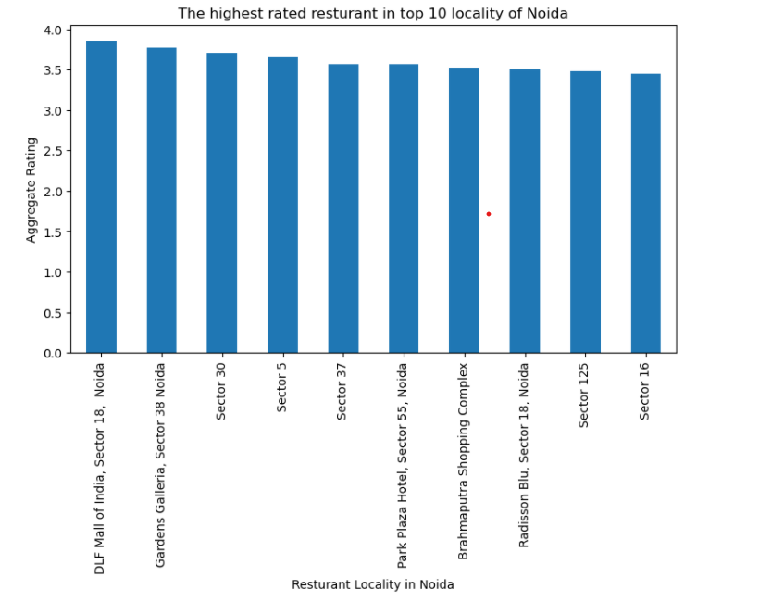
Which places In Noida have some of the finest Restaurants?

Slide 8
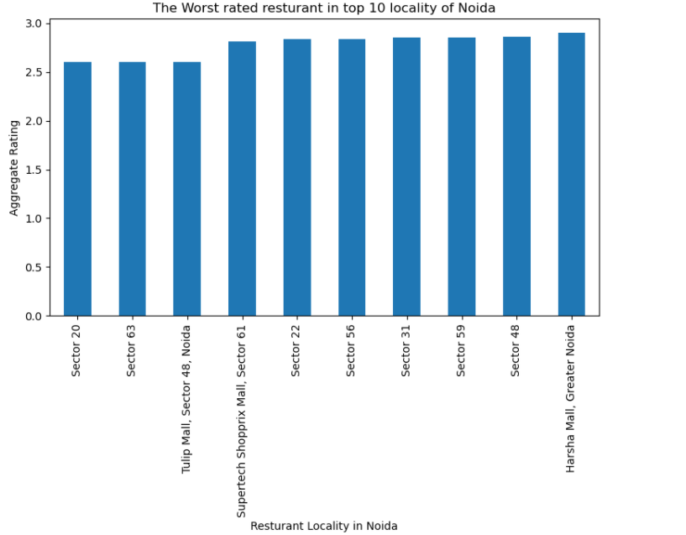
Which Places in Noida have Restaurants with Lowest rating?

Slide 9
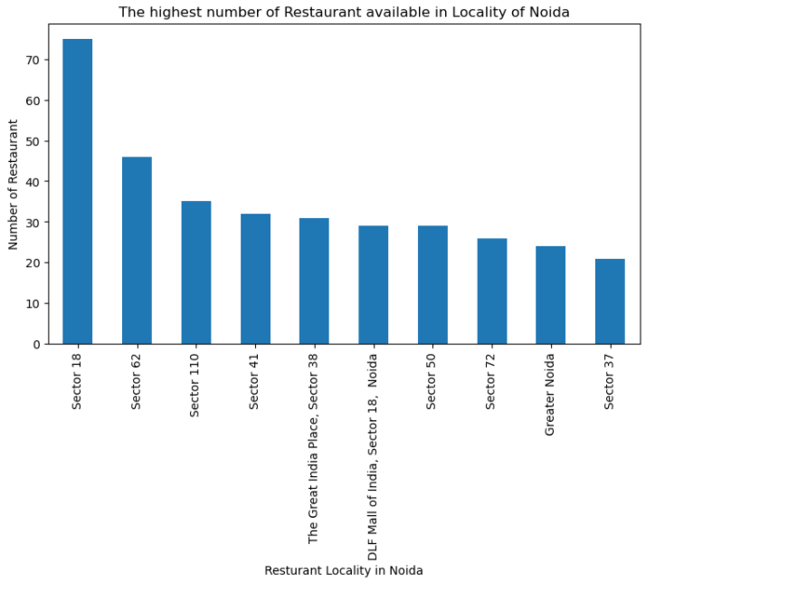
Which place in Noida is suitable for a Foodie?

Slide 10
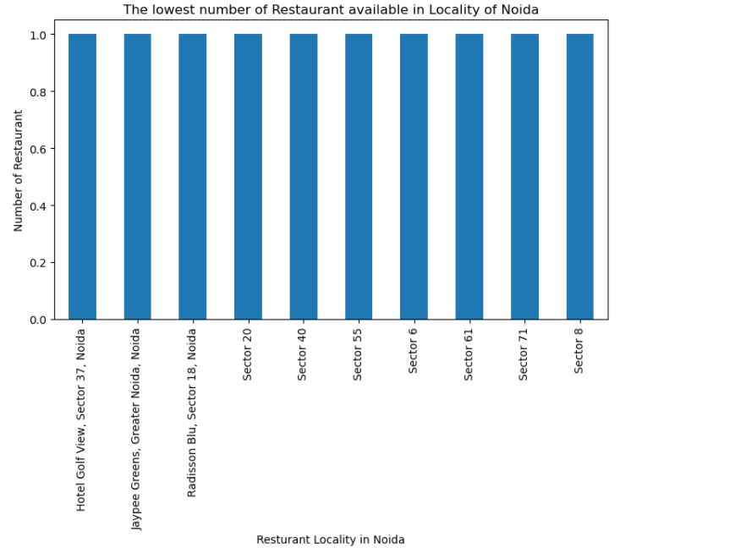
Which place in Noida is not suitable for a Foodie?

Slide 11
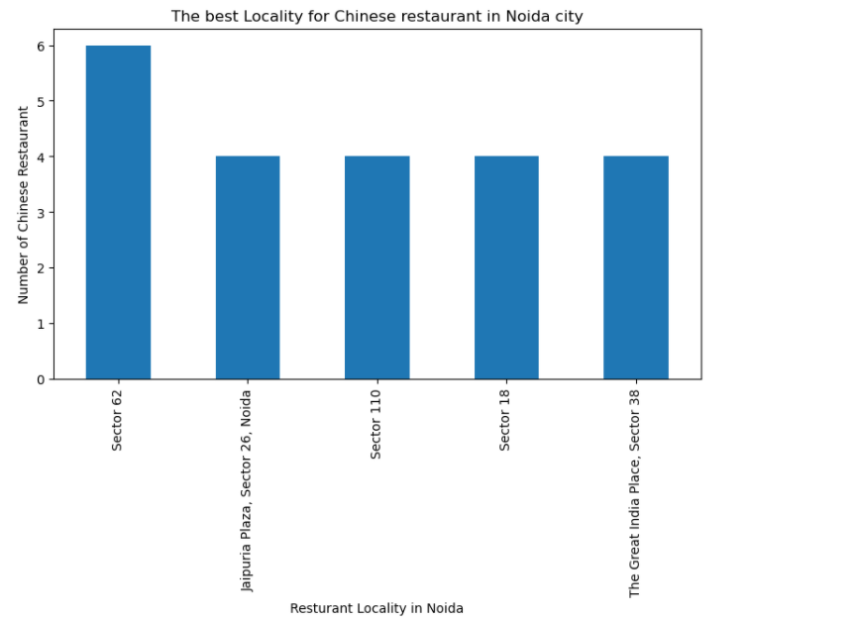
What are the best places in Noida for Chinese Restaurant?

Slide 12
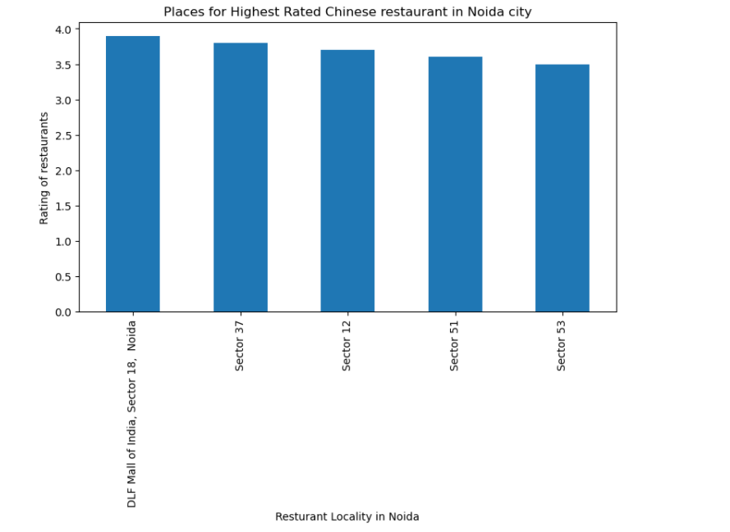
Which places in Noida have highest rated Chinese Restaurants?

Slide 13
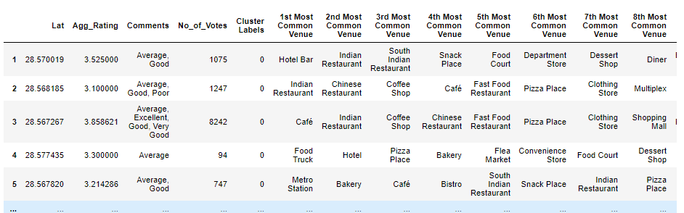
Cluster 1:
It is most recommended for family .

Slide 14
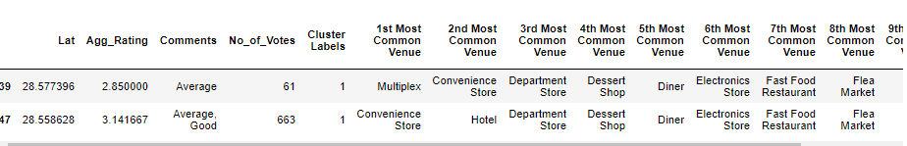
Cluster 2:
It is most recommended for convenient Store and Entertainment

Slide 15
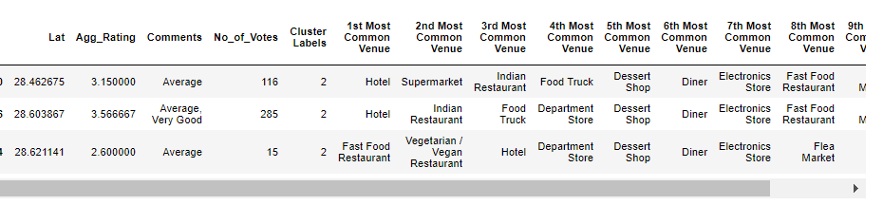
Cluster 3:
It is most recommended for restaurants

Slide 16
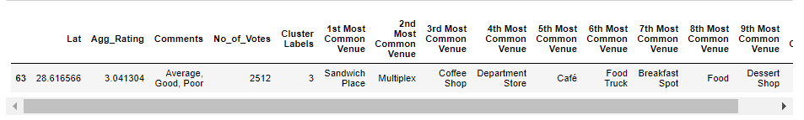
Cluster 4:
It is most recommended for the cafe and pizza

Slide 17
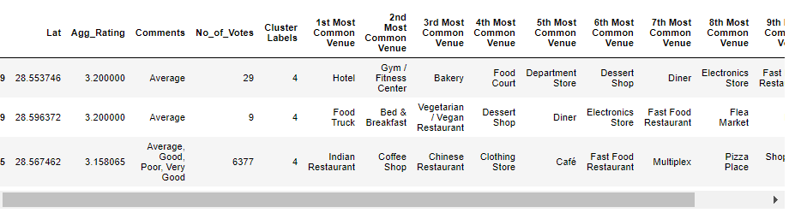
Cluster 5:
It is most recommended for family

Slide 18
Conclusion
- DLF Mall of India are some of the best neighbourhoods for Chinese cuisine
- Sector 62 place have the highest number of Chinese Restaurant.
- Sector 18 and Sector 32 are the best places for foodie.
- DLF Mall of India, Gardens Galleria have best restaurants in Noida.
Cluster 1 and Cluster 5 : It is most recommended for family
Cluster 2: It is most recommended for convenient Store and Entertainment
Cluster 3: It is most recommended for restaurants
Cluster 4: It is most recommended for the cafe and pizza

