Slide 1
Aqua AI
Autonomous Solar-Powered Edge-IoT Water Leakage Detection and Predictive Conservation System
💧
Supervisor
Abdullah Al-Wad‘i
Team
Hussein Mohammed Saeed Al-Qahtani • Wisam Mohammed Saeed Al-Qahtani • Abdullah Mohammed Saeed Al-Qahtani • Mohammed Jaber Qatman Al-Qahtani
Aqua AI | 1

Slide 2
1. The Problem
Non-Revenue Water (NRW) and treated-water losses
Water losses can occur because of leaks, pressure imbalance, pipe failures, or delayed detection.
Traditional monitoring may not provide an immediate local warning at the point of loss.
Pumping and treatment consume energy; reducing unnecessary flow can support more efficient operation.
Aqua AI targets early detection, local decision-making, and automatic response using connected sensors.
Aqua AI | 2

Slide 3
2. The Solution
Aqua AI: smart early warning and solar-powered automatic control
Sensing
Two water-flow sensors monitor inlet/outlet flow and provide data to the ESP32.
Edge Processing
ESP32 compares measured flow values and calculates a leakage indicator.
Action
A relay controls the 12V DC pump; the system can warn the operator when risk rises.
Power: solar panel → charge controller → 12V rechargeable battery.
Control: ESP32 → relay → 12V pump.
Programming/monitoring: Arduino IDE and USB Type-C connection to the ESP32.
Aqua AI | 3

Slide 4
3. Technical Operation
ESP32, flow sensing, pressure monitoring, and mass-balance logic
1
2
3
4
5
Measure
Flow sensor 1 measures incoming flow.
Measure
Flow sensor 2 measures downstream flow.
Compare
ESP32 compares the two measurements over a time window.
Estimate
A leakage percentage/risk indicator is calculated.
Respond
Green / Yellow / Red status can be shown in the serial monitor; the relay can control the pump.
Mass-balance concept: leakage is indicated when measured inlet and outlet flow are inconsistent beyond an allowed tolerance.
Pressure sensing can be added as an expansion to improve diagnosis and distinguish normal demand from leakage.
Aqua AI | 4

Slide 5
4. Expected Impact
Target outcomes — to be validated by field testing
Leakage reduction target
Up to 90% reduction is a project target, not a measured result yet.
Energy efficiency
Avoid unnecessary pump operation and support more efficient water handling.
Response time
Local sensing can provide an earlier warning than waiting for manual inspection.
The final percentage should be reported only after controlled testing and comparison with a baseline.
Performance metrics: detection accuracy, false alarms, response time, pump runtime, and estimated water saved.
Aqua AI | 5

Slide 6
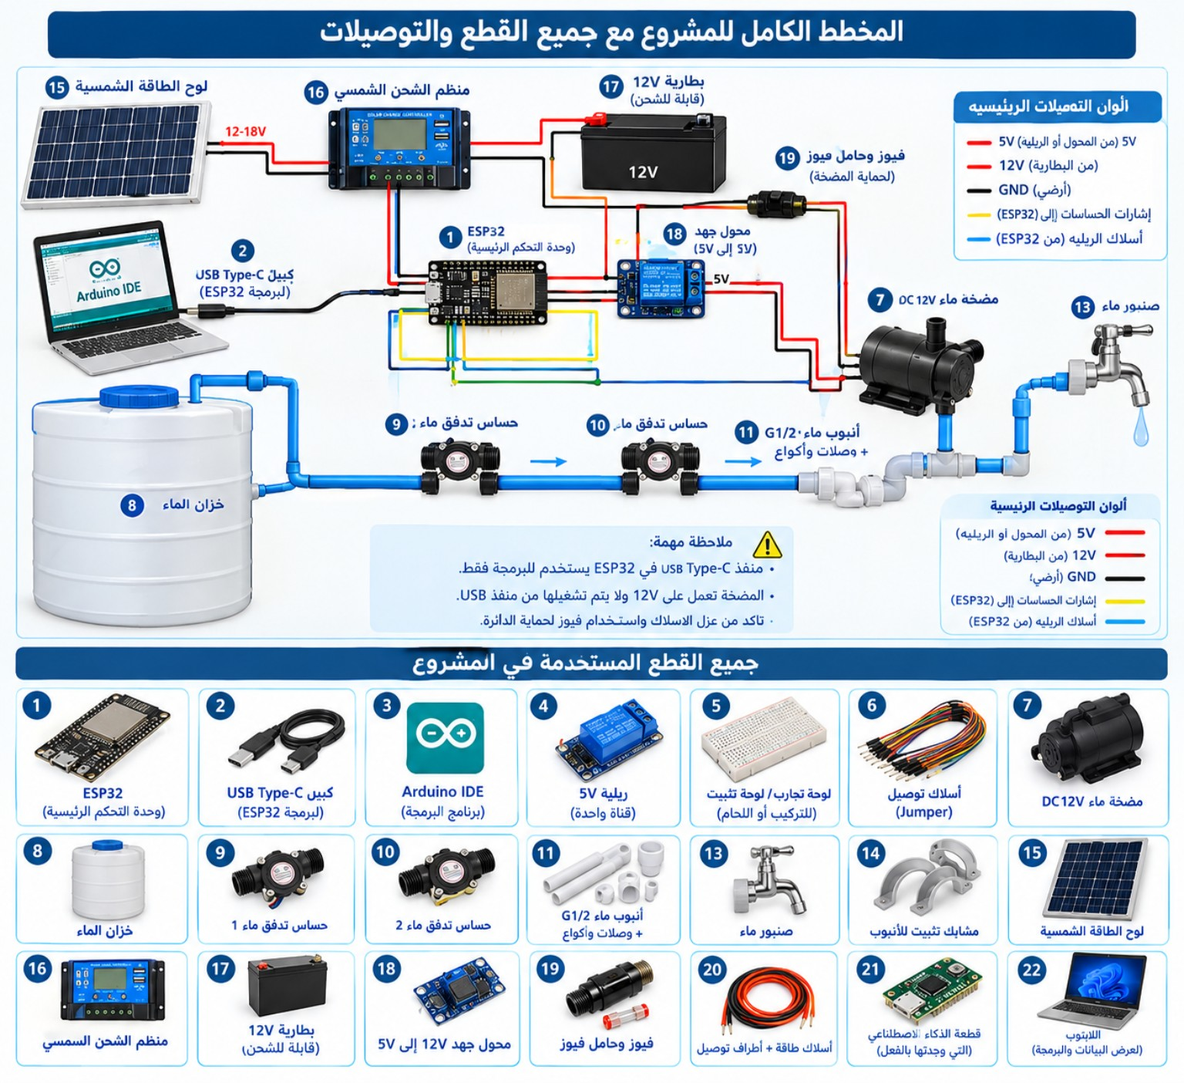
5. Full System Schematic
Project components and main connections
Aqua AI | 6

Slide 7
6. Main Components
Based on the supplied project schematic
1. ESP32 controller
2. USB Type-C cable
3. Arduino IDE
4. 5V relay
5. Breadboard / mounting board
6. Jumper wires
7. 12V DC water pump
8. Water tank
9. Flow sensor 1
10. Flow sensor 2
11. G1/2 water pipe + fittings
13. Water faucet
14. Pipe clamps
15. Solar panel
16. Solar charge controller
17. 12V rechargeable battery
18. 12V→5V buck converter
19. Fuse + fuse holder
20. Power wires + terminals
21. AI processing unit (already sourced)
22. Laptop for programming/monitoring
Aqua AI | 7

Slide 8
7. Bill of Materials (BOM)
Budget sheet — target total: 800 SAR
Category | Items | Qty | Budget allowance (SAR)
Control | ESP32 + USB Type-C + breadboard + jumper wires | 1 set | 150
Sensing | 2 flow sensors + optional pressure sensor | 2+ | 120
Hydraulics | Tank + G1/2 pipe + fittings + faucet + clamps | 1 set | 130
Pump | 12V DC water pump | 1 | 90
Power | Solar panel + charge controller + 12V battery | 1 set | 180
Protection | 5V relay + buck converter + fuse/holder + terminals | 1 set | 80
Computing | AI processing unit already sourced + laptop | 1 set | 50
TOTAL | Target project budget | — | 800
Note: the 800 SAR figure is a target budget allowance; actual prices should be updated from supplier quotations before submission.
Aqua AI | 8

Slide 9
8. Electrical Connections & Safety
Low-voltage architecture shown in the supplied schematic
Solar path
Solar panel → charge controller → 12V battery.
Logic power
12V battery → 5V buck converter → ESP32 / 5V relay.
Pump path
12V battery → fuse → relay contacts → 12V DC pump.
USB Type-C on the ESP32 is for programming/serial monitoring; it is not the 12V pump supply.
Use a fuse on the pump power branch and verify the pump's rated current before selecting the fuse.
Keep sensor signal wiring separate from high-current pump wiring where practical.
Confirm polarity and common ground according to the exact modules used.
Aqua AI | 9

Slide 10
9. Monitoring & AI Analysis
What the operator can see and what the AI layer can analyze
Serial Monitor
Flow 1, Flow 2, leakage %, status, pump state, and sensor readings.
Status logic
GREEN = normal
YELLOW = possible leakage
RED = high-risk leakage
AI layer
Analyze historical readings to identify patterns and support predictive conservation.
Example output: Leakage probability 0–100%.
The thresholds should be calibrated using real test data to avoid excessive false alarms.
AI predictions should complement, not replace, direct sensor measurements and safety checks.
Aqua AI | 10

Slide 11
10. Team & Roadmap
Four trainees + supervisor
Team members
Hussein Mohammed Saeed Al-Qahtani
Wisam Mohammed Saeed Al-Qahtani
Abdullah Mohammed Saeed Al-Qahtani
Mohammed Jaber Qatman Al-Qahtani
Supervisor
Abdullah Al-Wad‘i
Project guidance, validation, and review.
1. Component selection & procurement
2. Hydraulic assembly and leak-test setup
3. ESP32 programming and sensor calibration
4. Relay/pump control and safety testing
5. AI data analysis and threshold calibration
6. Field testing → results → future upgrades
Aqua AI | 11

Slide 12
11. Future Development
Roadmap beyond the prototype
Upgrade to ultrasonic / non-invasive flow measurement where suitable.
Add calibrated pressure sensors to improve leak localization and diagnosis.
Use IP67-rated enclosures and water-resistant connectors for outdoor deployment.
Add remote dashboard / IoT connectivity for alerts and historical trends.
Train the AI model on larger real-world datasets to improve predictive conservation.
Scale from a single prototype to multiple monitoring nodes across a water network.
Aqua AI | 12

Slide 13
12. Optional Supporting Evidence
Ready-to-attach evidence package
BOM Sheet with the target 800 SAR budget.
Electrical circuit schematic and hydraulic layout.
Photos of the assembled prototype and test setup.
Initial test logs: flow readings, leakage scenarios, response time, and pump runtime.
Calibration notes for flow / pressure sensors.
Institutional evaluation, preliminary report, or approval certificate if available.
Aqua AI | 13

Slide 14
Aqua AI
Detect early • Respond automatically • Conserve water
Solar-powered Edge-IoT monitoring with AI-assisted analysis.
Project status
Prototype design and target architecture — final performance requires practical testing.
Aqua AI | 14

